Slide 1
JUAS
Xsuite tutorial: Collective effects
David Amorim, Elena de la Fuente Garcia, Sébastien Joly
The tutorial was inspired from the CAS Intensity Limitations in Hadron Beams ones (many thanks for the material!)

Slide 2
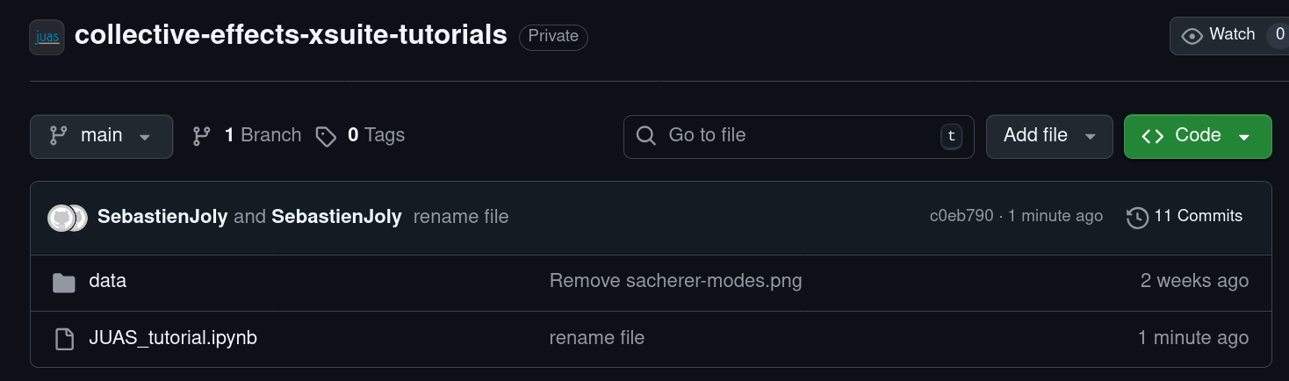
Download files from github
https://github.com/JUAS-tutorials/collective-effects-xsuite-tutorials
Save the files:
  Code → git clone https://github.com/JUAS-tutorials/collective-effects-xsuite-tutorials.git
  Code → Download ZIP
Remember where you saved the files, you will need their location to open the notebook!

Slide 3
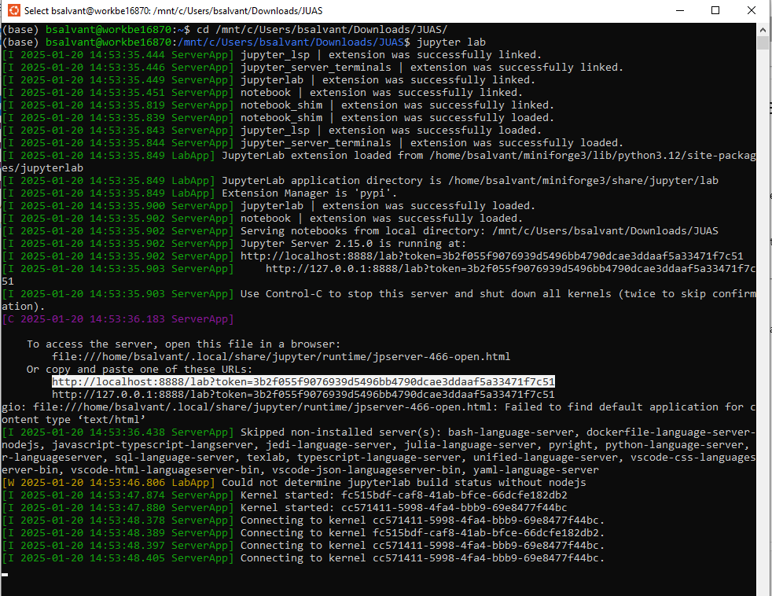
Open notebook in jupyter lab
In Ubuntu, change directory to the folder where the files are located
Open jupyter lab
Paste the webpage address
http://localhost:8888/lab?token=[...]
to any browser

Slide 4
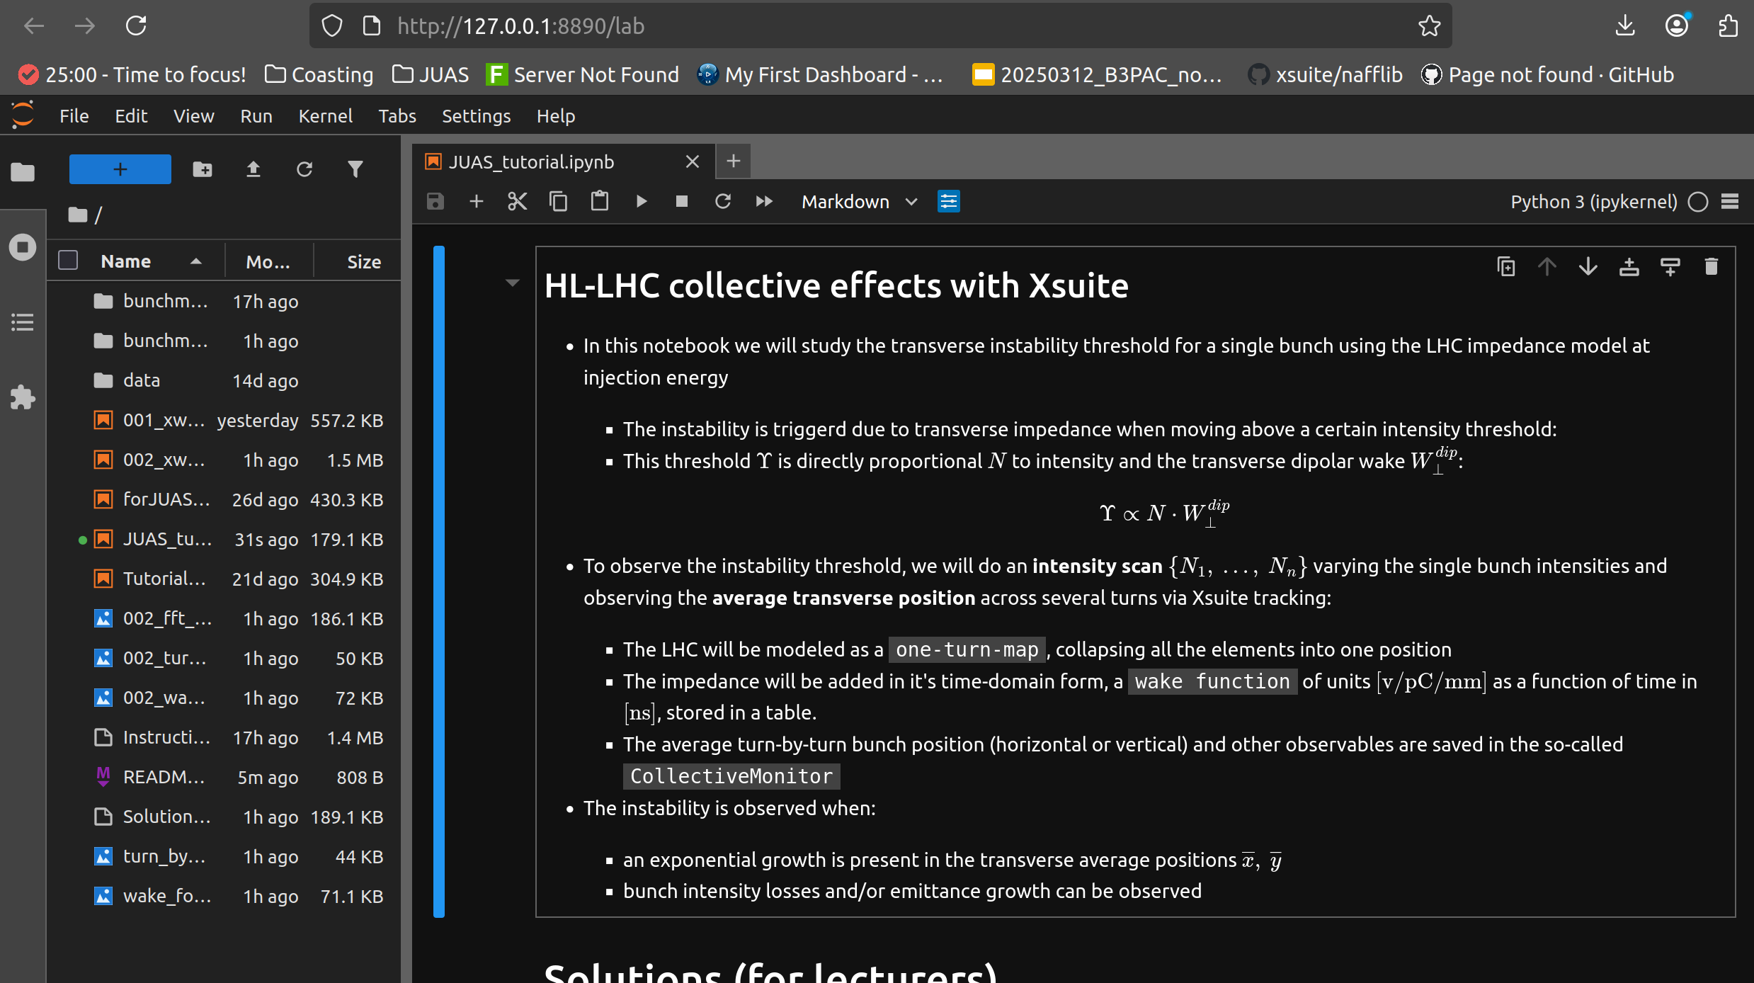
Open notebook in jupyter lab and run it!

Slide 5
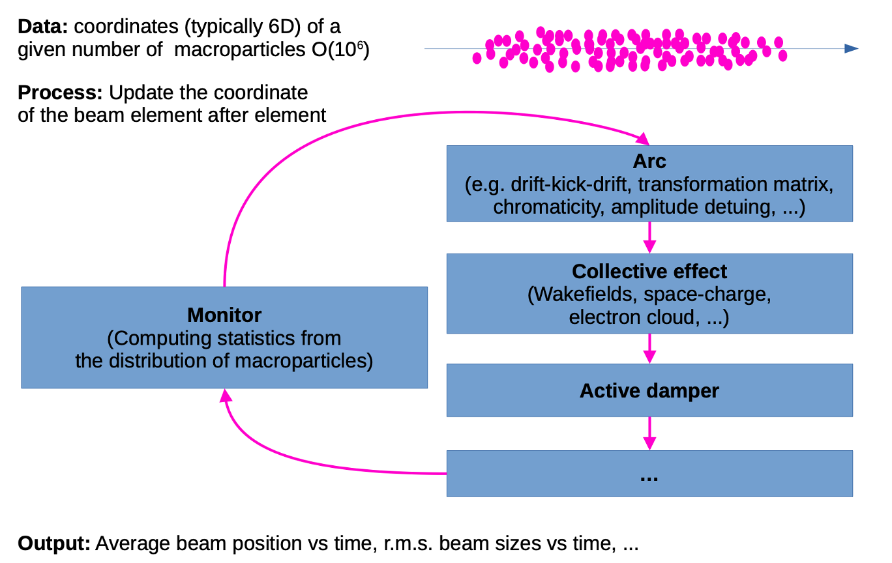
Macro-particle tracking simulations

Slide 6
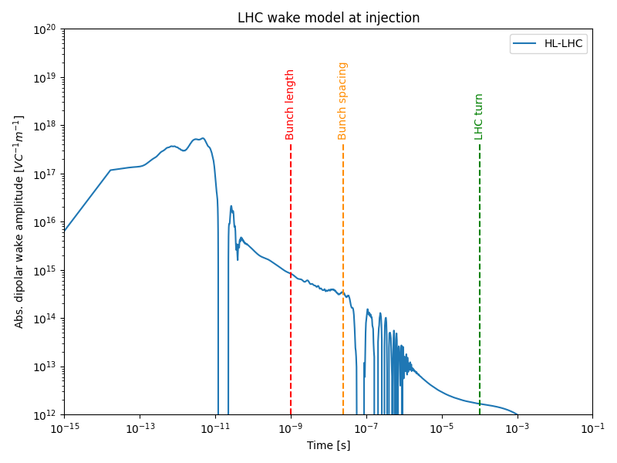
HL-LHC wake model
The HL-LHC wake model includes the main wake contributors (vacuum chamber, collimators, vacuum instrumentation, beam dump, etc)
The wakefield produced by a particle can interact with its own bunch, the following or even turns later!

Slide 7
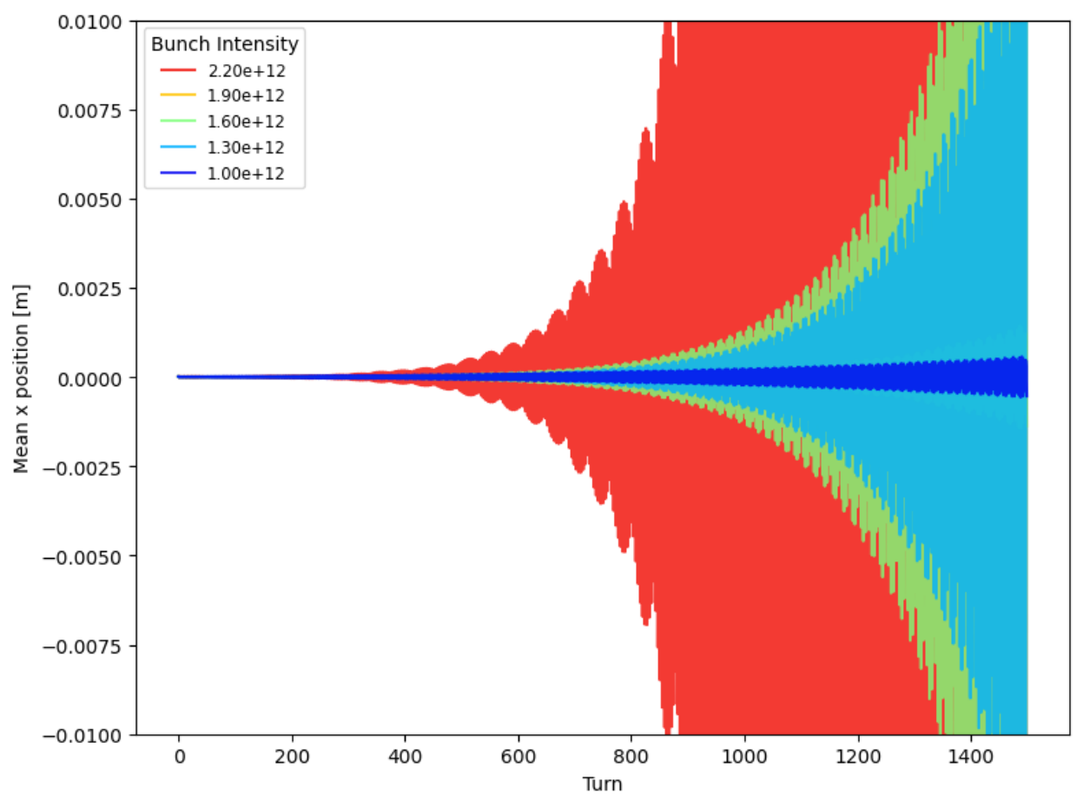
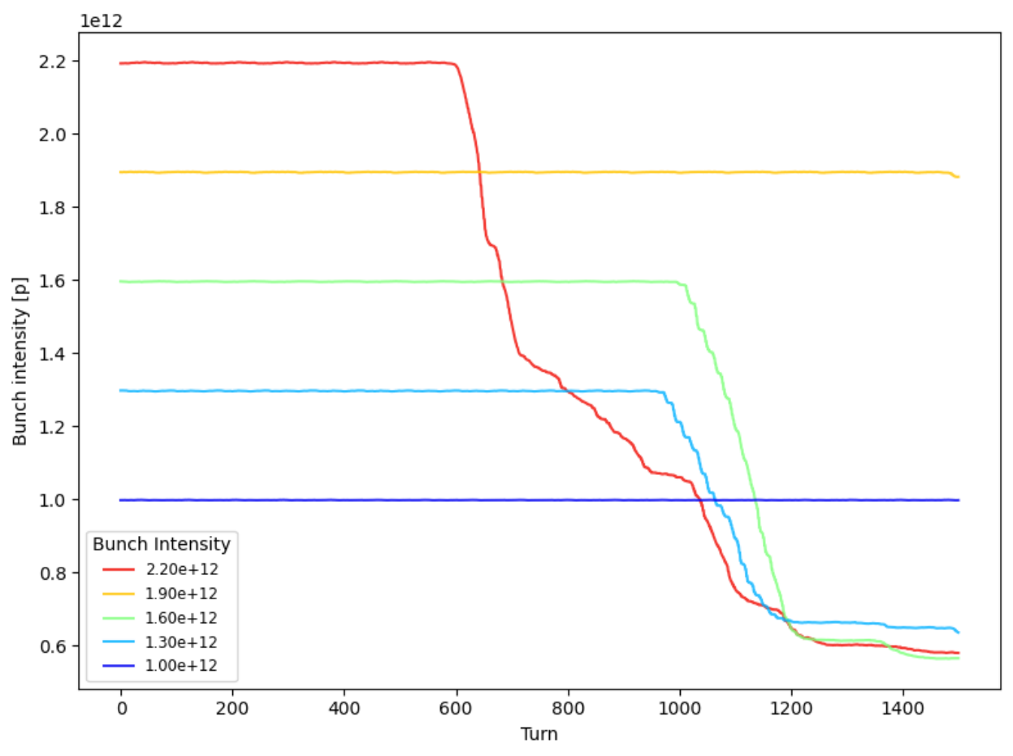
Instability signature
Exponential growth of the bunch transverse position → bunch losses once it hits the vacuum chamber
Vacuum chamber ⌀ = 1 cm

Slide 8
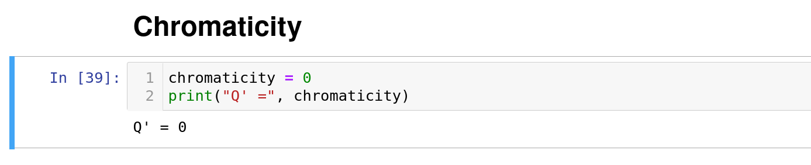
Task 1
Scan chromaticity (use big steps, stay within the range [-100,100]), when is the beam stable?
  Does the sign of chromaticity play a role?
  Is having a large chromaticity usually a good idea?

Slide 9
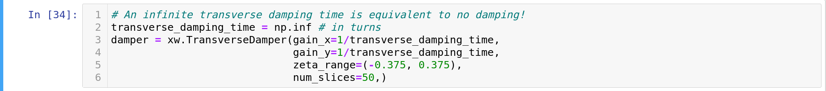
Task 2
Scan the transverse feedback damping time (stay within the range [1,∞]), when is the beam stable?
  Which damper gain would be required to stabilize the beam for a Q' = 0?

Slide 10
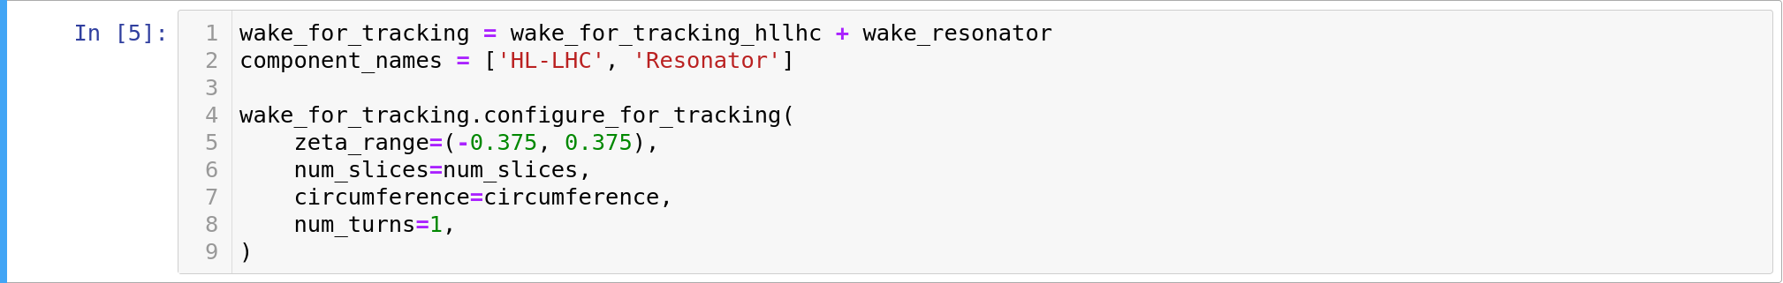
Task 3
Add the bellows’ impedance (modeled as a resonator), what happens?
Bonus: Replace the bellows by the shielded bellows’ impedance, what does it change?

Slide 11
Notebook file structure

Slide 12
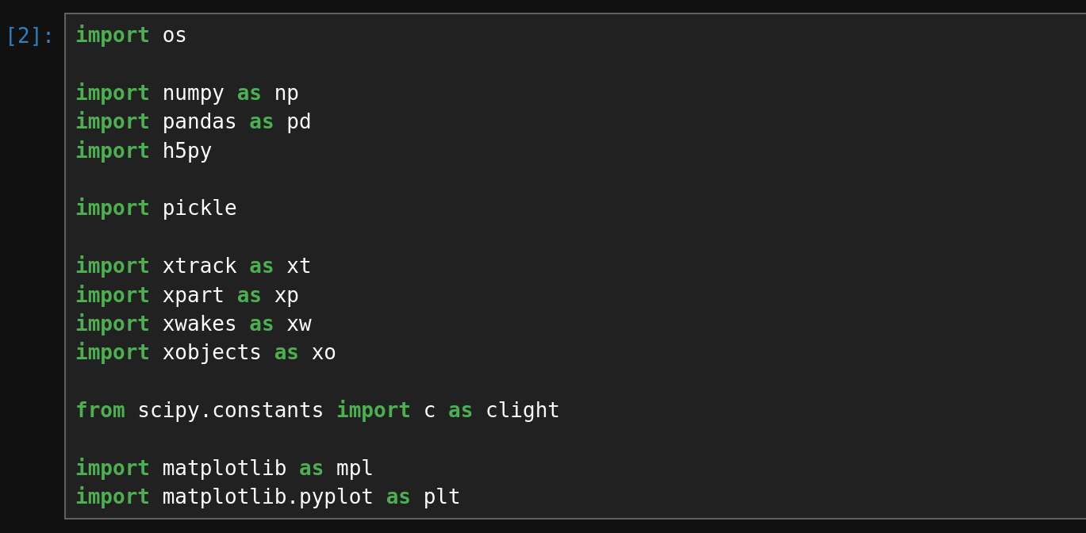
Structure of the iPython notebook (1):importing libraries
Import xtrack, xpart, xwakes and xobjects from Xsuite
and import other
required libraries and functions

Slide 13
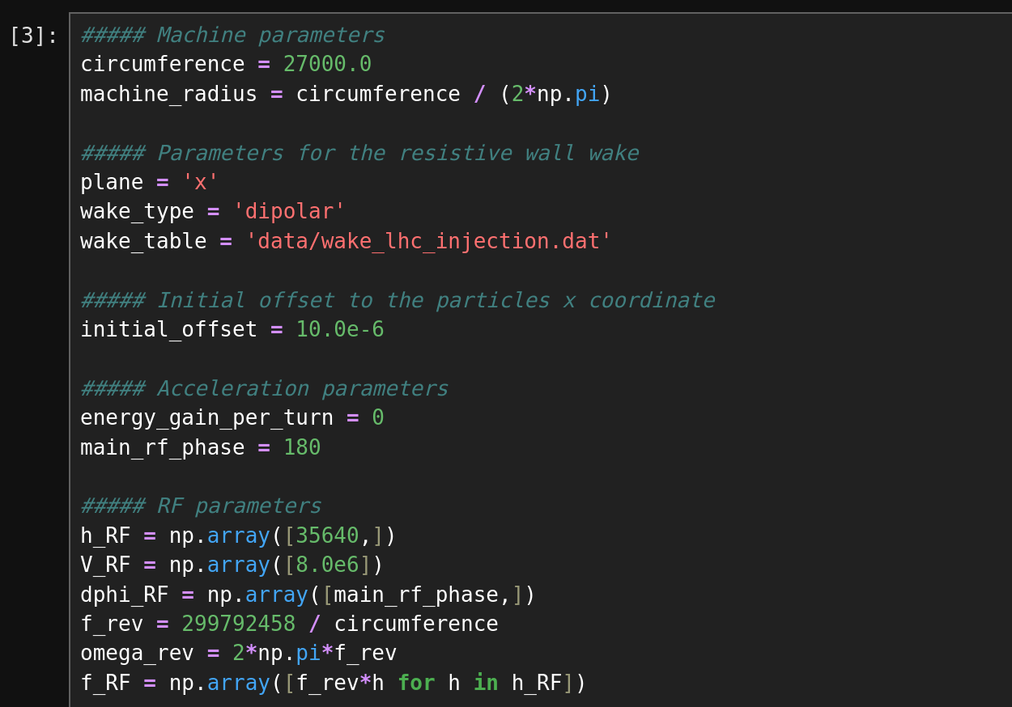
Structure of the iPython notebook (2): input parameters
Machine circumference (in m)
LHC wake table
Set machine and beam
parameters
No acceleration
RF parameters

Slide 14
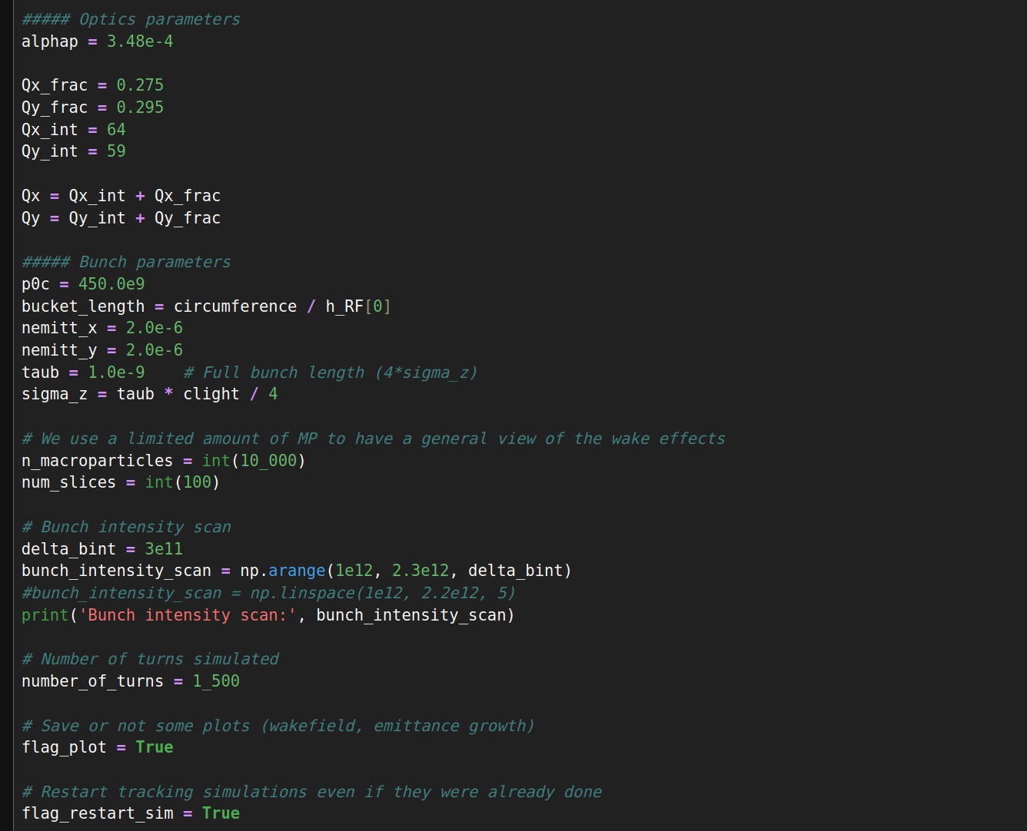
Structure of the Python notebook (3): input parameters
Momentum compaction factor
Optics parameters
Transverse tunes
Initial bunch parameters
Bunch length
Number of macroparticles
Number of slices
Definition of bunch intensity scan
Simulation parameters
Number of simulated turns

Slide 15
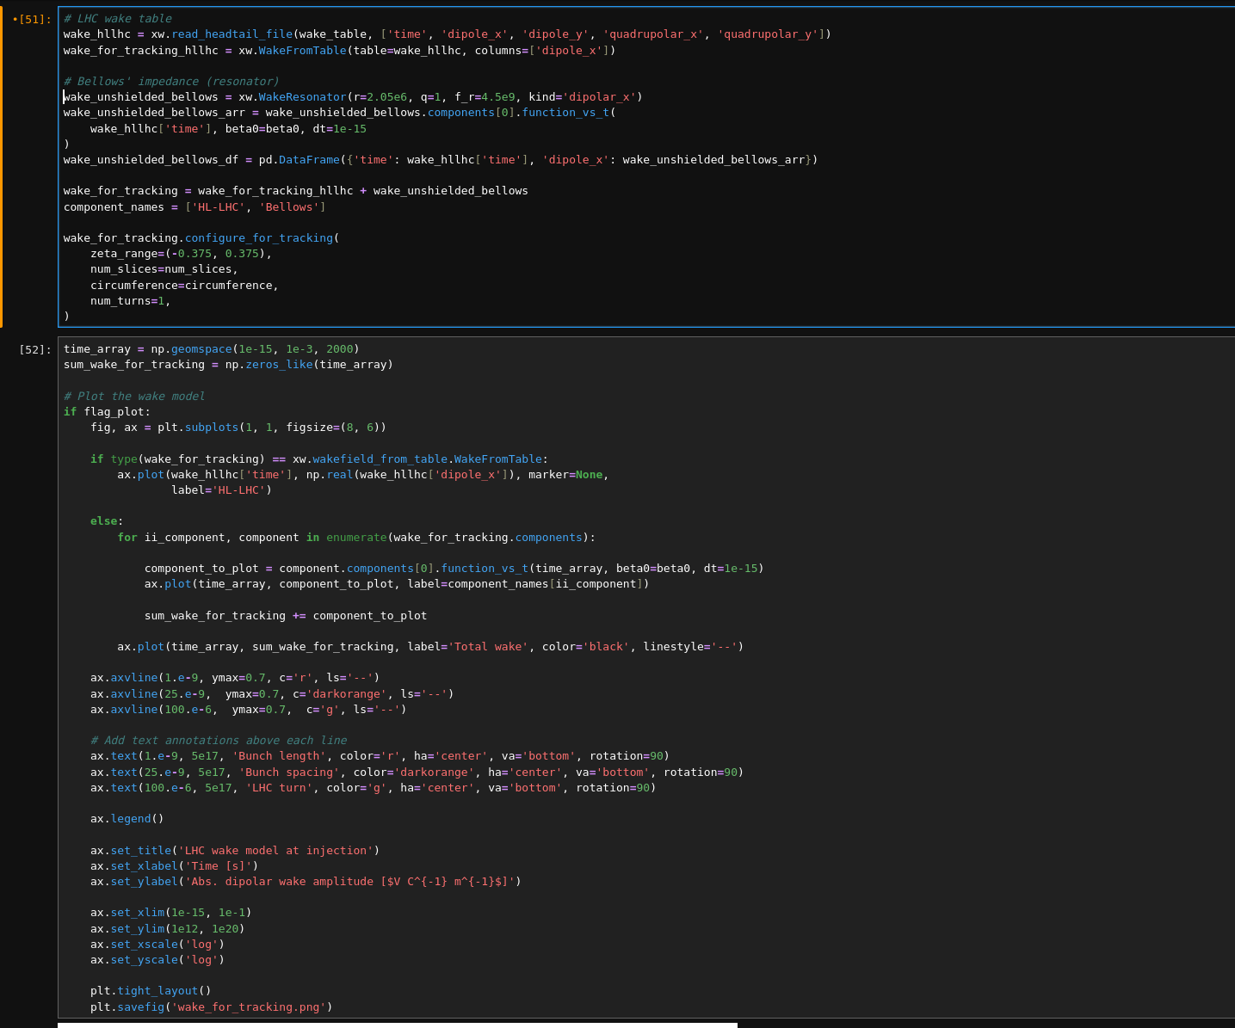
Structure of the iPython notebook (4):
Import and configure wakes
Plot the input wakes

Slide 16
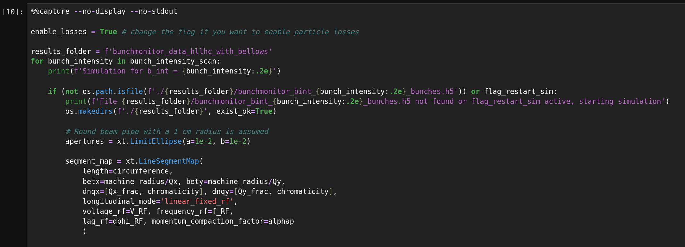
Structure of the iPython notebook (5):
Enable particle losses (needed for beam loss plot)
Loop over
bunch
intensities
to be
scanned
Create circular aperture
Define segment map used for tracking

Slide 17
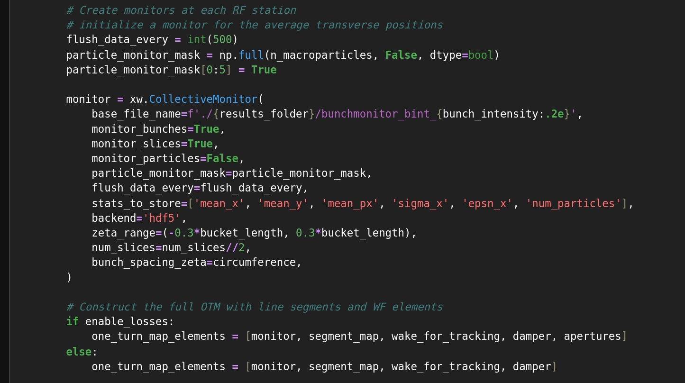
Structure of the iPython notebook (6):
Create monitor
Loop over
bunch
intensities
to be
scanned
Create one turn map

Slide 18
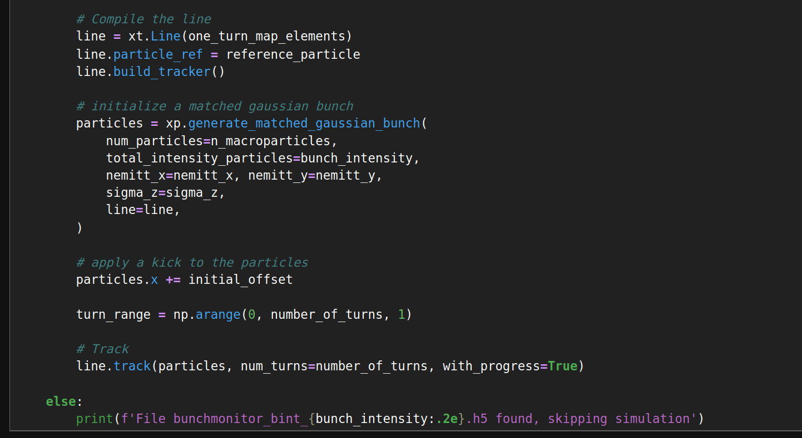
Structure of the iPython notebook (7):
Generate particles
Loop over
bunch
intensities
to be
scanned
Apply an initial kick to the distribution
Track particles

Slide 19
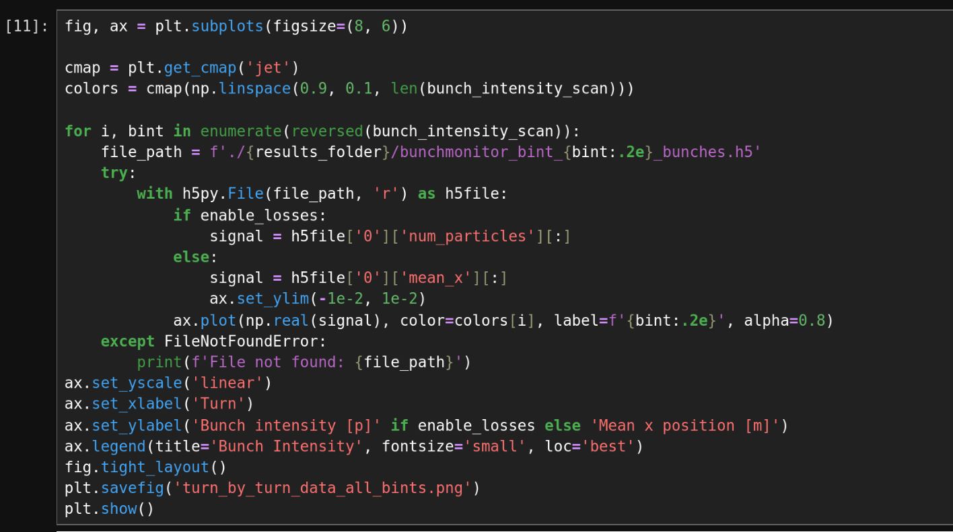
Structure of the Python notebook (7)
Plot average horizontal
positions/intensity of
the bunch turn by turn

Slide 20
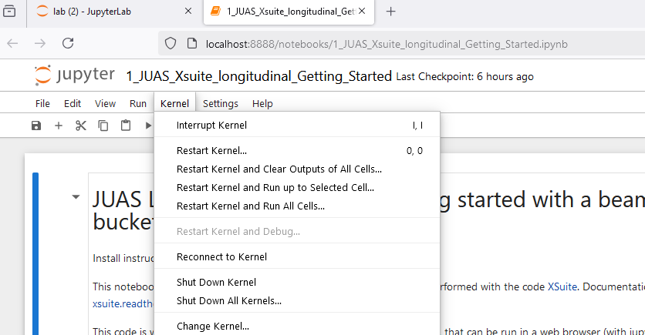
ipython cheat sheet
To restart the kernel at any point: “Kernel” → “Restart”
To only interrupt the kernel: “Kernel” → “Interrupt”
Shift-enter: execute current cell and move to next cell
Ctrl-enter: execute current cell and stay on current cell

