Slide 1
Access Downtown Fitness Facility
My Body
My Fitness Facility

Slide 2
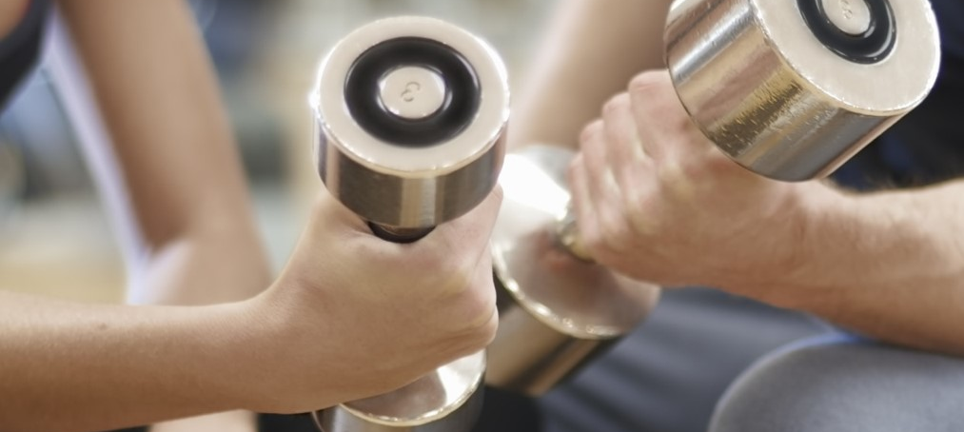
My Goals
Whether you want to lose weight or firm up, Access Downtown can make your fitness goals come true.
If you want it, we will help you accomplish it.

Slide 3
Access Downtown
Accredited Coaches
Professional Facilities
Specializing in weight training
In the West
Notes:
Access Downtown has locations in Washington, Oregon, and Idaho.

Slide 4
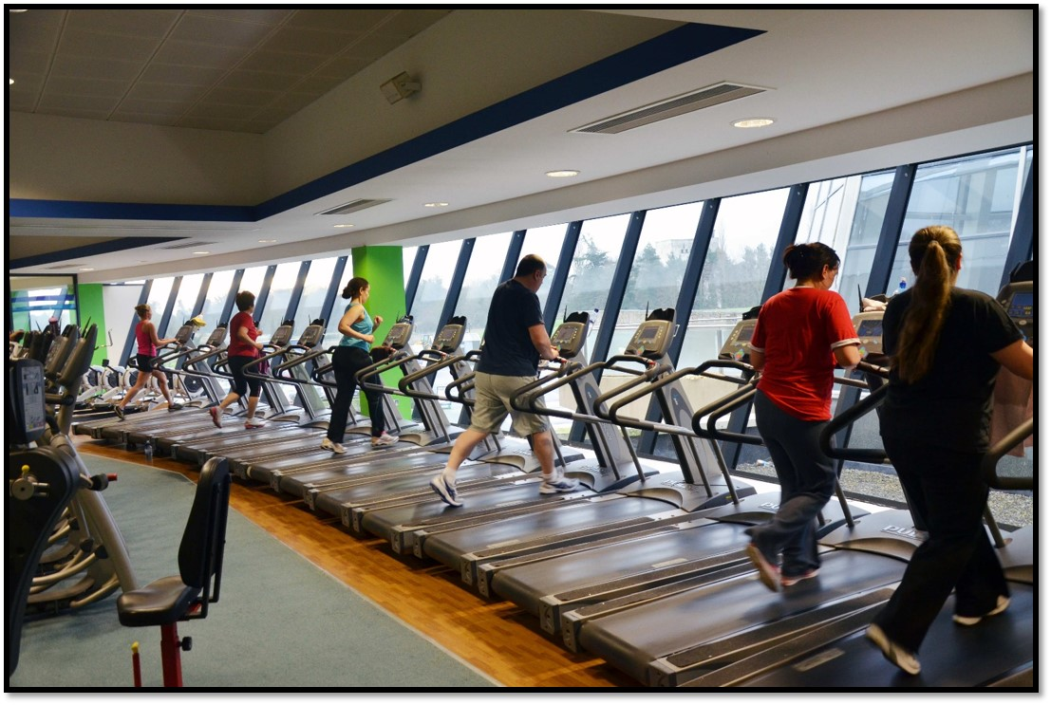
My Fitness Facility

Slide 5
About Us
Access Downtown was started by Mike Jaynes and Courtney Wedel in January of 2003. Both Mike and Courtney are committed to fitness at all levels.

