Slide 1

PYTHON
WEB SCRAPING PROJECT

Slide 2
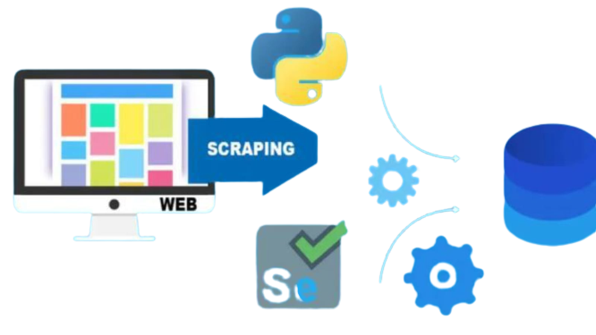
REQUIREMENTS
BUILD DATABASE SCHEMA
SCRAP DATA - SELENIUM
API - FLASK API
(Create,Insert, Select)
DATABASE - SQLITE

Slide 3
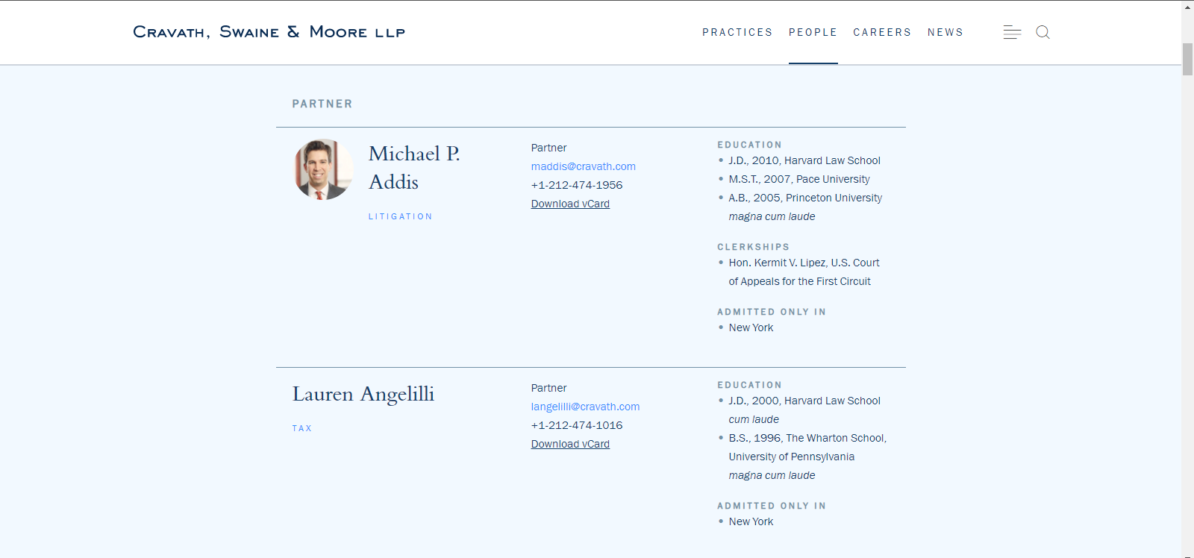
DATAPOINTS
NAME
1
1
2
EMAIL
2
5
TEL
3
3
4
PRACTICE
4
POSITION
5
URL
TIMESTAMP

Slide 4
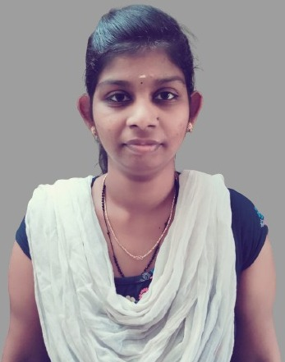
LINKS
JUHI PETER
WEBSITE LINK :https://www.cravath.com/people/index.html
GITHUB LINK :https://github.com/JUHIPETER/Python_Cravath.git

Slide 5
THANK YOU

