Slide 1

MCHE 479G (ENGR 400G): Practical Applications of Machine Learning in Engineering Design

Slide 2
Solar Irradiance Prediction and Anomaly Detection
Presented by
Jui Roy
Instructor
Brennan Domec, Ph.D., P.E.
Adjunct Professor
Department of Mechanical Engineering
University of Louisiana at Lafayette

Slide 3
Goal of the Project
Predict solar irradiance (Global_Avg) from environmental features.
Detect anomalies to flag unusual or faulty sensor readings.

Slide 4



Data Overview
12 months of dataset (2023)
Battery (min , agv voltage)
Temperature and Humidity
Rain and Wind speed
Solar Irradiance (Direct normal, global. diffused)

Slide 5
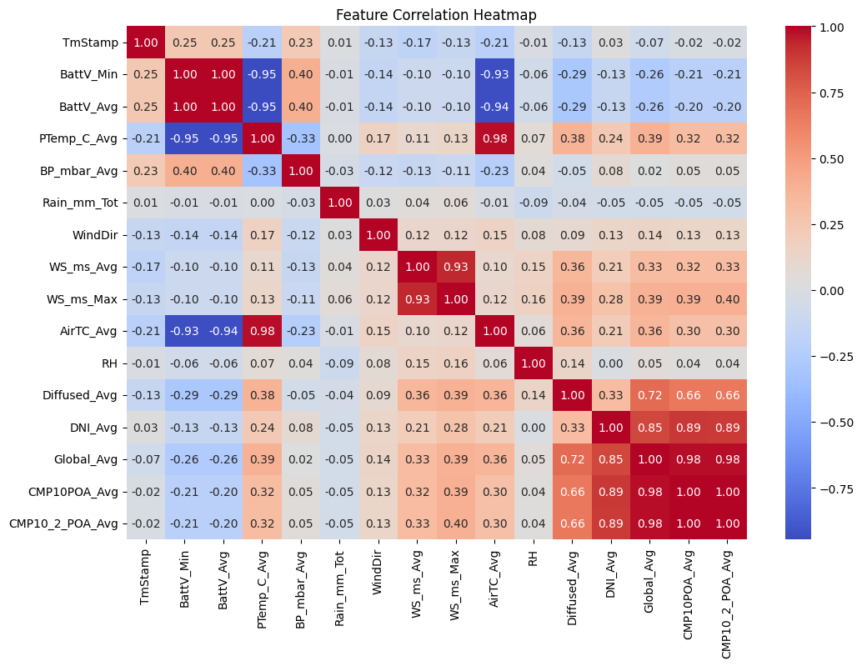
Data
Processing
Timestamp conversion and 30-minute resampling.
Feature scaling using StandardScaler.
Removal of non-numeric/irrelevant columns(RecNum, WS_ms_TMx, POA_Avg).
Outlier detection (1052) and removal using Local Outlier Factor (LOF).

Slide 6
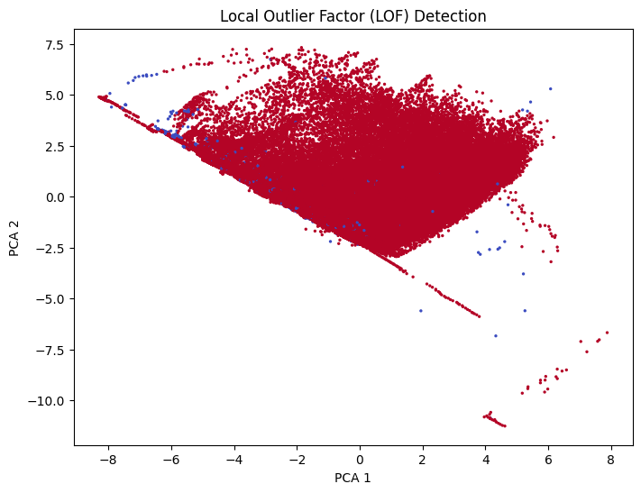
Data
Processing
Timestamp conversion and 30-minute resampling.
Feature scaling using StandardScaler.
Removal of non-numeric/irrelevant columns.
Outlier detection (1052) and removal using Local Outlier Factor (LOF).

Slide 7
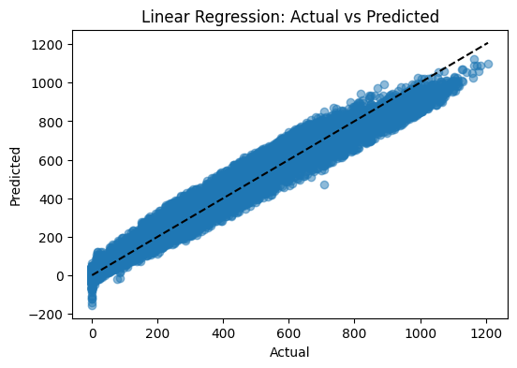
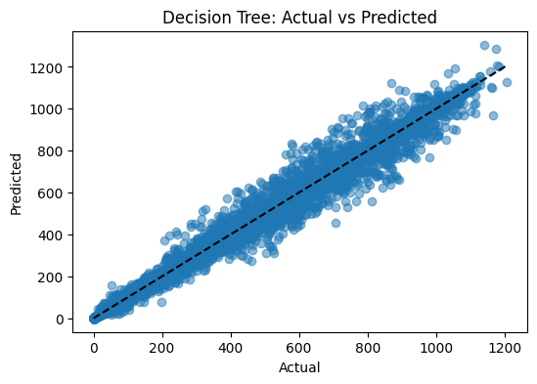
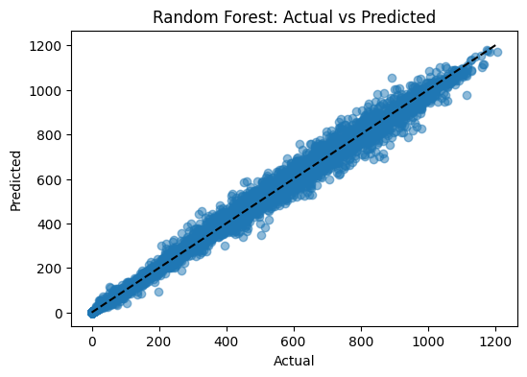
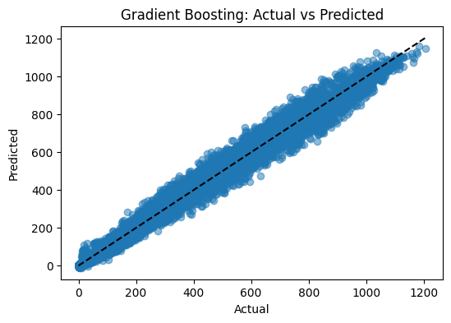
Model Construction
Built four regression models:
Linear Regression
Decision Tree Regressor
Random Forest Regressor
Gradient Boosting Regressor
R² Score: 0.9794 MAE : 25.82 RMSE : 40.69
R² Score: 0.9927 MAE : 8.80 RMSE : 24.23
R² Score: 0.9970 MAE : 6.24 RMSE : 15.64
R² Score: 0.9920 MAE : 12.91 RMSE : 25.38

Slide 8
Validation & Cross-Validation
Hyperparameter Tuning
Model Tuned: Random Forest Regressor
Tuning Approach: RandomizedSearchCV (20 random parameter combinations)
R² Score: 0.9970
MAE: 6.24
RMSE:
5-Fold Cross-Validation
Best Parameters Found:
max_depth = 20
max_features = 'sqrt'
min_samples_leaf = 1
min_samples_split = 2
n_estimators = 107
Best Cross-Validation R² Score: 0.9962
Metric | Test Set | Cross-validation
R² Score | 0.9970 | 0.9966
MAE | 6.24
RMSE | 15.64

Slide 9
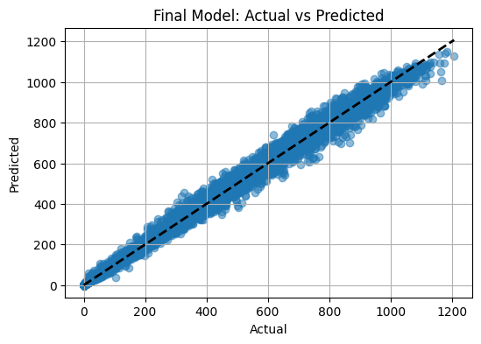
Results and Interpretations
High prediction accuracy after cleaning and tuning.
Anomaly removal improved model stability.
Random Forest was the best overall model.

Slide 10
Conclusion
Clean and prepared the data successfully.
Detected and removed anomalies using LOF.
Build, compared and achieved the best model.
Highly accurate prediction.
Other anomaly detection techniques could be tried, like Isolation Forest.
Incorporating a larger and more diverse dataset could enhance the performance.

