Slide 1
ABC pte Ltd. Network Project Proposal
Please note that many parts of this presentation have been removed for confidentiality and brevity purposes.

Slide 2
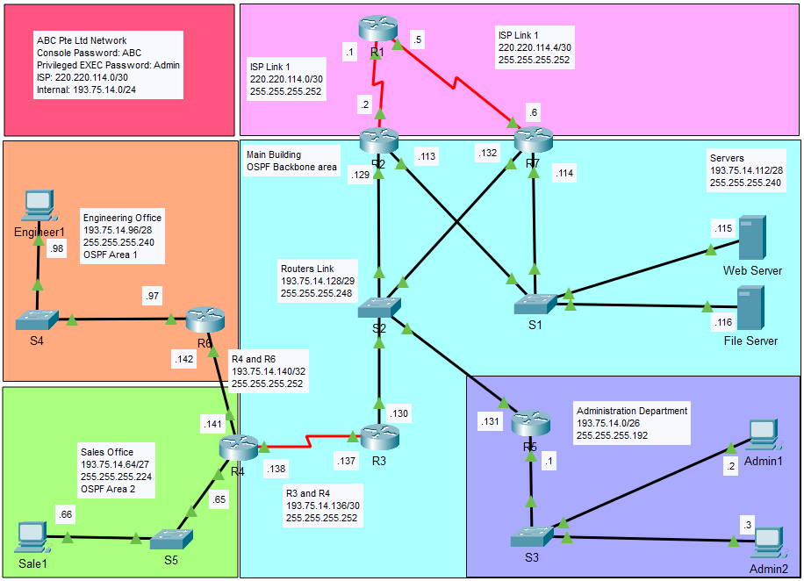
Logical diagram

Slide 3
Ip addressing – vlsm Table
Host Address Required for Employees is multiplied by 2 because company expect 100% growth. Additional IP is also required for router interface connecting to employees and servers. Furthermore, HSRP required additional IP addresses.
Host Address Required | Network Address | Subnet Mask | Max Possible Host | Network Name
50 | 193.75.14.0 | 255.255.255.192 | 62 | Administration Department
19 | 193.75.14.64 | 255.255.255.224 | 30 | Sale Office
11 | 193.75.14.96 | 255.255.255.240 | 14 | Engineering Office
9 | 193.75.14.112 | 255.255.255.240 | 14 | Servers
5 | 193.75.14.128 | 255.255.255.248 | 6 | Routers Link
2 | 193.75.14.136 | 255.255.255.252 | 2 | R3 and R4
2 | 193.75.14.140 | 255.255.255.252 | 2 | R4 and R6

Slide 4
Ip addressing – ISP and hsrp Table
To ensure network redundancy for Internet Service Provider (ISP) an additional Router R7 is added, ISP Link 2 is for Router R7.
Host Address Required | Network Address | Subnet Mask | Max Possible Host | Network Name
2 | 220.220.114.0 | 255.255.255.252 | 2 | ISP Link 1
2 | 220.220.114.4 | 255.255.255.252 | 2 | ISP Link 2
HSRP Group | Version | Virtual IP | Description
standby 1 | 2 | 193.75.14.126 | Connecting to Servers
standby 2 | 2 | 193.75.14.134 | Connecting to Routers Link

Slide 5
Ip addressing – router interfaces
Location: Internet Router Name: R1
Interface | Description | DTE/DCE | Network | Interface Address | Subnet Mask
s0/0/0 | R1 to R2 | DCE 64000 | ISP Link 1 | 220.220.114.1 | 255.255.255.252
s0/0/1 | R1 to R7 | DCE 64000 | ISP Link 2 | 220.220.114.5 | 255.255.255.252

Slide 6
Ip addressing – router interfaces
Location: Main Building Router Name: R2
Interface | Description | DTE/DCE | Network | Interface Address | Subnet Mask
s0/0/0 | R2 to R1 | - | ISP Link 1 | 220.220.114.2 | 255.255.255.252
g0/0 | R2 to Servers | - | Servers | 193.75.14.113 | 255.255.255.240
g0/1 | R2 to Routers | - | Routers Link | 193.75.14.129 | 255.255.255.248
f0 | Web Server | - | Servers | 193.75.14.115 | 255.255.255.240
f0 | File Server | - | Servers | 193.75.14.116 | 255.255.255.240
standby 1 | Servers | - | Servers | 193.75.14.126 | 255.255.255.240
standby 2 | Routers Link | - | Routers Link | 193.75.14.134 | 255.255.255.248

Slide 7
Ip addressing – router interfaces
Location: Main Building Router Name: R3
Interface | Description | DTE/DCE | Network | Interface Address | Subnet Mask
g0/0 | R3 to Routers | - | Routers Link | 193.75.14.130 | 255.255.255.248
s0/0/0 | R3 to R4 | DCE 64000 | R3 and R4 | 193.75.14.137 | 255.255.255.252
Location: Main Building Router Name: R4
Interface | Description | DTE/DCE | Network | Interface Address | Subnet Mask
s0/0/0 | R4 to R3 | DCE 64000 | R3 and R4 | 193.75.14.138 | 255.255.255.252
g0/0 | R4 to Sales Office | - | Sales Office | 193.75.14.65 | 255.255.255.224
g0/1 | R4 to R6 | - | R4 and R6 | 193.75.14.141 | 255.255.255.252
f0 | Sale1 | - | Sales Office | 193.75.14.66 | 255.255.255.224

Slide 8
Ip addressing – router interfaces
Location: Administration Office Router Name: R5
Interface | Description | DTE/DCE | Network | Interface Address | Subnet Mask
g0/0 | R5 to Routers | - | Routers Link | 193.75.14.131 | 255.255.255.248
g0/1 | R5 to Administration Department | - | Administration Department | 193.75.14.1 | 255.255.255.192
f0 | Admin1 | - | Administration Department | 193.75.14.2 | 255.255.255.192
f0 | Admin2 | - | Administration Department | 193.75.14.3 | 255.255.255.192

Slide 9
Ip addressing – router interfaces
Location: Engineering Office Router Name: R6
Interface | Description | DTE/DCE | Network | Interface Address | Subnet Mask
g0/0 | R6 to R4 | - | R4 and R6 | 193.75.14.142 | 255.255.255.252
g0/1 | R6 to Engineering Office | - | Engineering Office | 193.75.14.97 | 255.255.255.240
f0 | Engineer1 | - | Engineering Office | 193.75.14.98 | 255.255.255.240

Slide 10
Ip addressing – router interfaces
Location: Main Building Router Name: R7
Interface | Description | DTE/DCE | Network | Interface Address | Subnet Mask
s0/0/0 | R7 to R1 | - | ISP Link2 | 220.220.114.6 | 255.255.255.252
g0/0 | R7 to Servers | - | Servers | 193.75.14.114 | 255.255.255.240
g0/1 | R7 to Routers | - | Routers Link | 193.75.14.132 | 255.255.255.248
standby 1 | Servers | - | Servers | 193.75.14.126 | 255.255.255.240
standby 2 | Routers Link | - | Routers Link | 193.75.14.134 | 255.255.255.248

Slide 11
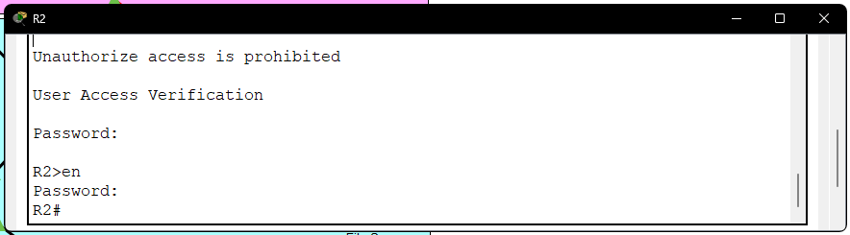
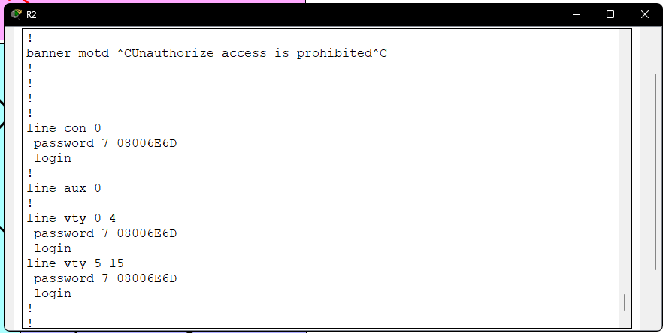
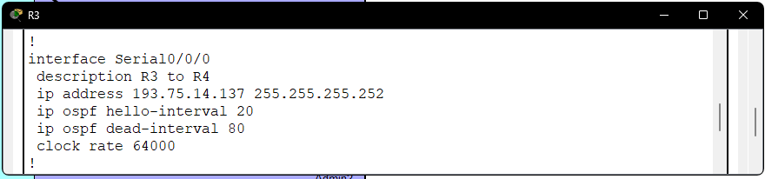
Details of Router configurations
Configurations | Commands Used | Screenshots
Appropriate hostnames for all routers | hostname R2
Banner Motd to show a message right before you login. | banner motd $Unauthorize access is prohibited$
Password with encryption on all routers to prevent malicious actors. Console: ABC Privileged EXEC: Admin | service password-encryption enable secret Admin line console 0 password ABC login line vty 0 15 password ABC login
Clock Rate 64000 for serial interface where applicable Between R3 and R4 Between R1 and R2 Between R1 and R7 | interface s0/0/0 clock rate 64000

Slide 12
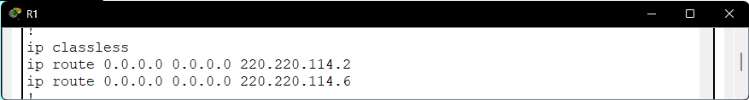
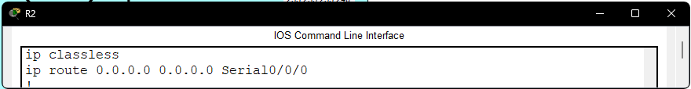
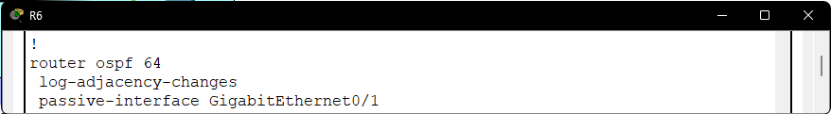
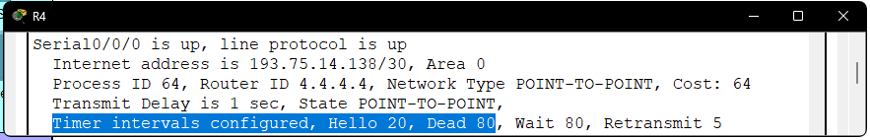
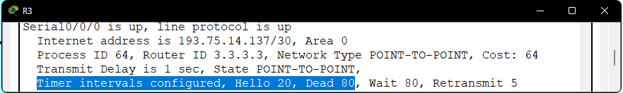
Details of Router configurations
Configurations | Commands Used | Screenshots
Static route between R1 and R2, R1 and R7. R1 is acting as the Internet Service Provider. | R1(config)#ip route 0.0.0.0 0.0.0.0 220.220.114.2 R1(config)#ip route 0.0.0.0 0.0.0.0 220.220.114.6 R2(config)#ip route 0.0.0.0 0.0.0.0 s0/0/0 R7(config)#ip route 0.0.0.0 0.0.0.0 s0/0/0
Disable routing updates to appropriate devices To all end devices only, only routers need other router routing updates | router ospf 64 passive-interface g0/1
Hello and Dead time interval for Serial interface to be updated to 20 seconds and 80 seconds respectively. Only between R3 and R4 | interface s0/0/0 ip ospf hello-interval 20 ip ospf dead-interval 80

Slide 13
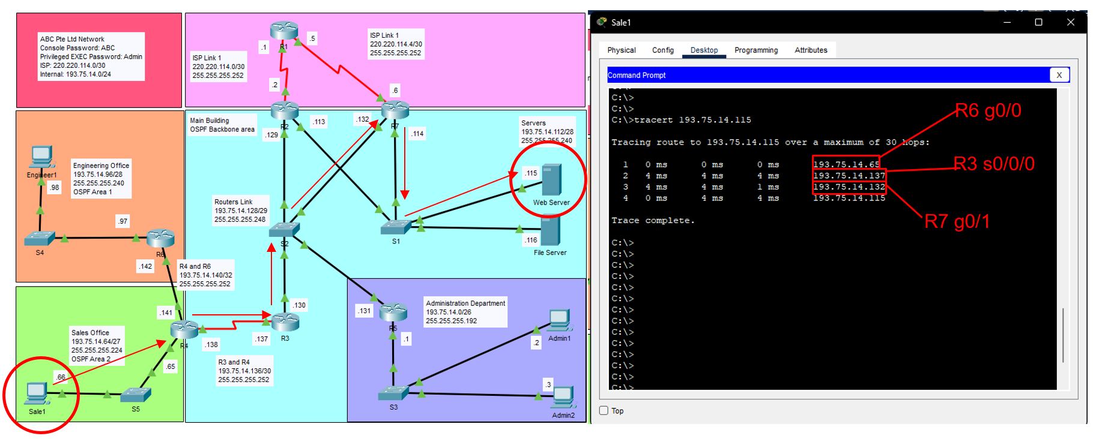
Details of OSPF implementation
Open Shortest Path First is routing protocol that help packets deliver by selecting the shortest network path to their destination.
We could test this using tracert command, below we are using Sale1 PC tracert to Web Server IP address. Tracert command can trace route to destination and show us the network path it taken.

Slide 14
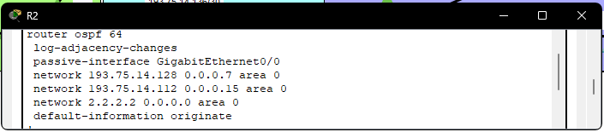
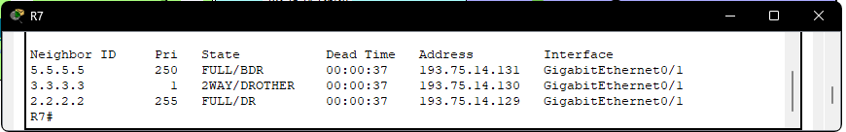
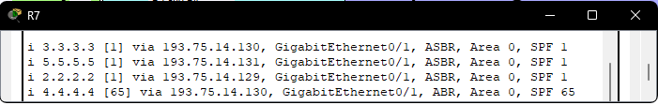
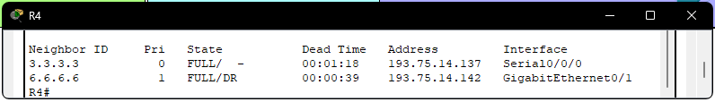
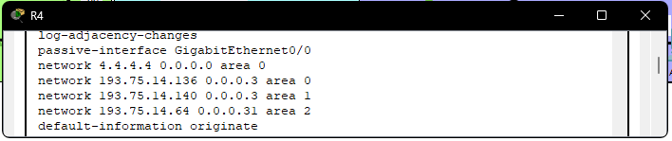
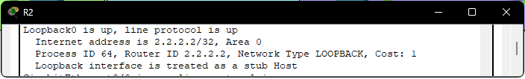
Details of OSPF implementation
OSPF Process ID 64 DR/BDR to be applied for multi-access network:
R2 to be designated as DR
R5 to be designated as BDR Multi area OSPF to be used:
R2, R3 and R5 (Backbone area 0)
R4 (ABR – Area 0, 1 and 2)
Use appropriate loopback address for router ID.

Slide 15
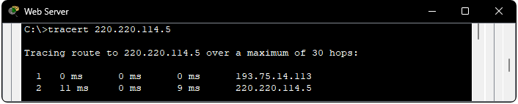
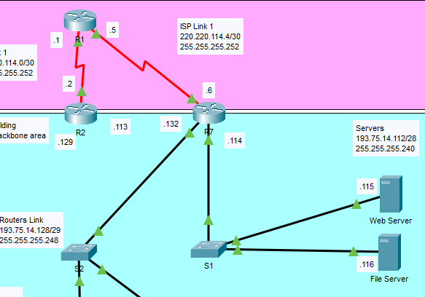
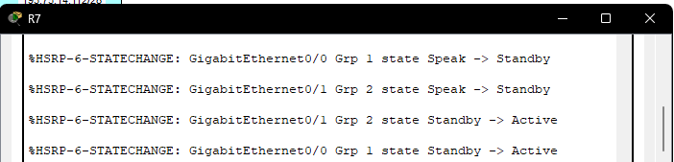
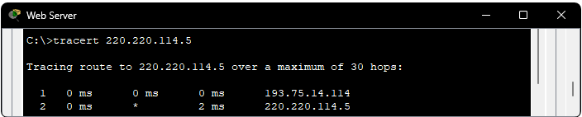
HSRP Configurations
Hot Standby Router Protocol provides network redundancy by combining 2 routers together into a single virtual router that shares the same IP address. This allows one router to be on standby and becomes active when the main router is down, and ensures that routing traffic immediately recovers.
In this case, router R2 is the main active router and router R7 is the standby backup router. Grp 1 is connected to the Servers and Grp 2 is connected to other routers. When R2 is disconnected, R7 will becomes active, and routing will turn to R7.
Before disconnected
R2 g0/0
After disconnected
R7 g0/0
Notes:
Commands of R2:
int g0/0
standby version 2
standby 1 ip 193.75.14.126
standby 1 priority 150
standby 1 preempt
int g0/1
standby version 2
standby 2 ip 193.75.14.134
standby 2 priority 150
standby 2 preempt
Commands of R7:
int g0/0
standby version 2
standby 1 ip 193.75.14.126
int g0/1
standby version 2
standby 2 ip 193.75.14.134

Slide 16
Testing of Network
Testing and Verifying Strategy of ABC Pte Ltd.'s Network.
Simple Protocol Data Unit (PDU) allow us to test basic communication between end devices. I have created multiple scenarios to verify the network routing.
Scenario 0: ISP testing from all end devices to R1
Scenario 1: Testing connection between employees, Engineering1 to all end devices
Scenario 2: Test HSRP connection, by disconnecting R2 connection to S2 and S1.
Additional to verify the HSRP and OSPF, the command tracert could help determines the network path taken.
Furthermore, the router command line interface’s commands could help verify the routing protocol.
OSPF: show ip ospf interface show ip ospf neighbor show ip ospf border-routers | HSRP: show standby brief show standby

Slide 17
Implementation Budget cost estimate
No. | Description/Model | Unit Price (SDG) | Quantity | Sub Total (SDG)
1 | Cisco Router 2911/K9 | $2154.12 | 6 | $12924.72
2 | Cisco Serial Port: HWIC-2T | $492.01 | 4 | $1968.04
3 | Cisco Catalyst Switch 2960: WS-C2960-24LT-L | $975.77 | 4 | $3903.08
4 | Cisco Catalyst Switch 2960: WS-C2960-48TC-L | $846.58 | 1 | $846.58
5 | Copper Straight-Through Cable: Cat5e, RJ45, 1M | $6.52 | 49 | $319.48
6 | Serial Cable: CAB-SS-2626X | $33.89 | 1 | $33.89
Total (SDG): |  |  |  | $19995.79
This is a rough estimation and doesn’t include the 2 copper straight-through cable to remote offices because of unknown length. Additionally, Internet Service Provider leased lines are also excluded due to unknown contract cost. Furthermore, Switch with 48 fast ethernet ports is for Administration Department as there are 25 current employees.
Notes:
https://www.router-switch.com/cisco2911-k9-p-156.html
https://www.router-switch.com/hwic-2t-p-1105.html
https://www.router-switch.com/ws-c2960-24lt-l-p-436.html
https://www.router-switch.com/ws-c2960-48tc-l-p-434.html
https://sg.rs-online.com/web/p/ethernet-cable/0557032
https://www.router-switch.com/cab-ss-2626x-3-p-5680.html

Slide 18
Future recommendations
Recommendation 1
Additional redundant links such as router R6 to R3 or R5 to S1. This help with redundancy, given there is only one line connection from Remote site to ISP, and one line connection from R5 to ISP.
Recommendation 2
Robust Network Security Planning:
Keep up with the latest security updates
Keep up with the latest network security threats
Change Passwords Frequently
Recommendation 3
Network Documentation is crucial to scaling a network. Proper documentation can save you from time to troubleshoot the network.

Slide 19
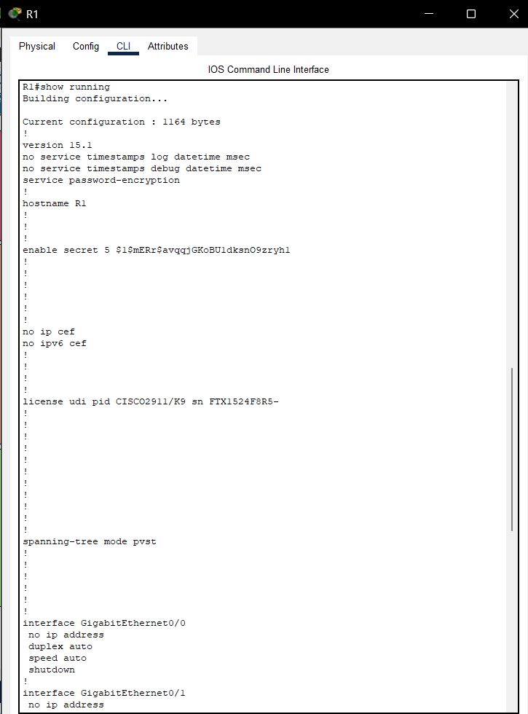
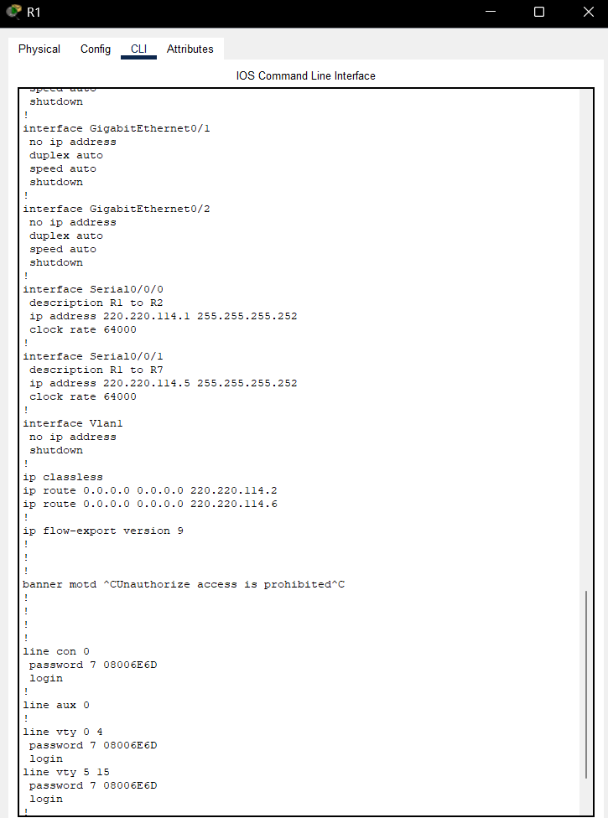
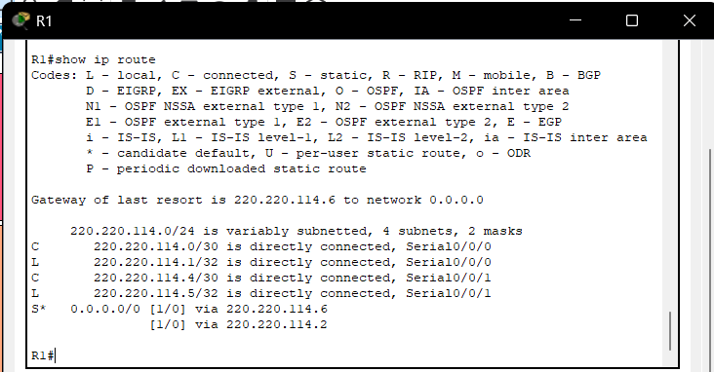
Printout – router r1
show run
show ip route

Slide 20
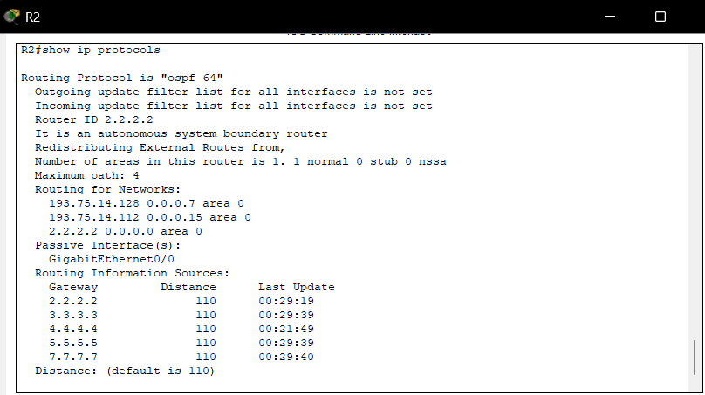
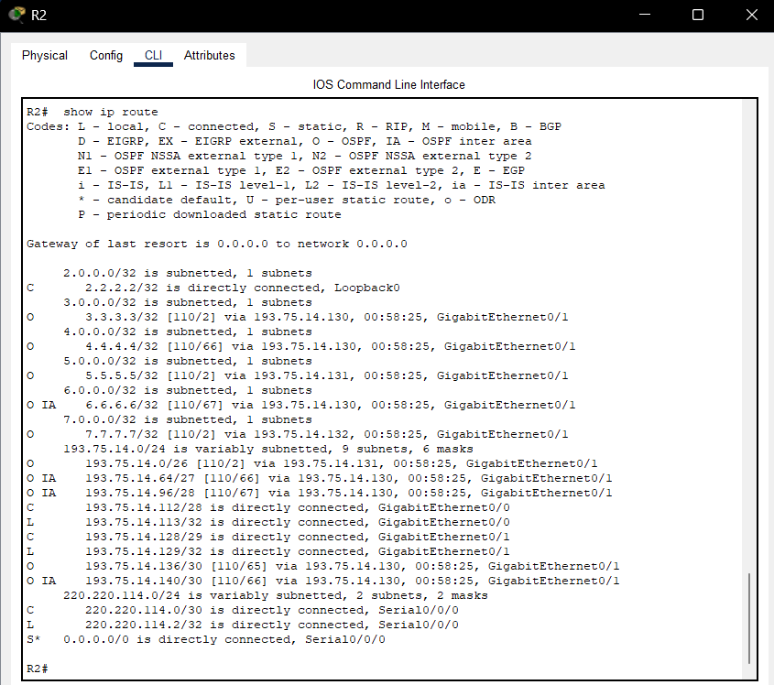
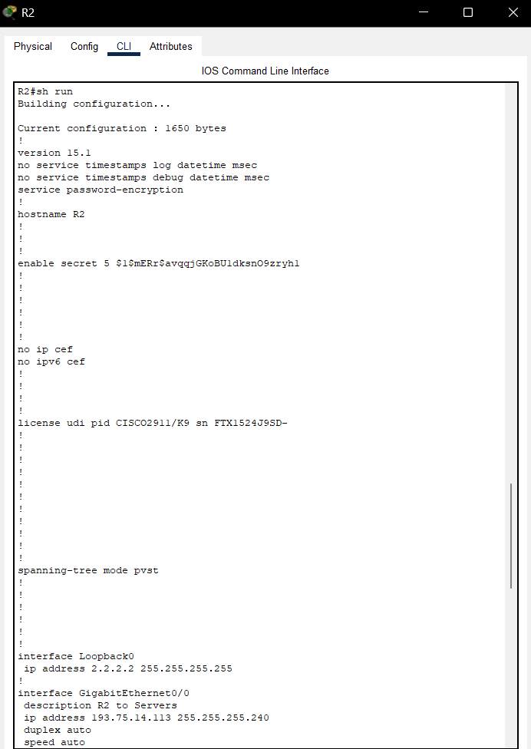
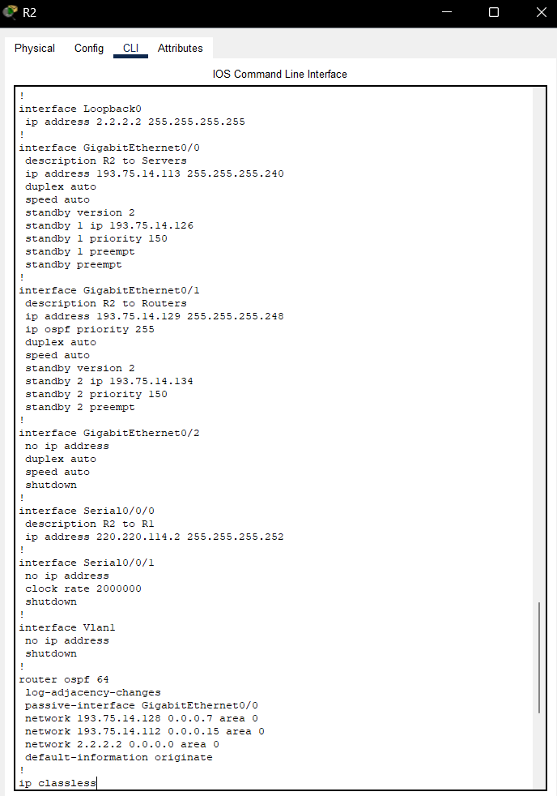
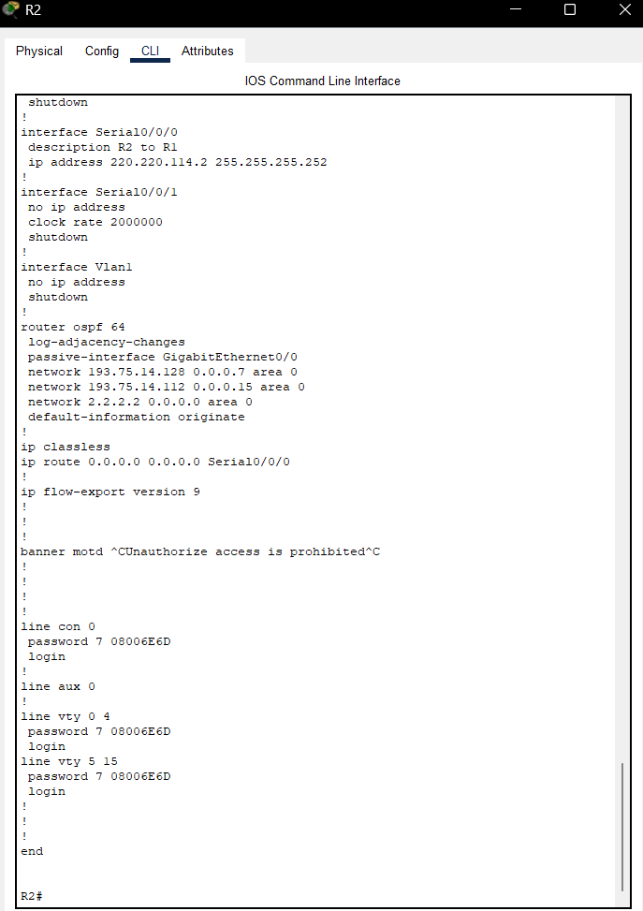
Printout – router r2
show ip protocols
show ip route
show run

Slide 21
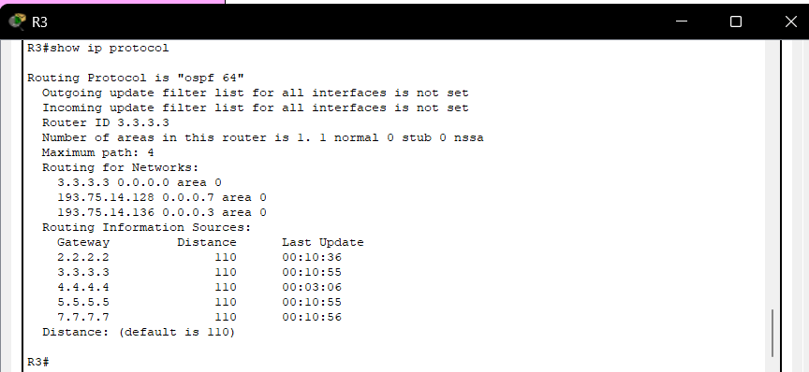
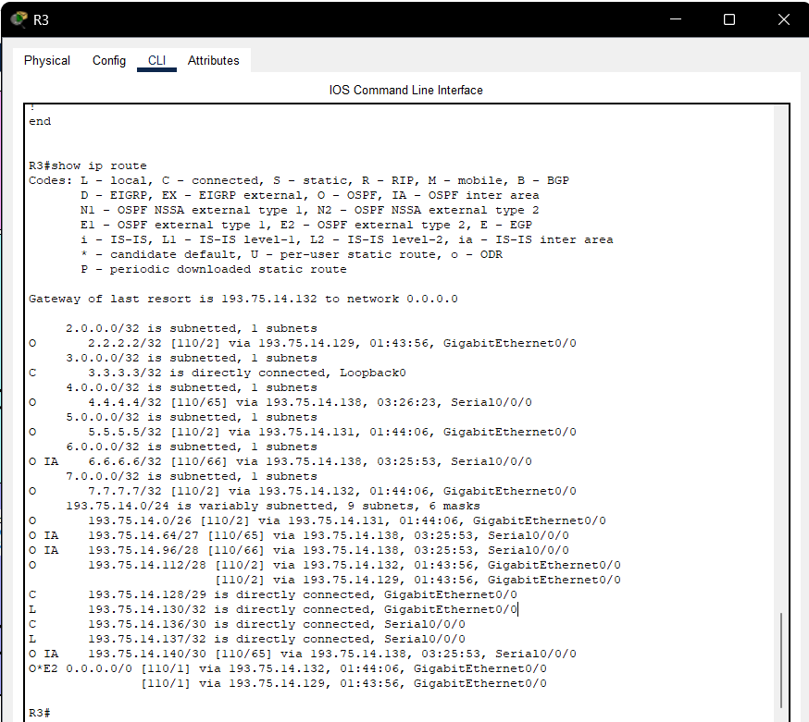
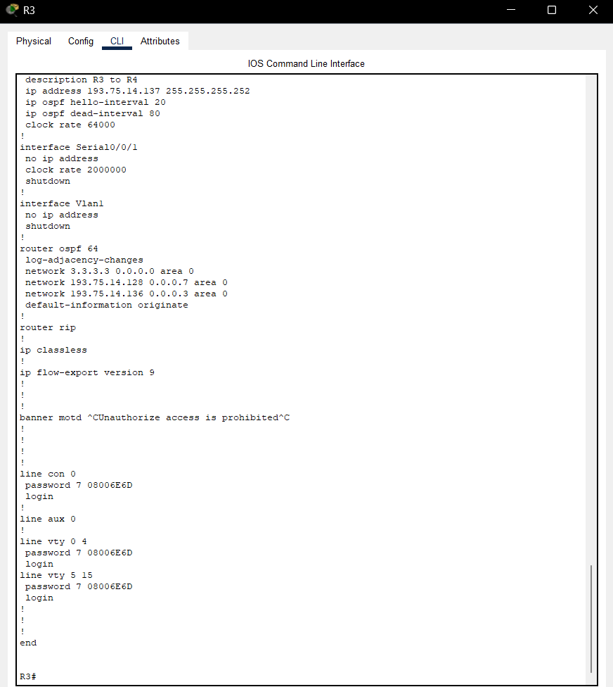
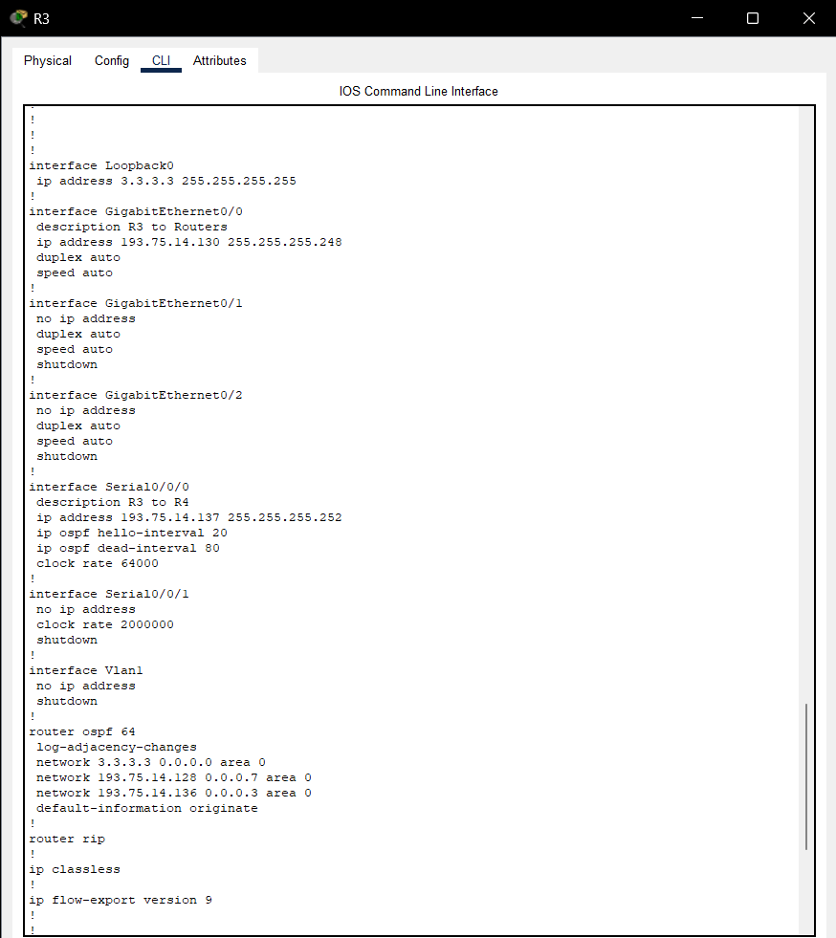
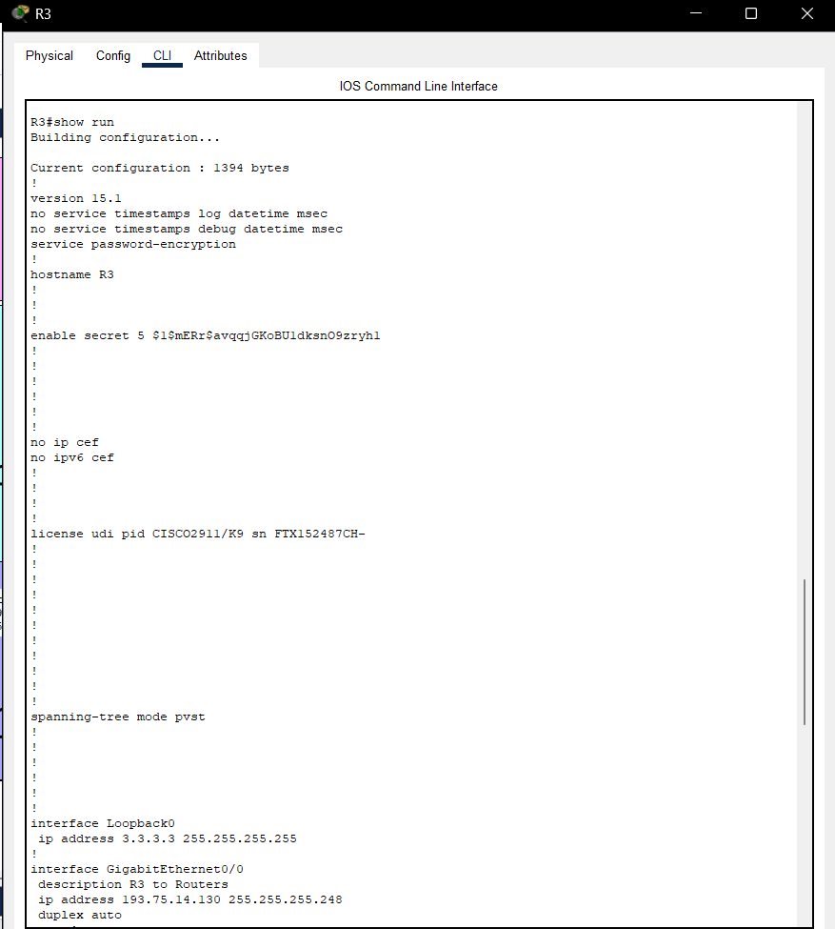
Printout – router r3
show ip protocols
show ip route
show run

Slide 22
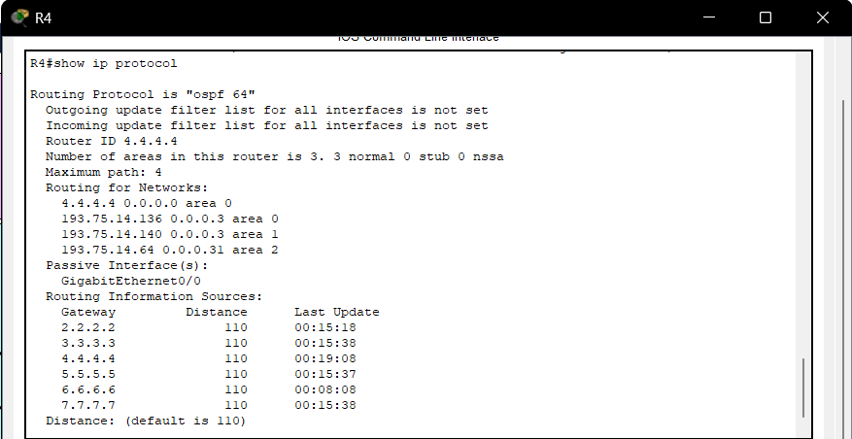
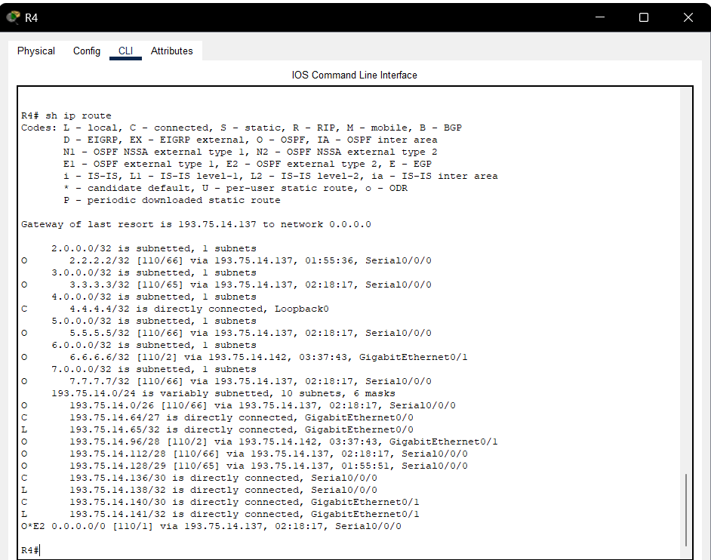
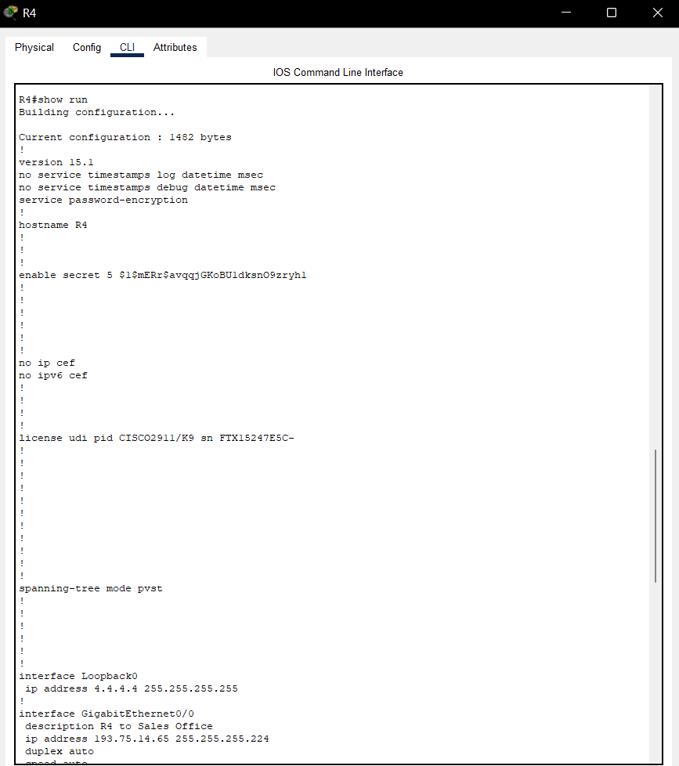
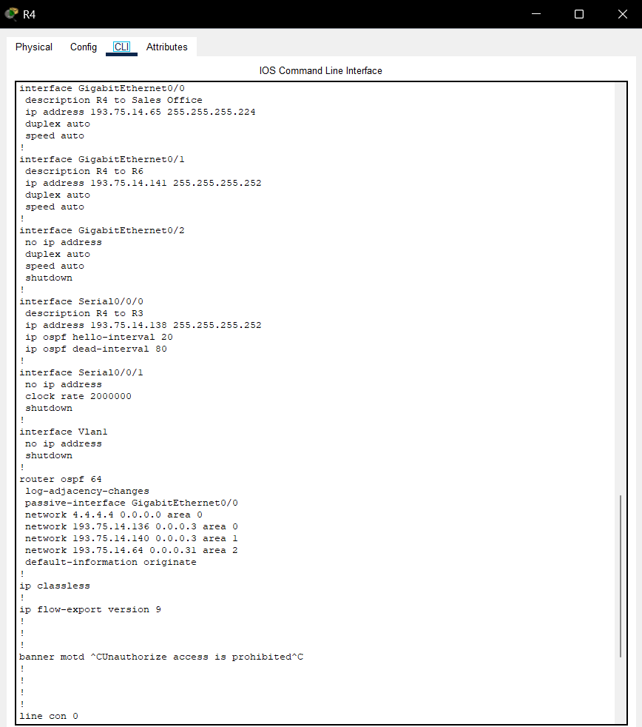
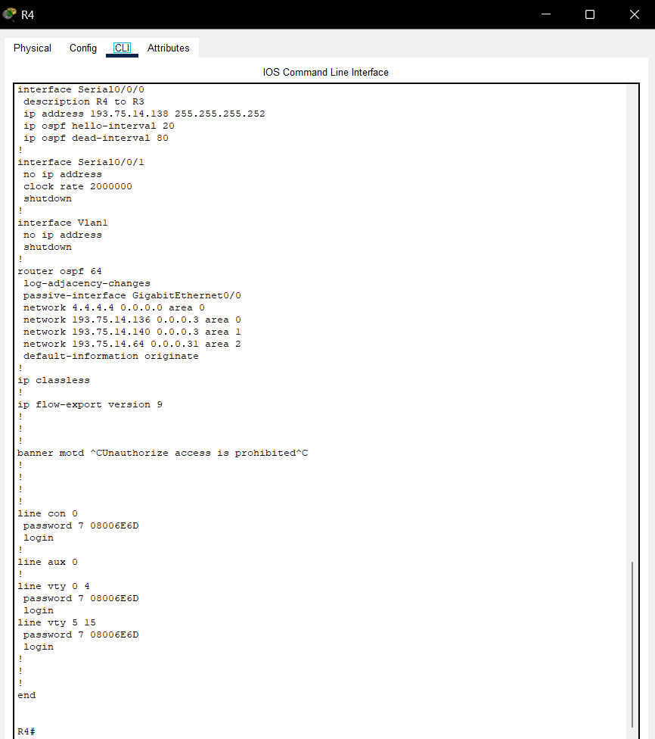
Printout – router r4
show ip protocols
show ip route
show run

Slide 23
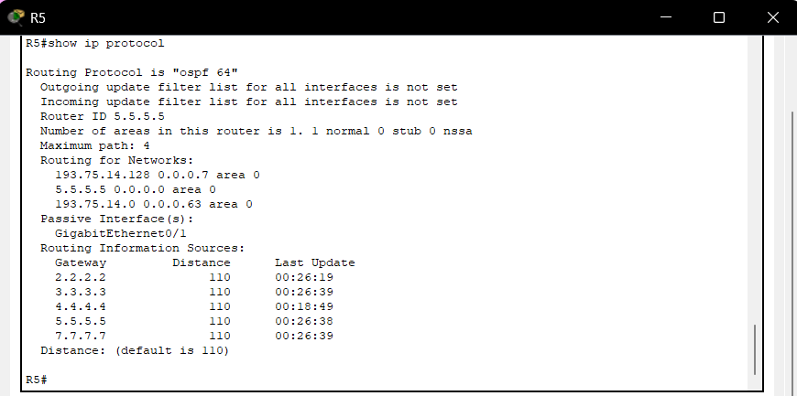
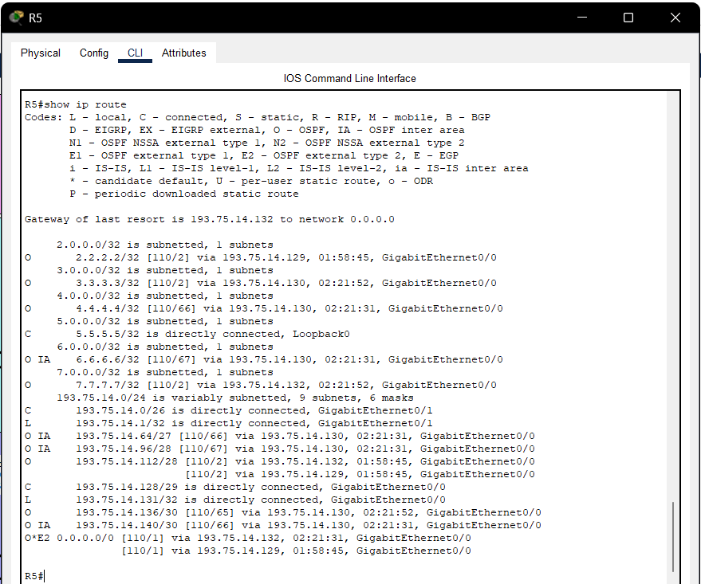
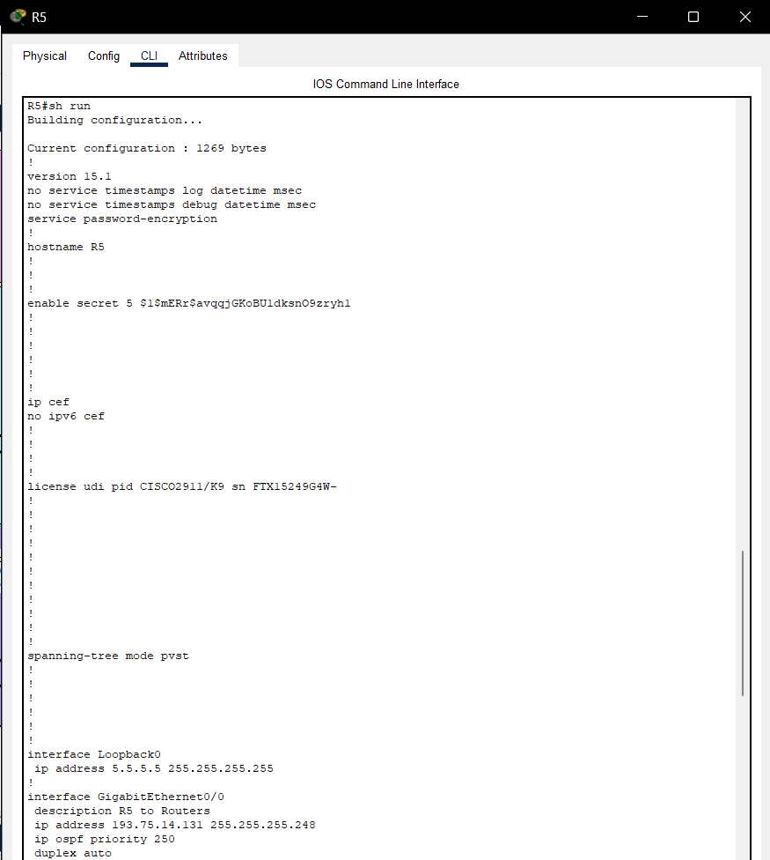
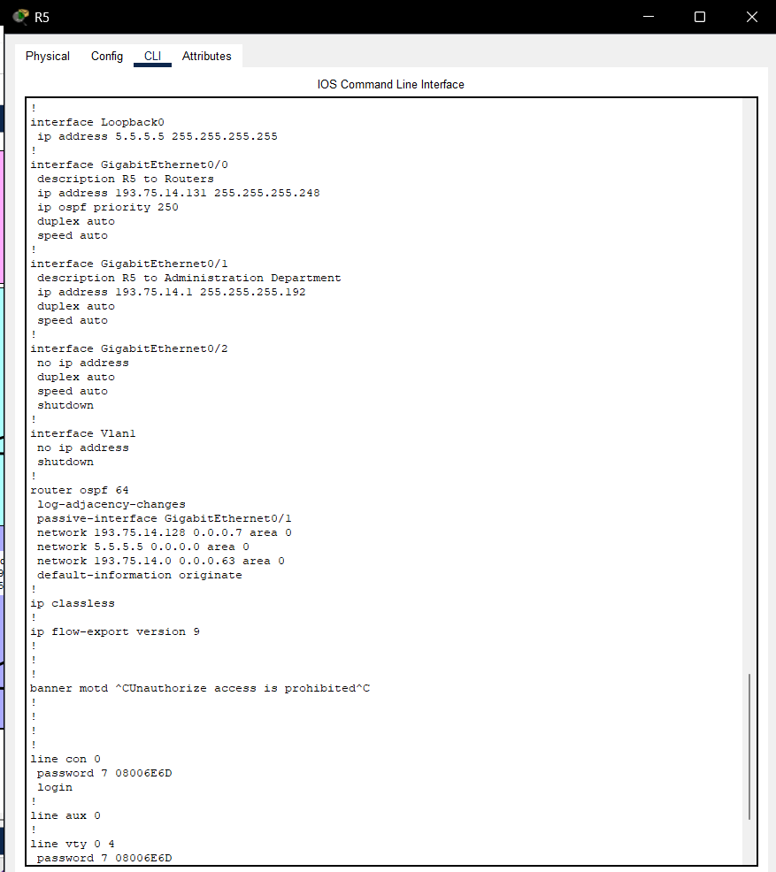
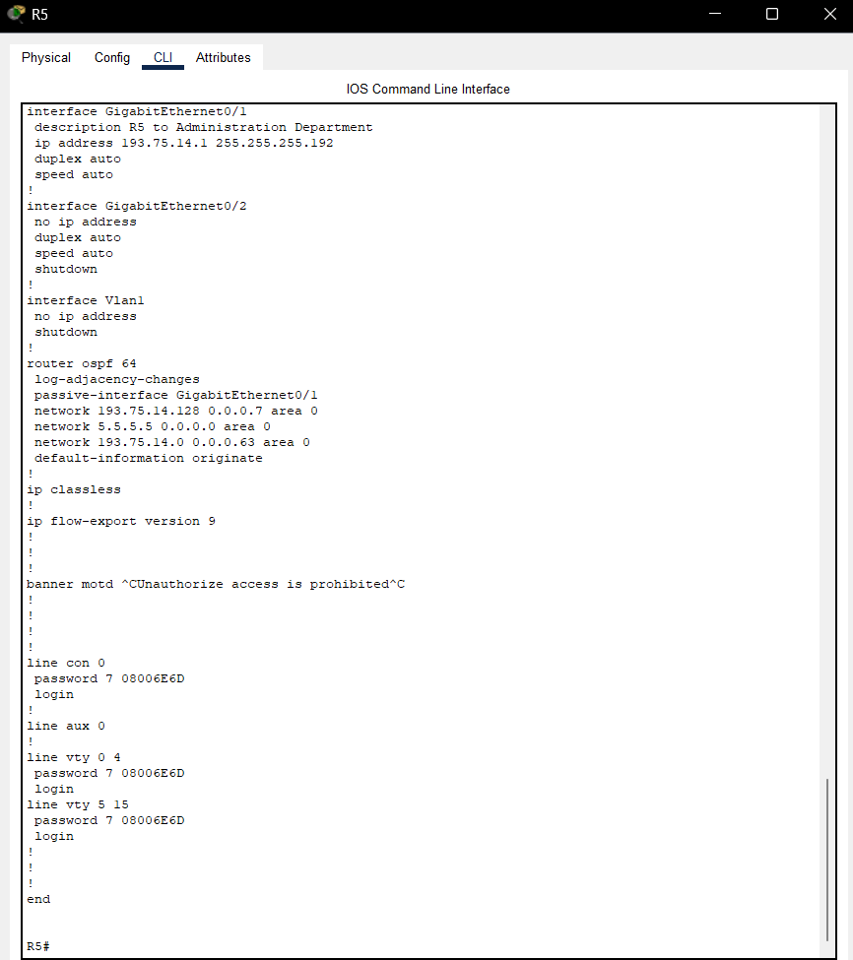
Printout – router r5
show ip protocols
show ip route
show run

Slide 24
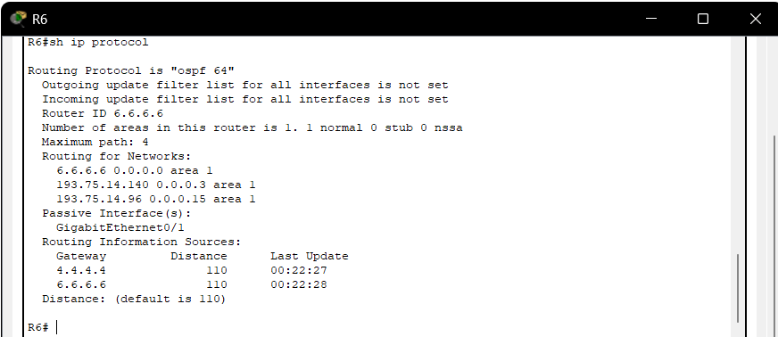
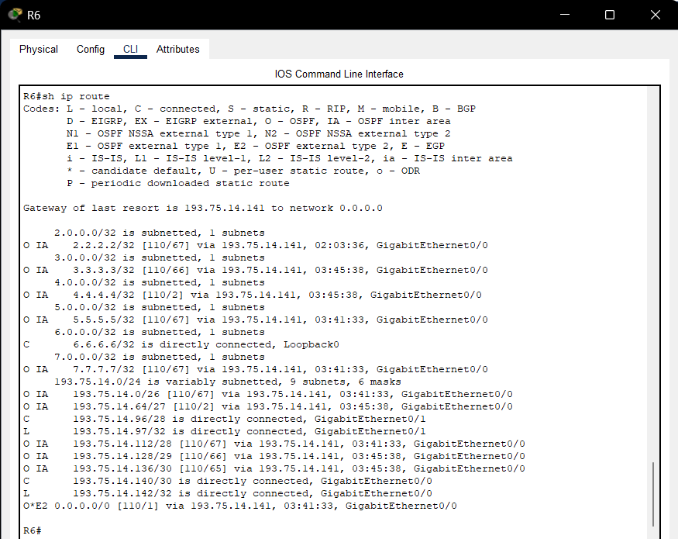
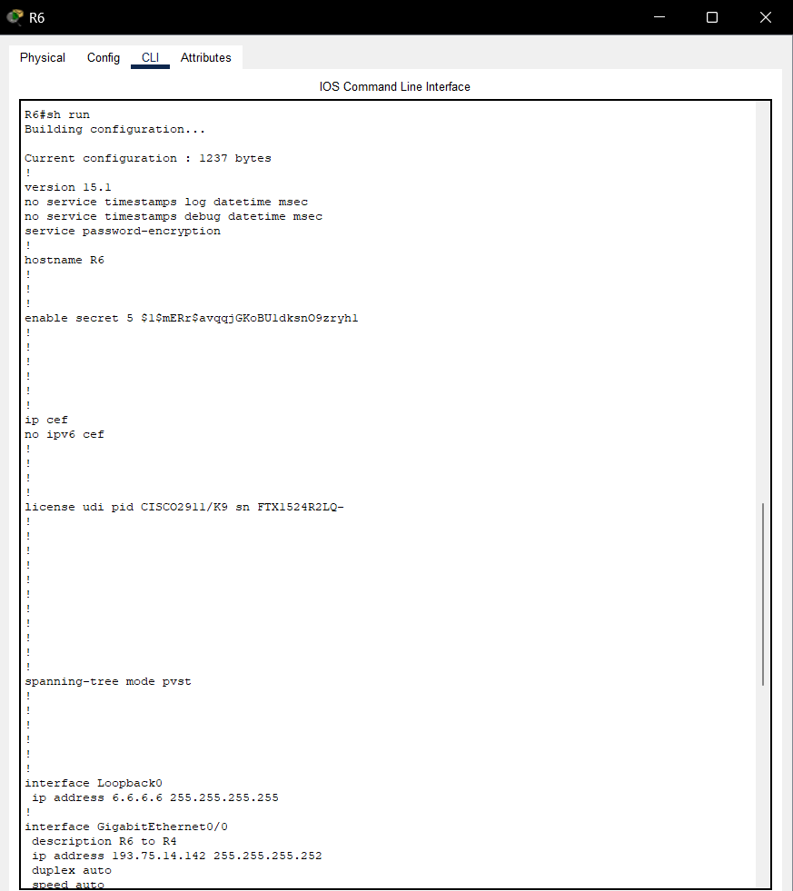
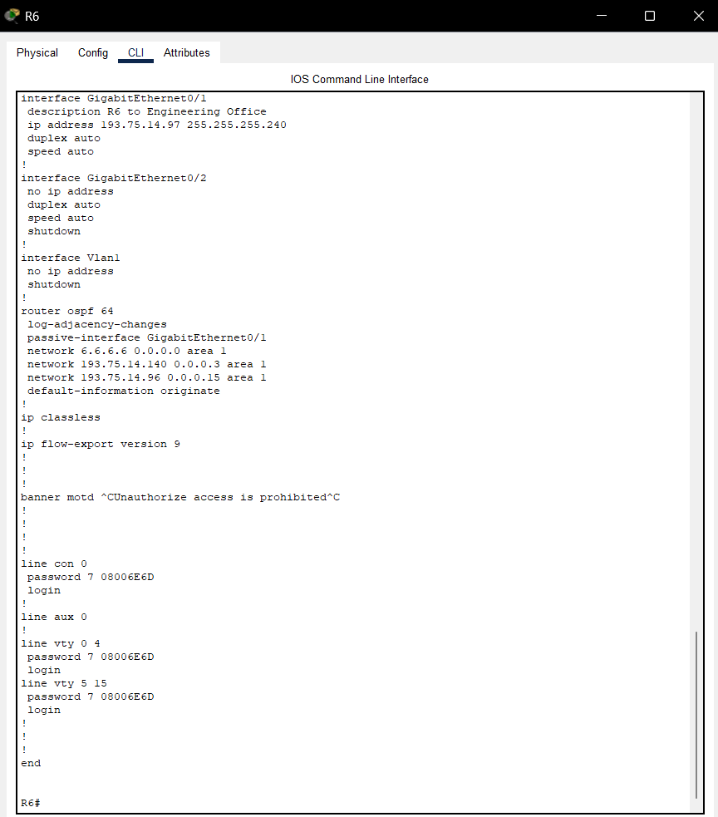
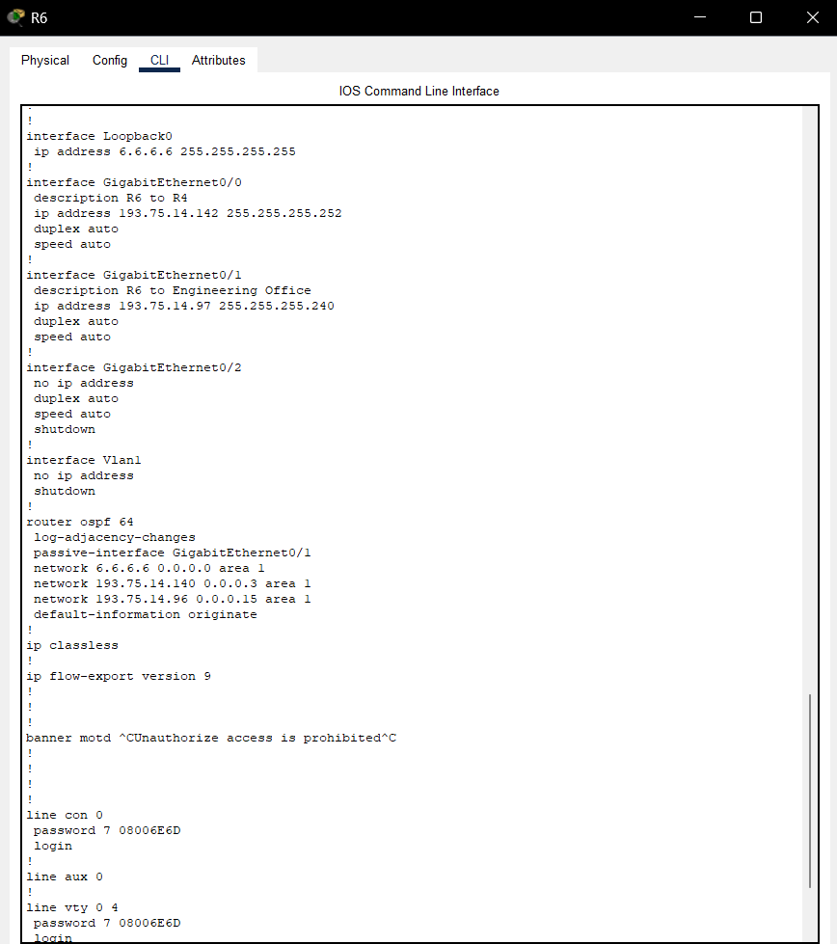
Printout – router r6
show ip protocols
show ip route
show run

Slide 25
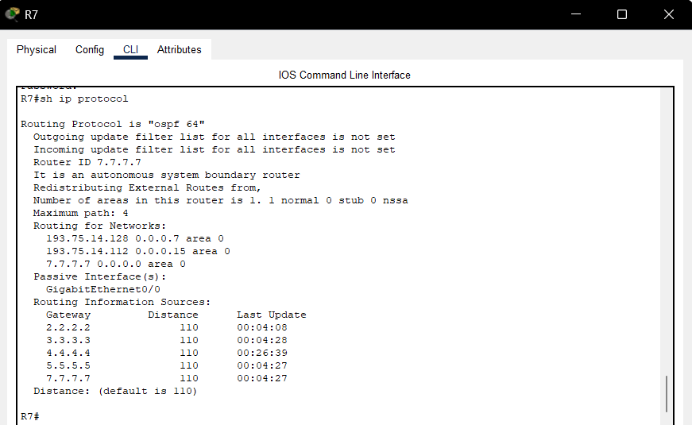
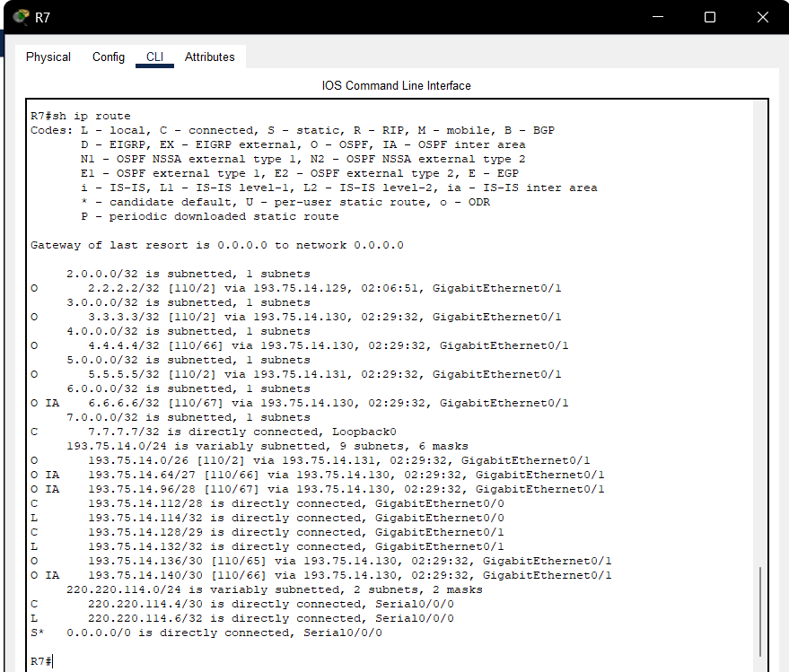



Printout – router r7
show ip protocols
show ip route
show run

