Slide 1
Source Estimation from BB to Amplitude Ratios
汇报人：周桂理 王景熙 朱俊
汇报日期：

Slide 2
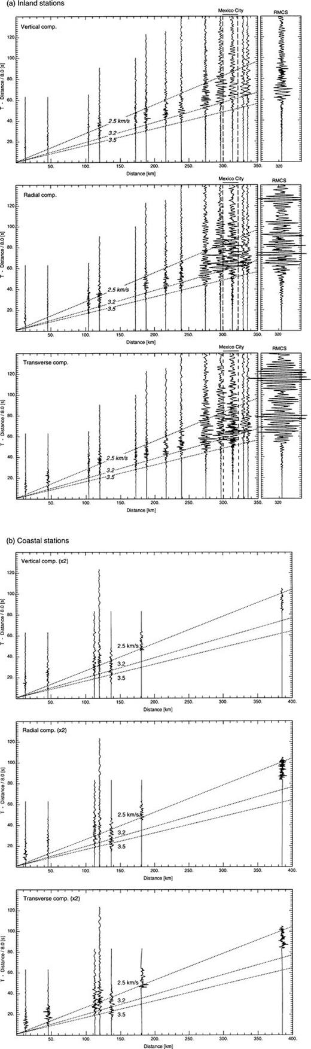
typical regional seismograms

Slide 3
Outline
Theory
Process
Application

Slide 4
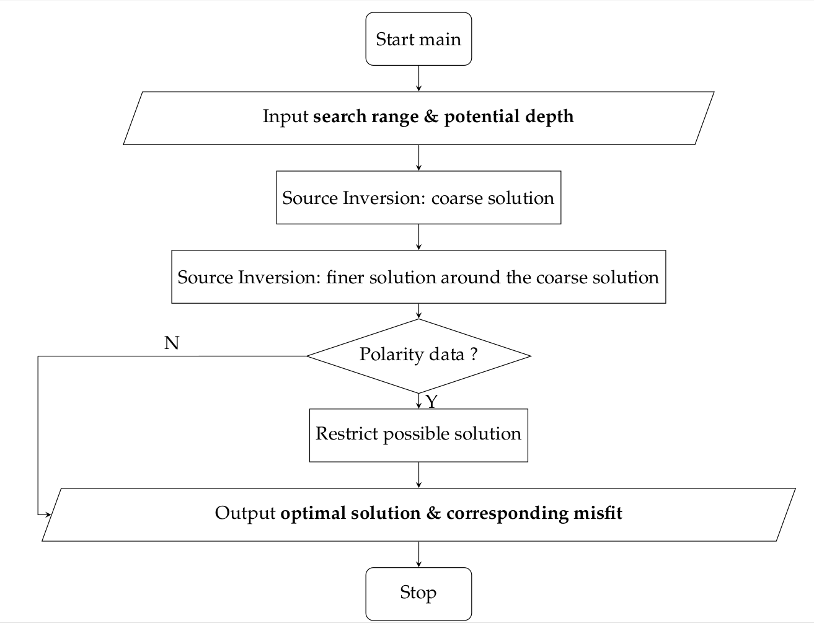
Process (Zhao et al)

Slide 5
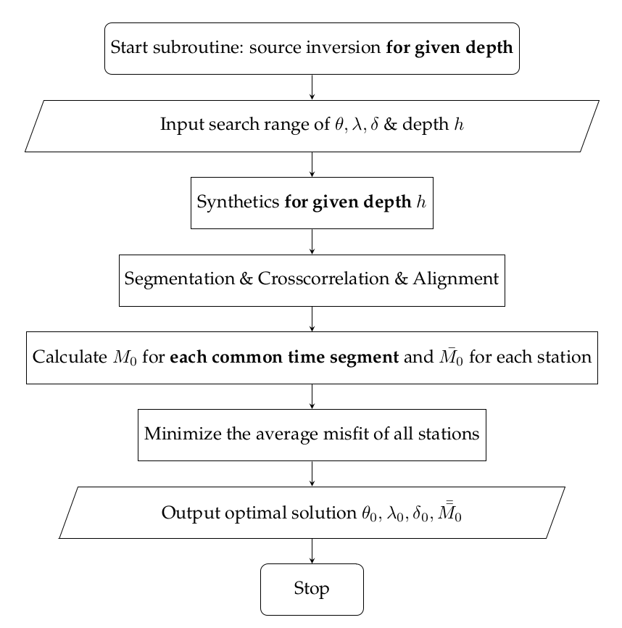

Slide 6
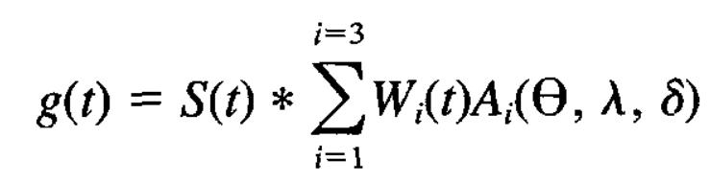
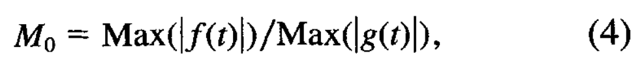
Related Formulae

Slide 7
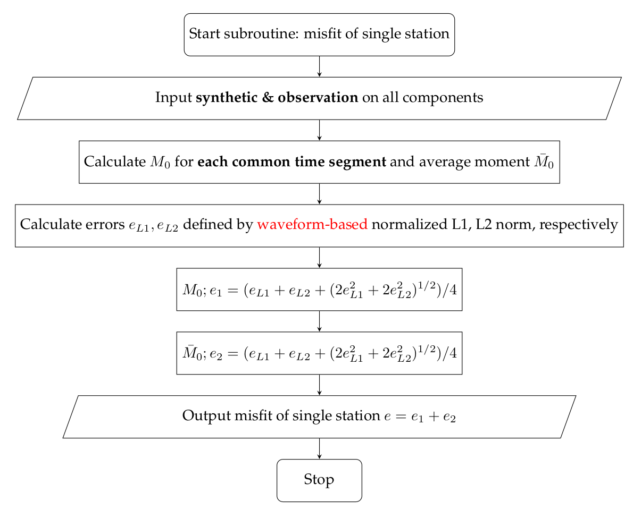

Slide 8
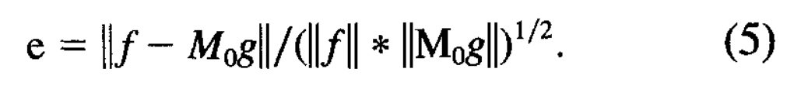
Related Formulae

Slide 9
Process (Zhu et al)
Share a common main process
Except for misfit normalization strategy
distance-based rather than waveform-based

Slide 10
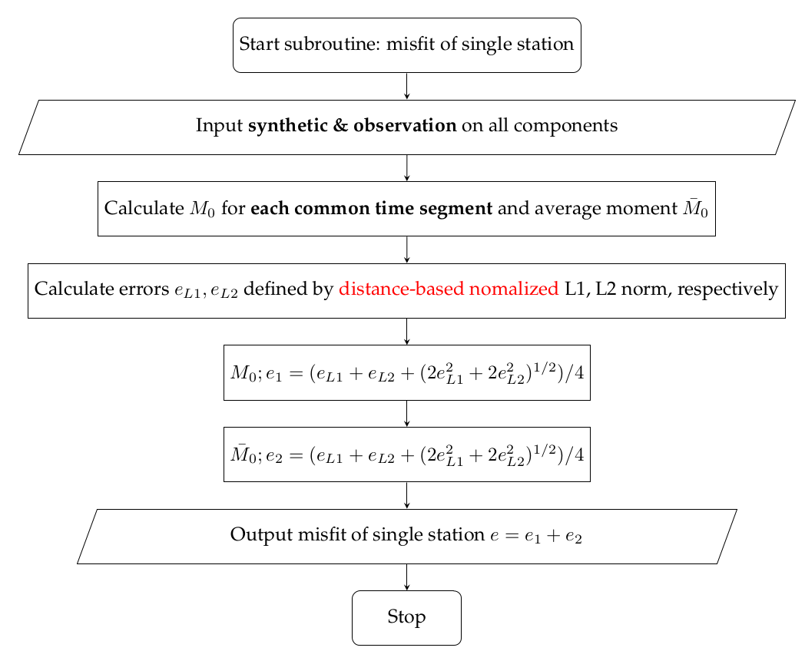

Slide 11
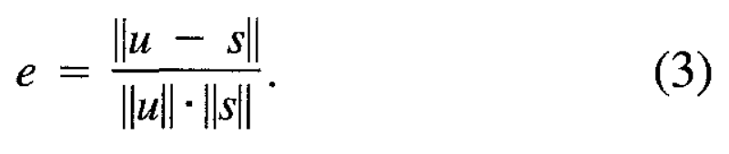
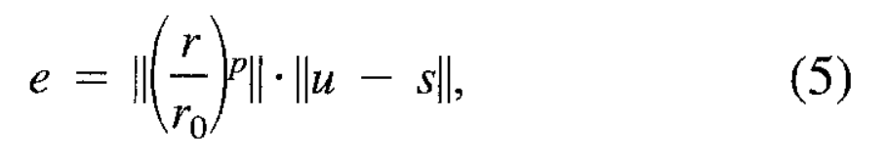
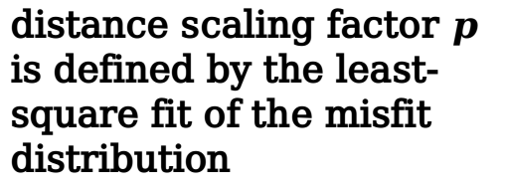
Related formulae
distance scaling factor $p$ is defined by the least-square fit of the misfit distribution

Slide 12
Conclusion
Imperfect Green’s function
Tradditional aternative
remove high frequency content & only invert selected portions
Zhao’s work
innovation: BB data rather than LP data
advantage: insensitive to the timing between crustal arrivals
Zhu’s work
innovation: distance scaling rather than waveform-based
advantage: utilization of amplitude ratios & resilience to nodal stations

