Slide 1

BARTRAC UNIT CONDITION INSPECTION REPORT
BA NUMBER: BA3157
CATERPILLAR 14-15A MOTOR GRADER
SERIAL NUMBER: TX06100
INSPECTION DATE: 13/05/2026
SERVICE DRIVEN SOLUTIONS

Slide 2
FML WHSE BARTRAC UNIT CONDITION INSPECTION
BA NUMBER: BA3157 — CATERPILLAR 14-15A MOTOR GRADER
S/N: TX06100
VIN: CAT00014VF5800380
INSPECTION DATE: 13/05/2026
NOTHING CHANGED TO THE CONDITION OF THE UNIT FROM LAST INSPECTION. NO CHANGES TO CONDITION.
CHECK POINT
OFFLOADED / STORAGE
DAMAGE NOTED
COMMENTS
PAINTWORK
!
!
Damage to RHS grease nipple on boom
BODY WORK
!
!
Hinge damaged on BA3036 bucket when nested therein
WINDOWS
✓
DECALS
✓
ALL LIGHTS
✓
BATTERIES
✓
Removed for safekeeping & improved starting
MIRRORS
✓
RADIO / AERIAL
✓
No radio — aerial stored in compartment
KEYS
✓
3x keys in torch (Operators manual bag)
SPEAKERS
✓
ASHTRAY
✗
OPERATORS MANUALS & PARTS MANUALS
✓
Found loose in container, storing in site office until unit loads out
WIPER BLADES
✓
TYRES / TRACKS
✓
Stowed in container
TOOL BOX
✗
LOOSE PARTS / CRATES
✓
In cab as per photos; In battery box as per photos; 3x unopened
LOCKING PIN
✓
GENERAL COMMENTS:
Other than mentioned damages to boom hinge resulting in damage to BA3157 bucket during voyage, together with general transit dirt & grime, machine is in excellent condition.

Slide 3
NOTES / ADDITIONAL INFORMATION
This page intentionally left blank.

Slide 4
NOTES / ADDITIONAL INFORMATION
This page intentionally left blank.

Slide 5
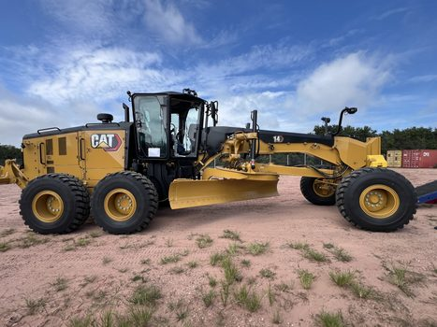
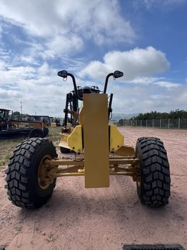
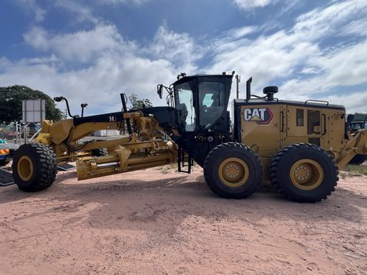
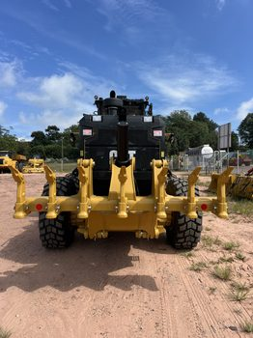
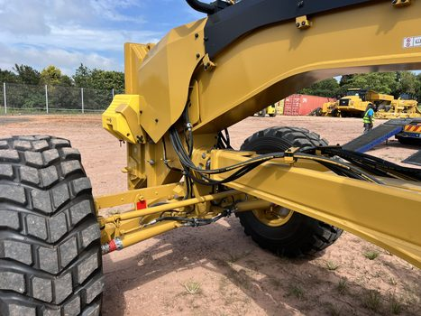
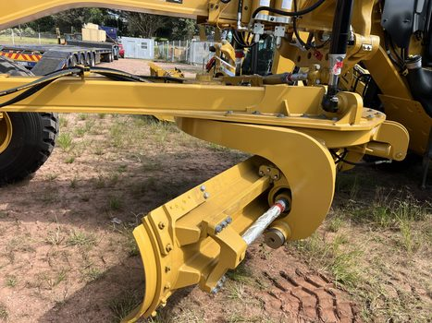
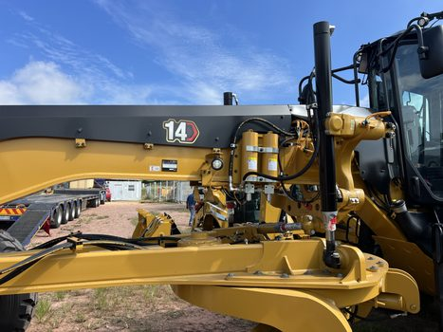
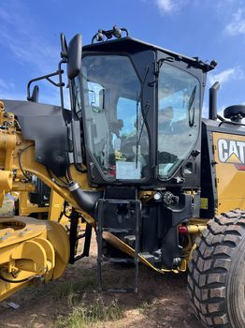
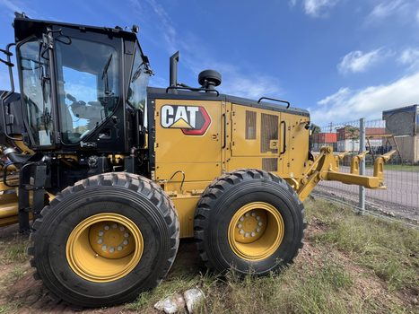
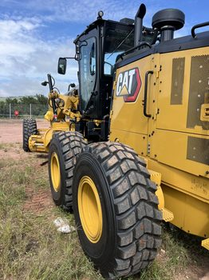
BA3157 — CONDITION PHOTOS (1)

Slide 6
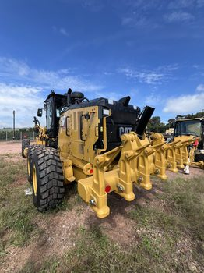
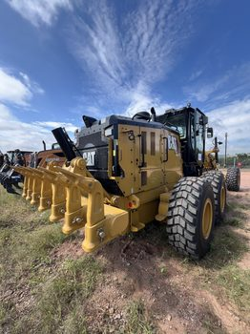
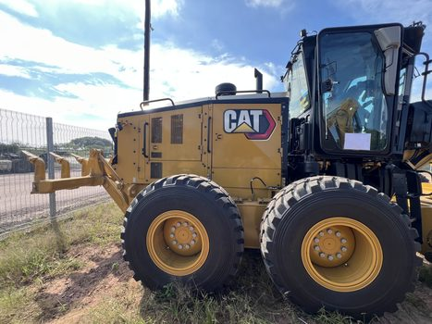
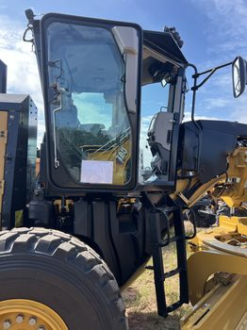
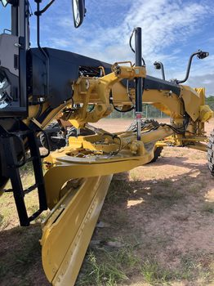
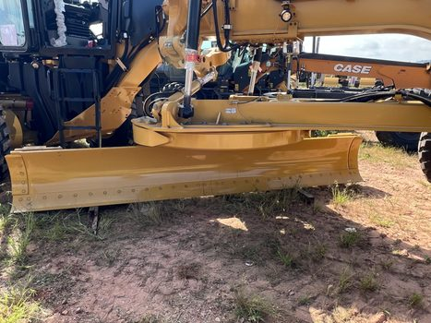
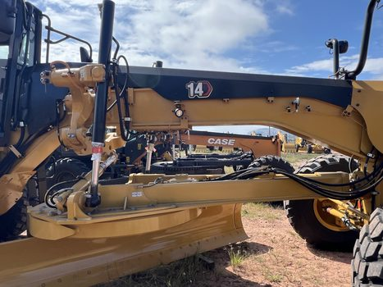
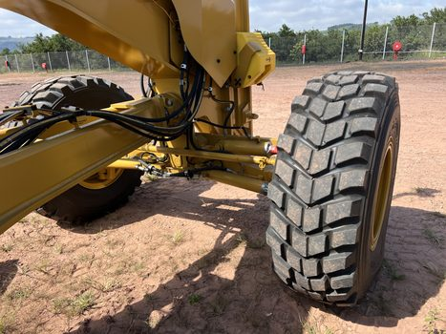
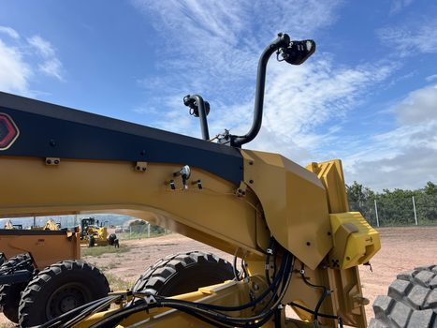
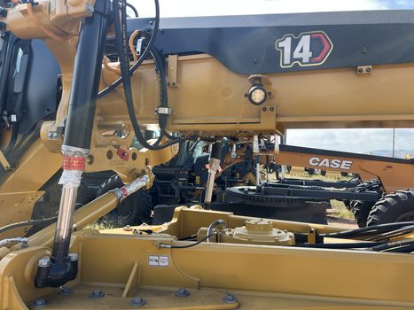
BA3157 — CONDITION PHOTOS (2)

Slide 7
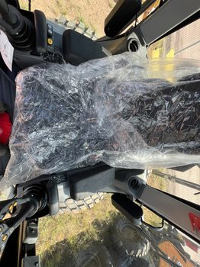
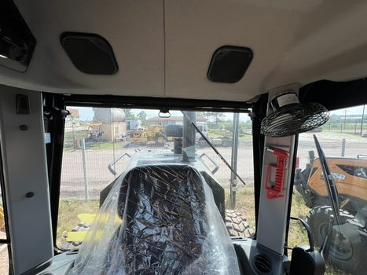
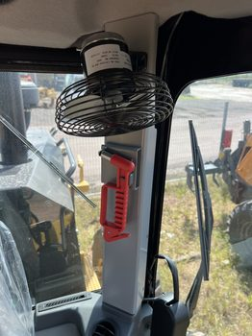
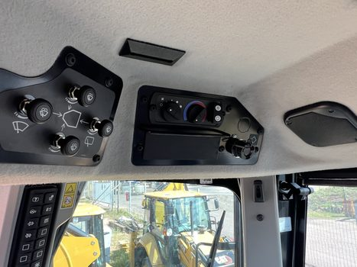
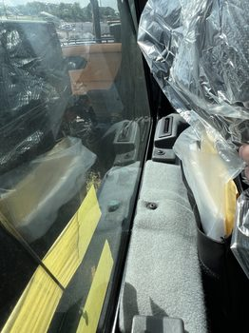
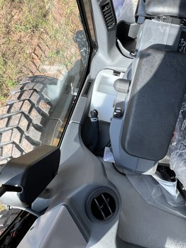
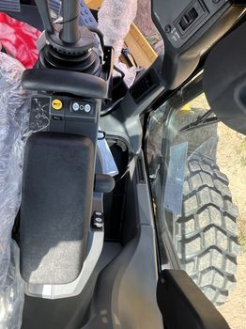
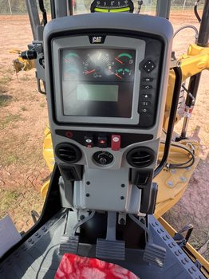
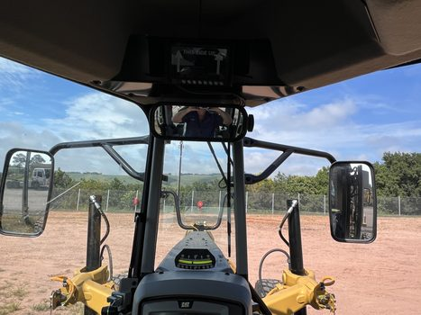
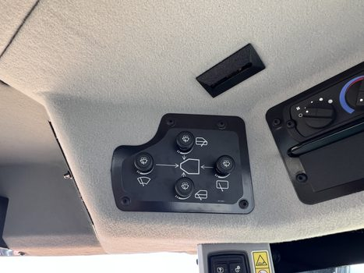
BA3157 — CONDITION PHOTOS (3)

Slide 8
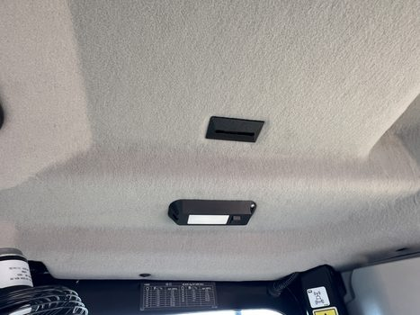
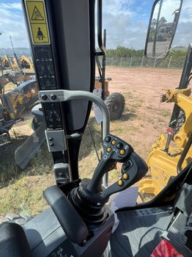
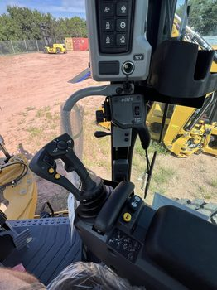
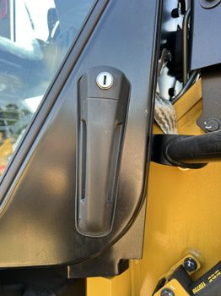
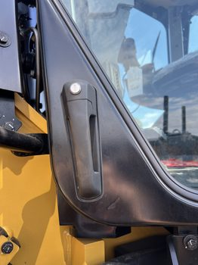
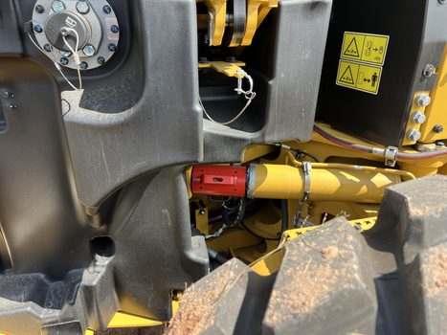
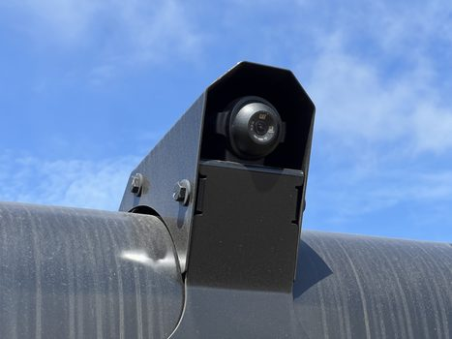
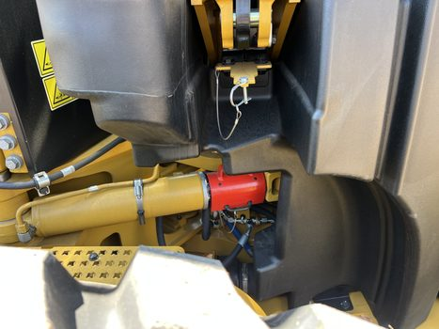
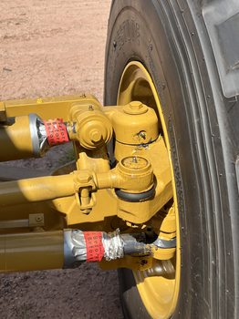
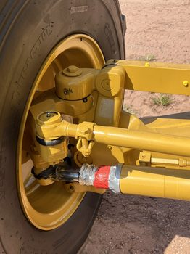
BA3157 — CONDITION PHOTOS (4)

Slide 9
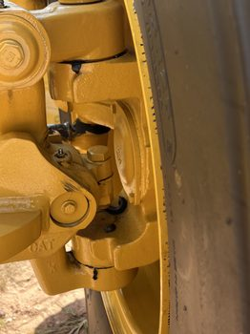
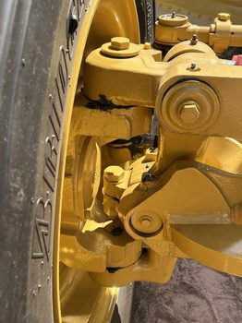
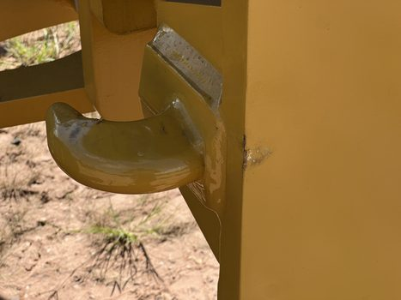
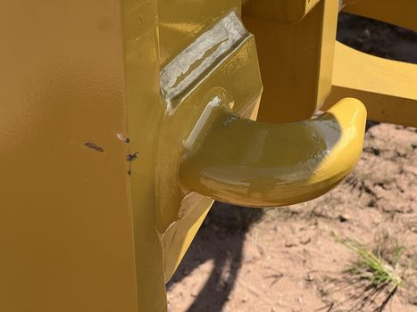
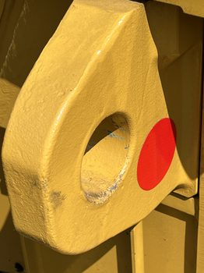
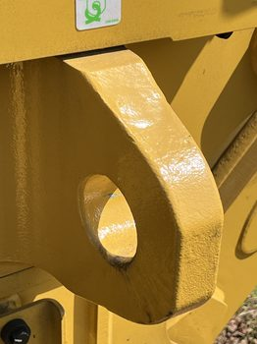
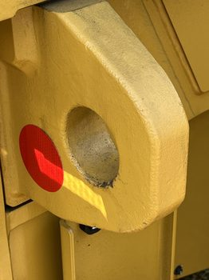
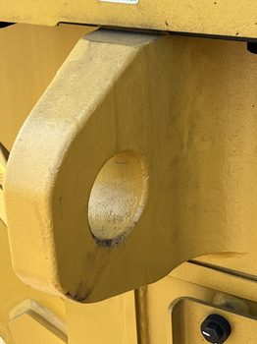
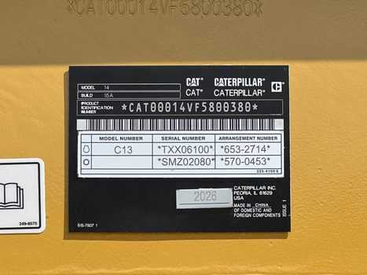
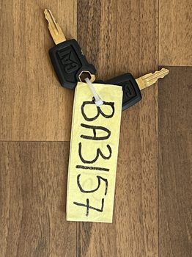
BA3157 — CONDITION PHOTOS (5)

Slide 10









BA3157 — CONDITION PHOTOS (6)

