Slide 1

BARTRAC UNIT CONDITION INSPECTION REPORT
BA NUMBER: BA3163
CATERPILLAR 350 06C HYDRAULIC EXCAVATOR
SERIAL NUMBER: NTB17515
INSPECTION DATE: 15/05/2026
SERVICE DRIVEN SOLUTIONS

Slide 2
FML WHSE BARTRAC UNIT CONDITION INSPECTION
BA NUMBER: BA3163 — CATERPILLAR 350 06C HYDRAULIC EXCAVATOR
S/N: NTB17515
VIN: CAT00350PWDP30484
INSPECTION DATE: 15/05/2026
NOTHING CHANGED TO THE CONDITION OF THE UNIT FROM LAST INSPECTION. NO CHANGES TO CONDITION.
CHECK POINT
OFFLOADED / STORAGE
DAMAGE NOTED
COMMENTS
PAINTWORK
✓
All in-tact, needs fresh paint
BODY WORK
!
!
All in-tact, needs fresh paint
WINDOWS
✓
All in-tact, needs lots of windowlene 'cos of the bird poo
DECALS
✓
All in-tact, needs a good wash
ALL LIGHTS
✓
All in-tact, working when battery plugged in
BATTERIES
✓
Removed for safekeeping & improved starting
MIRRORS
✓
All in-tact, needs a good wash
RADIO / AERIAL
✓
No radio — aerial stored in compartment
KEYS
✓
3x keys in pouch (Operators manual bag)
SPEAKERS
✓
No radio
ASHTRAY
✗
No radio
OPERATORS MANUALS & PARTS MANUALS
✓
Found loose in container, storing in site office until unit loads out
WIPER BLADES
✓
All in-tact, needs a good wash
TYRES / TRACKS
✓
Stowed in container
TOOL BOX
✗
Stowed in container
LOOSE PARTS / CRATES
✓
In cab as per photos; In battery box as per photos; 3x unopened
LOCKING PIN
✓
N/A
GENERAL COMMENTS:
Stowed in container, together with general transit dirt & grime, machine is in excellent condition.

Slide 3
NOTES / ADDITIONAL INFORMATION
This page intentionally left blank.

Slide 4
NOTES / ADDITIONAL INFORMATION
This page intentionally left blank.

Slide 5
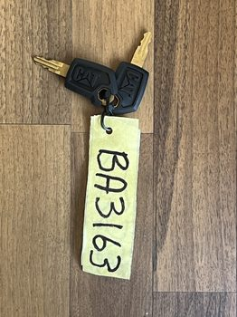
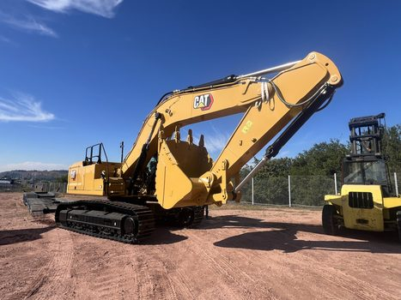
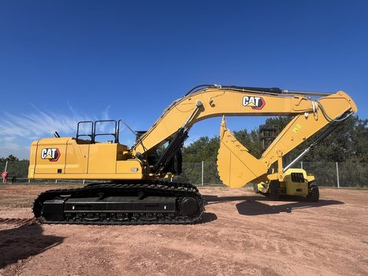
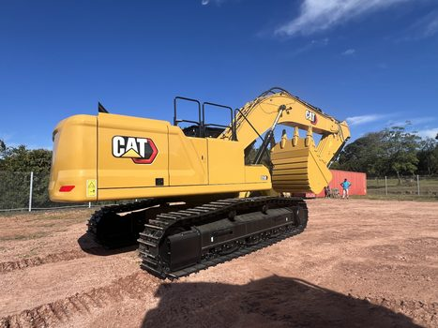
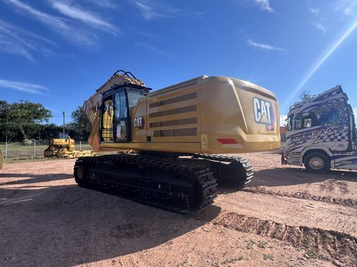
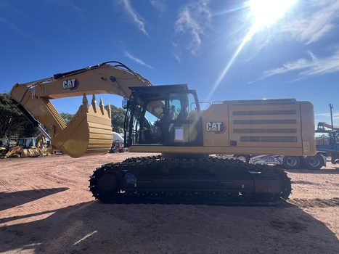
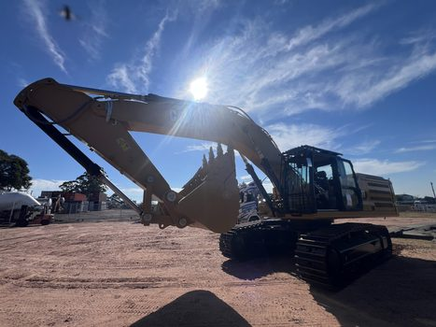
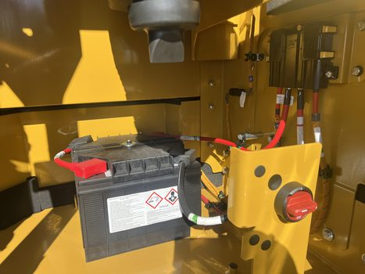
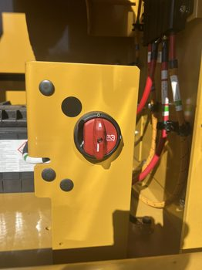
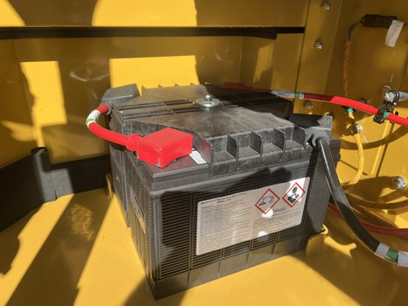
BA3163 — CONDITION PHOTOS (1)

Slide 6
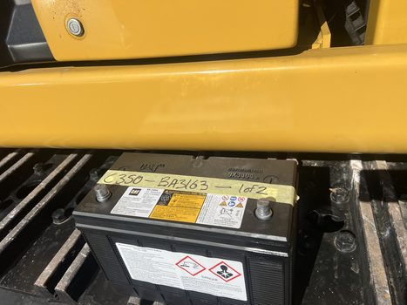
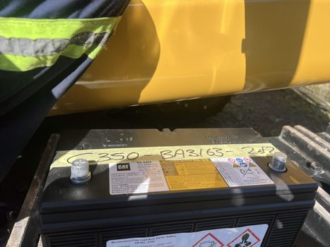
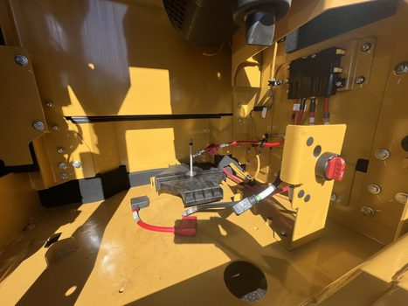
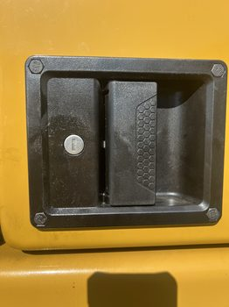
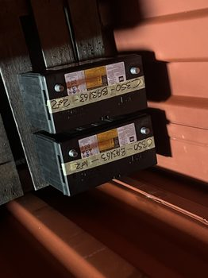
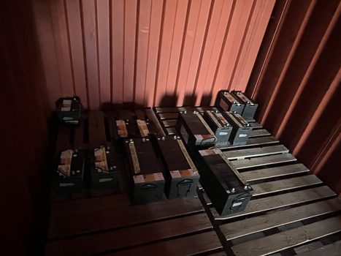
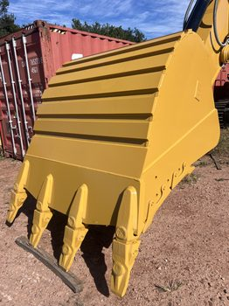
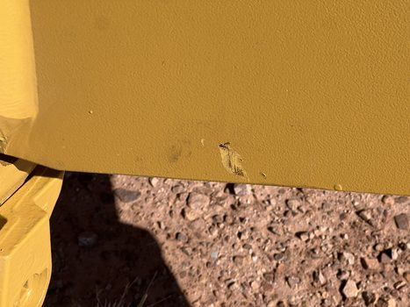
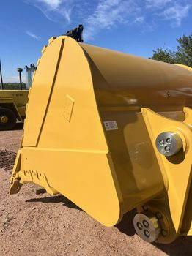
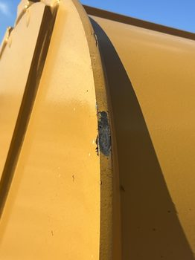
BA3163 — CONDITION PHOTOS (2)

Slide 7
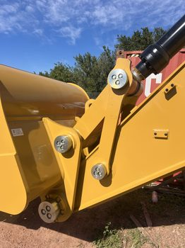
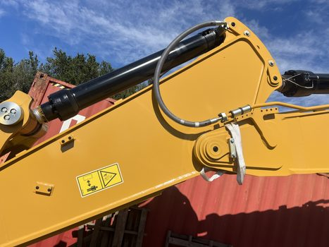
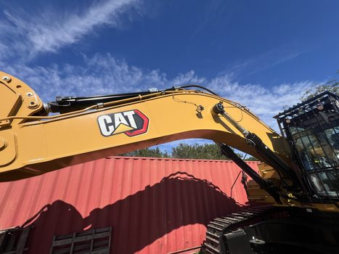
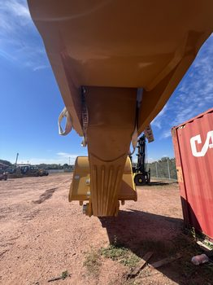
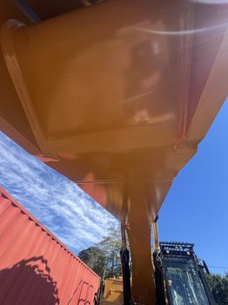

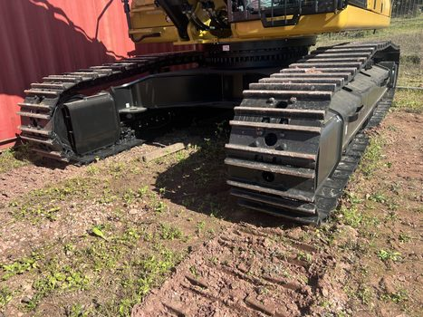
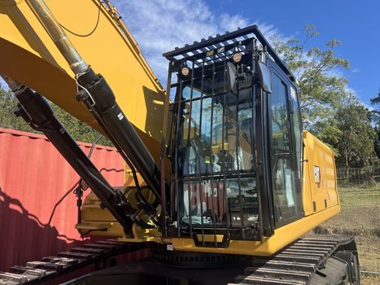
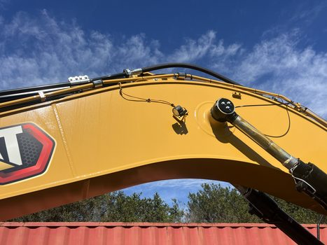

BA3163 — CONDITION PHOTOS (3)

Slide 8
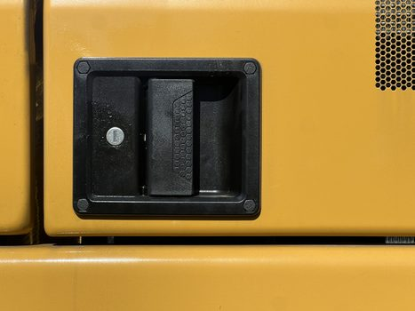
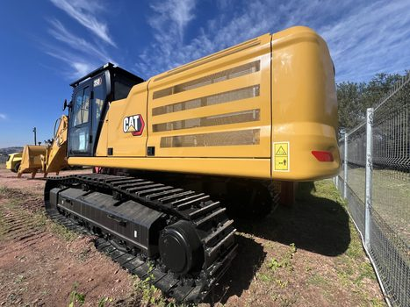
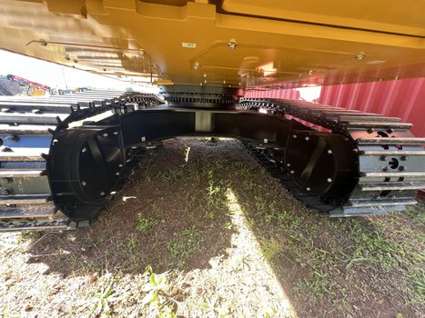
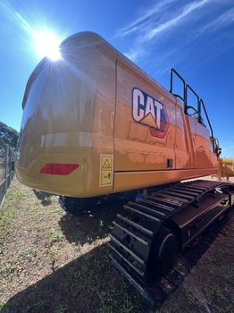
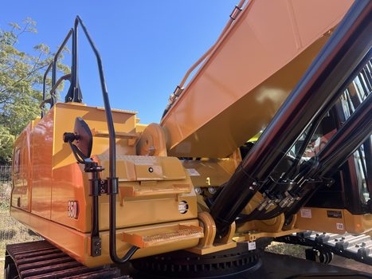
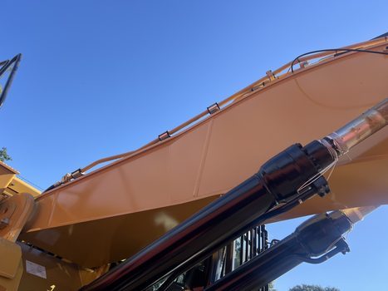
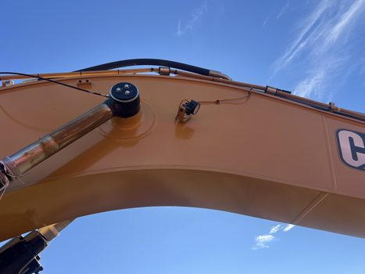
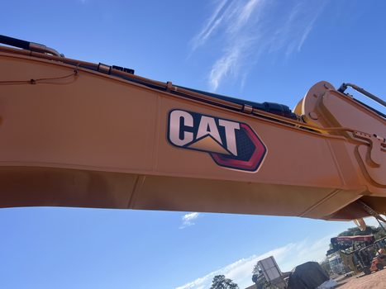
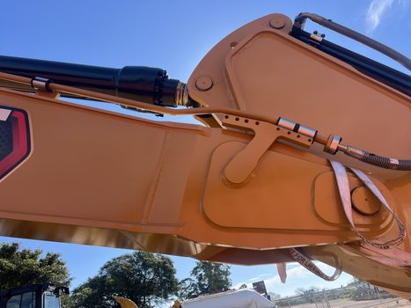
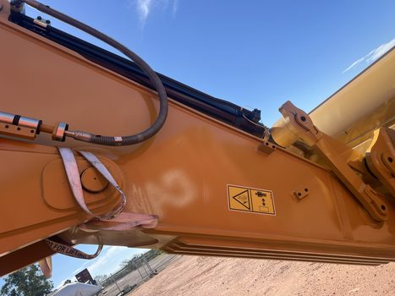
BA3163 — CONDITION PHOTOS (4)

Slide 9
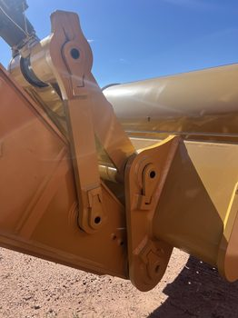
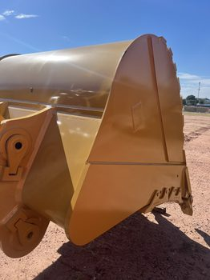
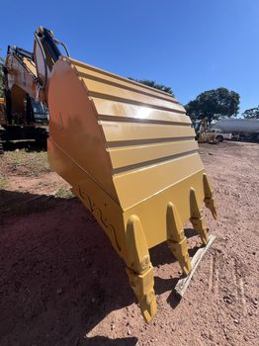


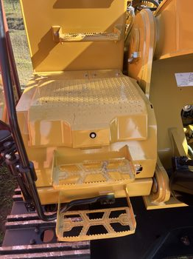
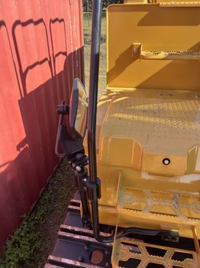
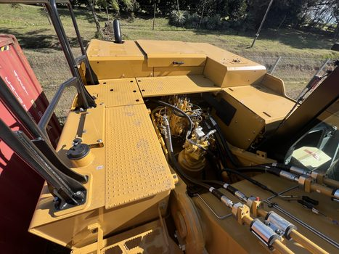
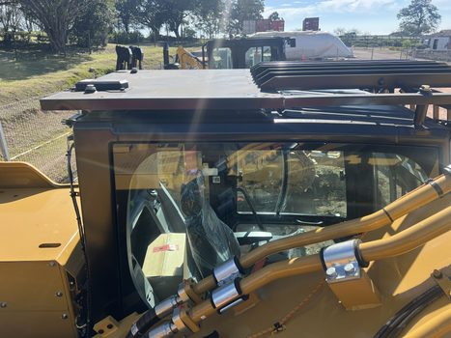
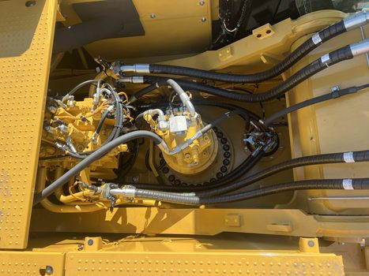
BA3163 — CONDITION PHOTOS (5)

Slide 10
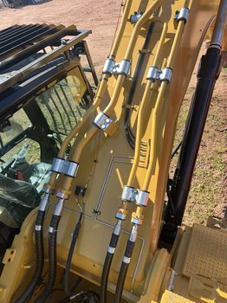
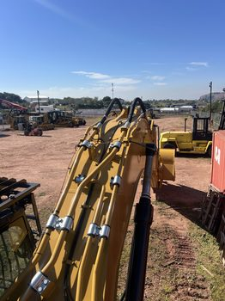
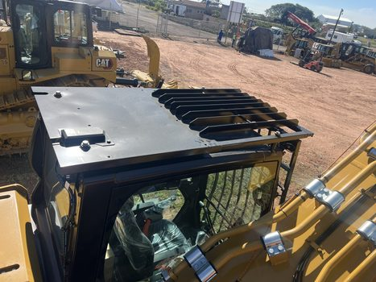
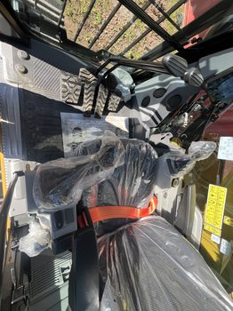






BA3163 — CONDITION PHOTOS (6)

Slide 11









BA3163 — CONDITION PHOTOS (7)

