Slide 1

BARTRAC UNIT CONDITION INSPECTION REPORT
BA NUMBER: BA2459
CATERPILLAR 140 K MOTOR GRADER
SERIAL NUMBER: SZLZ1042; TX713308
INSPECTION DATE: 01/04/2025
SERVICE DRIVEN SOLUTIONS

Slide 2
FML WHSE BARTRAC UNIT CONDITION INSPECTION
BA NUMBER: BA2459 — CATERPILLAR 140 K MOTOR GRADER
S/N: SZLZ1042; TX713308
VIN: CAT0140KJSZL21042
INSPECTION DATE: 01/04/2025
NOTHING CHANGED TO THE CONDITION OF THE UNIT FROM LAST INSPECTION. NO CHANGES TO CONDITION.
CHECK POINT
OFFLOADED / STORAGE
DAMAGE NOTED
COMMENTS
PAINTWORK
✓
All in-tact, needs fresh paint
BODY WORK
!
!
All in-tact, needs fresh paint
WINDOWS
✓
All in-tact, needs lots of windowlene 'cos of the bird poo
DECALS
✓
All in-tact, needs a good wash
ALL LIGHTS
✓
All in-tact, working when battery plugged in
BATTERIES
✓
Removed for safekeeping & improved starting
MIRRORS
✓
All in-tact, needs a good wash
RADIO / AERIAL
✓
No radio — aerial stored in compartment
KEYS
✓
3x keys in pouch (Operators manual bag)
SPEAKERS
✓
No radio
ASHTRAY
✗
No radio
OPERATORS MANUALS & PARTS MANUALS
✓
Found loose in container, storing in site office until unit loads out
WIPER BLADES
✓
All in-tact, needs a good wash
TYRES / TRACKS
✓
Stowed in container
TOOL BOX
✗
Stowed in container
LOOSE PARTS / CRATES
✓
In cab as per photos; In battery box as per photos; 3x unopened
LOCKING PIN
✗
BUCKET - FRONT
✓
N/A
BUCKET - REAR
✓
N/A
BACKHOE
✓
N/A
HYDRAULIC RAMS - FRONT
!
!
FITTINGS, SURFACE RUST
HYDRAULIC RAMS - REAR
!
!
FITTINGS, SURFACE RUST
LOAD BIN
✗
!
N/A
CAB
✓
IN ORDER
COUNTER WEIGHT
✓
SURFACE RUST ON CORNERS & BOLTS RUSTED
RIGHT FRONT
!
!
RUST ON STEERING ARMS
LEFT FRONT
!
!
RUST ON MAIN BLADE, BOOM KNUCKLE & OTHER FITTINGS
RIGHT REAR
!
!
RUST ON RIPPER AS PER PHOTOS & HYDRAULIC FITTINGS
LEFT REAR
!
!
RUST ON RIPPER AS PER PHOTOS & HYDRAULIC FITTINGS
RIGHT SIDE
!
!
RUST ON BOOM, RUST ON STEERING RAM COUPLER & FITTINGS
LEFT SIDE
!
!
RUST ON BOOM, RUST ON STEERING RAM COUPLER & FITTINGS
WHEELS
✓
IN ORDER
STARTING STATUS
✓
STARTED, MOVED, WASHED, STOWED
LASHING HOOKS
!
!
RUSTED IN AREAS & ON EDGES AS PER PHOTOS
CAB INTERIOR
✓
IN ORDER, DUSTY
ENGINE BAY
✓
EXHAUST PIPE RUSTED
GENERAL COMMENTS:
HUNDREDS.

Slide 3
NOTES / ADDITIONAL INFORMATION
This page intentionally left blank.

Slide 4
NOTES / ADDITIONAL INFORMATION
This page intentionally left blank.

Slide 5
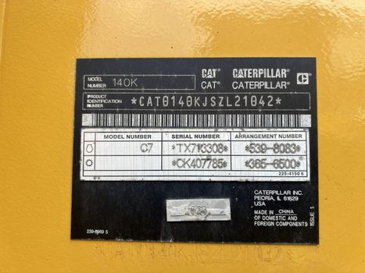
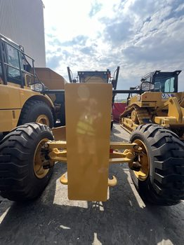
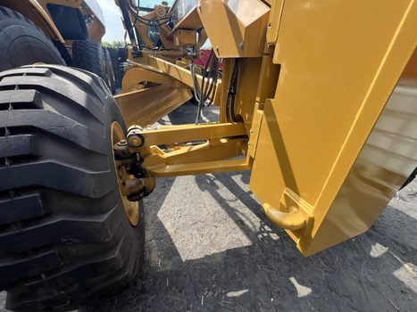
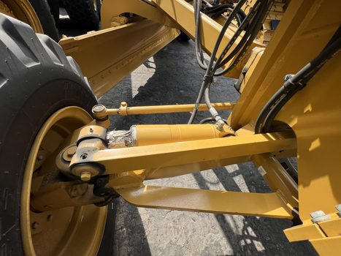
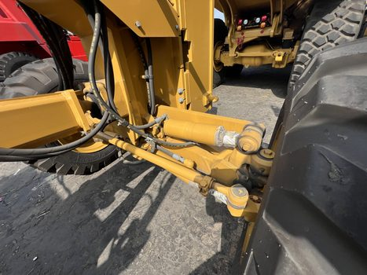
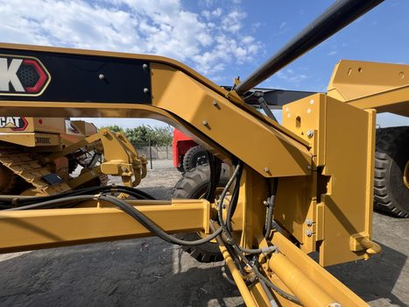
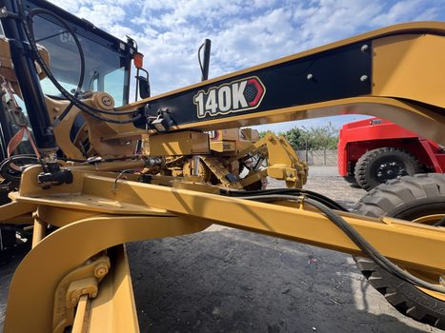
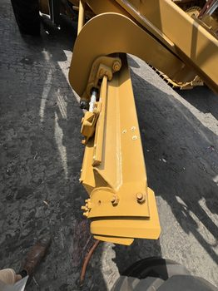
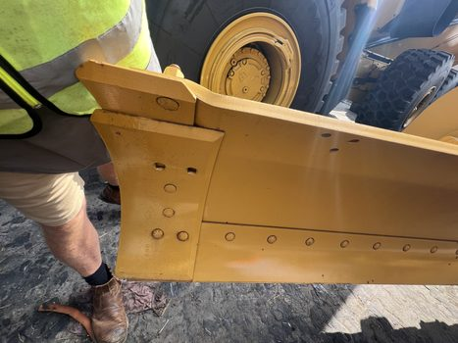
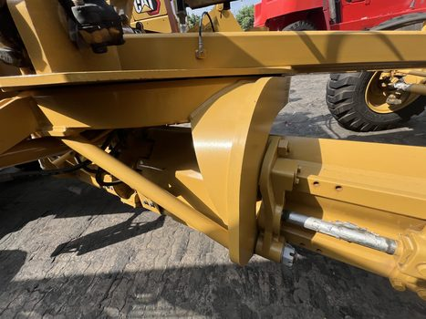
BA2459 — CONDITION PHOTOS (1)

Slide 6
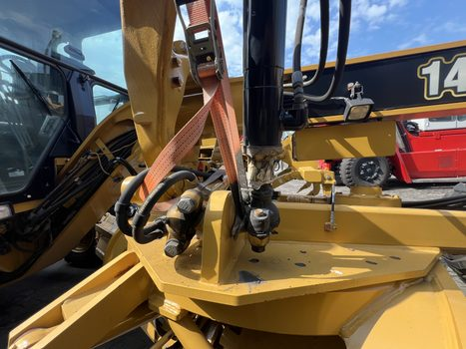
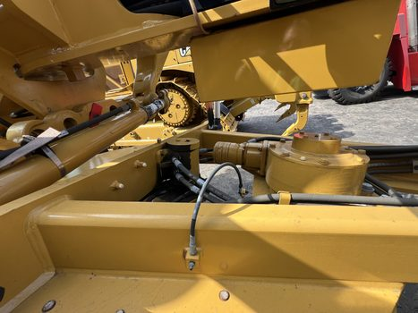
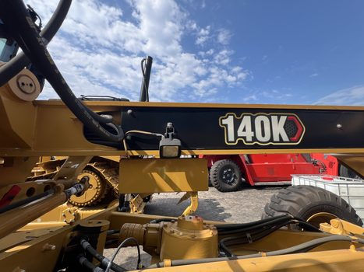
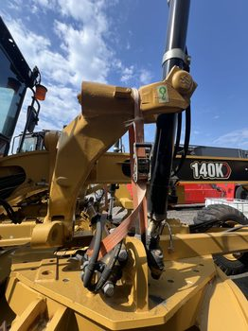
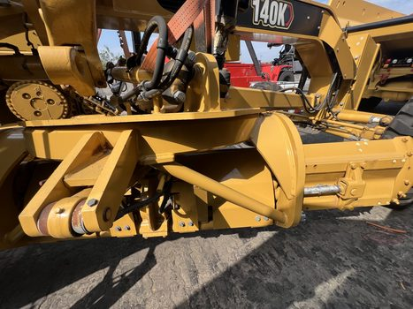
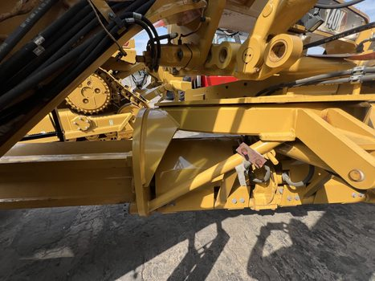
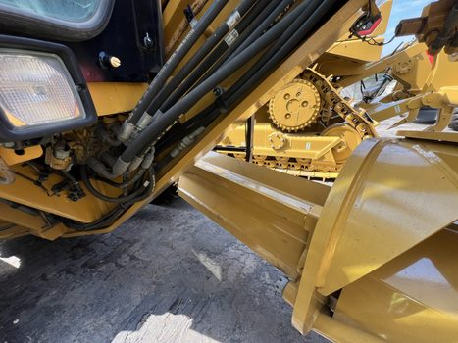
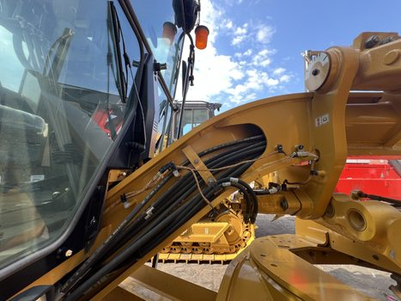
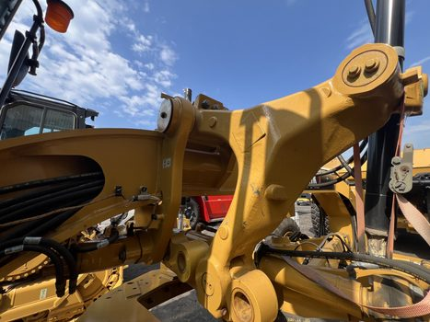
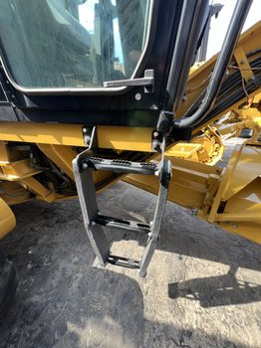
BA2459 — CONDITION PHOTOS (2)

Slide 7
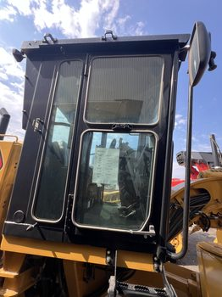

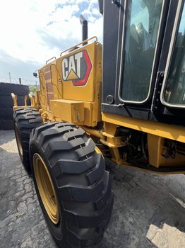

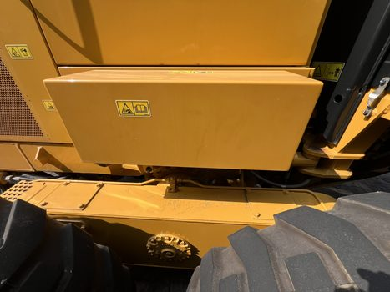

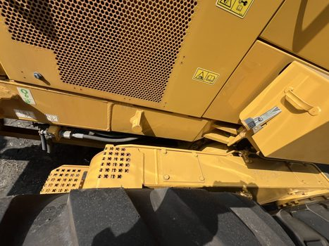
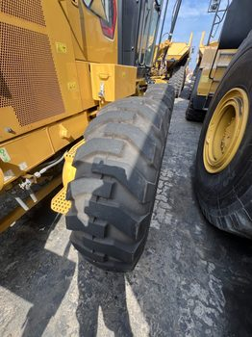
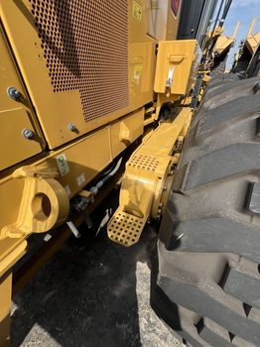
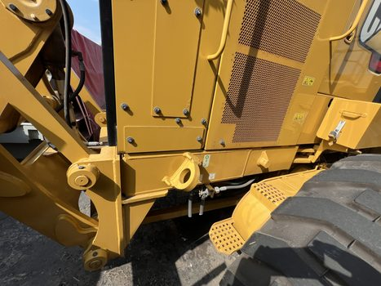
BA2459 — CONDITION PHOTOS (3)

Slide 8
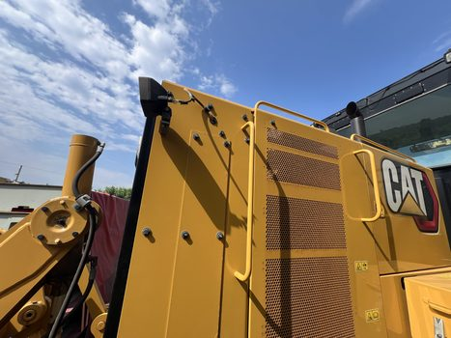
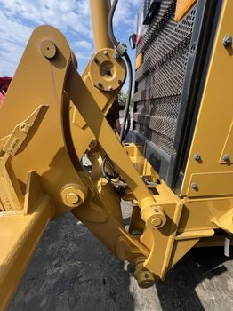
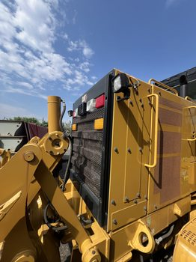
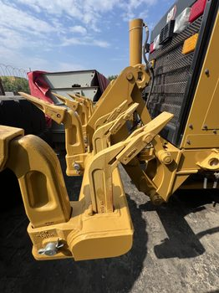
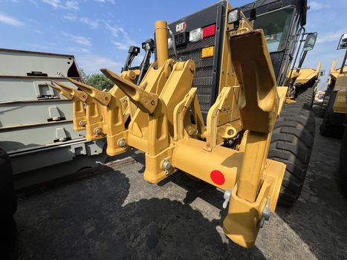
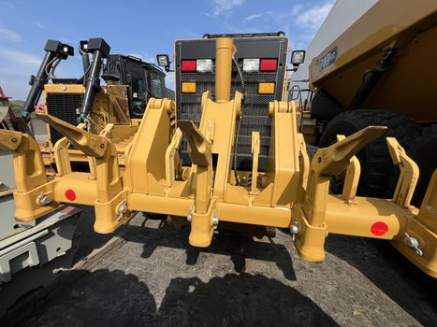
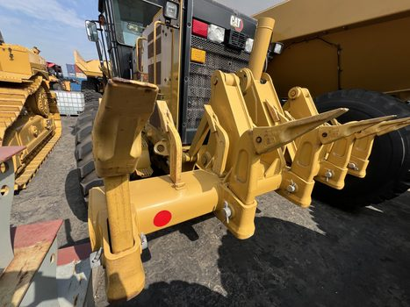
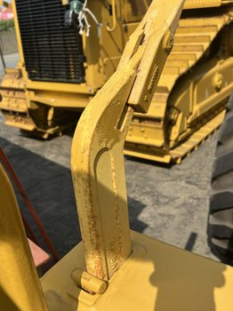
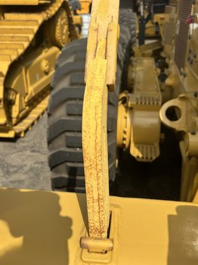
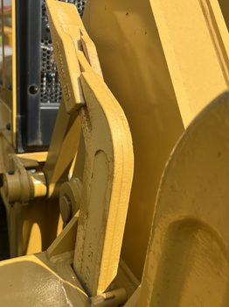
BA2459 — CONDITION PHOTOS (4)

Slide 9
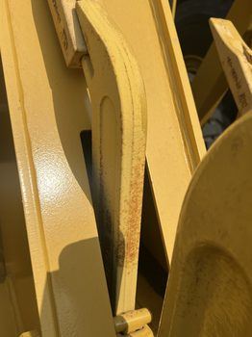
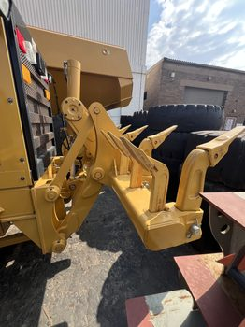
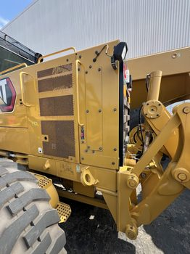
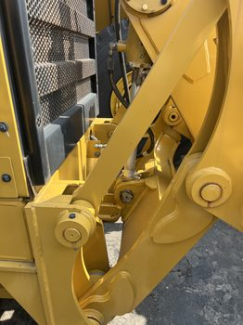
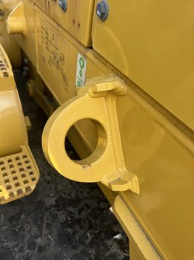
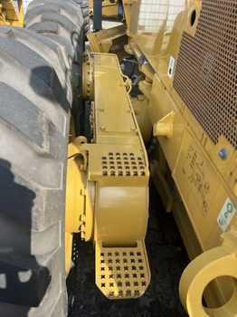
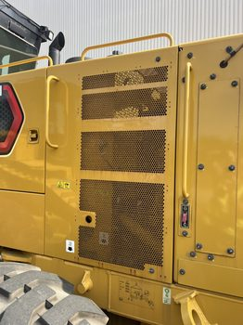
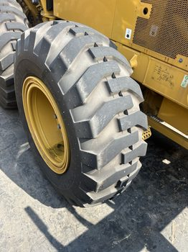
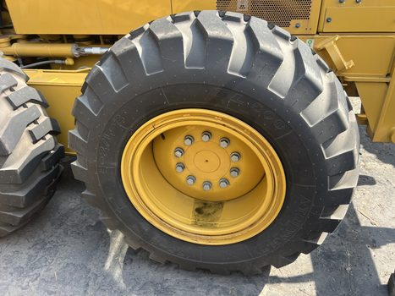
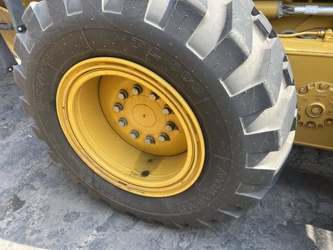
BA2459 — CONDITION PHOTOS (5)

Slide 10
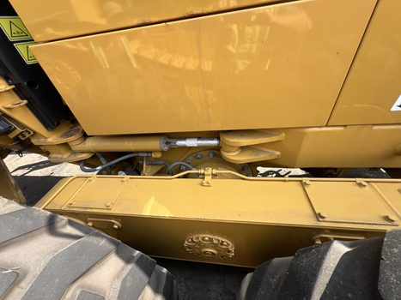
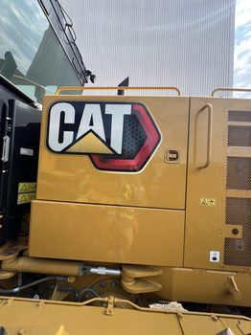
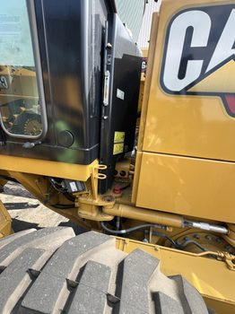







BA2459 — CONDITION PHOTOS (6)

Slide 11










BA2459 — CONDITION PHOTOS (7)

Slide 12










BA2459 — CONDITION PHOTOS (8)

Slide 13










BA2459 — CONDITION PHOTOS (9)

Slide 14










BA2459 — CONDITION PHOTOS (10)

Slide 15










BA2459 — CONDITION PHOTOS (11)

