Slide 1


A TALK FOR CHAIR: AI FOR MATHEMATICS. 27 MAY 2026.
The Very Confident Intern
How I use LLMs in mathematical research
Dennis Eriksson
Professor of Mathematics
→ meet the intern
fluent · fast · sometimes wrong

Slide 2
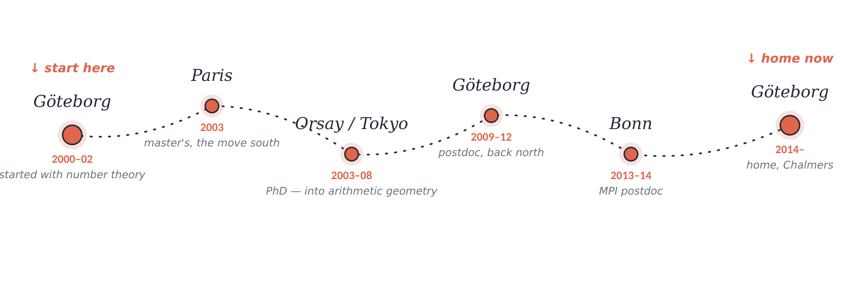
WHO I AM
Dennis Eriksson
the long way home
Professor at Chalmers since 2024 · often seen in Kyoto and Paris
number theory → arithmetic geometry → algebraic / arithmetic / complex geometry

Slide 3
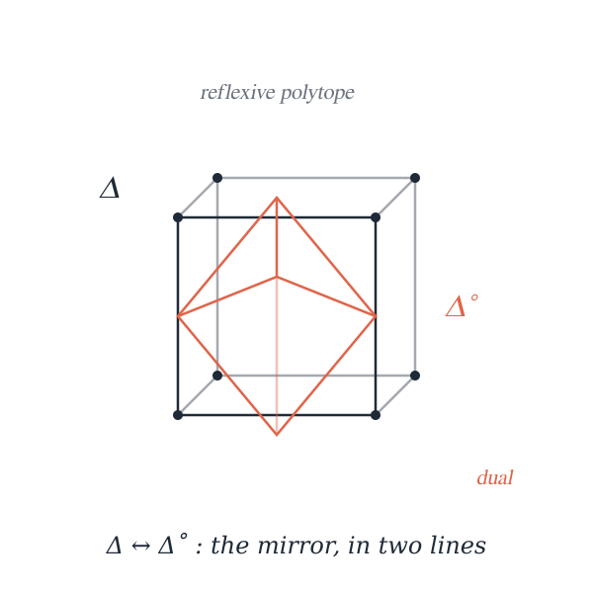
WHAT I WORK ON
Algebraic, complex and arithmetic geometry
— and related techniques.
PULLED IN BY
Geometry that talks to arithmetic and analysis at the same time —number theory, algebraic geometry, algebraic topology, singularities, modular forms…
BORED BY
Maximally general statements proved in maximally general settings just because they fit.
RIGHT NOW
Singularities, moduli spaces and mirror symmetry.
(Recent venues: Duke Math. J. · Forum Math. Pi · Adv. Math. · J. Reine Angew. Math.)

Slide 4




Meet the intern
Different LLMs in my research
I am:
SETUP
In my research I often think of LLMS as very confident interns.
Will explain how it has impacted my research and how I use it.
fast
fluent
useful
wrong
needs supervision
Less “can LLMs do mathematics?” — more “how does mathematical work change when an unreliable but fluent assistant joins the loop?”
The Very Confident Intern · Dennis Eriksson
1 / 26

Slide 5



HONEST ANTHROPOMORPHISM
My intern, in five moods
“Done!”
“See Smith '91!”
“Yes, of course.”
“Oh, you're right, actually.”
“My bad.”
asked to write code or answer a question
(but the convention was wrong)
asked for a citation
(Smith ’91 does not exist)
when I float a half-baked guess
(no actual evaluation happened)
when I disagree
(would reverse the other way too)
after I check
(will make the same mistake again)
A colleague is rarely any of these. The intern can be all five before lunch — which is why supervision isn’t optional. It’s the job.
The Very Confident Intern · Dennis Eriksson
3 / 26

Slide 6
THE RESEARCH LOOP
Approximative workflow
WITH A COLLEAGUE
WITH AN INTERN
TRUTH
DIRECTION
explore
explore
→
is it true?
is it worth doing?
↓
↓
formulate
formulate
→
is it true?
is it worth doing?
↓
↓
compute
compute
→
is it true?
is it worth doing?
↓
↓
write
write
→
is it true?
is it worth doing?
They bring their own taste and their own correctness.
Judgment is shared, not supervised.
Every stage gets two checks — is it right, and is it worth doing?
Both are mine to supply.
A colleague brings judgment. An intern needs it — twice, at every stage.
The Very Confident Intern · Dennis Eriksson
3 / 26

Slide 7










BEFORE MY MAIN EXAMPLES
Smaller daily uses
Skimming papers
Old-language access
TikZ & diagrams
Summarize long PDFs; surface key results before deep reading
Translate German, French, Russian sources into English
Handwritten commutative diagrams → TikZ-cd code
Grant applications
Letter templates
Abstract polishing
Drafting, restructuring, hitting strict word limits
Recommendation drafts I then personalize per student
Sharpening conference & workshop abstracts
Brainstorming
Rubber-ducking proofs
Learning Chinese
When ideas are too half-formed to take to a colleague
Running through arguments; pushback on gaps
Vocabulary practice, grammar, working through texts
The Very Confident Intern · Dennis Eriksson
4 / 26

Slide 8
LIMITS
What I don't use the intern for
✕
First drafts of papers
Writing is thinking. Outsourcing the first draft outsources the thinking — and the bits I'd later cut are where the math happens.
✕
Checking correctness formally
I treat LLM output as informal mathematics/reasoning: useful, suggestive and guilty until proven innocent.
✕
Re-checking results
If a step matters for a result, I redo it myself, both for correctness and understanding.
The Very Confident Intern · Dennis Eriksson
5 / 26

Slide 9
OVERVIEW
The three big ways I use it
01
Vibe coding for experimental mathematics on singularities
Building computational scaffolding I'd otherwise put off
Python glue around Singular, scans over families, parsing awkward output, debugging
02
Research orientation in adjacent territory
Turning a cloud of related ideas into a working plan
Toric mirror symmetry, GKZ variables, secondary fans — the table of contents for the problem
03
Simplifying combinatorial / algebraic expressions
Reindexing sums, spotting product rules, cleaning notation
BCOV invariants and their products, Eulerian and binomial numbers
The Very Confident Intern · Dennis Eriksson
6 / 26

Slide 10
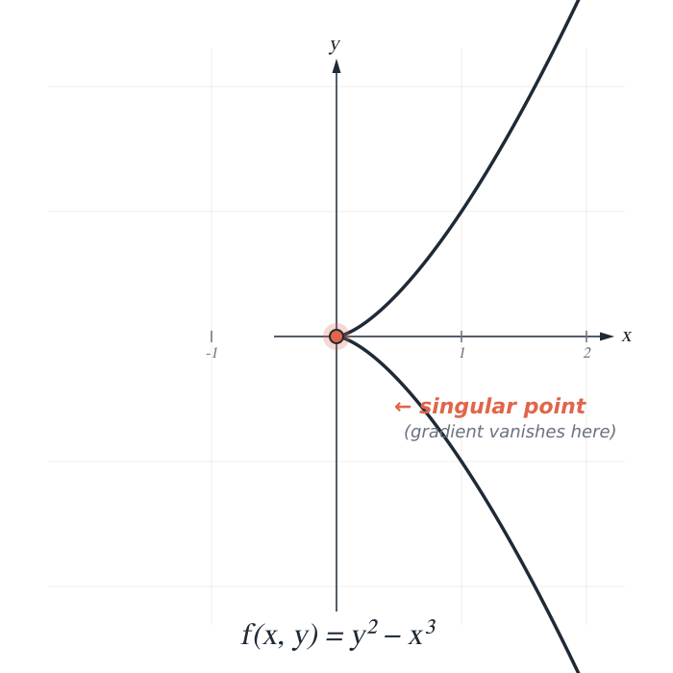
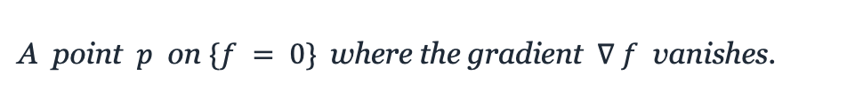
THE OBJECT OF STUDY
What's a singularity?
Special points on level sets of ${f:ℂ}^{n+1}→ℂ$
DEFINITION
A point $p$ on $\{f = 0\}$where the gradient $∇ f$ vanishes.
AT THE ORIGIN (the example on the left)
$$f(x,y) = y² − x³, ∇f = (−3x², 2y), ∇f(0,0) = 0$$
WHY IT MATTERS
Smooth points all look the same. Singular points carry geometry — each one has its own invariants, its own behaviour under deformation, its own arithmetic.
a small zoo: node (xy = 0) · cusp (y² = x³) · Aₙ, Dₙ, E₆ — E₈ · Brieskorn–Pham $x_{0}^{a_{0}}+x_{1}^{a_{1}}+…+x_{n}^{a_{n}}$
7 / 26

Slide 11





THE INVARIANTS
What we measure: sₖ
concrete — and full of normalization choices.
MILNOR FIBER
COHOMOLOGY
HODGE FILTRATION
MONODROMY
M := level surface close to the singular level surface
$$H^{n}(M, ℂ)$$
$${{…⊆F}^{2}⊆F}^{1}⊆F^{0}=H^{n}(M, ℂ)$$
T = $T_{s}⋅T_{u}$ on $H^{n}(M, ℂ)$
the local geometry near the singular point
finite-dimensional; dimension is the Milnor number μ
graded pieces $s_{k}=dim F^{k}/F^{k_1}$
Eigenvalues of $T_{s}$ $=exp\left(−2πi α\right), α∈ℚ$
SPECTRAL NUMBERS- SPECIAL LOGARITHMS OF THE MONODROMY $T_{S}$ MONODROMY ACTING ON $\frac{F^{k}}{F^{k+1}}$
$$s_{k}=\#\left\{α, n−k<α≤n−k+1\right\},$$
The spectral numbers are somehow computable, and hence can be used to compute $s_{k}$. W
CONVENTIONS YOU HAVE TO PICK
Nobody in the literature has the same definition !
8 / 26

Slide 12
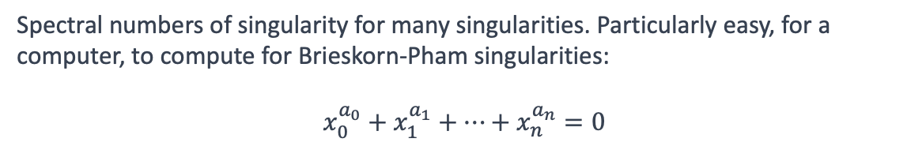
CASE 01 · SETUP
Vibe coding
for experimental mathematics
WHAT I WANTED
Spectral numbers of singularity for many singularities. Particularly easy, for a computer, to compute for Brieskorn-Pham singularities:
$x_{0}^{a_{0}}+x_{1}^{a_{1}}+…+x_{n}^{a_{n}}=0$
TOOLS
Python
Singular
gmssing.lib
subprocess
MATH IN PLAY
$$s_{k} := \#\{α: n − k < α ≤ n − k + 1 \}$$
The Very Confident Intern · Dennis Eriksson
9 / 26

Slide 13
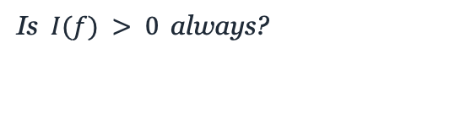
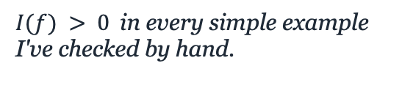
THE QUESTION I'M TESTING
An invariant built from sₖ and μ —
…that I'd really like to be positive.
THE INVARIANT, SIMPLIFIED CASE
$$I\left(f\right)=\frac{μ}{\left(n+1\right)! }−s_{n}$$
↑ actually. a bit more complicated
WHAT I KNEW
WHAT WE DON'T
WHY IT MATTERS
$I(f) > 0$in every simple example I've checked by hand.
Is $I(f) > 0$always?
Positivity would have non-trivial implications for moduli spaces of Calabi-Yau manifolds
ADE singularities. low-dim Brieskorn–Pham.
no proof. no counterexample either.
and rule out a whole class of singular behaviour.
THE PLAN
scan many singularities by computer — if any one gives I(f) ≤ 0, I've learned something either way.
10 / 26

Slide 14
CASE 01 · THE INTERN'S OUTPUT
“Sure! Here you go.”
— small intern, large confidence
spectrum.py
def compute_s_p(f, n, p): spec = singular.spectrum(f) # get Steenbrink spectrum values = spec[1] mults = spec[2] lo, hi = n - p - 1, n - p count = 0 for v, m in zip(values, mults): if lo <= v <= hi: # inclusive both sides count += m return count
Ran cleanly. Produced numbers. Looked correct.
The Very Confident Intern · Dennis Eriksson
11 / 26

Slide 15


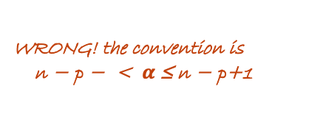
CASE 01 · MY CHECK
…except the convention was wrong.
Caught by an external sanity check, not by reading the code.
spectrum.py
def compute_s_p(f, n, p): spec = singular.spectrum(f) # get Steenbrink spectrum values = spec[1] mults = spec[2] lo, hi = n - p - 1, n - p count = 0 for v, m in zip(values, mults): if lo <= v <= hi: # inclusive both sides count += m return count
WRONG! the convention is
n − p − < $α$ ≤ n − p+1
the script ran perfectly. The math was wrong.
12 / 26

Slide 16
THE PAYOFF
A big red fail appeared on the screen.
— a counter-example to positivity, found by random scan.
THE FAIL
scan_BP.py — output
Exponents
scanning Brieskorn–Pham singularities x₀^a₀ + ⋯ + xₙ^aₙ
[ 3, 3, 7, 10, 11 ]
n=4, exponents in [2..20]
[2, 3, 5, 7] I = +12.4 ✓ ok
Invariant value
[2, 3, 5, 11] I = +8.1 ✓ ok
[3, 4, 5, 7] I = +3.2 ✓ ok
0
[3, 3, 5, 7] I = +2.9 ✓ ok
[3, 3, 5, 11] I = +1.6 ✓ ok
[3, 3, 7, 11] I = +0.8 ✓ ok
not a glitch.
n=5, exponents in [2..20]
checked with integer arithmetic.
[2, 3, 5, 7, 11] I = +18.3 ✓ ok
[3, 3, 5, 7, 11] I = +6.4 ✓ ok
[3, 3, 7, 10, 11] I = [ — ] ✗ FAIL
positivity is false.
[3, 3, 7, 11, 13] I = +0.3 ✓ ok
[3, 3, 7, 11, 17] I = +1.1 ✓ ok
[5, 5, 7, 11, 13] I = +2.0 ✓ ok
— expanded to 2–5 variables, exponents 2–14: no other counter-examples! Counterexamples are sparse.
13 / 26

Slide 17

AND THE INTERN HELPED
“Where should I look for more?”
the intern reached for the Sylvester sequence.
THE INTERN'S IDEA
TWO MORE COUNTER-EXAMPLES
Sylvester's sequence
From variations on Sylvester:
2, 3, 7, 43, 1807, …
2, 3, 7, 43, 1806
RULE
2, 3, 7, 43, 1805
$$aₙ₊₁ = a₀ · a₁ ⋯ aₙ + 1$$
— I wouldn't have
tried these.
DOESN’T WORK
The example itself doesn’t give any new counterexample
— still don't fully understand
the connection.
THE INTERN'S CONTRIBUTION
a search direction I wouldn't have tried — two new counter-examples — a connection I'm still chasing.
RULE
14 / 26

Slide 18
AN UNEXPECTED BONUS
And while I was looking at the spectra…
— the sₖ sequence is log-concave. Why?
THE SPECTRUM
WHAT I NOTICED
dimensions s₀, s₁, … , sₙ for a typical singularity
Across every example I scanned, the sequence is
8
8
unimodal
(goes up, then down)
6
6
log-concave
sₖ² ≥ sₖ₋₁ · sₖ₊₁
3
3
AND NOBODY KNOWS WHY
1
1
the standard toolkit doesn't apply:
· sl₂ representation theory — no obvious action
· reduction to a known geometric setup — not clear how
· Newton–Okounkov / Lorentzian polynomials — unclear
s₀
s₁
s₂
s₃
s₄
s₅
s₆
s₇
BONUS QUESTION
the safety-check vector turned into the more interesting open problem.
15 / 26

Slide 19
CASE 01 · LESSON
Code can run and still be wrong
Many exciting numerical data developed despite not knowing Singular or Python.
Many newly generated questions
16 / 26

Slide 20
CASE 02 · SETUP
Orienting myself
in toric mirror symmetry
THE QUESTION
OBJECTS IN PLAY
“Extending my own mirror symmetry results to the situations where toric geometry techniques apply”
Continuation of joint project w. former PhD student, Mykola Pochekai.
nef partitions
Gelfand-Kapranov-Zelevinsky variables zₐ
Mori cone
secondary fan and triangulations of polytopes
Large complex structure limits
MPCP desingularizations
Integral structures
Variations of Hodge structures
WHY IT'S HARD
Vocabulary scattered across Batyrev–Borisov, hypergeometric GKZ systems, secondary fans, Mori cones, monomial-divisor mirror maps, MPCP desingularizations… Not an expert, but have enough general training and information to understand how the big picture should work.
The Very Confident Intern · Dennis Eriksson
17 / 26

Slide 21
CASE 02 · THE INTERN'S OUTPUT
“Here's a plan!”
Vague question → structured checklist.
01
Start with a reflexive Gorenstein cone / nef partition
06
Find GKZ variables zₐ from relations among exponents
02
Identify ambient toric variety + MPCP model
07
Compare #variables with expected Hodge number
03
Write the mirror complete intersection (dual nef partition)
08
Choose LCSL / cone in the secondary fan
04
Identify coefficient space of monomials
09
Compute periods via GKZ hypergeometric series
05
Quotient by torus + redundant parameters
10
Extract mirror coordinates; compare with enumerative predictions
Plus dialect-translation: Laurent coefficients ↔ GKZ systems ↔ Mori-cone coordinates ↔ period integrals.
The Very Confident Intern · Dennis Eriksson
17 / 26

Slide 22

CASE 02 · MY CHECK
Now… which parts are actually true?
Same list. Add the marginalia.
which MPCP?
Which Hodge number
01
Start with a reflexive Gorenstein cone / nef partition
06
Find GKZ variables zₐ from relations among exponents
02
Identify ambient toric variety + MPCP model
07
Compare #variables with expected Hodge number
03
Write the mirror complete intersection (dual nef partition)
08
Choose LCSL / cone in the secondary fan
04
Identify coefficient space of monomials
09
Compute periods via GKZ hypergeometric series
05
Quotient by torus + redundant parameters
10
Extract mirror coordinates; compare with enumerative predictions
ambient or primitive cohomology?
did Iritani really say this?
Clean textbook narrative — the real work lives in triangulations, MPCP choices, basis choices, stacky corrections.
18 / 26

Slide 23
CASE 02 · LESSON
The energy need to start the project
seemed almost insurmountable
The intern gave me a way to
create a project with table of contents
References are search queries. Frameworks are checklists. Theorems are still mine to prove.
19 / 26

Slide 24


CASE 03 · SETUP
Simplifying
a messy volume expression for a compact Riemannian manifold X
THE TASK
$$B\left(X\right) = Σᵢ {\left(−1\right)}^{k} k·\log{vol_{k}\left(X\right)},$$
THINGS TO TRACK
Volume of a polytope
Cohomology terms
Behavior under products
THE PRODUCT-RULE STRUCTURE
$$B\left(X ×Y\right)=???$$
The Very Confident Intern · Dennis Eriksson
20 / 26

Slide 25
CASE 03 · THE INTERN'S OUTPUT
“Here's the simplification.”
Reindexed, collected, written cleanly in LaTeX. Looks great.
(1) Introduce a help polynomials
$$P_{X}\left(t\right)=∑{\left(−1\right)}^{k}{\log{vol_{k}\left(X\right)t^{k}}}, χ_{X}\left(t\right)={∑\left(−1\right)}^{k}dim H^{k}\left(X, ℝ\right)t^{k} , P^{′}\left(1\right)= B(X)$$
(2) Clever observation, Künneth formula
$$P_{X×Y}\left(t\right)=P_{X}\left(t\right)χ_{Y}\left(t\right)+P_{Y}\left(t\right)χ_{X}(t)$$
(3) Identity found!
$$P_{X}\left(1\right)=0.$$
(4) Differentiate and compute
$$B\left(X×Y\right)=B{\left(X\right)}^{χ_{Y}\left(1\right)}⋅B{\left(Y\right)}^{χ_{X}(1)}$$
Clean derivation. Clear bookkeeping. Final answer in a single line.
The Very Confident Intern · Dennis Eriksson
21 / 26

Slide 26
CASE 03 · MY CHECK
Wait — step (3) is doing too much.
The algebra is fine. The mathematics quietly isn't.
(1) Introduce a help polynomials
$$P_{X}\left(t\right)=∑{\left(−1\right)}^{k}{\log{vol_{k}\left(X\right)t^{k}}}, χ_{X}\left(t\right)={∑\left(−1\right)}^{k}dim H^{k}\left(X, ℝ\right)t^{k} , P^{′}\left(1\right)= B(X)$$
(2) Clever observation, Kunneth formula
$$P_{X×Y}\left(t\right)=P_{X}\left(t\right)χ_{Y}\left(t\right)+P_{Y}\left(t\right)χ_{X}(t)$$
(3) Identity found!
Not true. ! …. But almost true. My PhD student Gabriel Abanades found an earlier mistake. It allowed us to find amd correct a mistake in the paper.
$$P_{X}\left(1\right)=0.$$
(4) Differentiate and compute
$$B\left(X×Y\right)=B{\left(X\right)}^{χ_{Y}\left(1\right)}⋅B{\left(Y\right)}^{χ_{X}(1)}$$
← actually essentially correct
Silent symmetry + dropped boundary terms = formally correct algebra of the wrong expression.
22 / 26

Slide 27
CASE 03 · LESSON
Good at algebraic
choreography.
I still have to
verify the assumptions
Symbolic correctness ≠ mathematical correctness.
23 / 26

Slide 28
HOW THE INTERN GOES WRONG
A small taxonomy of confident mistakes
Plausible but wrong
Phantom citations
Statement looks right, proof breaks at line 3.
Confidently invents authors, years, and theorem numbers.
Swapped definitions
Quietly drops hypotheses
Uses two incompatible conventions inside one calculation.
Omits the assumption that makes the whole thing work.
Too eager to agree
Local correctness only
Agrees with my wrong guess; reverses on push-back.
Each step fine — the overall argument doesn't add up.
The Very Confident Intern · Dennis Eriksson
24 / 26

Slide 29
THE PAYOFF
Where judgment relocates
LESS OF
MORE OF
Googling for code snippets in e.g. Singular
Slow startup of a project
Tidying mechanical prose
Mechanical computations
Brainstorming alone at 11pm
Checking that the intern didn't quietly lie
Asking if this is worth pursuing?
Asking sharper questions, faster
Exploring high level arguments
Knowing where my own taste lives
The accelerator is real. The bottleneck moves to where it always was: judgment about what is true and what is worth doing.
25 / 26

Slide 30
ONE LAST THOUGHT
“Can LLMs do mathematics?”
is not the most relevant question for me.
“How does mathematical work
change when a fluent but unreliable assistant joins the loop?”
The intern can talk very fast,
but I still sign the paper.

Slide 31


THANK YOU
Questions?
Dennis Eriksson
Department of Mathematical Sciences
Chalmers University of Technology and University of Gothenburg
dener@chalmers.se
QR
here
Webpage
Göteborg → the Rockies → back at Chalmers

Slide 32
