Slide 2
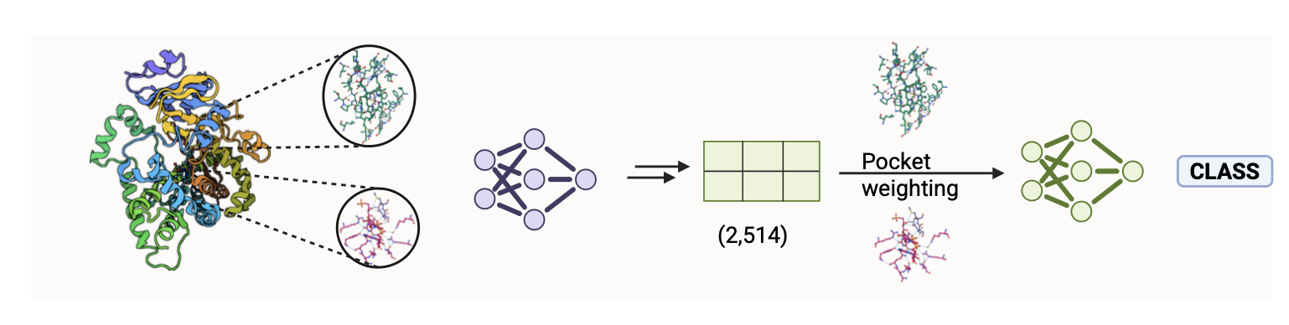
E(n)-GNN
MLP Class.

Slide 3
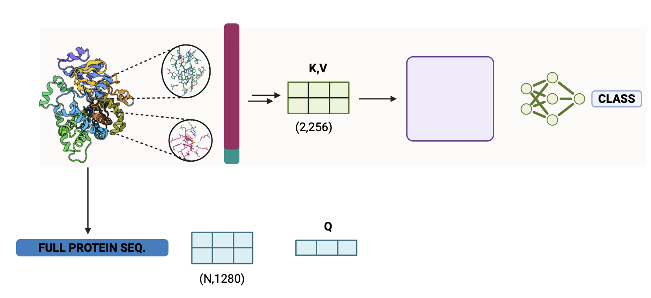
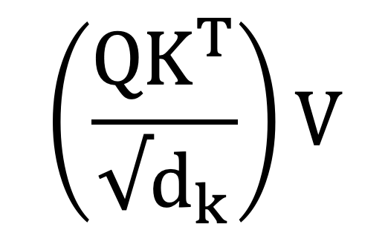
MKASLESEFKD……
M
$$\left(\frac{QK^{T}}{{√d}_{k}}\right)V$$
(1,256)

Slide 4
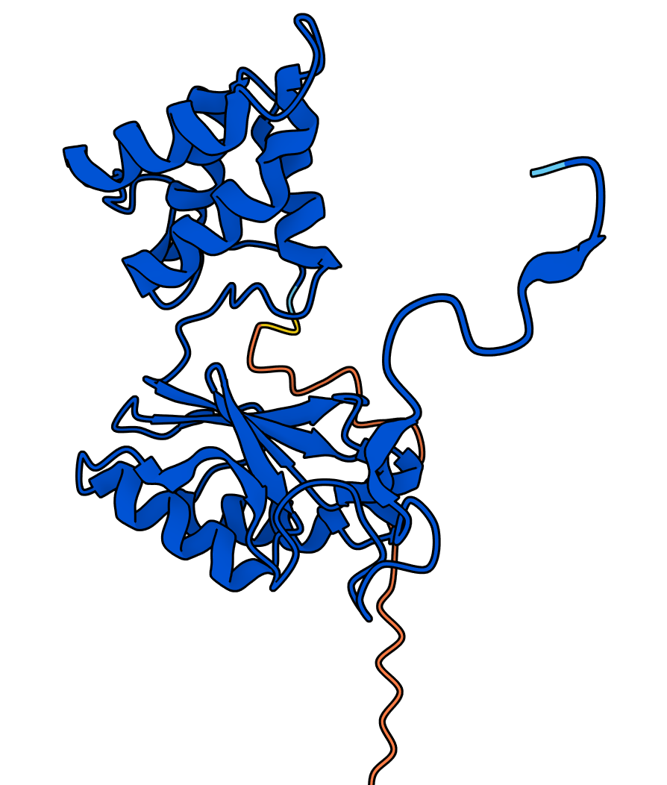
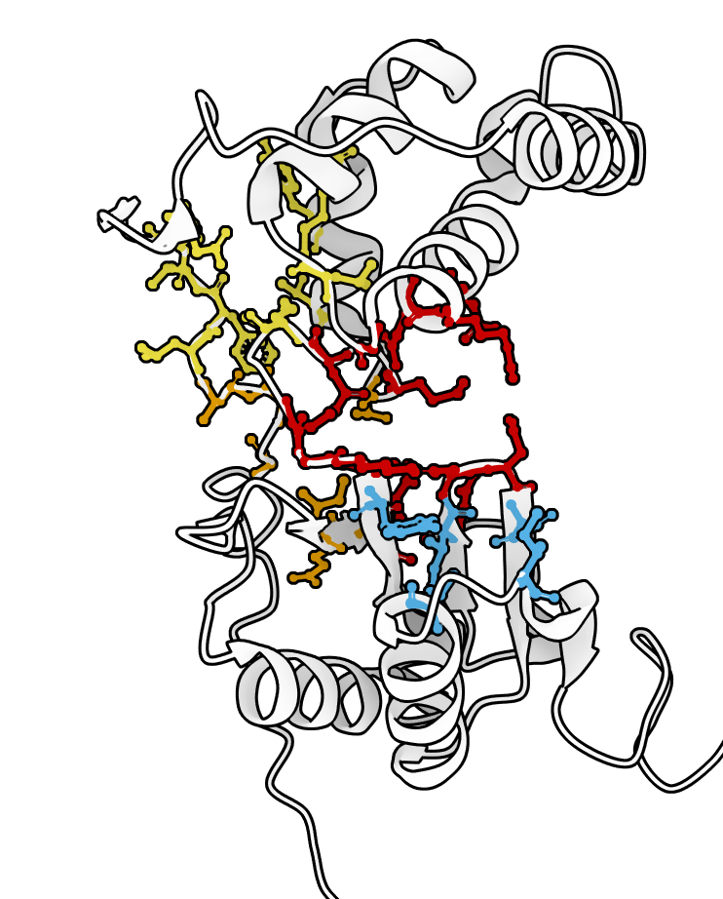
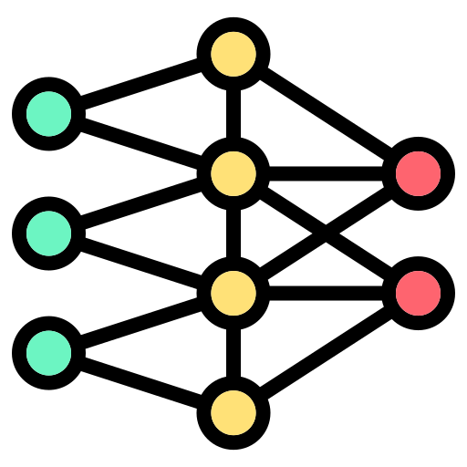
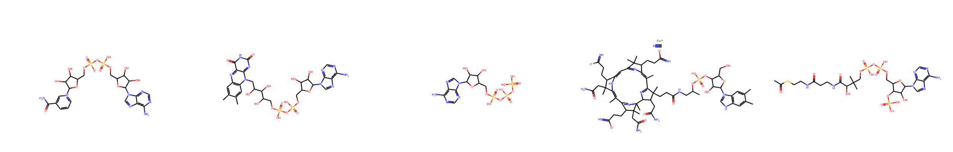
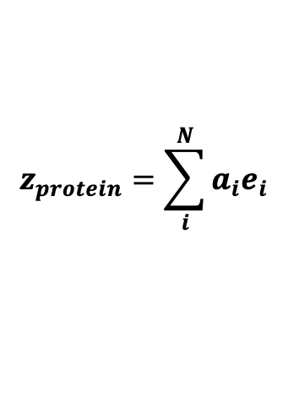

P2rank Pocket Pred.
Pocket extraction
Embedding extraction and mean pooling
Pocket Embeddings
[N,1280]
A. Pocket Only
$$z_{protein}=\sum_{i}^{N}{a_{i}e_{i}}$$
Pocket weight $a_{i}$
MLP Classifier
Logits
B. Pocket + Global context
Self-attention transformer
$$X = [z_{protein},z_{{pocket}_{1}},z_{{pocket}_{2}},z_{{pocket}_{N}}]$$
Residual Con. + FFN
+ MLP classifier
Logits
Protein Emb. [1,1280]
Self-attention Block
C. Ligand + Pocket + Global context
Ligand cross-attention
$$X = [z_{protein},z_{{pocket}_{1}},z_{{pocket}_{2}},z_{{pocket}_{N}}]$$
Key,Value
Protein Emb. [1,1280]
Attention w. + Residual Con. + FFN
+ MLP classifier
Logits
ECFP-Fingerprints
Cross-attention Block
Query
NADH+
FAD
ATP
B12
Acetyl-CoA
D. Graph Encoders
Pocket Extraction
DNN Arch.
Logits
E(n)-GNN Encoder
3D-enriched Embeddings

