Slide 1

Project Libby
Presentation
ChatLibby

Slide 2
Project Overview
Project Libby is an AI-driven chatbot and automation system designed to streamline library services at the University of Batangas – Lipa Campus. It allows students to search books, check availability, and request information through a responsive conversational interface. The system integrates AI processing with n8n automation and tools like Gmail, Google Sheets, and Google Docs to ensure fast, consistent, and reliable library assistance while reducing manual workload for staff.
Assignment of Roles
Name | Role | Responsibilities
John Rico Tolentino | Project Lead, Frontend Developer, UI/UX | Oversees the project and develops the responsive user interface.
Erik John Roxas | Backend Developer, Security | Designs backend automation and ensures data security.
John Vincent Ferrer | DevOps, Tester | Manages deployment, GitHub activity, and system testing.

Slide 3
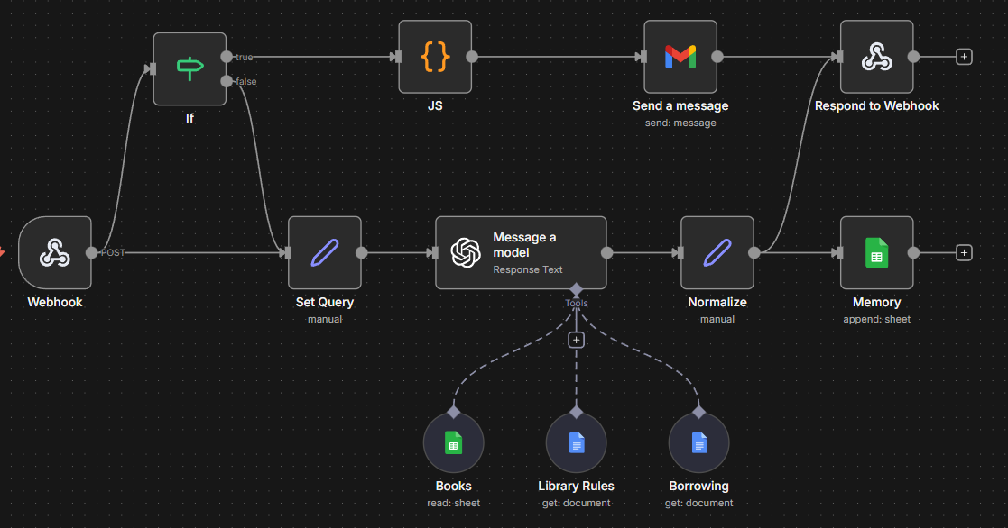
System Architecture

Slide 4
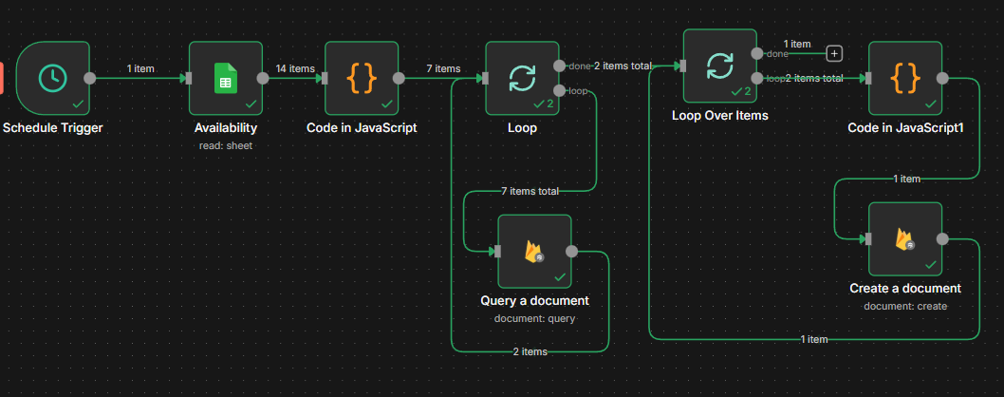
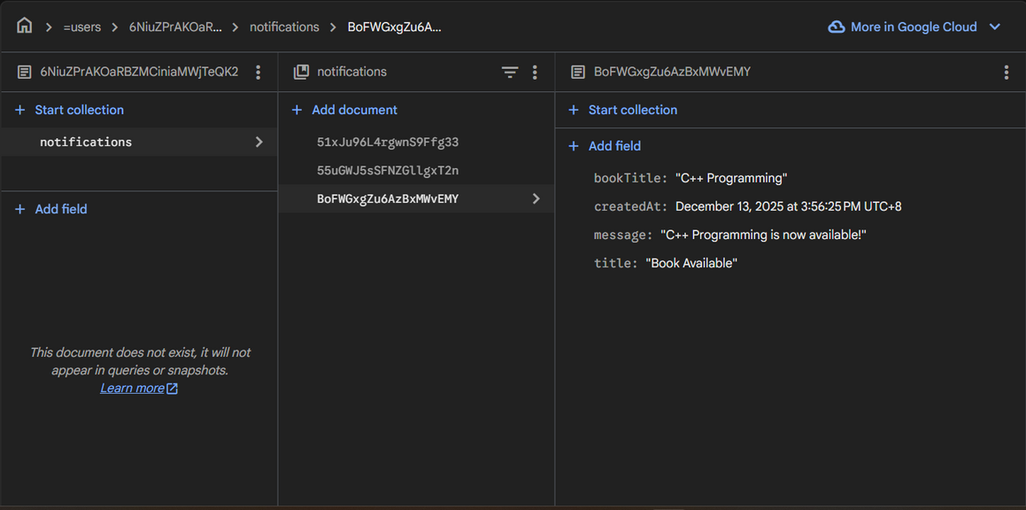
Backend Process

Slide 5
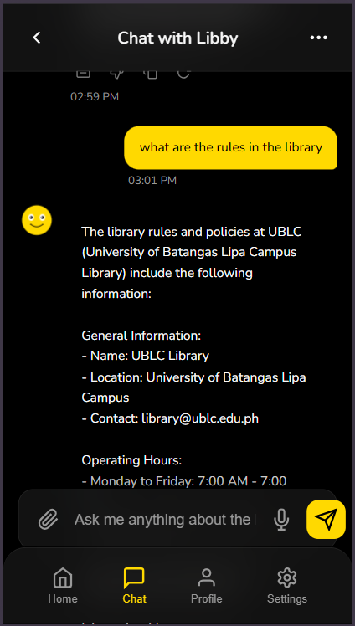
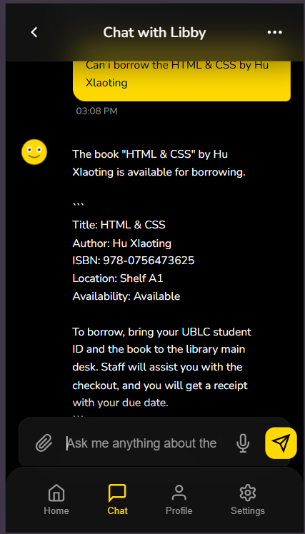
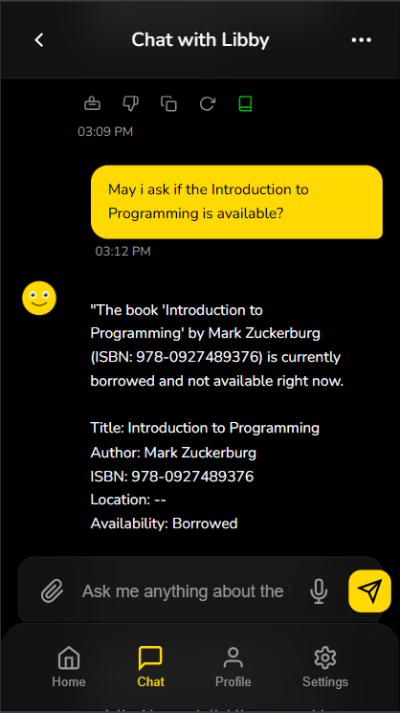
Performance Report

Slide 6
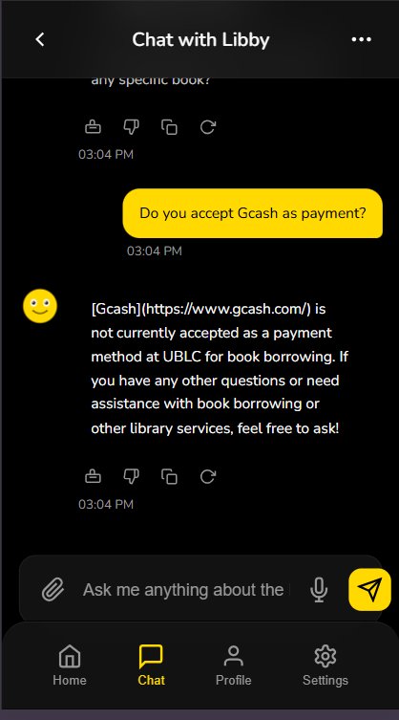
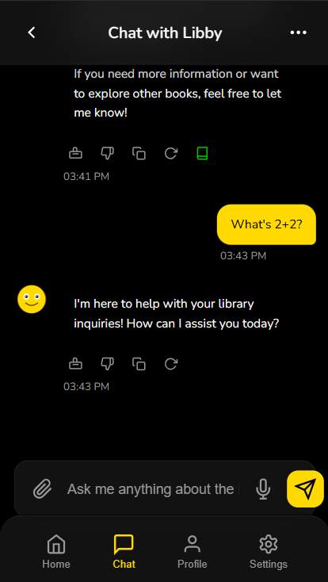
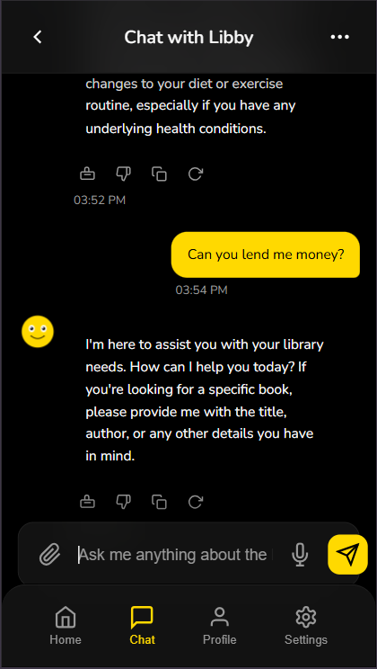
Performance Report

Slide 7
Ethics and Security
Responsible AI Use
  AI acts as a support tool, not a decision-maker
  Limited to library-related inquiries only
  Human oversight for critical actions
Privacy Protection
  Minimal data collection (data minimization)
  No unnecessary storage of personal data
  Complies with the Data Privacy Act of 2012 (RA 10173
Security Measures
  HTTPS encrypted communication
  Role-based access control
  Secure authentication
  Protected n8n workflows and databases
Risk Mitigation
  Regular dataset review
  Workflow audits
  AI output monitoring

Slide 8
THANK YOU

