Slide 1

Retail Sales Analysis
Tools Used: MS Excel | Dashboard | Pivot Tables

Slide 2
Project Overview
Retail dataset of ~500K+ transactions.
Analyzed cancellations, top products, customer segments, and revenue trends.
Created an interactive Excel dashboard with slicers and visual KPIs.
Delivered insights to optimize pricing and customer strategy.

Slide 3
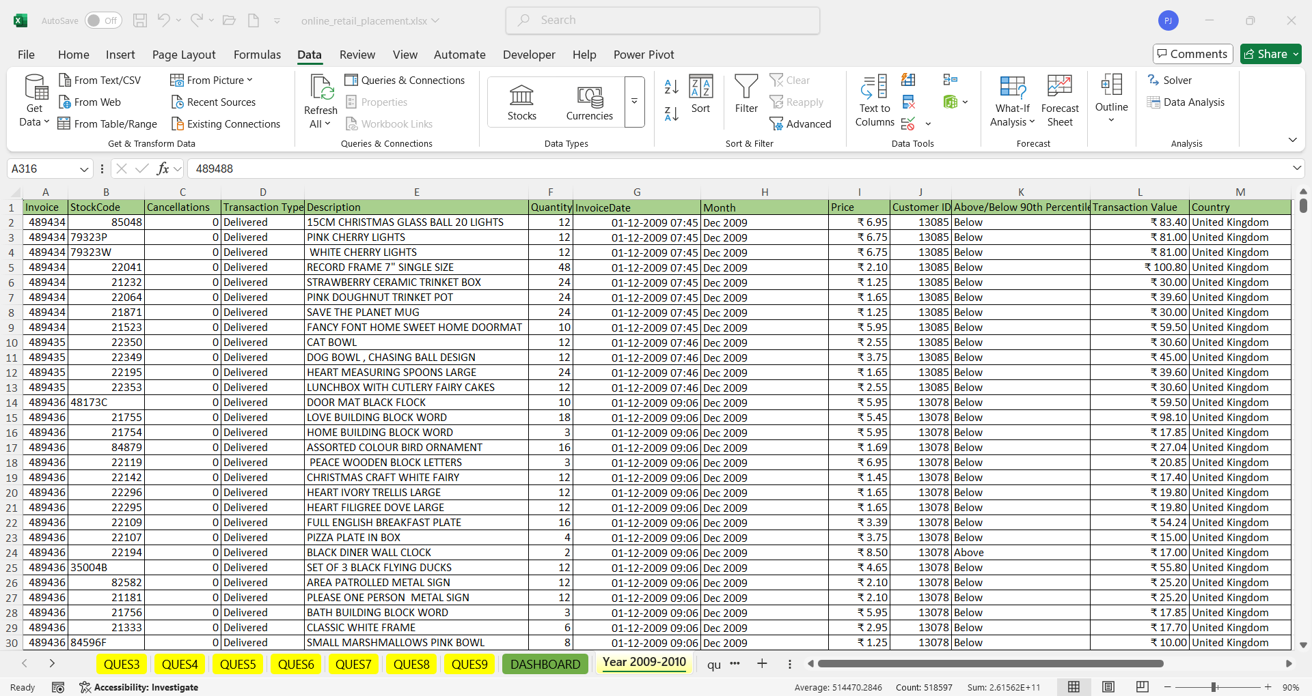

Slide 4
Data Cleaning and Preparation
Removed duplicates using Remove Duplicates.
DATA >DATA TOOLS >REMOVE DUPLICATES

Slide 5
Handling Cancellations
Transactions with invoices starting with 'C' are cancellations.
Created new column to flag cancellations using functions LEFT() and IF() .
Total Transactions(2009-2010) :508411
Total Cancelled Transactions: 10,182
Total Value of Cancelled Transactions: ₹6,29,435.08

Slide 6
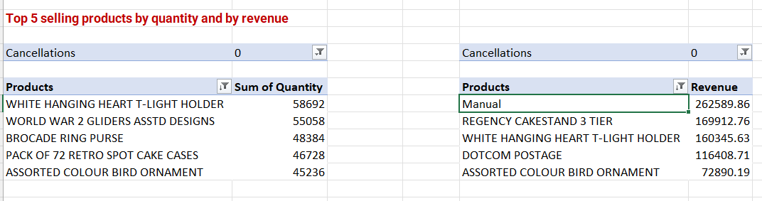
Sales Performance Per Product
Top 5 Products by Quantity and Revenue identified using Pivot Table.
Highest quantity: White Hanging Heart (58,692 units)
Highest revenue: Manual (₹2.6L)

Slide 7
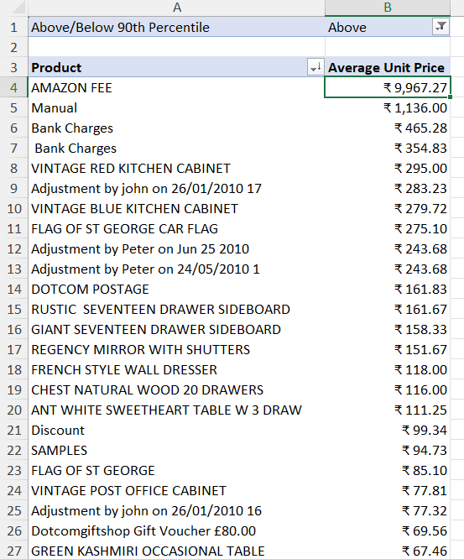
Pricing Strategy Analysis
Used PIVOT TABLE and PERCENTILE.INC to determine the top 10% priced items.
Created a column above/below 90 percentile by using IF() and value from PERCENTILE.INC().

Slide 8
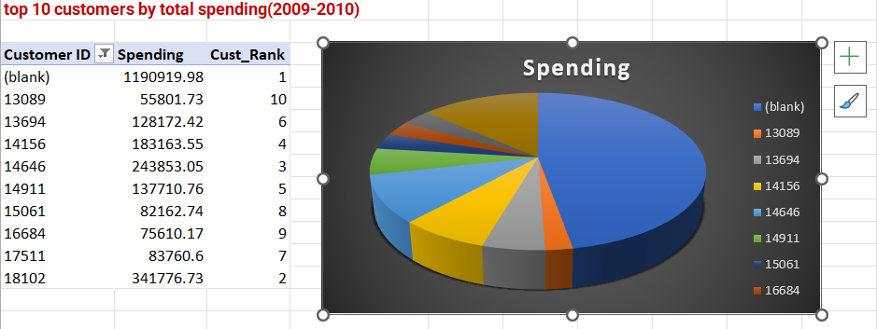
Customer Analysis
Top 10 customers by spending identified.
Highest spending: ₹11,90,919.98
Ranked Customer by Using Measure created by using DAX
=RANKX(
ALL(Range[Customer ID]),
[Revenue(2009-10)] )

Slide 9
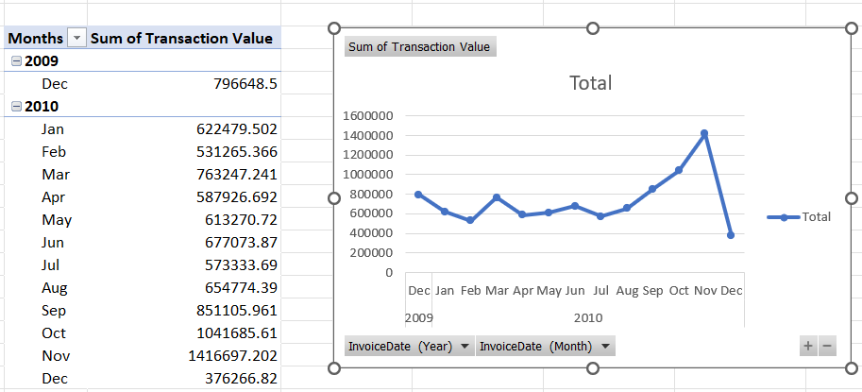
Monthly Sales Trends
Line chart created using PIVOT TABLE over months.
Peak observed in Nov–Dec 2010

Slide 10
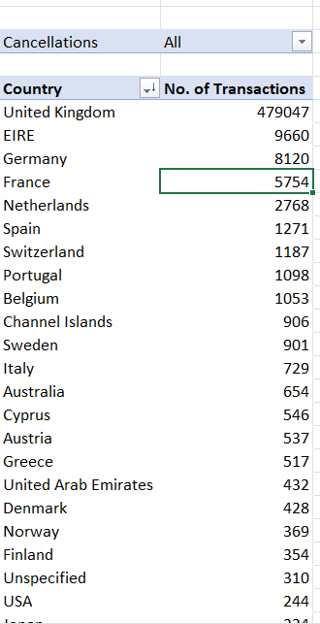
Geographical Insights
Pivot table shows UK as the country with highest transactions (4.79L+).

Slide 11
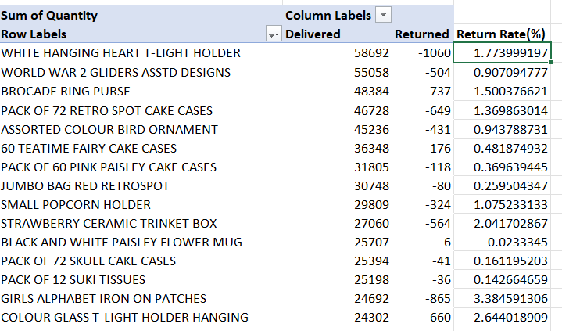
Product Return Rate
Return Rate = ABS(Returned) / Total Ordered(Delivered+ABS(Returned))
Returns are identified by:
Invoice No starting with "C" (i.e., cancellation) or Quantity values that are negative

Slide 12
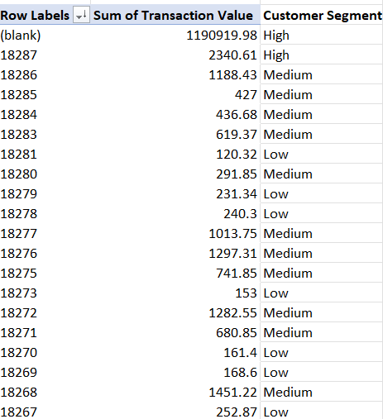
Customer Segmentation
Segmented customers based on total spend using QUARTILE.INC.
Q1: 282.9025 |Q2: 652.575 |Q3:1634.7275
COUNT: High: 1,096 | Medium: 2,192 | Low: 1,096

Slide 13
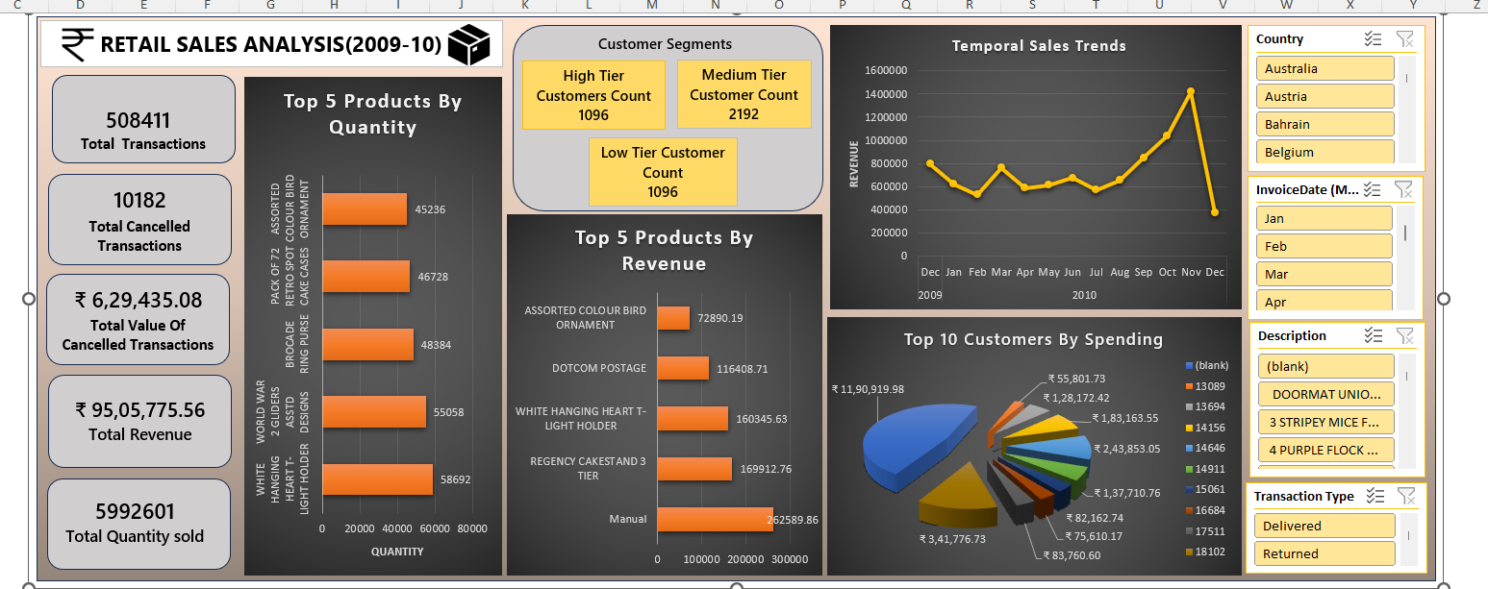
DASHBOARD

Slide 14
Recommendations:
• Focus marketing in Q4
• Push top revenue products with offers
• Improve product descriptions to reduce returns
• Target high-value customers with loyalty rewards

