Slide 1
ICS小班
郭天魁
2015.12.10

Slide 2
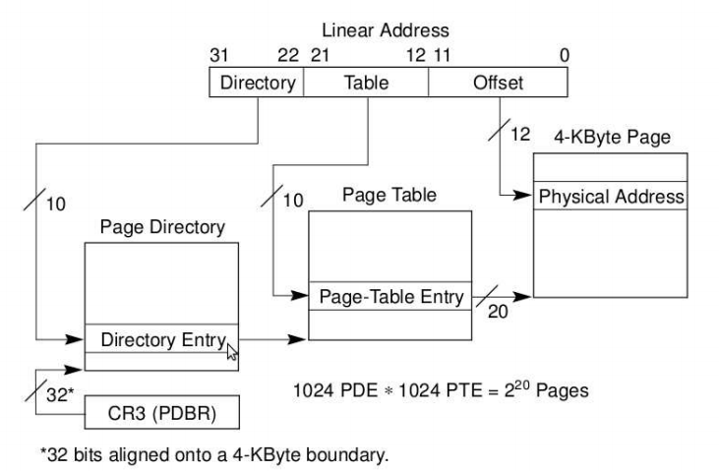
Virtual Memory: Concepts

Slide 3
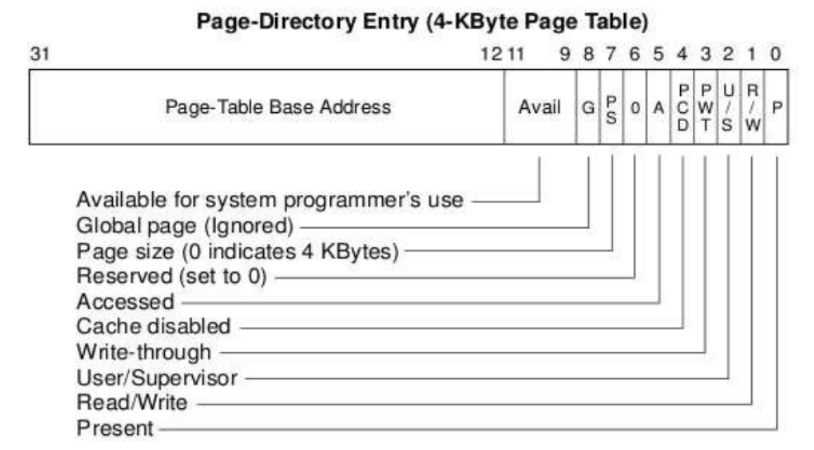
Virtual Memory: Concepts

Slide 4
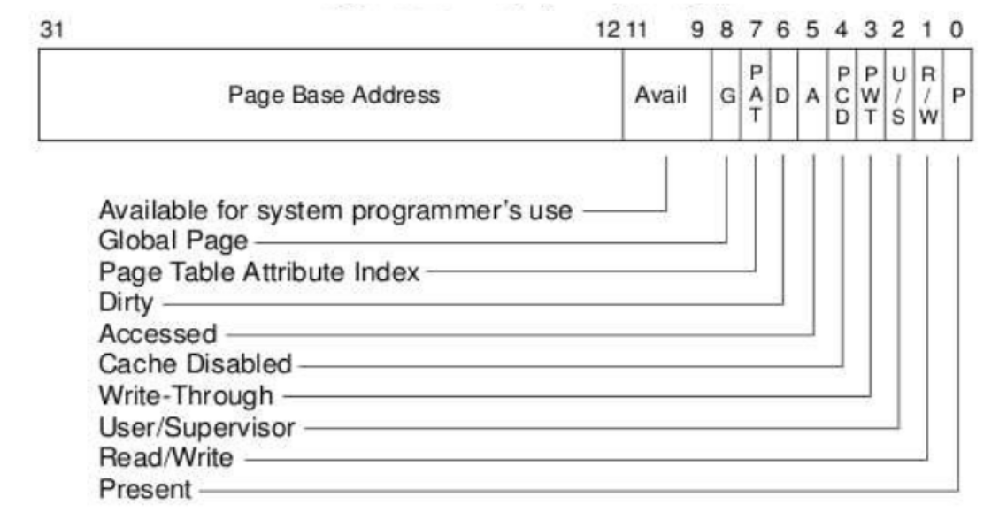
Virtual Memory: Concepts

Slide 5
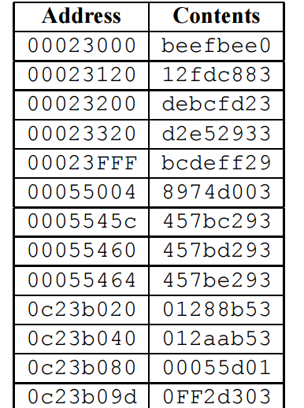
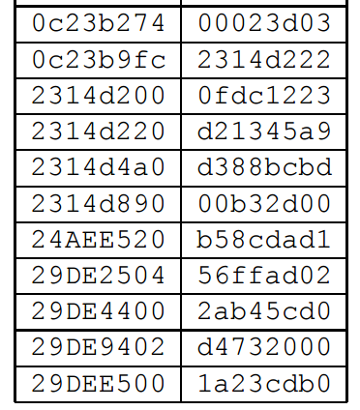
Virtual Memory: Concepts
0x080016ba
0x9fd28c10

Slide 6
Virtual Memory: Systems
fork的实现
execve的实现

Slide 7
Virtual Memory: Systems
mmap的参数意义

Slide 8
Virtual Memory: Systems
垃圾收集
串行/并行/并发

Slide 9
Virtual Memory: Systems
简单分离存储
分离适配
伙伴系统

Slide 10
Internetworking
p624
p625
p631

Slide 11
Internetworking
域名/IP
DNS
IPv4/IPv6

Slide 12
Internetworking
struct sockaddr{
unsigned short sa_family;
char sa_data[14];
}
struct sockaddr_in{
unsigned short sin_family; unsigned short sin_port;
struct in_addr sin_addr;
unsigned char sin_zero[8];
}

Slide 13
Internetworking
int socket(int domain, int type, int protocol);
int connect(int sockfd, struct sockaddr *serv_addr, int addrlen);
int bind(int sockfd, struct sockaddr *my_addr, int addrlen);
int listen(int sockfd, int backlog);
int accept(int listenfd, struct sockaddr *addr, int *addr_len);
请完成
int open_clientfd(char *hostname, int port);
int open_listenfd(int port);
echo 服务器
echo 客户端

Slide 14
Good Luck & Have Fun!

