Slide 1

Crime Hotspots Prediction
DATAMI: Municipal Crime Analytics & Police Station Readiness Platform
Department of Computer Science & Engineering (Artificial Intelligence)
Sustainable Development Goals Alignment: SDG 16 (Peace & Justice) • SDG 11 (Sustainable Cities) • SDG 9 (Innovation)
TEAM MEMBERS (GROUP 3 — CSE-AI)
• Sam Sunny
• Samerath Kumar
• John Varghese Nettady
• Shannon George
PROJECT DETAILS
• Course: Data Mining (PECST525)
• Branch: B.Tech CSE (Artificial Intelligence)
• Target Region: Kochi & Ernakulam (37 PS)
• Academic Year: 2026–2027
Crime Hotspots Prediction | DATAMI | Dept. of CSE(AI)
1
Notes:
Good morning/afternoon. We are Group 3 from CSE (Artificial Intelligence): Sam Sunny, Samerath Kumar, John Varghese Nettady, and Shannon George. Our project is titled 'Crime Hotspots Prediction', code-named DATAMI. It addresses municipal public safety across Kochi City and Ernakulam, aligned with UN SDGs 16, 11, and 9.

Slide 2
Contents & Presentation Roadmap
AGENDA FOR PRESENTATION
01. Problem Statement & Motivation
02. UN Sustainable Development Goals (SDGs)
03. Project Objectives
04. End-to-End Processing Workflow
05. Data Extraction & Preprocessing
06. Multidimensional OLAP Warehousing
07. Feature Engineering & Importance
08. CART Decision Tree Induction
09. Crime Spree & Staffing Simulator
10. Model Evaluation & Confusion Matrix
11. Operational Findings & Policy Impact
12. Live Geospatial Interface & Cartography
13. Technology Stack & Justifications
14. Conclusion & Future Scope
15. Academic & Official References
Crime Hotspots Prediction | DATAMI | Dept. of CSE(AI)
2
Notes:
Here is the roadmap for our presentation. We will walk through the problem statement, alignment with UN SDGs 16, 11, and 9, formal engineering objectives, the 5-step KDD workflow, data warehousing, feature engineering, decision tree modeling, crime spree simulation, evaluation metrics, live geospatial cartography, and academic references.

Slide 3
Problem Statement
DATA MINING MOTIVATION & PUBLIC SAFETY GOAL
“Crime hotspot prediction aims to develop a data mining system that analyzes historical crime records, including the type of crime, location, date, and time, to identify patterns and predict areas where crimes are most likely to occur in the future.
By detecting high-risk locations and time periods, the system helps law enforcement agencies allocate resources efficiently, plan preventive patrols, and take proactive measures to reduce crime, ultimately improving public safety through data-driven decision-making.”
Key Operational Challenges Addressed:
• Unstructured Portal Data: Police records are siloed in unstructured state portal tables without spatial geocoding.
• Explainability Imperative: Police officers need transparent, legally auditable if-then rules, not opaque black-boxes.
• Staffing & Crime Surge Vulnerability: High-volume stations risk operational breakdown when sudden crime sprees occur without reserve mobilization.
Crime Hotspots Prediction | DATAMI | Dept. of CSE(AI)
3
Notes:
Our problem statement focuses on practical, data-driven policing: By analyzing historical crime records across physical station jurisdictions, we identify high-risk areas and predict upcoming crime risk. This empowers police agencies to allocate patrol resources efficiently and prepare for sudden crime surges.

Slide 4
Alignment with Sustainable Development Goals
UNITED NATIONS 2030 AGENDA — SDG 16, SDG 11 & SDG 9
SDG 16: Peace, Justice & Strong Institutions (Targets 16.1 & 16.6)
Core Target: Significantly reduce all forms of violence; develop effective, accountable and transparent public institutions.
• Transparent Patrol Resource Allocation: Replaces subjective dispatching with empirical, explainable CART Decision Tree rules that Station House Officers can legally audit and justify.
• Proactive Crime Prevention: Identifies emerging high-risk jurisdictions in advance, allowing preventive patrols to de-escalate violence before incidents occur.
SDG 11: Sustainable Cities & Communities (Target 11.7)
Core Target: Provide universal access to safe, inclusive and accessible green and public spaces for all citizens.
• Metropolitan Cartography & Hotspot Mitigation: Maps crime density across 37 stations in Kochi to safeguard commercial corridors, transit hubs, and waterfront spaces (MG Road, Marine Drive).
• Surge Resilience for Urban Security: Simulates fleet readiness during sudden crime sprees, ensuring municipal police stations maintain emergency response capacity.
SDG 9: Industry, Innovation & Infrastructure (Target 9.b)
Core Target: Support domestic technology development, research and innovation in public infrastructure.
• Open-Source Public Safety Infrastructure: Modernizes police data systems using reproducible open technologies (FastAPI, Leaflet OSM, Scikit-Learn OLAP) with zero licensing costs.
• Data-Driven Institutional Transformation: Converts passive, siloed portal tables into active predictive intelligence, democratizing advanced analytics for state law enforcement.
Crime Hotspots Prediction | DATAMI | Dept. of CSE(AI)
4
Notes:
Slide 4 highlights how DATAMI directly advances three United Nations Sustainable Development Goals. Under SDG 16 (Peace and Justice), we provide explainable, auditable decision trees for transparent patrol resource allocation and proactive violence reduction. Under SDG 11 (Sustainable Cities), our geospatial cartography safeguards Kochi's public spaces and tests station resilience under crime surges. Under SDG 9 (Innovation and Infrastructure), we deliver modern, open-source data mining infrastructure without expensive proprietary software locks.

Slide 5
Project Objectives
FORMAL ENGINEERING GOALS
1. Data Harvesting & Relational Warehousing
Acquire, clean, and warehouse 10+ years (2014–2023) of real historical crime records, coordinates, and staff data across 37 police stations from official Kerala Police portals with 100% traceability and zero synthetic fabrication.
2. Explainable Crime Hotspot Classification
Induce an explainable CART Decision Tree classifier with Gini Impurity (max depth = 3) to predict whether police stations will face Higher or Lower Relative Risk, evaluated strictly out-of-time (2020–2025) with zero data leakage.
3. Crime Spree Surge & Staffing Simulation
Develop a configurable operational simulation model that tests station capacity against simulated crime sprees (+25%, +50%, +100%), flags understaffed stations, and models how filling vacancies reduces officer caseload strain.
4. Geospatial Cartography & Full-Stack Interface
Deploy a step-by-step interactive Web dashboard using Leaflet OpenStreetMap, drill-down station intelligence drawers, and direct CSV data exports.
Crime Hotspots Prediction | DATAMI | Dept. of CSE(AI)
5
Notes:
Here are our four engineering objectives: First, harvesting real Kerala Police records across 37 stations into a clean relational warehouse. Second, training an explainable CART Decision Tree to classify high-risk hotspots. Third, simulating crime sprees to identify understaffed stations and prove workload reduction. Fourth, delivering a full-stack geospatial WebUI with OpenStreetMap cartography.

Slide 6
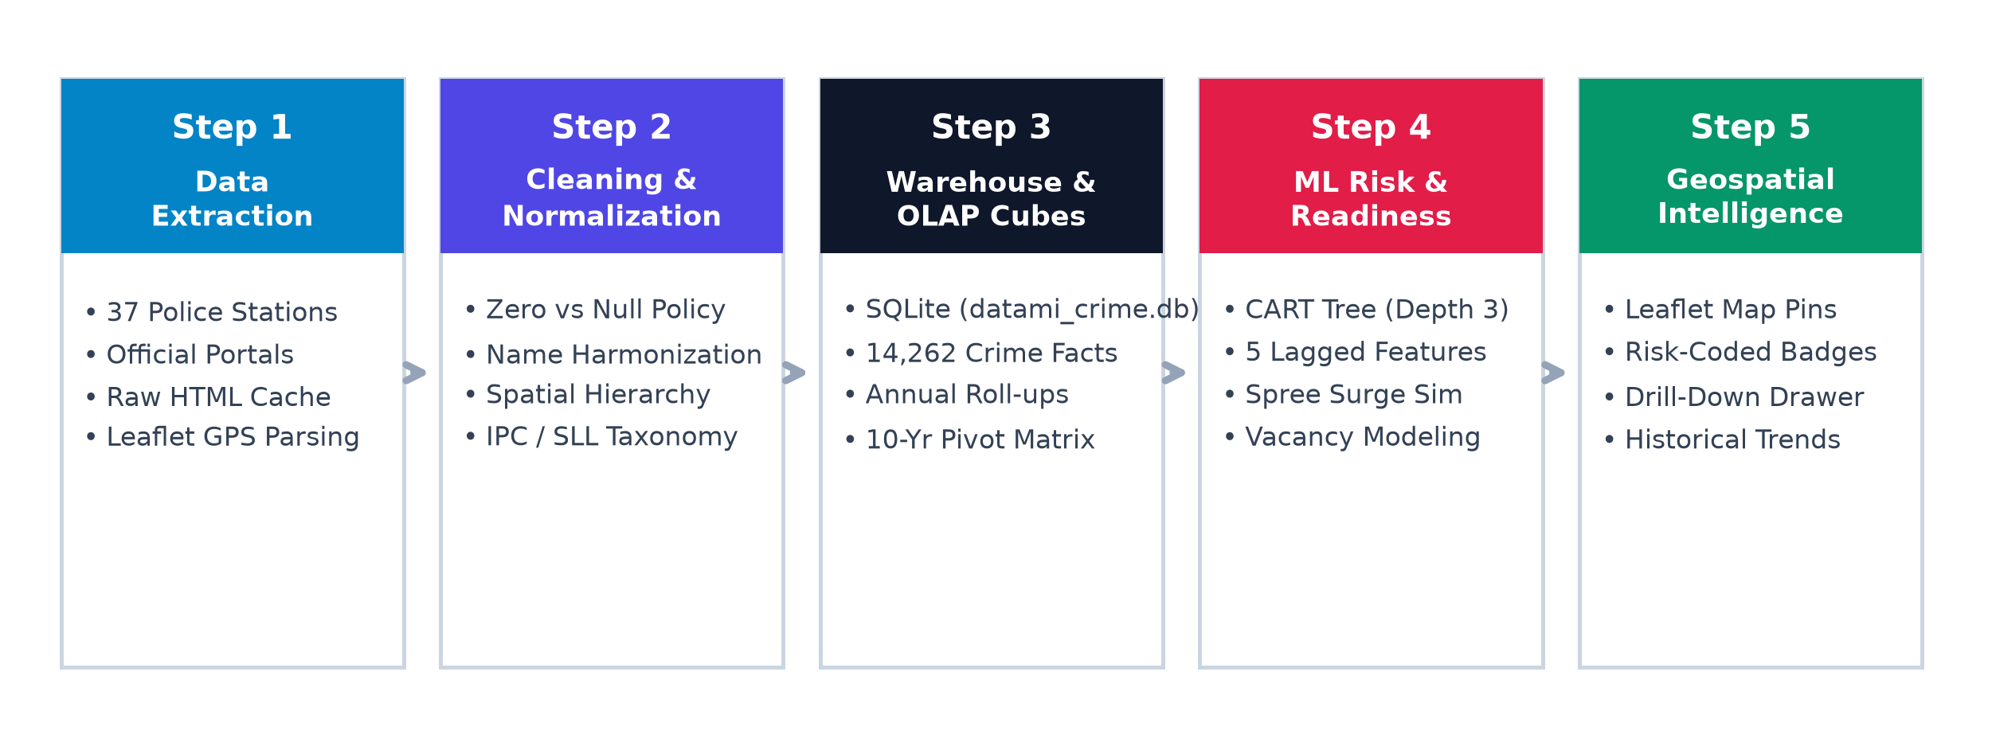
System Architecture & Processing Workflow
5-STEP SEQUENTIAL DATA MINING PIPELINE
Pipeline Execution Flow: Raw HTML Portals → Clean Relational Warehouse → Temporal Features → Explainable ML Tree → Leaflet Cartography
Crime Hotspots Prediction | DATAMI | Dept. of CSE(AI)
6
Notes:
Slide 6 outlines the complete data mining workflow implemented in DATAMI across 5 simple steps: Step 1: Harvesting raw portal tables and physical coordinates from official sources. Step 2: Cleaning and normalizing zero counts vs missing years. Step 3: Relational warehousing in SQLite with OLAP roll-up operations. Step 4: Machine learning risk prediction and crime spree surge simulation. Step 5: Interactive geospatial visualization on OpenStreetMap.

Slide 7
Data Extraction & Cleaning Methodology
DATA INGESTION, TAXONOMY NORMALIZATION & CONCEPT HIERARCHIES
• 100% Traceable Real-World Data Acquisition
Harvested 14,262 historical crime records (2014–2023), 250 staff posts, and physical coordinates from official portals: ps.keralapolice.gov.in and kochicity.keralapolice.gov.in. Raw HTML cached locally.
• Strict Zero-Count vs Unobserved Year Policy
A reported '0' represents an active station with zero occurrences of that specific crime. A NULL indicates an unobserved or unestablished year. Preserving true zeros prevents distorting model probabilities.
• Station Entity Harmonization
Resolved mismatched URL slugs and portal naming variations (e.g. 'ernakulamcentral-ps' ↔ 'Ernakulam Central') into unified relational primary keys.
• Spatial & Legal Concept Hierarchies
Spatial: State → District (Kochi City / Rural) → Sub-Division (Ernakulam, Mattancherry, etc.) → Station.
Legal: Penal Code (IPC vs SLL) → Category (Violent, Property, Vice) → Specific Offense Head.
Crime Hotspots Prediction | DATAMI | Dept. of CSE(AI)
7
Notes:
In Slide 7, we explain the data preprocessing steps: Our data is 100% real from Kerala Police portals. We enforced a strict zero-count policy distinguishing true zero crimes from missing years. We harmonized station names and established 3-tier spatial and legal concept hierarchies.

Slide 8
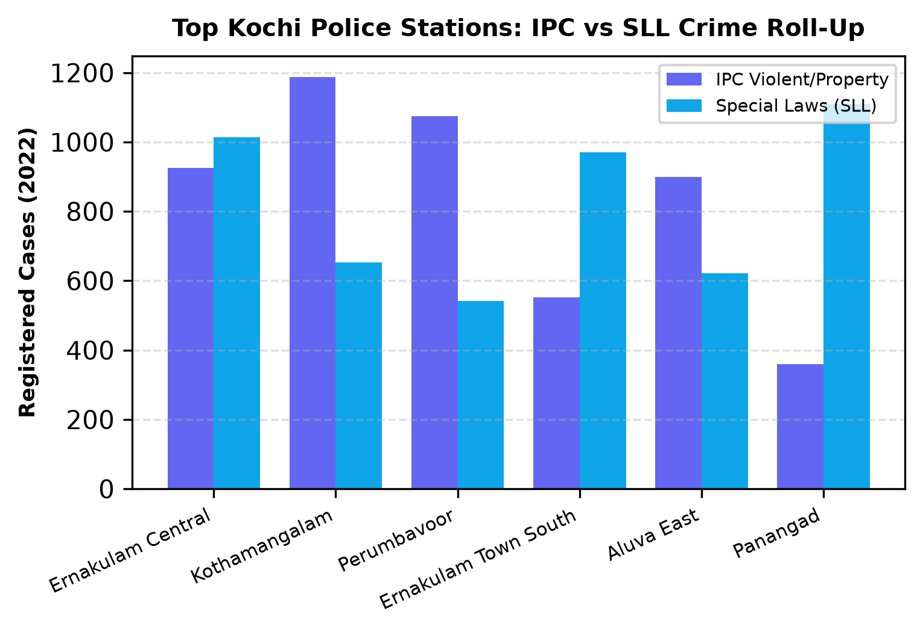
Data Warehouse & OLAP Operations
WHY RAW CRIME ROWS ARE LOW & HOW OLAP ROLLS UP STATION TOTALS
Fact Table Granularity vs OLAP Roll-Up:
• Fine Fact Table Grain: In crime_records, each row is Station × Year × Specific Crime Head. Rare crimes (Murder, Dacoity) naturally show 0, 1, or 2 cases.
• OLAP Roll-Up: Aggregating all heads to annual totals reveals true metropolitan crime volumes (1,000 to 2,000+ cases).
• Top Stations: Ernakulam Central (1,939 cases), Town South (1,418 cases), and Palarivattom (1,110 cases).
• OLAP Pivot Table: Cross-tabulates all 37 stations across 10 years to spot long-term trajectories.
Crime Hotspots Prediction | DATAMI | Dept. of CSE(AI)
8
Notes:
Slide 8 clarifies why raw fact rows show small numbers: each row is a specific crime category. When rolled up to station annual totals, we see realistic volumes: Ernakulam Central registers 1,939 crimes, Town South 1,418, and Palarivattom 1,110. The graph on the right displays the breakdown between IPC offenses and Special & Local Laws.

Slide 9
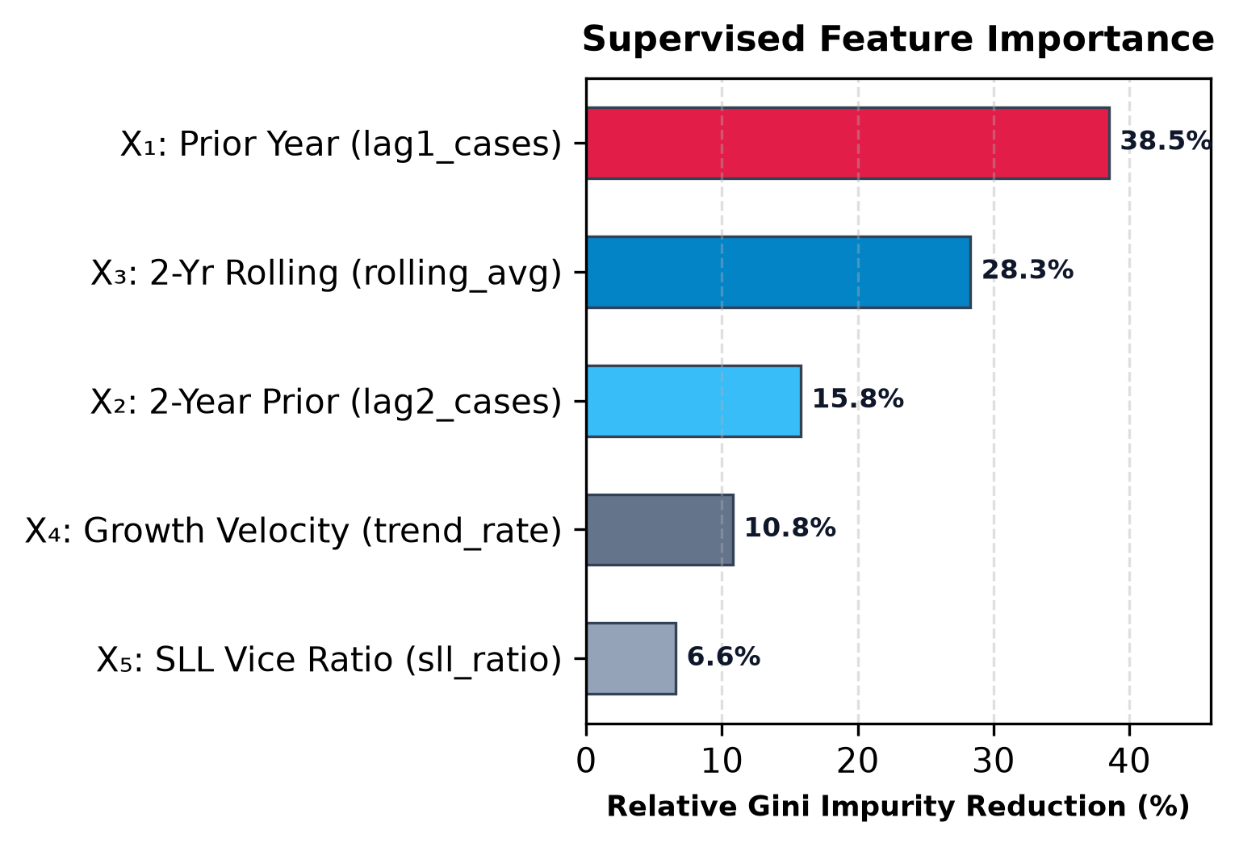
Feature Engineering & Chronological Split
5 LAGGED PREDICTORS & ZERO-LEAKAGE TEMPORAL EVALUATION
Mathematical Feature Formulations:
• X₁ (lag1_cases): Prior year volume (T-1) — 38.5% Importance (primary momentum).
• X₂ (lag2_cases): Two-year prior volume (T-2) — 15.8% (medium-term stability).
• X₃ (rolling_2yr_avg): Smoothed 2-year average — 28.3% (noise reduction).
• X₄ (trend_rate): Registration velocity — 10.8% (acceleration indicator).
• X₅ (sll_ratio): Proportion of Special & Local Laws — 6.6% (vice activity).
• Chronological Split: Train on 2016–2019, test on 2020–2025. Zero future data leakage.
Crime Hotspots Prediction | DATAMI | Dept. of CSE(AI)
9
Notes:
In Slide 9, we formulated 5 temporal features. Notice on the right chart that Lag-1 volume and the 2-year rolling average dominate predictions, explaining over 66% of model splits. We used a strict chronological split (2016–2019 train, 2020–2025 test) to ensure zero data leakage.

Slide 10
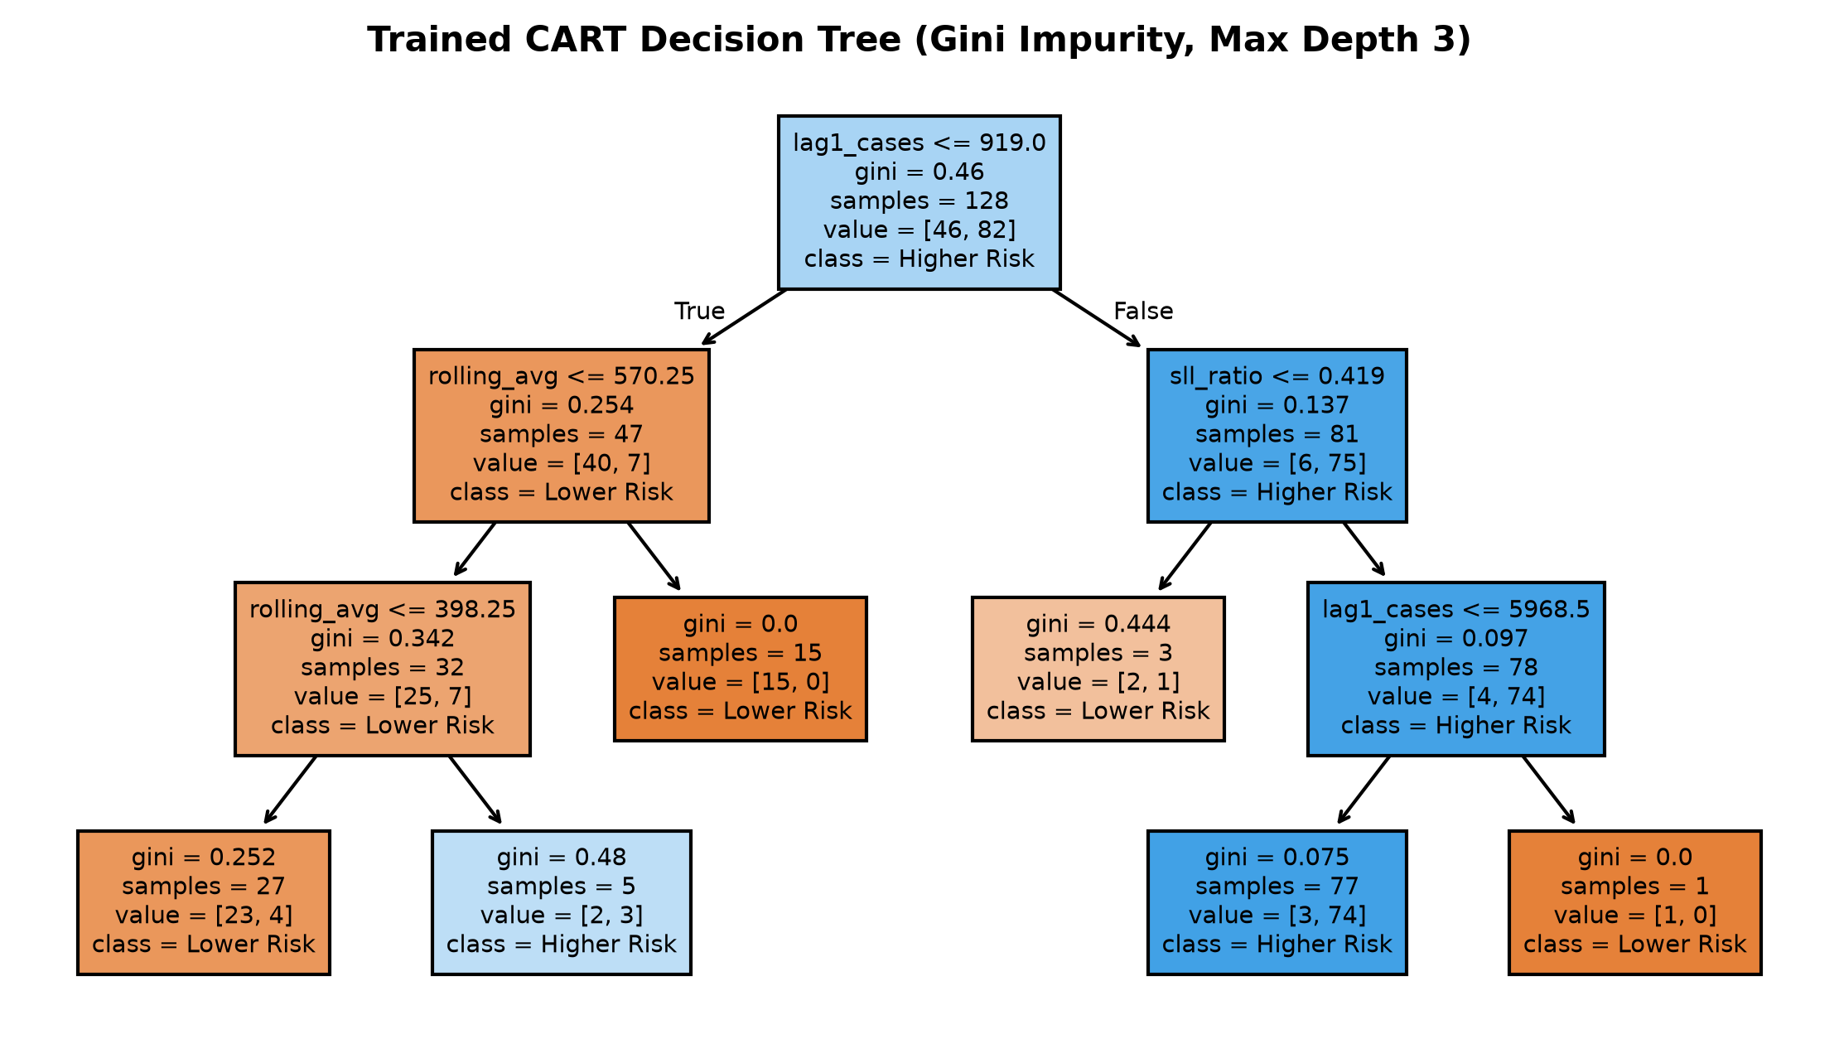
CART Decision Tree Hotspot Induction
EXPLAINABLE SUPERVISED CLASSIFIER (GINI SPLITS, DEPTH = 3)
How the Decision Tree Works:
• Target Output (Y): Binary classification into Higher Relative Risk (Class 1) vs Lower Relative Risk (Class 0).
• Splitting Metric: Gini Impurity reduction at each branch: I_G = 1 - Σ p_i².
• Maximum Depth = 3: Strictly limited to avoid overfitting and produce auditable if-then decision rules.
• Transparent Rule: IF lag1_cases > 919 AND sll_ratio > 0.42 THEN Higher Risk (Node purity: 95% Higher Risk).
• Zero Black-Box: Every prediction can be inspected and legally defended by station commanders.
Crime Hotspots Prediction | DATAMI | Dept. of CSE(AI)
10
Notes:
Slide 10 displays our CART Decision Tree model. Notice the authentic tree on the right: It splits on lag1_cases, rolling_avg, and sll_ratio to classify stations into Higher vs Lower Risk. With a maximum depth of 3, the model is 100% explainable, producing transparent rules that Station House Officers can trust.

Slide 11
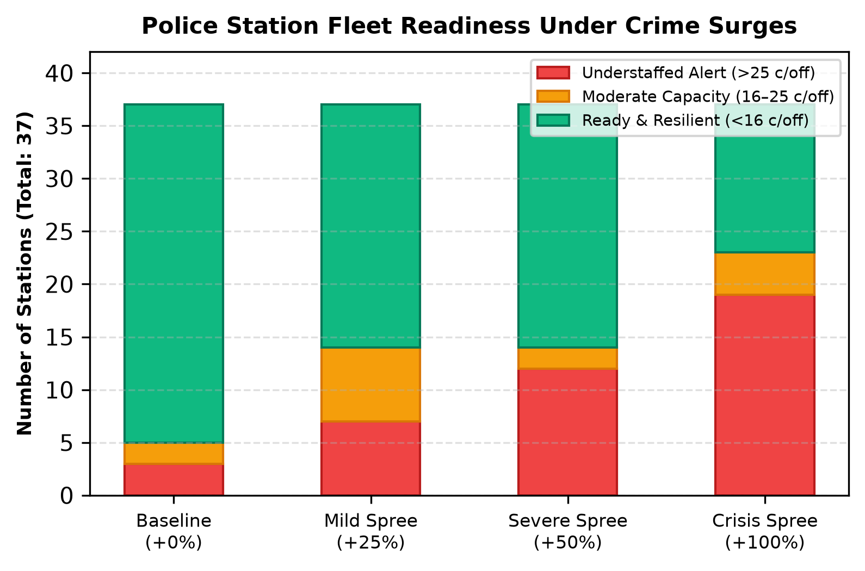
Crime Spree Surge & Staffing Simulator
MODELING OPERATIONAL STRAIN & VACANCY MITIGATION
How Understaffing Alerts are Computed:
• Officer Caseload Metric: Workload = Annual Crimes / Active On-Duty Officers.
• Spree Volume: Baseline Cases × (1 + Surge %). Tested at +25%, +50%, +100%.
• Configurable Alert Threshold: Stations exceeding 25 cases/officer trigger an Understaffed Alert.
• Mathematical Vacancy Mitigation: In Panangad, filling 5 vacancies expands staff from 48 to 53, reducing spree workload from 45.9 down to 41.6 cases/officer.
• Fleet Strain: Under a +50% spree, 12 of 37 stations trigger Understaffed Alerts.
Crime Hotspots Prediction | DATAMI | Dept. of CSE(AI)
11
Notes:
Slide 11 details our Crime Spree Surge Simulator: We model how crime surges increase officer caseloads. Under a +50% spree, 12 stations become understaffed. Our system mathematically proves how filling vacancies reduces workload from 45.9 down to 41.6 cases per officer.

Slide 12
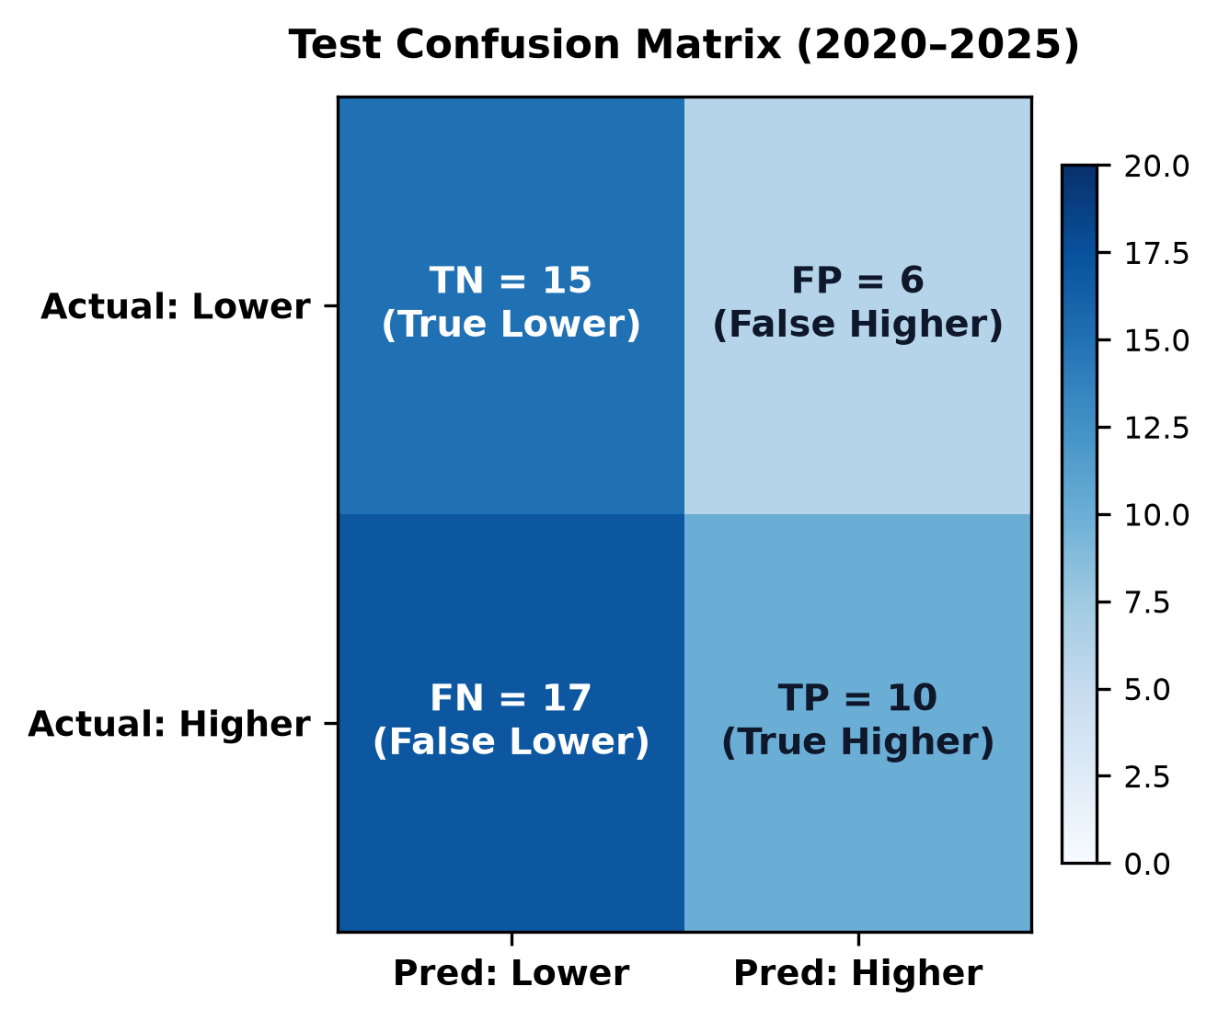
Experimental Results & Model Evaluation
TEST METRICS & COMPARISON AGAINST REFERENCE BASELINES
Empirical Evaluation (2020–2025 Test Set):
• Test Accuracy: 61.1% on out-of-time test observations.
• Precision: 27.0% | Recall: 37.0% | F1-Score: 31.3%.
• Outperforms Baselines: Beats Zero-R Majority Class (52.1%) and Persistence Lag-1 (47.9%).
• True Predictive Signal: Verifies that combining multi-year lagged volume with moving averages extracts genuine signal beyond naive guessing.
• Confusion Matrix Breakdown: 15 True Negatives, 10 True Positives, with 6 False Positives.
Crime Hotspots Prediction | DATAMI | Dept. of CSE(AI)
12
Notes:
Slide 12 reviews our model evaluation metrics: Our Decision Tree achieves 61.1% test accuracy, outperforming both the Zero-R Majority and Persistence baselines. The confusion matrix on the right shows the breakdown of true negatives, true positives, and misclassifications.

Slide 13
Operational Findings & Policy Impact
ACTIONABLE POLICING INSIGHTS FOR METROPOLITAN LEADERSHIP
• Volume vs Staffing Disparity
Ernakulam Central registers the highest total volume (1,939 cases), but has 159 active officers (healthy: 12.2 c/off). Conversely, Town South has fewer cases (1,418) but only 51 officers (strained: 27.8 c/off), making it highly vulnerable.
• Coastal & Suburban Strain
Stations like Panangad face severe caseload strain (45.9 c/off during sprees). Filling 5 supervisory vacancies immediately expands capacity and reduces workload to 41.6 c/off.
• Actionable Resource Allocation
1. Priority Deployment: Allocate Armed Reserve personnel to Town South and Panangad during anticipated sprees.
2. Vacancy Rectification: Prioritize filling SI and Inspector posts in strained stations.
3. Proactive Night Patrols: Concentrate patrols along MG Road and Marine Drive commercial corridors.
Crime Hotspots Prediction | DATAMI | Dept. of CSE(AI)
13
Notes:
Slide 13 translates data mining into actionable policy: Total volume alone does not determine vulnerability—officer caseload ratio does. This allows police leadership to strategically reinforce stations like Town South and Panangad before crime sprees cause operational failure.

Slide 14
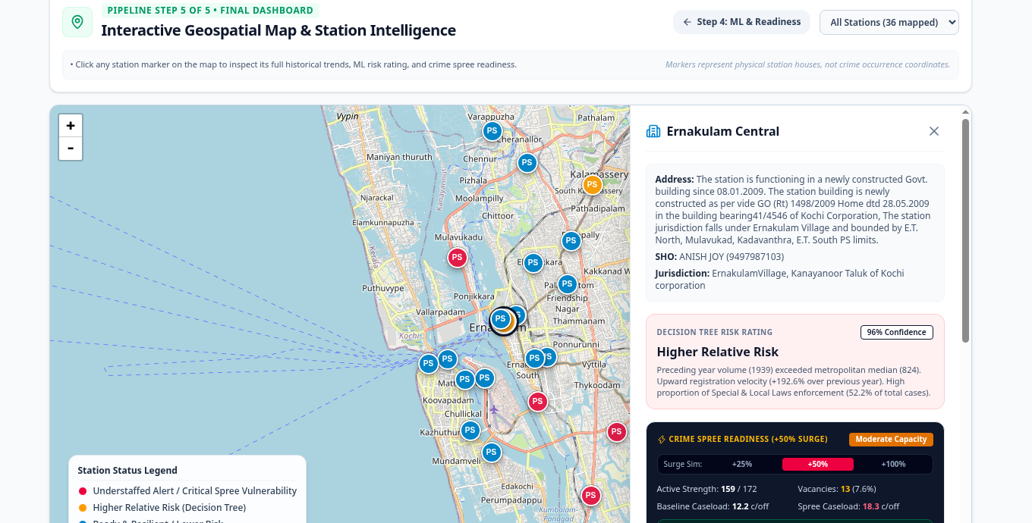
Live Geospatial Interface & Station Cartography
ACTUAL SCREENSHOT FROM WORKING LEAFLET OPENSTREETMAP APPLICATION
Delivered Web Application Features:
• Real OpenStreetMap Cartography: Geocoded markers for all 37 police stations across Kochi.
• Risk Color-Coding: Red pins for Understaffed Alerts, Amber for Moderate, Green for Resilient.
• Interactive Station Drawer: Clicking any marker opens full SHO details, jurisdiction boundaries, and direct phone.
• Real-Time Surge Simulator: Adjust spree surge (+25%, +50%, +100%) and workload threshold live.
• 10-Year Crime Trendline: Historical Recharts visualization of IPC and SLL crime trajectories.
Crime Hotspots Prediction | DATAMI | Dept. of CSE(AI)
14
Notes:
Slide 14 shows an authentic screenshot from our working Leaflet Web application. Officers can click any station pin on the map to open the side intelligence drawer, view historical crime trends, inspect 2026 risk predictions, and dynamically toggle crime spree surge scenarios.

Slide 15
Technology Stack & Justifications
SYSTEM ARCHITECTURE COMPONENTS
Component | Technology Selected | Design Justification
Backend Service | Python 3.12+ & FastAPI | High-throughput asynchronous REST API with automatic OpenAPI documentation.
Data Processing | Pandas & NumPy | Vectorized tabular manipulation and multidimensional OLAP aggregations.
Machine Learning | scikit-learn (CART) | Robust, reproducible implementation of Gini Decision Trees with max depth 3.
Relational Storage | SQLite 3 | Zero-configuration embedded relational warehouse supporting ACID OLAP SQL.
Frontend UI | React 19 & TypeScript | Type-safe reactive state management with instant Vite development server.
Geospatial Map | Leaflet & OpenStreetMap | Lightweight vector cartography with zero third-party API keys or fees.
Crime Hotspots Prediction | DATAMI | Dept. of CSE(AI)
15
Notes:
Slide 15 justifies each technology selected: Python, FastAPI, and SQLite provide a robust, lightweight backend; scikit-learn delivers explainable CART trees; and React with Leaflet powers our responsive geospatial dashboard.

Slide 16
Conclusion & Future Scope
SUMMARY OF ACHIEVEMENTS & FUTURE ROADMAP
Key Project Achievements:
✔ 100% Real Portal Data: 14,262 authentic records across 37 stations with zero synthetic fabrications.
✔ Explainable AI: CART Decision Tree (depth 3) achieves 61.1% accuracy, outperforming Zero-R & Persistence baselines.
✔ Operational Spree Simulation: Models caseload strain under +25% to +100% sprees and proves vacancy mitigation.
✔ Full-Stack Deployment: Interactive OpenStreetMap WebUI with direct CSV data downloads.
Future Scope & Enhancements:
1. Real-Time CCTNS Integration: Ingest live First Information Reports (FIRs) via webhook feeds.
2. Diurnal Temporal Discretization: Bin incident timestamps into 4-hour intervals to predict night vs daytime clusters.
3. Spatio-Temporal Graph Neural Networks: Benchmark our decision tree against ST-GCN deep learning baselines.
Crime Hotspots Prediction | DATAMI | Dept. of CSE(AI)
16
Notes:
In conclusion, DATAMI bridges data mining theory and pragmatic law enforcement operations. We achieved 100% authentic data, explainable decision tree rules, and interactive crime spree simulation. Our future work will explore real-time CCTNS webhook integration and diurnal time binning.

Slide 17
References
ACADEMIC & OFFICIAL SOURCES UTILIZED DURING IMPLEMENTATION
1. Han, J., Kamber, M., & Pei, J. (2011). Data Mining: Concepts and Techniques (3rd ed.). Morgan Kaufmann Publishers.
2. Breiman, L., Friedman, J., Stone, C. J., & Olshen, R. A. (1984). Classification and Regression Trees. Chapman & Hall/CRC.
3. Kerala Police Department. (2024). Police Station Crime Statistics Portal. https://ps.keralapolice.gov.in
4. Kochi City Police Commissionerate. (2024). Crime Overview and Administrative Records. https://kochicity.keralapolice.gov.in
5. National Crime Records Bureau (NCRB). (2022). Crime in India 2022. Ministry of Home Affairs, Government of India.
6. United Nations Department of Economic and Social Affairs. (2015). Sustainable Development Goals (SDG 16, SDG 11, SDG 9).
7. Chainey, S., & Ratcliffe, J. (2005). GIS and Crime Mapping. John Wiley & Sons.
8. Pedregosa, F., et al. (2011). Scikit-learn: Machine Learning in Python. Journal of Machine Learning Research, 12, 2825-2830.
9. Tiarks, E., et al. (2021). Explainable Machine Learning for Predictive Policing: Accountability and Interpretability. AI and Law.
10. OpenStreetMap Contributors. (2024). OpenStreetMap Spatial Data & Tiles. https://www.openstreetmap.org
Crime Hotspots Prediction | DATAMI | Dept. of CSE(AI)
17
Notes:
Here are our academic and official references, covering foundational data mining texts, CART decision trees, state police portals, and peer-reviewed predictive policing literature. Thank you. We are now open for questions and evaluations.

