Slide 1
Michael Chung

Slide 2
Accomplishments So Far:
Familiarized myself with a new software
Watched tutorials on how to make a main menu in Unity
Made a main menu with buttons

Slide 3
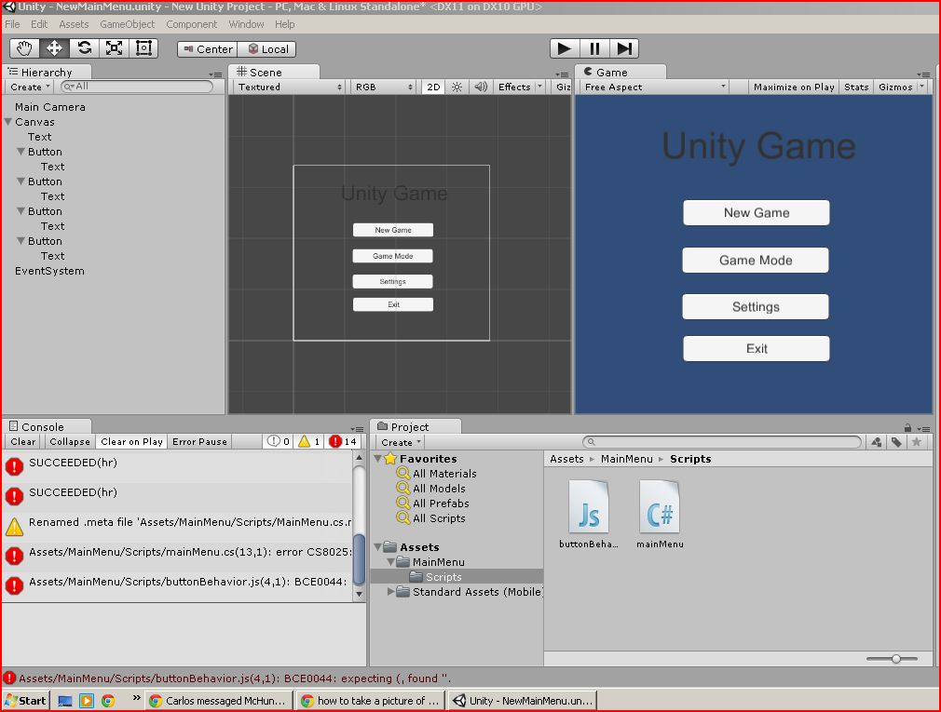

Slide 4
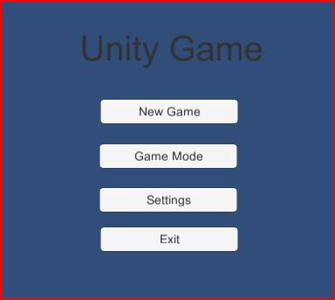

Slide 5
What’s next?
Incorporate menu with the game
Start scripting the buttons
Add backgrounds/texture

