Slide 1
NETS 212: Scalable and Cloud Computing
Cloud basics; Amazon AWS
September 13, 2016

Slide 2
Announcements
HW1MS1 is due on 9/20 at 10:00pm EDT
HW1MS2 code will be released soon
If you're still on the waiting list, please come see me after class one last time

Slide 3
Plan for today
A brief history of cloud computing
Introduce one specific commercial cloud
Amazon Web Services (AWS)
Elastic Compute Cloud (EC2)
Elastic Block Storage (EBS)
Other services: Mechanical Turk, CloudFront, ...
Next time: S3 and SimpleDB / DynamoDB
NEXT

Slide 4
History: The early days
Cloud computing: A new term for a concept that has been around since the 1960s
Who invented it?
No agreement. Some candidates:
John McCarthy (Stanford professor and inventor of Lisp; proposed the 'service bureau' model in 1961)
J.C.R. Licklider (contributed key ideas to ARPANET; published a memo on the "Intergalactic Computer Network" in 1963)
Douglas Parkhill (published a book on "The Challenge of the Computer Utility" in 1966)

Slide 5
History: Becoming a cloud provider
Technology | Cost in medium DC (~1,000 servers) | Cost in large DC (~50,000 servers) | Ratio
Network | $95 per Mbit/sec/month | $13 per Mbit/sec/month | 7.1
Storage | $2.20 per GByte/month | $0.40 per GByte/month | 5.7
Administration | ~140 servers/admin | >1,000 servers/admin | 7.1
Source: James Hamilton's Keynote, LADIS 2008
Early 2000s: Phenomenal growth of web services
Many large Internet companies deploy huge data centers, develop scalable software infrastructure to run them
Due to economies of scale, these companies were now able to run computation very cheaply
What else can we do with this?

Slide 6
History: Incentives
Idea: Use your existing data center to provide cloud services
Why is this a good idea?
Make a lot of money
Price advantage of 3x-7x → Can offer services much cheapter than medium-size company and still make profit
Leverage existing investment
New revenue stream at low incremental cost (example: many Amazon AWS technologies were initially developed for Amazon's internal operations)
Defend a franchise
Example: Microsoft enterprise apps → Microsoft Azure

Slide 7
History: Incentives (continued)
Attack an incumbent
Company with requisite datacenter may want to establish a 'beach head' before a '800 pound gorilla' emerges
Leverage existing customer relationships
IT service organizations like IBM Global Services have extensive customer relationships; provide anxiety-free migration path to existing customers
Become a platform
Example: Facebook's initiative to enable plug-in applications is a great fit for cloud computing

Slide 8
History: The pioneers
Jul 2002: Amazon Web Services launched
Third-party sites can search and display products from Amazon's web site, add items to Amazon shopping carts
Available through XML and SOAP
Mar 2006: Amazon S3 launched
Innovative 'pay-per-use' pricing model, which is now the standard in cloud computing
Cheaper than many small/medium storage solutions: $0.15/GB/month of storage, $0.20/GB/month for traffic
Amazon no longer a pure retailer, entering technology space
Aug 2006: EC2 launched
Core computing infrastructure becomes available

Slide 9
History: Wide-spread adoption
Apr 2008: Google App Engine launched
Same building blocks Google uses for its own applications: Bigtable and GFS for storage, automatic scaling and load balancing, ...
Nov 2009: Windows Azure Beta launched
Becomes generally available in 21 countries in Feb 2010
Microsoft’s online services are gradually transitioned to Azure
Dec 2013: Google Compute Engine launches
Provides lower level support vs. App Engine; full set of services
Dramatically lower prices, quickly matched by AWS and Azure

Slide 10

Plan for today
A brief history of cloud computing
Introduce one specific commercial cloud
Amazon Web Services (AWS)
Elastic Compute Cloud (EC2)
Elastic Block Storage (EBS)
Other services: Mechanical Turk, CloudFront, ...
Next time: S3 and SimpleDB / DynamoDB
NEXT

Slide 11
Why Amazon AWS and not ?
Insert your favorite cloud here
Amazon is only one of several cloud providers
Others include Microsoft Azure, Google Cloud Engine / App Engine, …
But there is no common standard (yet)
Initially, MS and Google supported PaaS (.NET and Java, resp.)
Gradually each has grown to support both IaaS and PaaS
AWS is PaaS/IaaS with a broad menu of choices
So we had to pick one specific provider
Amazon AWS is going to be used for the rest of this class
Full disclosure: Amazon's only involvement is providing free AWS access for this class (through AWS Educate)
Everything we do on AWS has an equivalent on Azure, GCE/GAE

Slide 12
What is Amazon AWS?
Amazon Web Services (AWS) provides a number of different services, including:
Amazon Elastic Compute Cloud (EC2) Virtual machines for running custom software
Amazon Simple Storage Service (S3) Simple key-value store, accessible as a web service
Amazon DynamoDB Distributed NoSQL database, one of several in AWS
Amazon Elastic MapReduce Scalable MapReduce computation
Amazon Mechanical Turk (MTurk) A 'marketplace for work'
Amazon SimpleDB Simple NoSQL database
...
Used for the projects

Slide 13
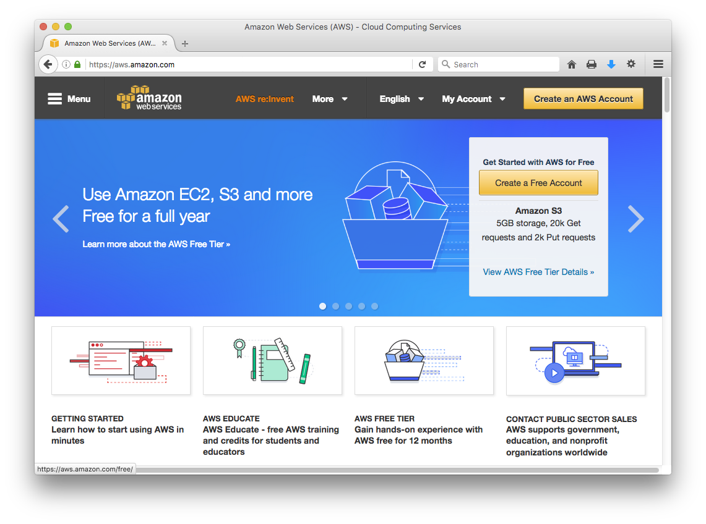
Setting up an AWS account
aws.amazon.com
Sign up for an account on aws.amazon.com
You need to choose an username and a password
These are for the management interface only
Your programs will use other credentials (RSA keypairs, access keys, ...) to interact with AWS

Slide 14
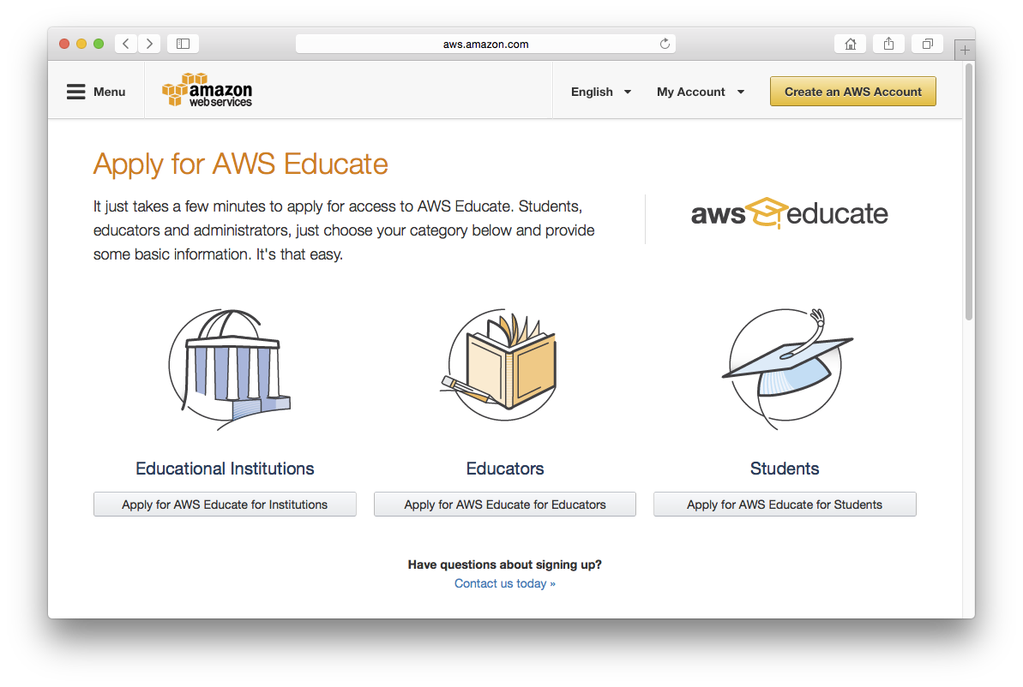
Signing up for AWS Educate
Complete the web form on www.awseducate.com
Assumes you already have an AWS account
Use your Penn email address!
Amazon says it should only take 2-5 minutes (but don’t rely on this!!)
This should give you $100/year in AWS credits

Slide 15
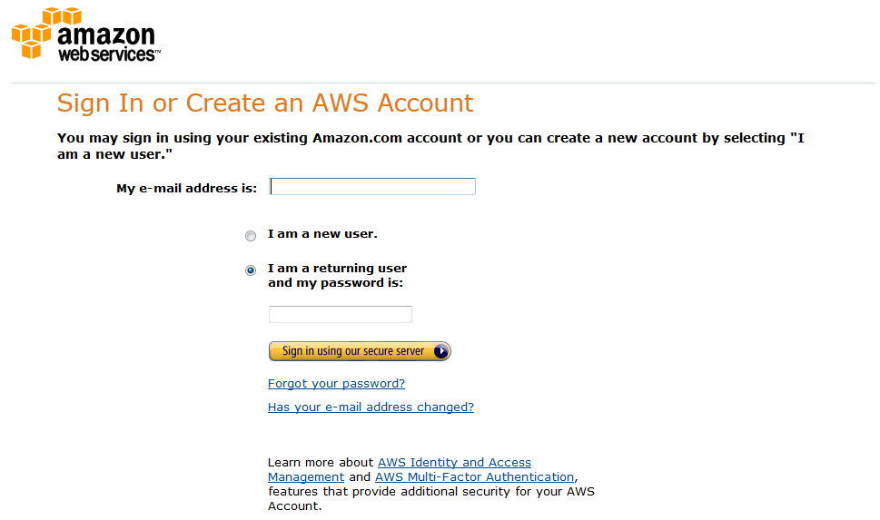
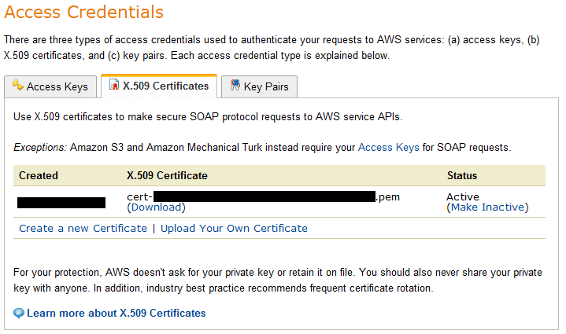
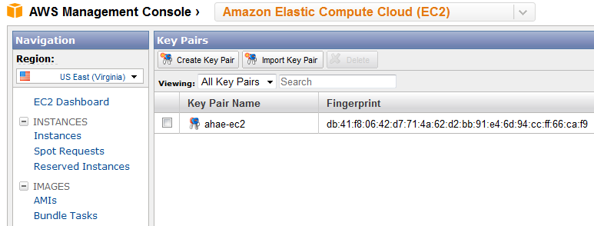
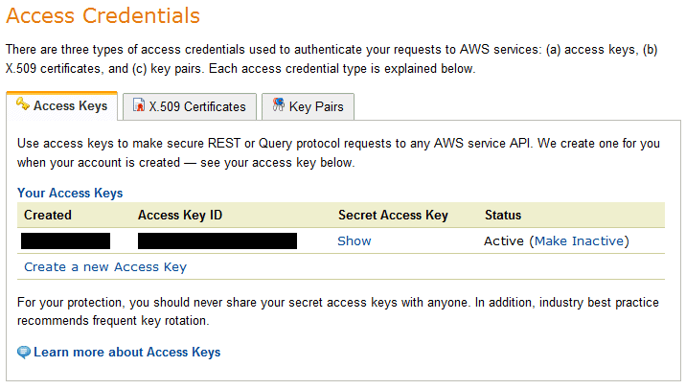
AWS credentials
Command-line tools SOAP APIs
AWS web site and management console
Sign-in credentials
X.509 certificates
Connecting to an instance (e.g., via ssh)
EC2 key pairs
Access keys
REST APIs
Why so many different types of credentials?

Slide 16
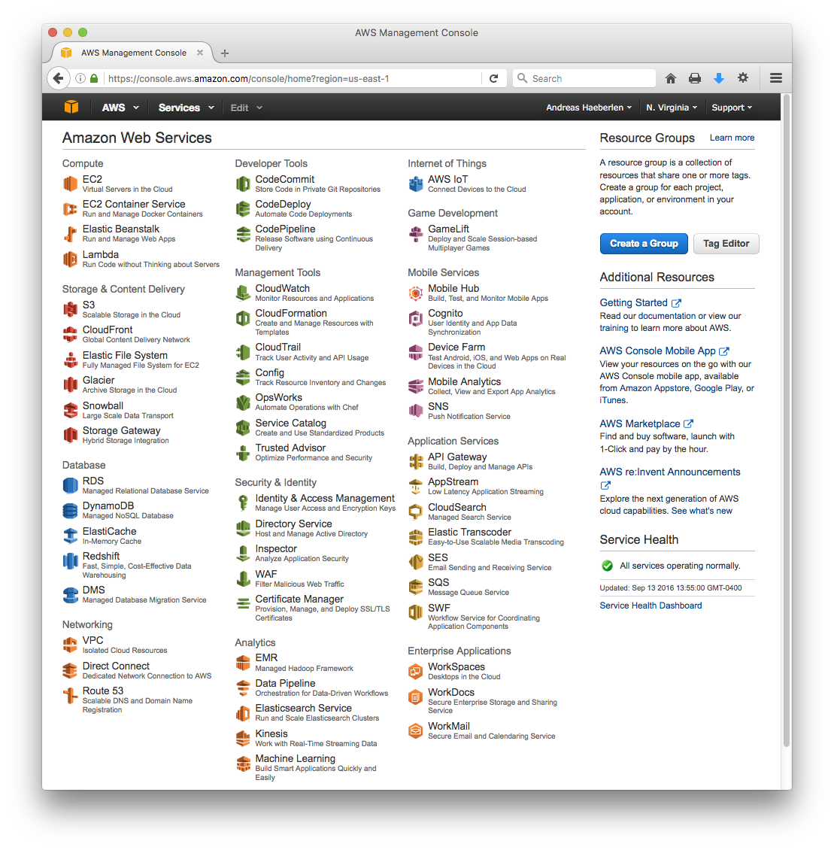
The AWS management console
Used to control many AWS services:
For example, start/stop EC2 instances, create S3 buckets...

Slide 17
REST and SOAP
How do your programs access AWS?
Example: Launch an EC2 instance, store a value in S3, …
Via the REST protocols
Representational State Transfer (REST)
Request submitted via HTTP (GET or POST); any parameters are encoded in the URL or included in the body
Reponse is an XML data structure, also received via HTTP
Earlier: Simple Object Access protocol (SOAP)
Not as simple as the name suggests
XML-based, extensible, general, standardized, but also somewhat heavyweight and verbose
Supported until December 2014

Slide 18
REST example
Invoked method
Response elements
https://sdb.amazonaws.com/?Action=PutAttributes
&DomainName=MyDomain
&ItemName=Item123
&Attribute.1.Name=Color&Attribute.1.Value=Blue
&Attribute.2.Name=Size&Attribute.2.Value=Med
&Attribute.3.Name=Price&Attribute.3.Value=0014.99
&AWSAccessKeyId=<valid_access_key>
&Version=2009-04-15
&Signature=[valid signature]
&SignatureVersion=2
&SignatureMethod=HmacSHA256
&Timestamp=2010-01-25T15%3A01%3A28-07%3A00
<PutAttributesResponse>
<ResponseMetadata>
<StatusCode>Success</StatusCode>
<RequestId>f6820318-9658-4a9d-89f8-b067c90904fc</RequestId>
<BoxUsage>0.0000219907</BoxUsage>
</ResponseMetadata>
</PutAttributesResponse>
Parameters
Credentials
Sample request
Sample response
Source: http://awsdocs.s3.amazonaws.com/SDB/latest/sdb-dg.pdf

Slide 19
For comparison: SOAP
<?xml version='1.0' encoding='UTF-8'?>
<SOAP-ENV:Envelope
xmlns:SOAP-ENV='http://schemas.xmlsoap.org/soap/envelope/'
xmlns:SOAP-ENC='http://schemas.xmlsoap.org/soap/encoding/'
xmlns:xsi='http://www.w3.org/2001/XMLSchema-instance'
xmlns:xsd='http://www.w3.org/2001/XMLSchema'>
<SOAP-ENV:Body>
<PutAttributesRequest xmlns='http://sdb.amazonaws.com/doc/ 2009-04-15'>
<Attribute><Name>a1</Name><Value>2</Value></Attribute>
<Attribute><Name>a2</Name><Value>4</Value></Attribute>
<DomainName>domain1</DomainName>
<ItemName>eID001</ItemName>
<Version>2009-04-15</Version>
</PutAttributesRequest>
</SOAP-ENV:Body>
</SOAP-ENV:Envelope>
<?xml version="1.0"?>
<SOAP-ENV:Envelope xmlns:SOAP-ENV="http://schemas.xmlsoap.org/soap/envelope/">
<SOAP-ENV:Body>
<PutAttributesResponse>
<ResponseMetadata>
<RequestId>4c68e051-fe45-43b2-992a-a24017ffe7ab</RequestId>
<BoxUsage>0.0000219907</BoxUsage>
</ResponseMetadata>
</PutAttributesResponse>
</SOAP-ENV:Body>
</SOAP-ENV:Envelope>
Sample request
Sample response
Source: http://awsdocs.s3.amazonaws.com/SDB/latest/sdb-dg.pdf

Slide 20
Plan for today
A brief history of cloud computing
Introduce one specific commercial cloud
Amazon Web Services (AWS)
Elastic Compute Cloud (EC2)
Elastic Block Storage (EBS)
Other services: Mechanical Turk, CloudFront, ...
Next time: S3 and SimpleDB / DynamoDB
NEXT

Slide 21
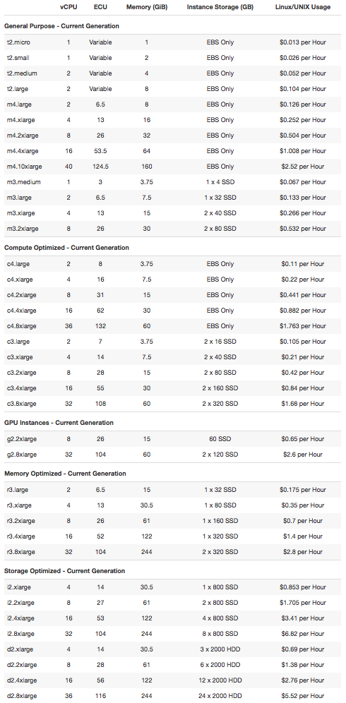
What is Amazon EC2?
0.5 GB memory 1 virtual core (ECU variable) Storage: EBS only
http://aws.amazon.com/ec2/#pricing (9/10//2015)
Infrastructure-as-a-Service (IaaS)
You can rent various types of virtual machines by the hour
In your VMs, you can run your own (Linux/Windows) programs
Examples: Web server, search engine, movie renderer, ...
244 GB memory 36 virtual cores (116 ECU) 24x2TB HDD

Slide 22
Demo
Logging into AWS Management Console
Launching an instance
Contacting the instance via ssh
Terminating an instance
Have a look at the AWS Getting Started guide:
http://www.cis.upenn.edu/~nets212/handouts/aws-getting-started.pdf

Slide 23

Oh no - where has my data gone?
Not all EC2 instances have persistent storage
Data survives stops & reboots, but not termination
So where should I put persistent data?
Elastic Block Store (EBS) - in a few slides
Ideally, use an AMI with an EBS root (Amzon's default AMI has this property)
Caution: Default behavior is to delete the EBS upon termination of the instance
If you store data on the virtual hard disk of your instance and the instance fails or you terminate it, your data WILL be lost!

Slide 24
Amazon Machine Images
When I launch an instance, what software will be installed on it?
Software is taken from an Amazon Machine Image (AMI)
Selected when you launch an instance
Essentially a file system that contains the operating system, applications, and potentially other data
Lives in S3
How do I get an AMI?
Amazon provides several generic ones, e.g., Amazon Linux, Fedora Core, Windows Server, ...
You can make your own
You can even run your own custom kernel (with some restrictions)

Slide 25



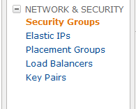
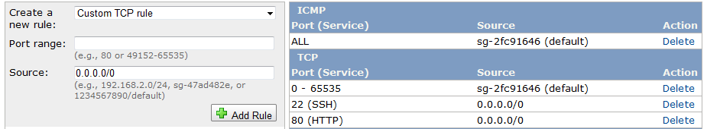
Security Groups
Evil attacker
Legitimate user (you or your customers)
Instance
Basically, a set of firewall rules
Can be applied to groups of EC2 instances
Each rule specifies a protocol, port numbers, etc...
Only traffic matching one of the rules is allowed through
Sometimes need to explicitly open ports

Slide 26
Regions and Availability Zones
Where exactly does my instance run?
No easy way to find out - Amazon does not say
Instances can be assigned to regions
Currently 12 availble: US East (Northern Virginia), US West (Northern California), US West (Oregon), EU (Ireland), EU (Frankfurt), Asia/Pacific (Seoul), Asia/Pacific (Singapore), Asia/Pacific (Sydney), Asia/Pacific (Tokyo), Asia/Pacific (Mumbai), South America (Sao Paulo), AWS GovCloud
Important, e.g., for reducing latency to customers
Instances can be assigned to availability zones
Purpose: Avoid correlated fault
Several availability zones within each region

Slide 27
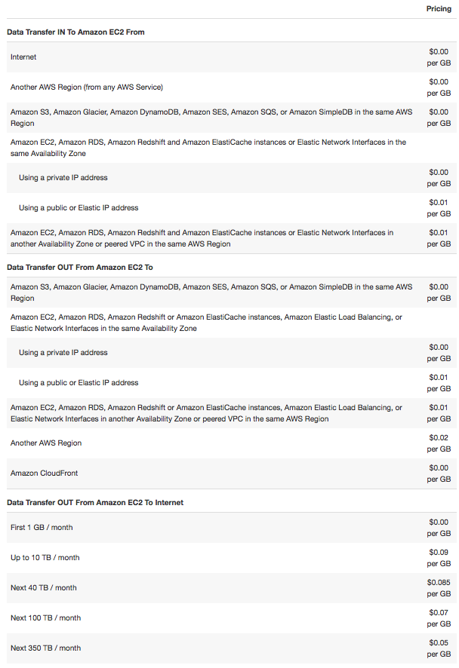
Network pricing
http://aws.amazon.com/ec2/#pricing (9/10/2015)
AWS does charge for network traffic
Price depends on source and destination of traffic
Free within EC2 and other AWS services in the same region (e.g., S3)
Remember: ISPs are typically charged for upstream traffic

Slide 28
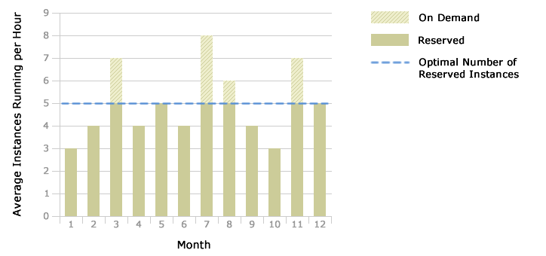
Instance types
Source: http://aws.amazon.com/ ec2/reserved-instances/
So far: On-demand instances
Also available: Reserved instances
One-time reservation fee to purchase for 1 or 3 years
Usage still billed by the hour, but at a considerable discount
Also available: Spot instances
Spot market: Can bid for available capacity
Instance continues until terminated or price rises above bid

Slide 29
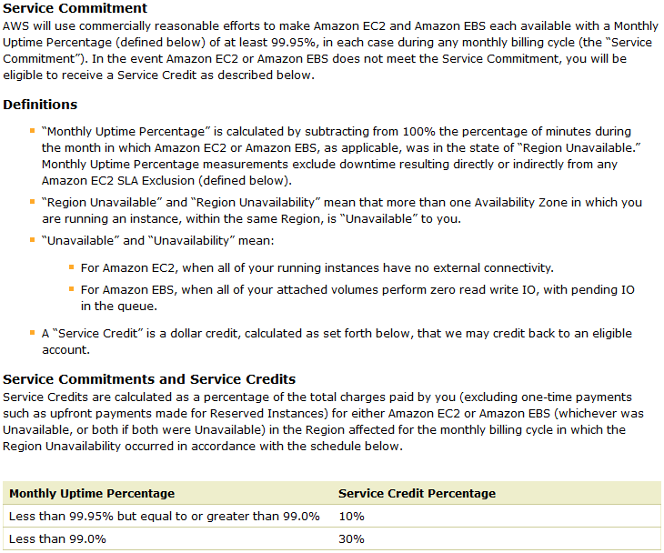
Service Level Agreement
4.38h downtime per year allowed
http://aws.amazon.com/ec2-sla/ (9/11/2013; excerpt)

Slide 30
Recap: EC2
What EC2 is:
IaaS service - you can rent virtual machines
Various types: Very small to very powerful
How to use EC2:
Ephemeral state - local data is lost when instance terminates
AMIs - used to initialize an instance (OS, applications, ...)
Security groups - "firewalls" for your instances
Regions and availability zones
On-demand/reserved/spot instances
Service level agreement (SLA)

Slide 31
Plan for today
A brief history of cloud computing
Introduce one specific commercial cloud
Amazon Web Services (AWS)
Elastic Compute Cloud (EC2)
Elastic Block Storage (EBS)
Other services: Mechanical Turk, CloudFront, ...
Next time: S3 and SimpleDB / DynamoDB
NEXT

Slide 32
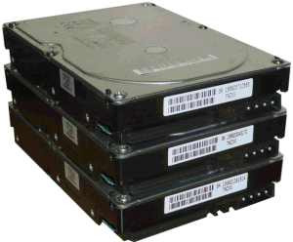
What is Elastic Block Store (EBS)?
Instance
EBS storage
Persistent storage
Unlike the local instance store, data stored in EBS is not lost when an instance fails or is terminated
Should I use the instance store or EBS?
Typically, instance store is used for temporary data

Slide 33
Volumes
EBS storage is allocated in volumes
A volume is a 'virtual disk' (size: 1GB - 1TB)
Basically, a raw block device
Can be attached to an instance (but only one at a time)
A single instance can access multiple volumes
Placed in specific availability zones
Why is this useful?
Be sure to place it near instances (otherwise can't attach)
Replicated across multiple servers
Data is not lost if a single server fails
Amazon: Annual failure rate is 0.1-0.2%

Slide 34
EC2 instances with EBS roots
EC2 instances can have an EBS volume as their root device ("EBS boot")
Result: Instance data persists independently from the lifetime of the instance
You can stop and restart the instance, similar to suspending and resuming a laptop
You won't be charged for the instance while it is stopped (only for EBS)
You can enable termination protection for the instance
Blocks attempts to terminate the instance (e.g., by accident) until termination protection is disabled again
Alternative: Use instance store as the root
You can still store temporary data on it, but it will disappear when you terminate the instance
You can still create and mount EBS volumes explicitly

Slide 35
Snapshots
Time
You can create a snapshot of a volume
Copy of data in the volume at the time snapshot was made
Only the first snapshot makes a full copy; subsequent snapshots are incremental
What are snapshots good for?
Sharing data with others
DBpedia snapshot ID is "snap-882a8ae3"
Access control list (specific account numbers) or public access
Instantiate new volumes
Point-in-time backups

Slide 36
Pricing
You pay for...
Storage space (SSD): $0.10 per allocated GB per month
Storage space (disk): $0.045 per allocated GB per month
Provisioned IOPS are charged extra
Charge is only for actual storage used
Empty space does not count

Slide 37
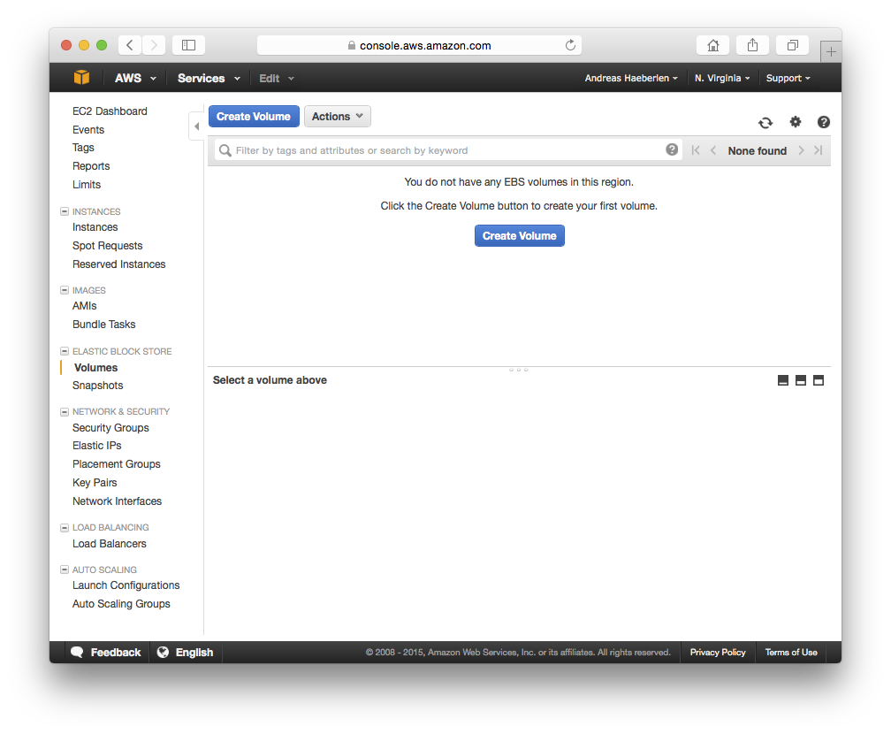
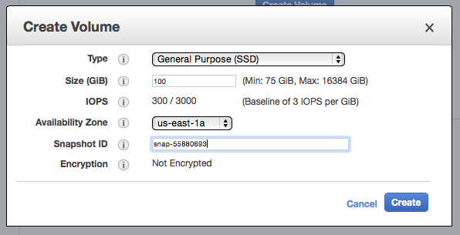
Creating an EBS volume
Create volume
Needs to be in same availability zone as your instance!
DBpedia snapshot ID

Slide 38
Mounting an EBS volume
Step 1: Attach the volume
Step 2: Mount the volume in the instance
nets212@vm:~$ ec2-attach-volume -d /dev/sda2 -i i-9bd6eef1 vol-cca68ea5
ATTACHMENT vol-cca68ea5 i-9bd6eef1 /dev/sda2 attaching
nets212@vm:~$
nets212@vm:~$ ssh ec2-user@ec2-50-17-64-130.compute-1.amazonaws.com
__| __|_ ) Amazon Linux AMI
_| ( / Beta
___|\___|___|
See /usr/share/doc/system-release-2011.02 for latest release notes. :-)
[ec2-user@ip-10-196-82-65 ~]$ sudo mount /dev/sda2 /mnt/
[ec2-user@ip-10-196-82-65 ~]$ ls /mnt/
dbpedia_3.5.1.owl dbpedia_3.5.1.owl.bz2 en other_languages
[ec2-user@ip-10-196-82-65 ~]$

Slide 39
Detaching an EBS volume
Step 1: Unmount the volume in the instance
Step 2: Detach the volume
[ec2-user@ip-10-196-82-65 ~]$ sudo umount /mnt/
[ec2-user@ip-10-196-82-65 ~]$ exit
nets212@vm:~$
nets212@vm:~$ ec2-detach-volume vol-cca68ea5
ATTACHMENT vol-cca68ea5 i-9bd6eef1 /dev/sda2 detaching
nets212@vm:~$

Slide 40
Recap: Elastic Block Store (EBS)
What EBS is:
Basically a virtual hard disk; can be attached to EC2 instances
Persistent - state survives termination of EC2 instance
How to use EBS:
Allocate volume - empty or initialized with a snapshot
Attach it to EC2 instance and mount it there
Can create snapshots for data sharing, backup

Slide 41
Plan for today
A brief history of cloud computing
Introduce one specific commercial cloud
Amazon Web Services (AWS)
Elastic Compute Cloud (EC2)
Elastic Block Storage (EBS)
Other services: Mechanical Turk, CloudFront, ...
Next time: S3 and SimpleDB / DynamoDB
NEXT

Slide 42
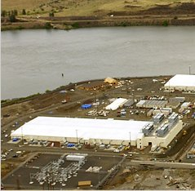


AWS Import/Export
Method | Time
Internet (20Mbps) | 45 days
FedEx | 1 day
Time to transfer 10TB [AF10]
Import/export large amounts of data to/from S3 buckets via physical storage device
Mail an actual hard disk to Amazon (power adapter, cables!)
Signature file for authentication
Discussion: Is this the Right Way to be shipping data, or should we rather be using a network?

Slide 43
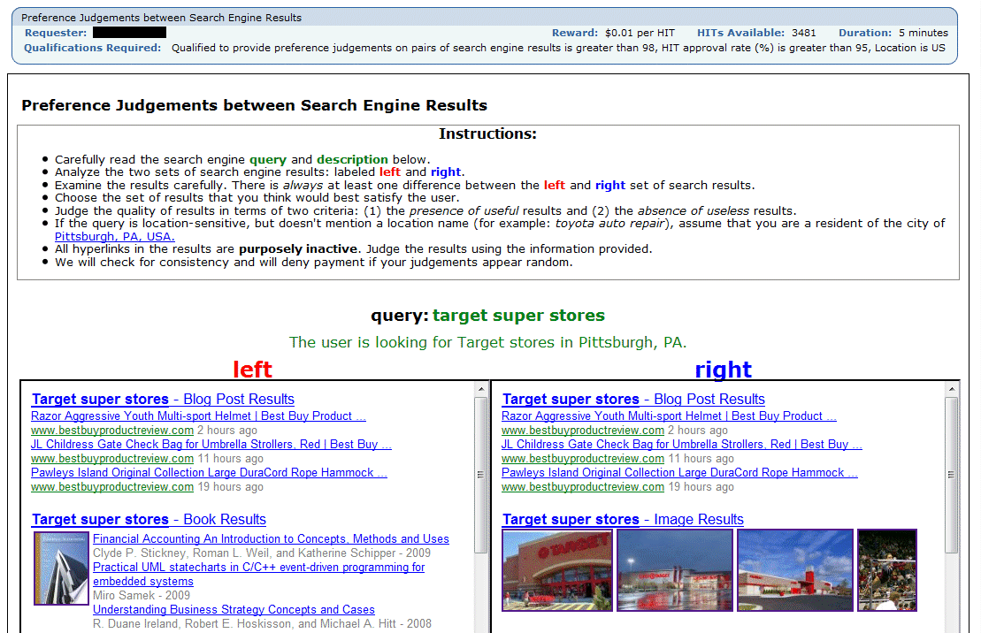
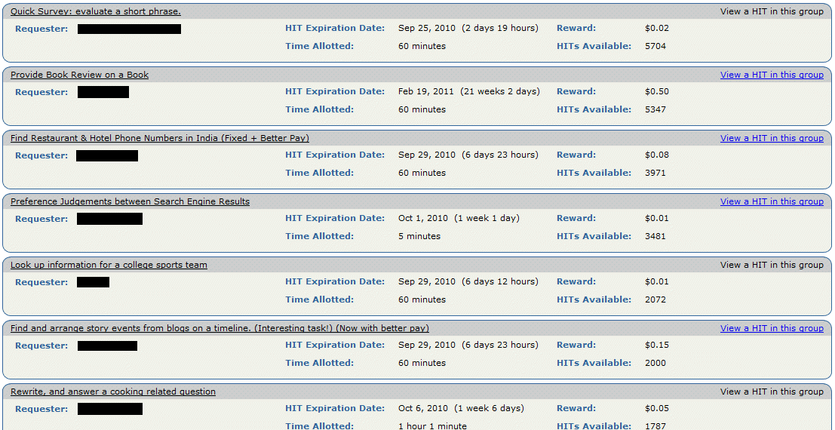
Mechanical Turk (MTurk)
https://www.mturk.com/mturk/ (9/23/2010 1:58am)
A crowdsourcing marketplace
Requesters post small jobs (HIT - Human Intelligence Task), offer small rewards ($0.01-$0.10)

Slide 44

CloudFront
Content distribution network
Caches S3 content at edge locations for low-latency delivery
Some similarities to other CDNs like Akamai, Limelight, ...

Slide 45
Plan for today
A brief history of cloud computing
Introduce one specific commercial cloud
Amazon Web Services (AWS)
Elastic Compute Cloud (EC2)
Elastic Block Storage (EBS)
Other services: Mechanical Turk, CloudFront, ...
Next time: S3 and SimpleDB / DynamoDB
NEXT

Slide 46

Stay tuned
Next time you will learn about: Cloud storage

