Slide 1
3D Object Detection with LiDAR
Batch No: 02
22071A6683 G.Dharaneesh
22071A6688 J.V.S Chandraditya
22071A66C1 Siddharth Verma
22071A66D3 Anurag Sahu
K. Kishan Babu
Assistant Professor
Dept. of CSE(AIML & IoT)

Slide 2
Abstract
In recent times there has been an advancement in technologies such as autonomous vehicles, robotics and etc, where the need to perceive the environment becomes of paramount importance. The typical 2D vision models fail to provide the depth and spatial awareness needed for such applications. As a result there has been a rise in the usage of LiDAR data to get a 3D view of the scene.
In this project we implement a LiDAR based 3D object detection system using opensource tools. we used the KITTI dataset which comprises of labelled LiDAR point cloud data. we chose to implement a point pillar model for the computational efficiency it offers making it feasible to deploy in real-time scenarios. The pipeline consists of extracting the point clouds and reconstructing them into 2D pseudo images followed by convolution operations to extract features and real time inference to detect objects and classify them.

Slide 3
Introduction
Purpose: Build a robust, lightweight, real-time object detection system from 3D LiDAR data.
Existing Methods: Point-based, voxel-based, BEV, and fusion methods—all with tradeoffs in accuracy, speed, and complexity.
Proposed Approach: Efficient PointPillars model converting 3D data to 2D pseudo-images for quick CNN processing.
The model supports deployment on edge devices and handles varied environments effectively.

Slide 4
Tools & Technologies Used
Programming & Frameworks: Python, PyTorch, TensorFlow, Keras, OpenCV
Development Platforms: Google Colab for model training; Roboflow for dataset annotation and augmentation
Hardware:
LiDAR: Intel RealSense L515
Supporting Tools: CUDA (for GPU acceleration), PyRealSense (for sensor access), NumPy (for numerical ops), OpenCV(for sensor control)

Slide 5
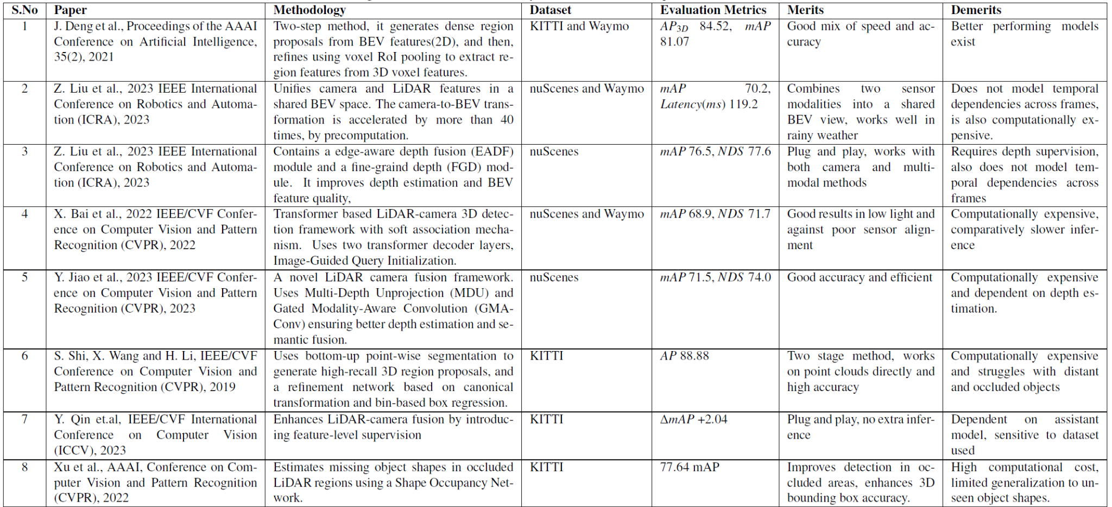
Literature Survey

Slide 6
Summary of Literature Survey
No single method performs best across all datasets (KITTI, Waymo, nuScenes).
Fusion methods (BEVFusion, MSMDFusion) are more resilient in weather-affected or occluded environments.
PointPillars chosen for its balance between speed, simplicity, and real-time capabilities without heavy computational cost.
Key insights: Domain adaptation, sensor fusion, and efficient feature extraction are essential for reliable 3D detection.

Slide 7
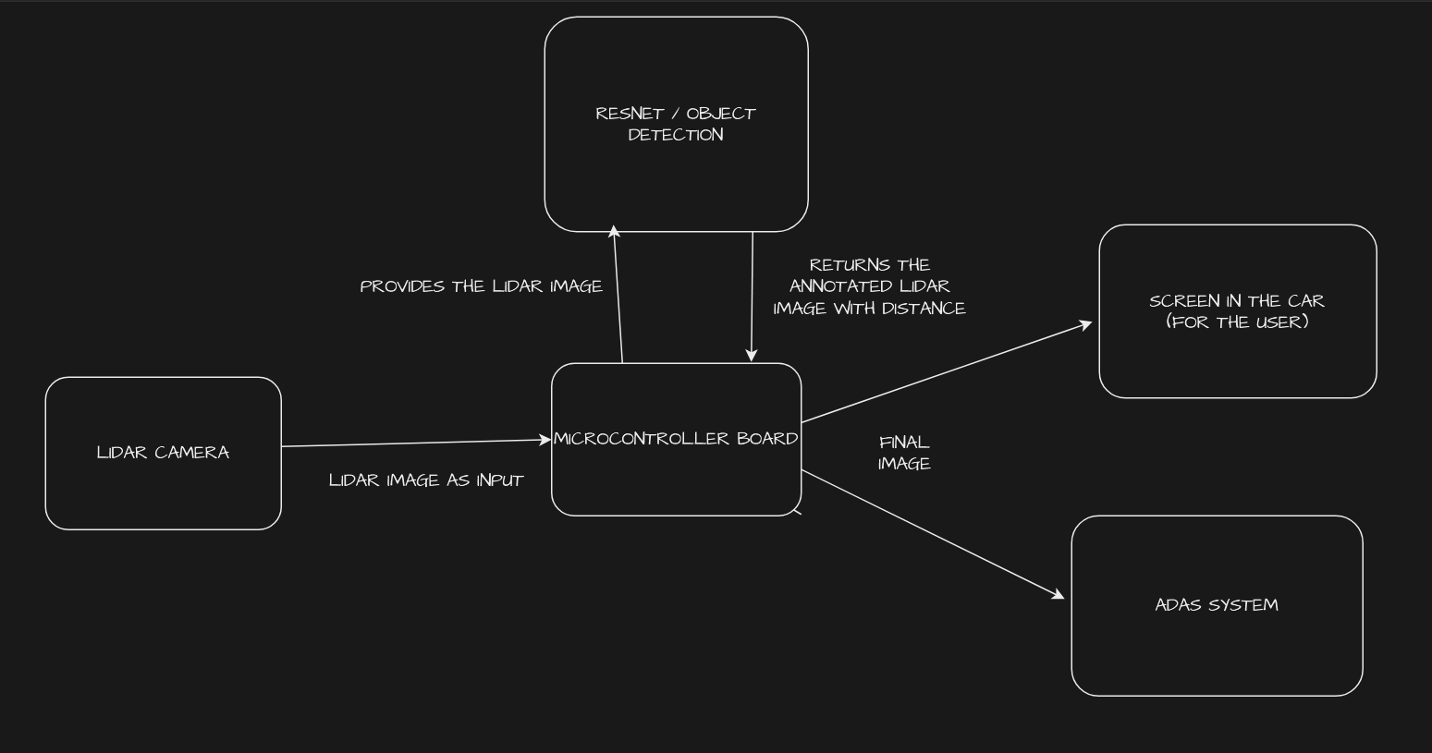
Design
System Architecture

Slide 8
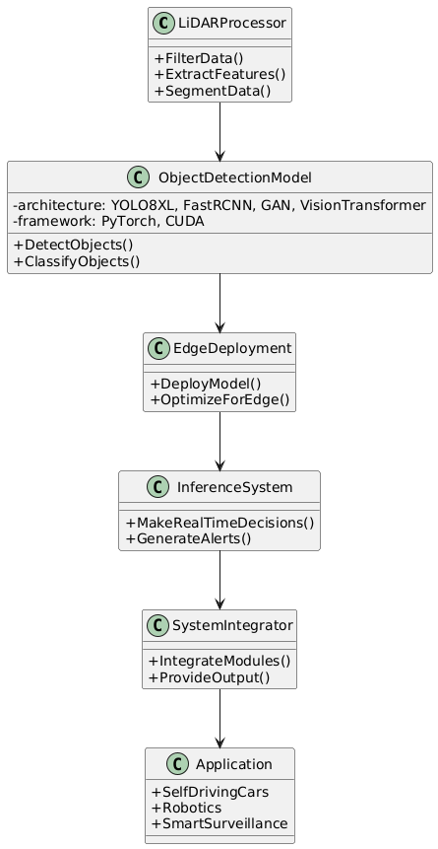
Design
Class Diagram

Slide 9
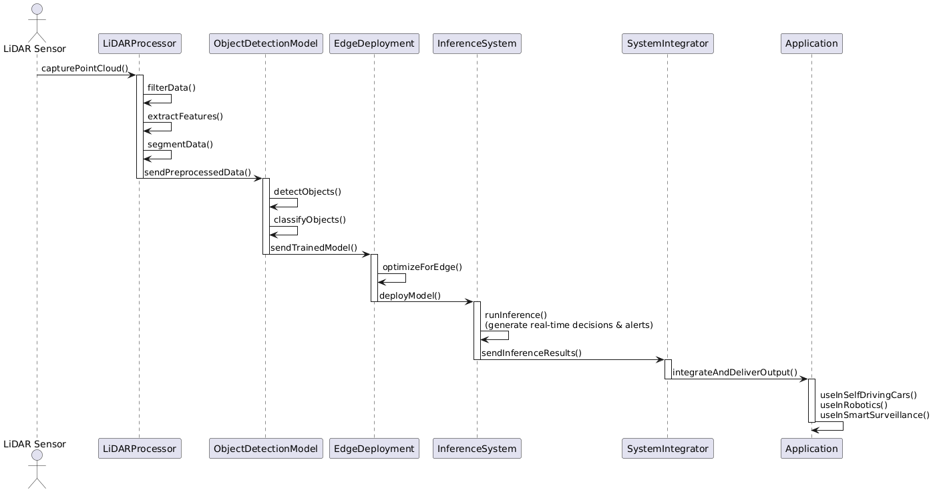
Design
Sequence Diagram

Slide 10
Methodology
Data: Datasets like KITTI and Waymo with annotated 3D point clouds.
Preprocessing: Pillarization, BEV transformation, denoising, outlier removal.
Model Training: Used OpenPCDet with pretrained weights finetuned with KITTI dataset
Testing: Evaluated using metrics like IoU and mAP.
Integration: Real-time pipeline setup using rs-capture API for L515 LiDAR.
Postprocessing: NMS, confidence thresholding, label mapping.
User Interaction: Output visualized on a display screen, assisting users in low-visibility navigation.

Slide 11
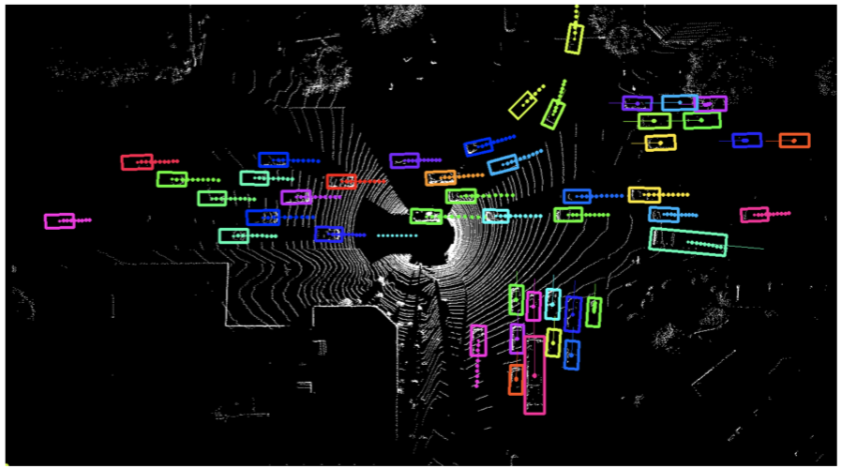
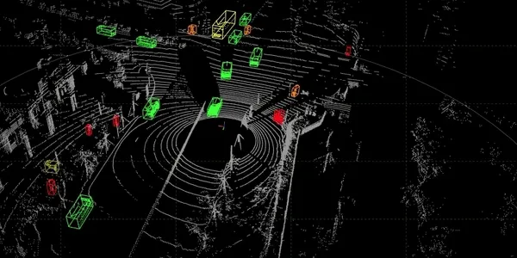
Results

Slide 12
Conclusion & Future Work
Conclusion:
  Successfully built and tested a real-time 3D object detector using PointPillars and LiDAR data.
  Deployed system demonstrates strong performance in practical scenarios.
Future Work:
  Enhance uncertainty estimation and model generalization.
  Test in extreme environments (rain, fog, low light).
  Add temporal data to detect movement and improve predictions.
  Use transfer learning for better performance in low-data domains.

Slide 13
THANK YOU

