Slide 1

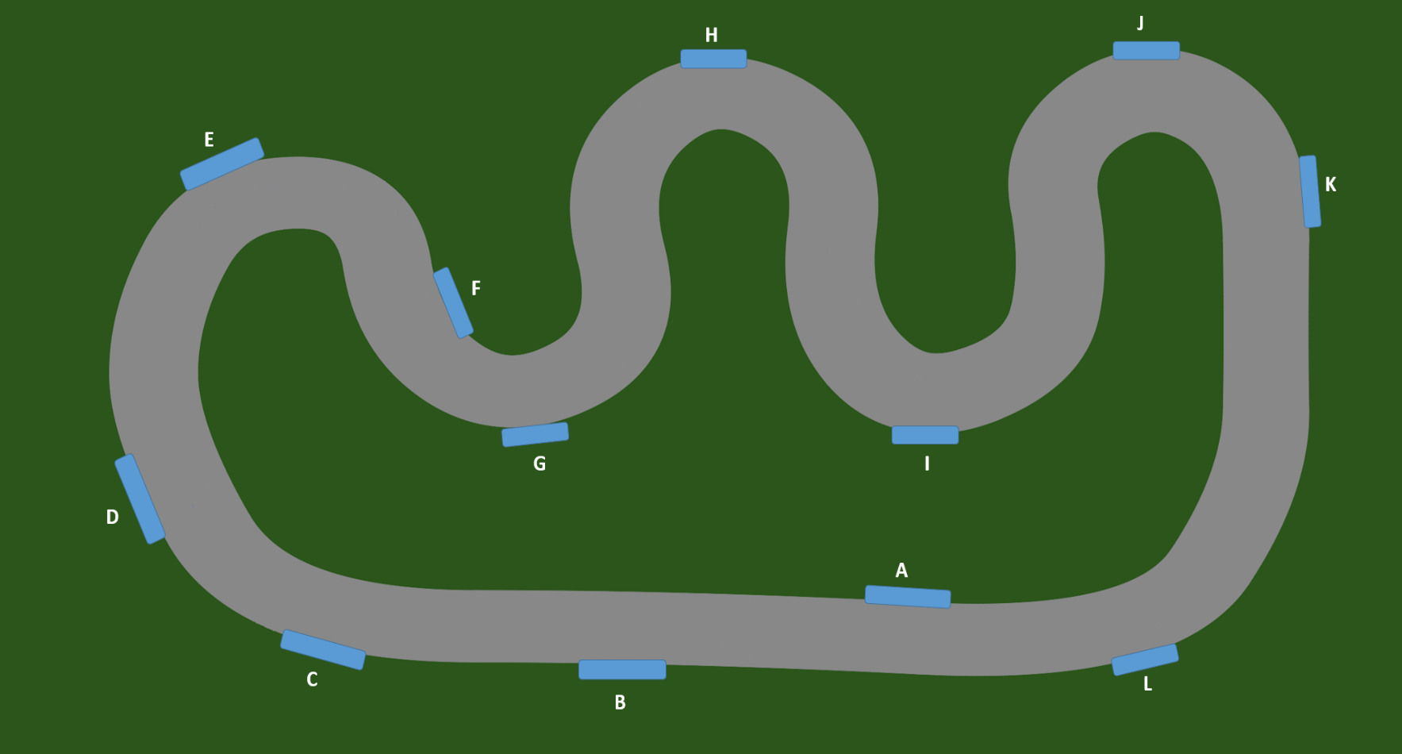
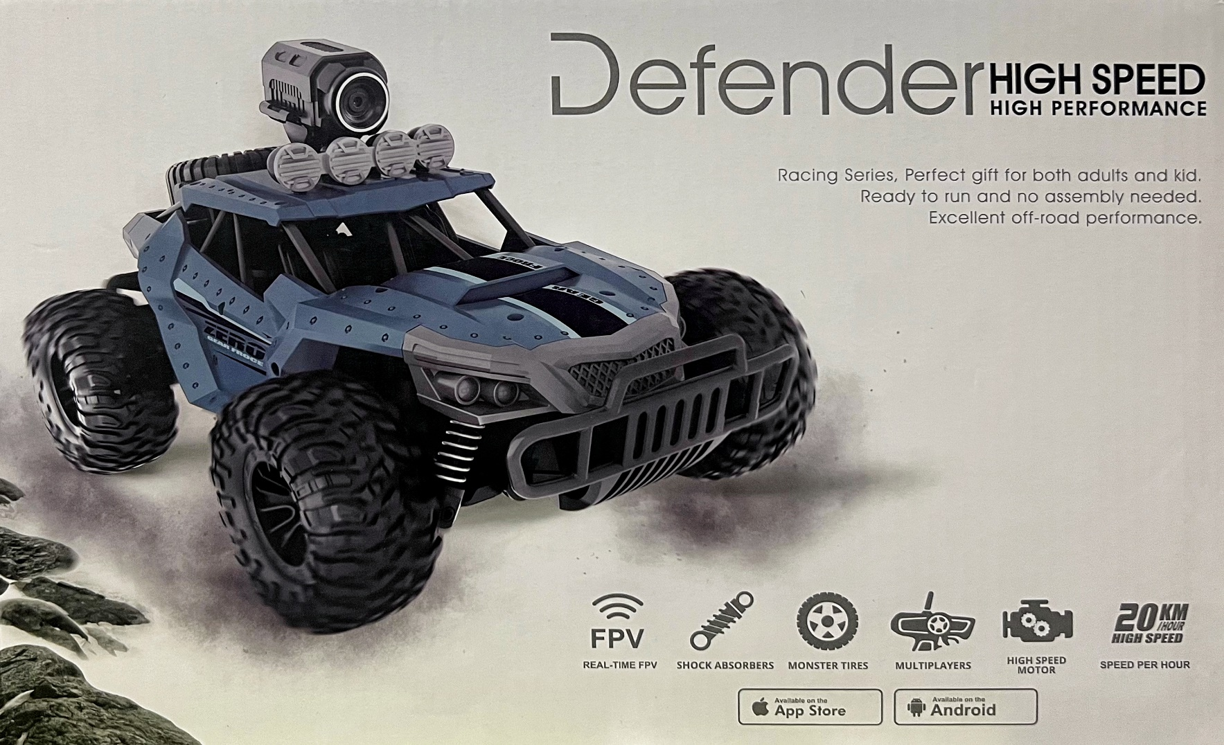

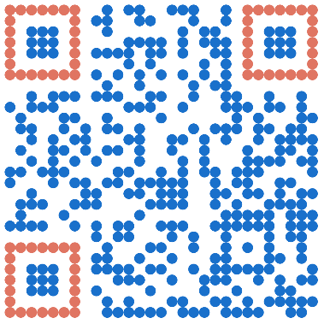

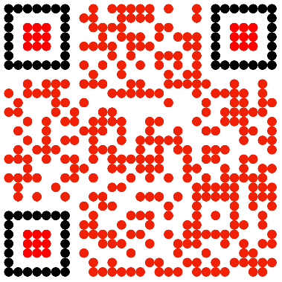
Telemetry: Case study on operating vehicle remotely
Pavan Kumar Jonnadula, Vamsi Alapaty, Harish Jaladi, Naveen Krishnam, Ramya Deshetti,
Shajahan Mohammad, Raju Thada, Sarath Boddu
Advisor: Dr. Sejun Song, University of Missouri – Kansas City
MOTIVATION
In recent years, the automotive industry has witnessed a surge in the popularity of automated cars. There is a growing interest among individuals to incorporate electrified and automated vehicles into their daily routines. One of the primary motivations behind this trend is the potential reduction in the manual effort required to operate a vehicle. Consequently, this reduction in manual control holds the promise of minimizing accidents caused by human errors. To substantiate these claims, a comprehensive case study was conducted to assess the reliability of remote vehicle operation.
MOTIVATION:
DESCRIPTION
WORKING OF Telemetry
A case study was undertaken to examine the remote operation of a toy vehicle on a custom-designed race track.
Two distinct driving modes were evaluated:
One utilizing the remote control included with the vehicle,
The other employing a mobile application that allowed users to drive the vehicle by viewing a live video feed transmitted from a camera mounted on the vehicle, providing a first-person perspective.
A team of eight members was assembled to validate the driving accuracy in both modes. The accuracy assessment involved calculating the number of obstacles hit during vehicle operation.
In the first mode, where the vehicle is driven using the remote control with a 2.4GHz frequency signal, users benefited from a third-person view of the vehicle. This perspective enabled them to easily avoid obstacles, resulting in higher driving accuracy.
In the second mode, the vehicle was operated using the "Heliway Racing" mobile application. Users drove the vehicle by relying on the high-definition video transmitted from the camera mounted on top of the vehicle. Prior to the driving phase, users were familiarized with the track to minimize errors. It should be noted that most users were not accustomed to driving remote-controlled vehicles.
The participants then proceeded to drive the vehicle in both modes, and relevant metrics were recorded for analysis and evaluation.
MODES OF DRIVING
Mode One:
In this mode, users operate the vehicle using the provided remote control.
The remote control and the vehicle communicate via radio signals, utilizing a frequency of 2.4GHz.
Mode Two:
In this mode, users operate the vehicle without direct visual contact.
Instead, they rely solely on the live video feed transmitted from a camera positioned atop the vehicle.
To control the vehicle, users utilize the Heliway Racing mobile application, which is available for download from the app store.
Future Works
One limitation of both driving modes is the difficulty in controlling the vehicle's speed, resulting in reduced control and performance during operation. To overcome this, future vehicles should incorporate improved speed control mechanisms, enabling users to have finer adjustments and better handling capabilities for enhanced control.
Another limitation is the absence of obstacle avoidance systems, which affects driving performance and safety. To address this, vehicles should be equipped with technologies like sonar sensors, LIDARs, and image processing units to detect and avoid obstacles in real-time.
Hardware Requirements
Track details:
Length: 42 feet
Loops: 5
Width: 1.5 feet
Obstacles: 12
Car details:
Name: Defender High Speed
Top speed: 20kmph / 12.5 mph
Length: 1 feet
Width: 0.8 feet
Control: Remote and Mobile operation
CONCLUSION
Based on the findings of the case study, it was observed that users exhibited greater comfort and ease when driving the vehicles using the remote mode compared to the first-person view mode.
This preference for the remote mode contributed to a reduction in manual effort required during vehicle operation.
Consequently, this reduction in manual effort contributed to a decrease in the number of accidents while driving the vehicles, ultimately enhancing the overall driving experience.
GitHub
Youtube

