Slide 1

Comparison between the human reactions in a simulacrum and in a real fire situation
Fire and Evacuation Modeling Technical Conference (FEMTC) 2016
November 16 – November 18
Elisabete Cordeiro / António Leça Coelho / Miguel C. S. Nepomuceno
UBI / LNEC / UBI
eccordeiro@gmail.com / alcoelho@lnec.pt / mcsn@ubi.pt

Slide 2
CONTENTS
Fire and Evacuation Modeling Technical Conference (FEMTC) 2016
Introduction
Summary of the Results of the Study
Comparison of occupant behavior between Type 1, Type 2 and Type 3 Surveys
Conclusion
Aware
Interpretation
Time Spent
Reaction
Assessment of the situation
Receive indication by someone
Take Something
Task
Way To Leave The Building
See Smoke
View the fire

Slide 3
Introduction

Slide 4

INTRODUCTION
Fire and Evacuation Modeling Technical Conference (FEMTC) 2016
Visual cues (Flame, Smoke)
Olfactory cues (Smell)
Audible cues (Cracking)
Other cues (Heat)
Fire
Characteristics
Human
Behaviour
Strong impact on risk
Building Characteristics
Occupant Characteristics
Profile (Gender, Age, Limitation)
Knowledge and Experience
Condition at the Time of Event
Personality
Role (Visitor, Employee)
Occupancy
Architecture
Activities in the Building
Fire Safety Features

Slide 5
Summary of the Results of the Study
Aware
Interpretation
Time Spent
Reaction
Assessment of the situation
Receive indication by someone
Take Something
Task
Way To Leave The Building
See Smoke
View the fire
Comparison of occupant behavior between Type 1, Type 2 and Type 3 Surveys

Slide 6
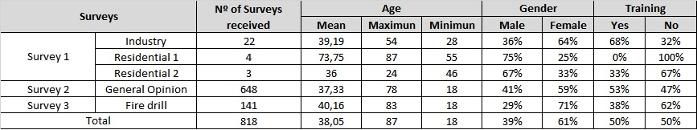
SUMMARY OF THE RESULTS OF THE STUDY
Fire and Evacuation Modeling Technical Conference (FEMTC) 2016
In order to minimize the difficulties and problems related to the acquisition of information, a methodology was established based on 3 different surveys.
TYPE 1
Distributed among people who were involved in a fire
29
Distributed to the general population, no selection was made for this distribution
SURVEYS
TYPE 2
648
TYPE 3
People who took part in a fire drill at two shopping centers
84% were aware of the fire drill.
141

Slide 7
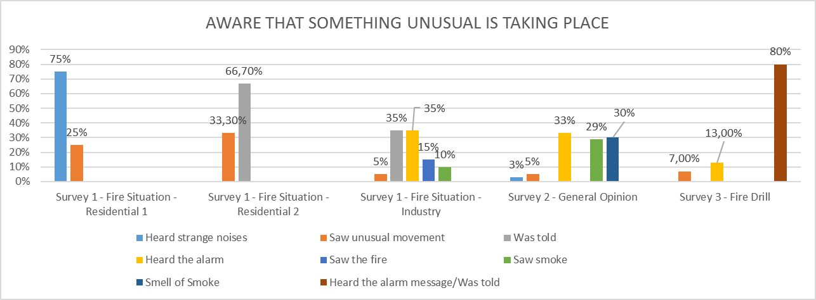
AWARE THAT SOMETHING UNUSUAL IS TAKING PLACE
Fire and Evacuation Modeling Technical Conference (FEMTC) 2016
NO ALARM
ALARM MESSAGE

Slide 8
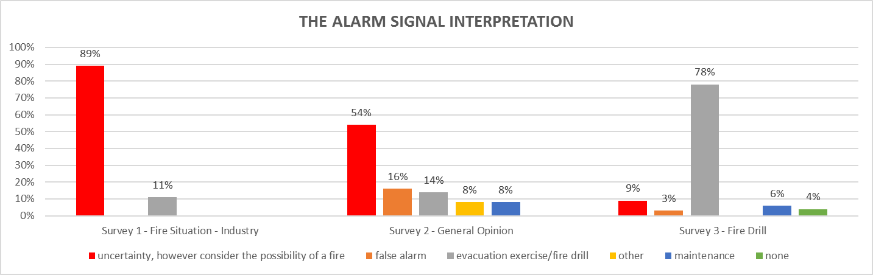
Fire and Evacuation Modeling Technical Conference (FEMTC) 2016
THE ALARM SIGNAL INTERPRETATION
84% were aware of the fire drill.
“What interpretation do you usually give to the alarm?”

Slide 9
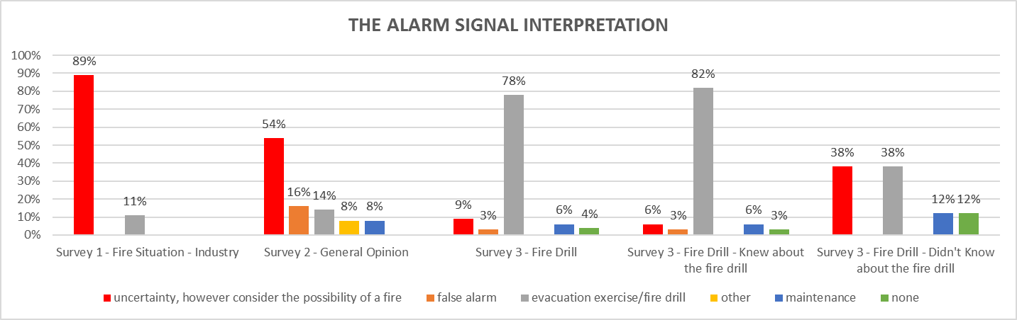
THE ALARM SIGNAL INTERPRETATION
Fire and Evacuation Modeling Technical Conference (FEMTC) 2016

Slide 10
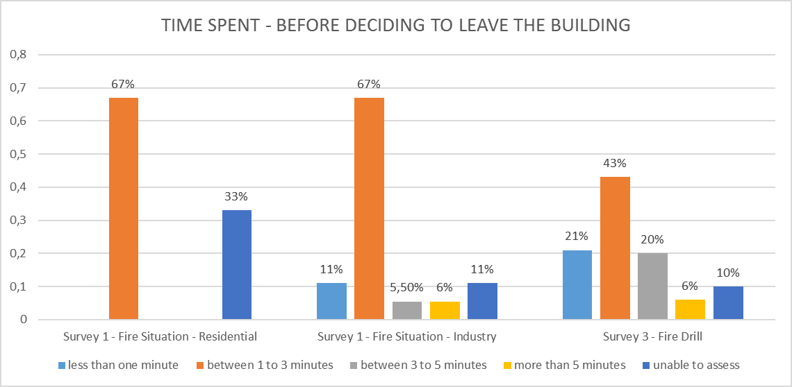
TIME SPENT - BEFORE DECIDING TO LEAVE THE BUILDING
Fire and Evacuation Modeling Technical Conference (FEMTC) 2016
“How much time passed between the moment you became aware that something unusual was happening and the moment you decided to leave the building?”

Slide 11
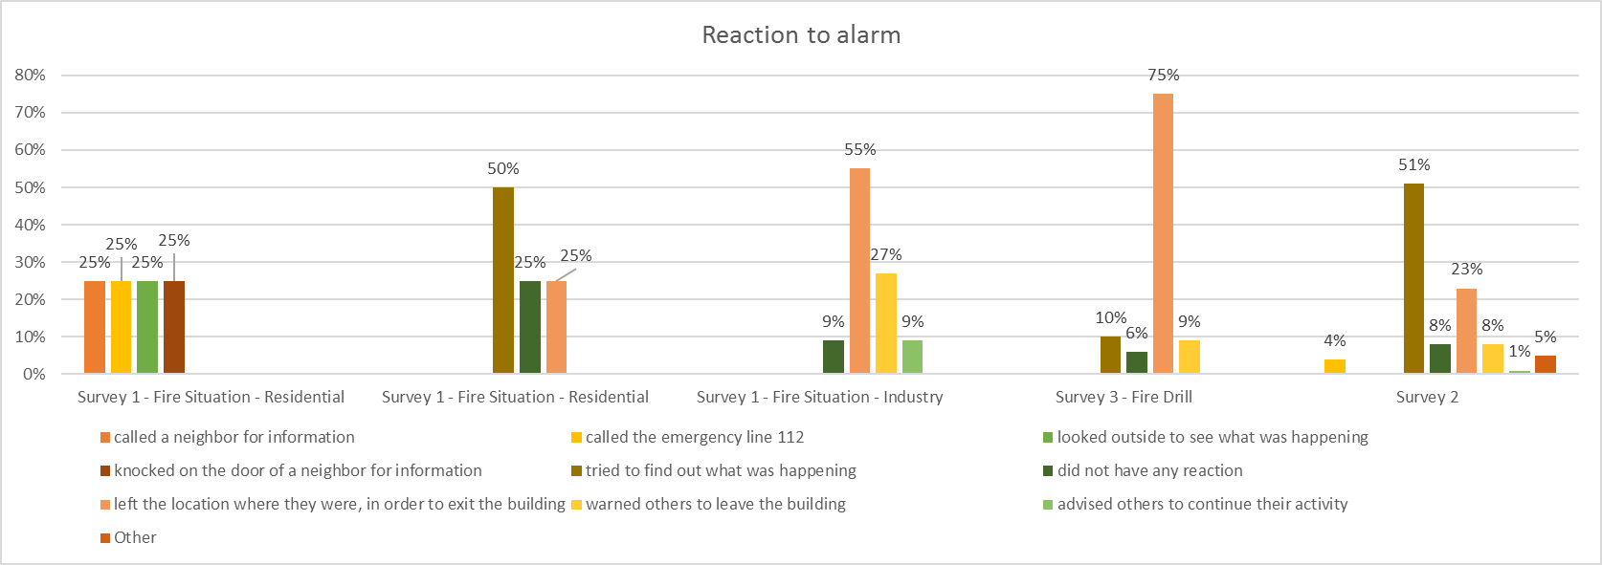
Reaction to alarm
Fire and Evacuation Modeling Technical Conference (FEMTC) 2016
“What did you do once you became aware that something unusual was happening?”
Left the location
Left the location
Find out
“What is usually your reaction to the alarm?”

Slide 12
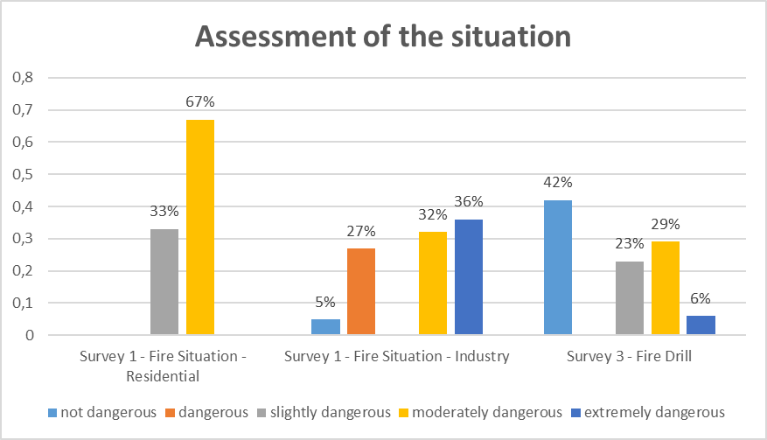
Assessment of the situation
Fire and Evacuation Modeling Technical Conference (FEMTC) 2016
“How dangerous do you think the situation was?”

Slide 13
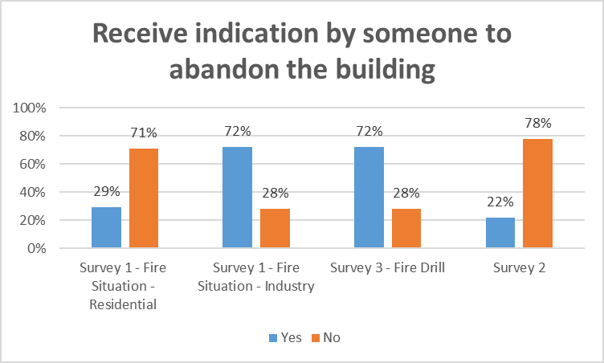
Receive indication by someone to abandon the building
Fire and Evacuation Modeling Technical Conference (FEMTC) 2016
“Did you decide to abandon the building because someone told you to?"
“Would you leave the building in case someone told you to?"
No Security staff
Both with Security staff
The message indicated to leave the building

Slide 14
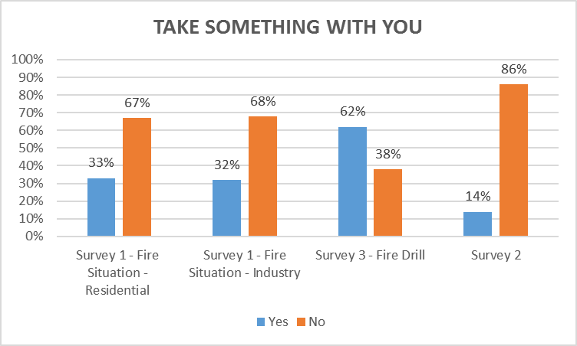
TAKE SOMETHING WITH YOU
Fire and Evacuation Modeling Technical Conference (FEMTC) 2016
“When you decided to leave the building, did you take anything with you?"
“Before leaving the building would you try to collect personal belongings?”

Slide 15
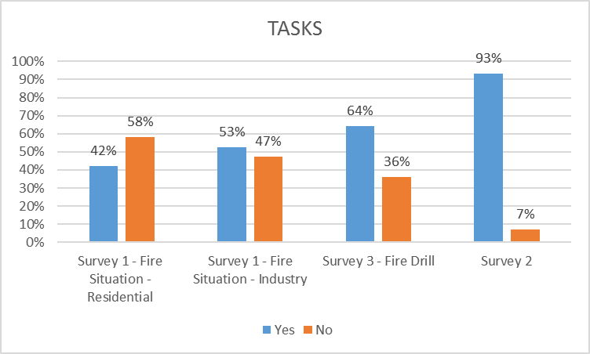
TASK
Fire and Evacuation Modeling Technical Conference (FEMTC) 2016
"Before deciding to abandon the building did you perform any of the following tasks (look for family members, warn others, contact the fire brigade, fight the fire, help others, pack your things)?"

Slide 16
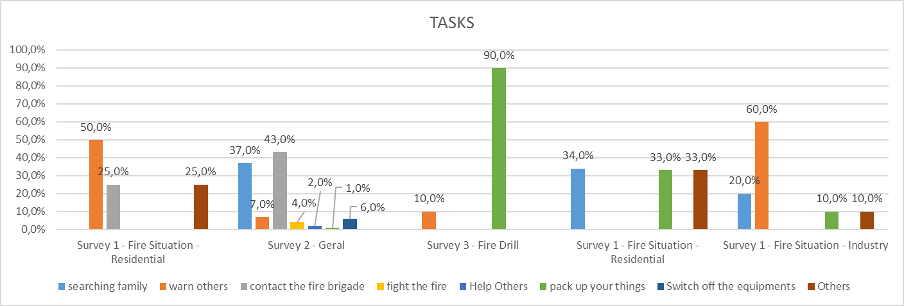
TASK
Fire and Evacuation Modeling Technical Conference (FEMTC) 2016
"Before deciding to abandon the building did you perform any of the following tasks (look for family members, warn others, contact the fire brigade, fight the fire, help others, pack your things)?"

Slide 17
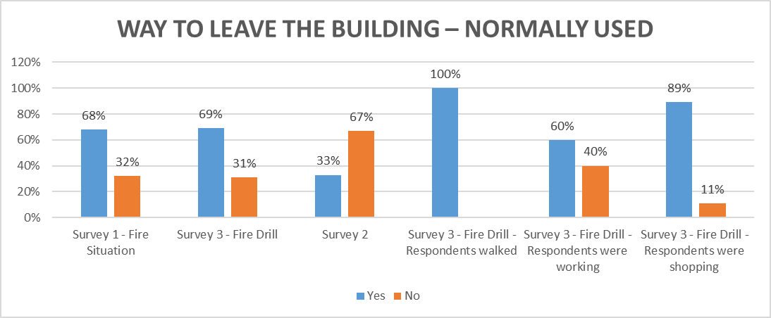
WAY TO LEAVE THE BUILDING – NORMALLY USED
Fire and Evacuation Modeling Technical Conference (FEMTC) 2016
“To leave the building did you use the way you normally use?”
“If you were in a building, which path would you use to exit the building?”

Slide 18
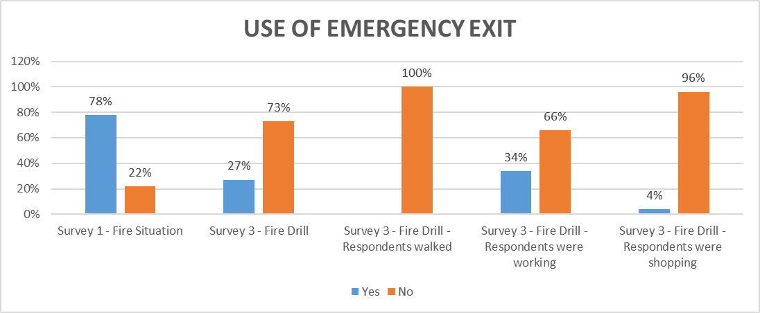
WAY TO LEAVE THE BUILDING – USE OF EMERGENCY EXIT
Fire and Evacuation Modeling Technical Conference (FEMTC) 2016

Slide 19
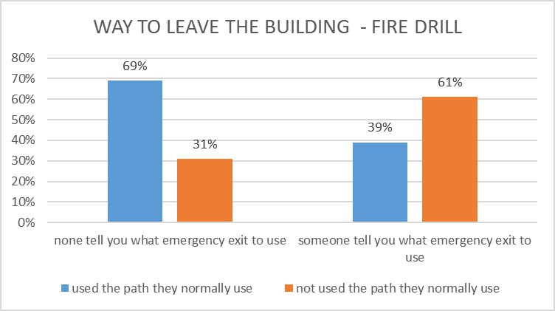
WAY TO LEAVE THE BUILDING – FIRE DRILL
Fire and Evacuation Modeling Technical Conference (FEMTC) 2016

Slide 20
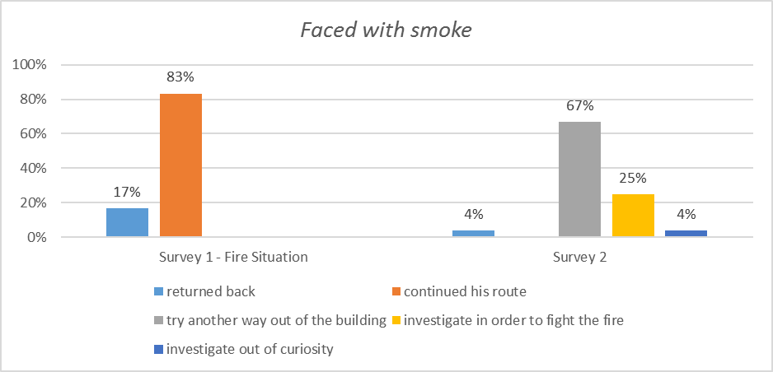
FACED WITH SMOKE
Fire and Evacuation Modeling Technical Conference (FEMTC) 2016
“If you were faced with smoke when trying to leave the building, what would your reaction be?

Slide 21
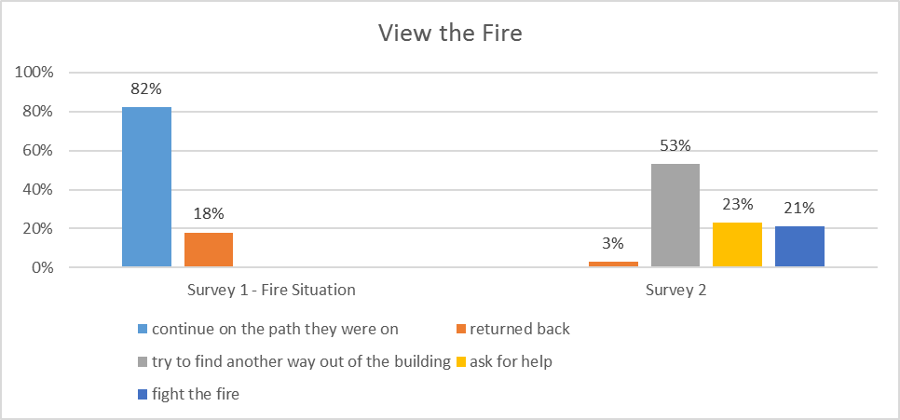
View the Fire
Fire and Evacuation Modeling Technical Conference (FEMTC) 2016
“If you were leaving the building and you were faced with the fire. What would your first reaction be?”

Slide 22
Conclusion

Slide 23
Conclusion
Fire and Evacuation Modeling Technical Conference (FEMTC) 2016
Having in mind the conditionality, some of the observed tendencies have been observed as follows:
The behavior of occupants can depend on their knowledge of the situation as well as their assessment of it;
When the alarm is heard sometimes it is not enough to decide to leave the building;
Before leaving the building the occupants perform several tasks, the main tasks are “look for family” or “warn others” as well as “take personal items”;
In order to leave the building, occupants tend not always to use the most appropriate way, giving preference to the normal path they used to enter the building;
In a fire drill, the behavior of the occupants may be different compared to a real fire situation.

Slide 24
The End

