Slide 1
Overview of the TUD Palladian IR Toolkit
Pre-Release Presentation
10/03/2011

Slide 2
Agenda
What is Palladian, where does the name come from
What can it do so far?
Who uses it?
What is up next?
Report
Knime nodes
Website

Slide 3
Palladian?
[puh-ley-dee-uhn]
- wise or learned
- of or relating to the goddess Pallas Athena
Name?
- shared implementation and experience
- re-use good student‘s results - added value to the community
What for?

Slide 4
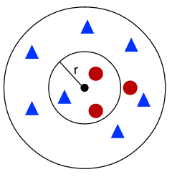


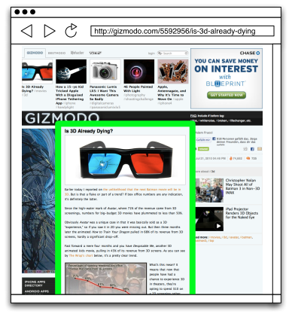











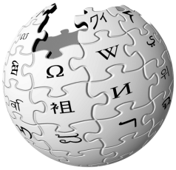




Capabilities
Classification
Retrieval
Extraction
Pre-Processing
Text
Numeric
Nominal
HTML Text
Dates
Tags
Entities
Tokenization
N-Grams
Web Page Segmentation
Text Similarities
Search Engines
Feed Reader
Wiki Crawler
Language

Slide 5

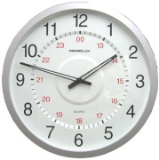
Where does Palladian excel?
Product Classification
Feed Reading
Date Recognition
Combining Algorithms and Sources

Slide 6




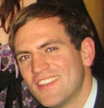

Who uses it?
Forest 3333
Effingo
Intellix
WebKnox
Intellix
Effingo
PRISMA

Slide 7
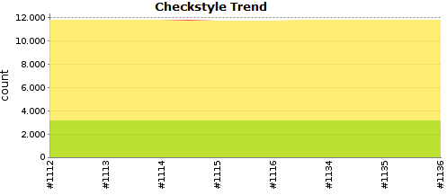
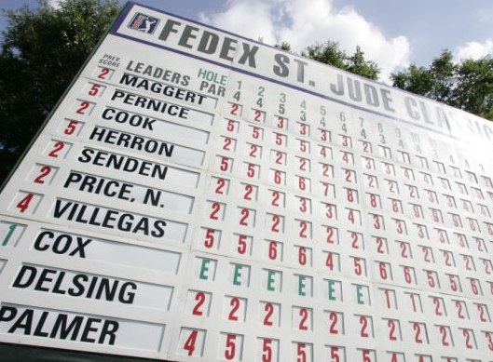
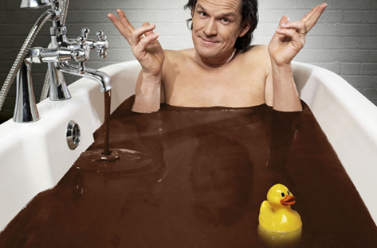
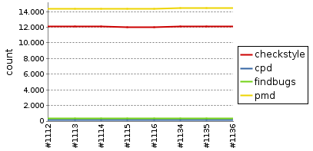
Build Managment

Slide 8




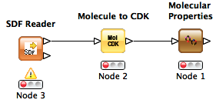
Up Next: Publish x 4
Technical
Report

Slide 9
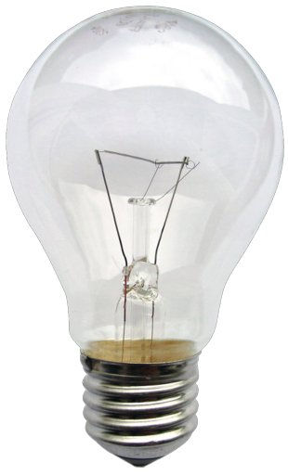
Ideas?

