Slide 1
Overview of the TUD Palladian IR Toolkit
Constance, KNIME Open Source Days
05/10/2011

Slide 2
Agenda
Who are we?
What is Palladian?
What can it do so far?
Functionality ported to KNIME nodes
Palladian and KNIME for the Intellix system

Slide 3
System Architecture – TU Dresden
Information Retrieval team of about 8 people
Focus on IR from the Web
Efficient feed reading strategies
Index field extraction from PDF files
Forum Q/A detection
Distributed architecture and relation detection
Entity and fact extraction

Slide 4
Palladian?
- shared implementation and experience
- re-use good student‘s results - added value to the community
What for?

Slide 5
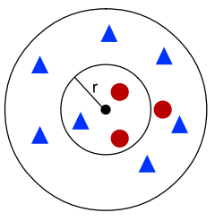


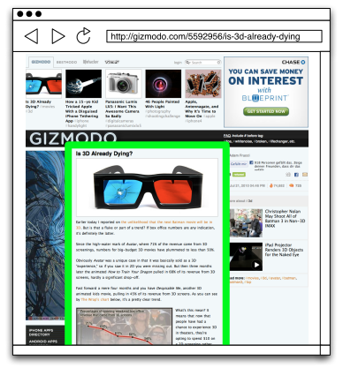











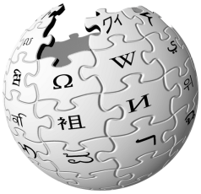



Capabilities
Classification
Retrieval
Extraction
Pre-Processing
Text
Numeric
Nominal
HTML Text
Dates
Tags
Entities
Tokenization
N-Grams
Web Page Segmentation
Text Similarities
Search Engines
Feed Reader
Wiki Crawler
Language

Slide 6

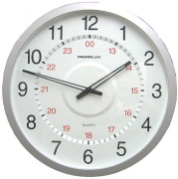
Where does Palladian excel?
Product Classification
Feed Reading
Date Recognition
Combining Algorithms and Sources
8 NERs
3 Keyphrase Extractors

Slide 7
Functionality of Palladian in KNIME
AP - Average Precision
RMSE – Root Mean Square Error
BayesClassifier
Content Extractor
Date Recognizer
Document Retriever
Feed Discovery
FeedRetriever
KNN – K-Nearest Neighbor
Palladian Named Entity Recognizer
Ratio Normalizer Node
TextClassifier
WebSearcher

Slide 8
Demo

Slide 9
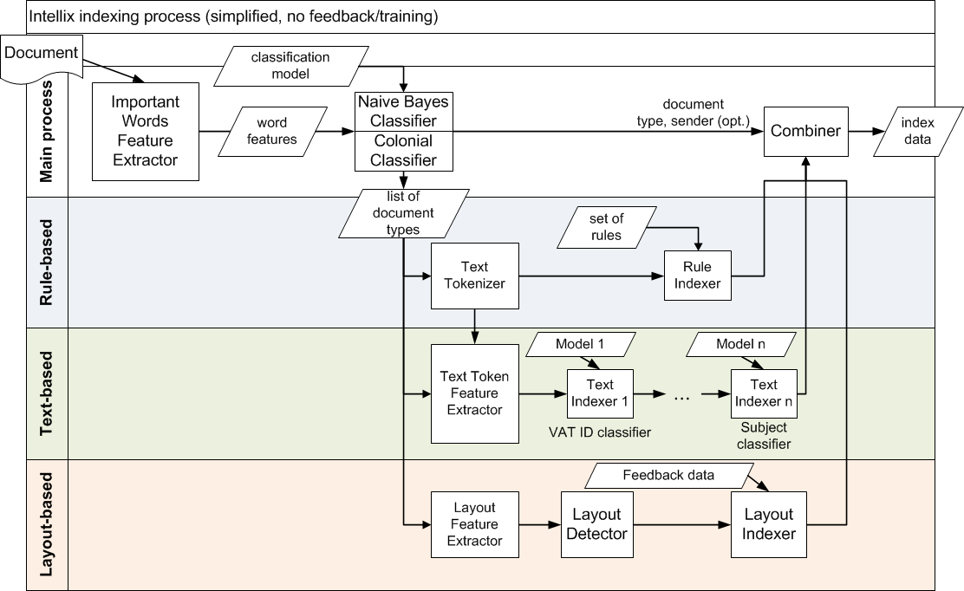
Intellix Workflow

Slide 10
Our Questions
Any functionality that you would like to have?
Export of the workflow -> execute (BPMN)?
Continuous integration? (we use maven)
Handling big data, streaming
Progress
Memory consumption

Slide 11
Your Questions
?
www.palladian.ws

