Slide 1

Kindred Souls A Feature Addition to Airbnb
Jatin Verma
M.Eng, NTU
JATIN001@e.ntu.edu.sg

Slide 2
Problem
Given the room listing data from Airbnb Seattle in Kaggle, please think of 1 important business question (for Airbnb) that can be addressed from the data.

Slide 3
My Approach
Summarising the problem.
Background check on Airbnb, the client, to find out it’s business model.
Gaining familiarity with data using Pandas, a data handling tool.
Coming up with multiple possible ideas that could profit Airbnb.
Narrowing down to one idea and working on it.

Slide 4
Few facts on Airbnb
Brian Chesky and Joe Gebbia wanted to rent their loft online but they wanted a platform more personalized than Craigslist, so they came up with ‘Airbed and Breakfast’ in 2007 which later became Airbnb.
Some milestones throughout the journey (features added along the journey to the website):
Achieved in making Craigslist hosts to move to Airbnb which resulted in increased user-base.
Personally verifying host and listing addresses to build trust among buyers(tenants).
Enabled direct communication between hosts and tenants pre-booking.
Introduced Wish List feature for elongating the time spent on the website by the users, even when they don’t have an intention to post/purchase a listing.
Hired professionals for rental photography in selected cities to better the visualization of a listing.
Adding features like Social Connection Network to increase user-website interaction.
Promoting the website through Referral program.
Reading about what ideas and motivations boosted the growth of Airbnb helped in getting a better perspective on the given datasets, viz., figuring out the features on which Airbnb might focus.
Reference: https://growthhackers.com/growth-studies/airbnb

Slide 5
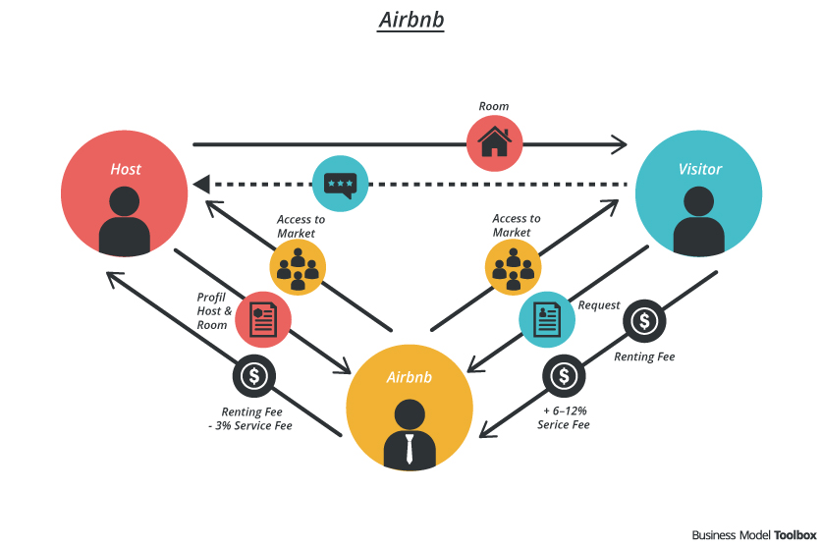
Business Model
From Airbnb’s website:
"We make our money from our service fee. We charge travelers a 6-12% service fee, depending on the total of the reservation. The higher the total, the lower the percentage of the fee. Airbnb also charges the host a 3% fee for every booking that is completed.”
Focus is on:
More hosts
More interested tenants
More purchases
Image: https://bmtoolbox.net/stories/airbnb/
Reference: https://www.quora.com/How-does-Airbnb-make-money/answer/Luke-Bornheimer#

Slide 6
Initial Ideas
1. Price recommendation for hosts when they post a new listing on Airbnb:
New hosts might not know how much their rental is worth.
By analysing the host’s superhost status, listings count, and rental’s property type, accommodation capacity, number of beds, bed types, number of bathrooms, we can recommend a price for the listing based on the past data.
Similar work has already been done and can be followed here: https://www.kaggle.com/ibjohnsson/predicting-listing-prices
2. Studying the factors due to which some hosts are successful and encouraging other hosts to follow the same:
Already done here: https://www.kaggle.com/yogi045/how-to-become-top-earner-in-airbnb

Slide 7
Inspired by the Wish List feature…
In 2012, Airbnb introduced Wish List to increase the time the travellers spend on Airbnb. It became a reason to visit the site not only when they’re looking for a room, but when work is boring or weather is oppressive.
Within four months, 45% of Airbnb users were engaging in Wish Lists and 1 million Wish Lists had been created.
Wish Lists helped Airbnb to move toward a more engaging social discovery model.
My proposal is to introduce ‘Kindred Souls’ which would increase the hosts’ engagement with the site.

Slide 8
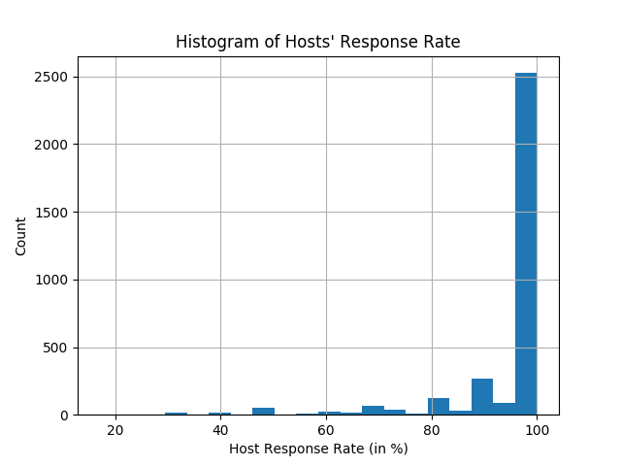
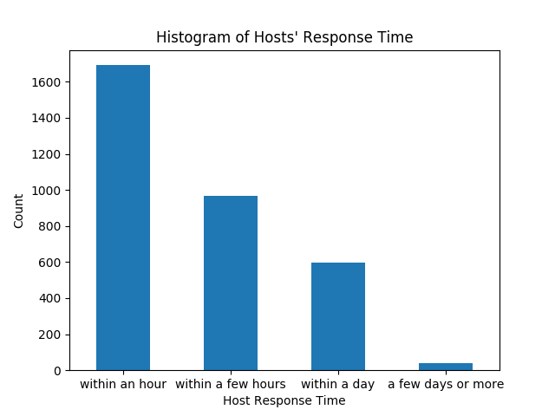
How would this benefit Airbnb?
The plots shown are obtained from the current data for hosts’ response time and response rate.
There is a window for increasing the frequency of hosts responding to the user’s queries by making them stay on the website for longer.
Greater portions of hosts’ leisure time is spent on Airbnb. More are the chances that they entertain tenant queries faster, which allows the deals to fix faster.

Slide 9
Kindred Souls
It is noteworthy how hosts liked to describe themselves, their interests, pastimes, and a little about their lives in the ‘host_about’ column in listings.csv.
“i love living in Seattle. i grew up in the mid-west but the Pacific North West has always felt like home. i am a mom to 3 beautiful kids, love playing tennis, cooking, reading and being with friends and family. i manage a few long-term rental properties as well as consult and manage AirBnB properties for those living in the Seattle area. ”
The idea is to make utmost use of this section to connect people with similar interests.
Airbnb will encourage hosts to connect to other hosts (for eg. by pop-up recommendation) which happen to share their hobbies or have something in common. After getting connected, they can probably chat with each other on their favourite books or football players and exchange experiences and learn more.
Meanwhile, if a user query comes up, they can answer faster.

Slide 10
Data Stats…
There are 2751 unique hosts. Out of which 2016 hosts have provided their ‘host_about’ description.
Word count of a description:
Average = 75.885
Minimum = 1
Maximum = 756
In the corpus of ‘host_about’, the most frequent words are {‘and’, ’I’, ’to’, ‘the’, ‘a’, ‘in’, ‘Seattle’, ‘my’, ‘love’…}

Slide 11
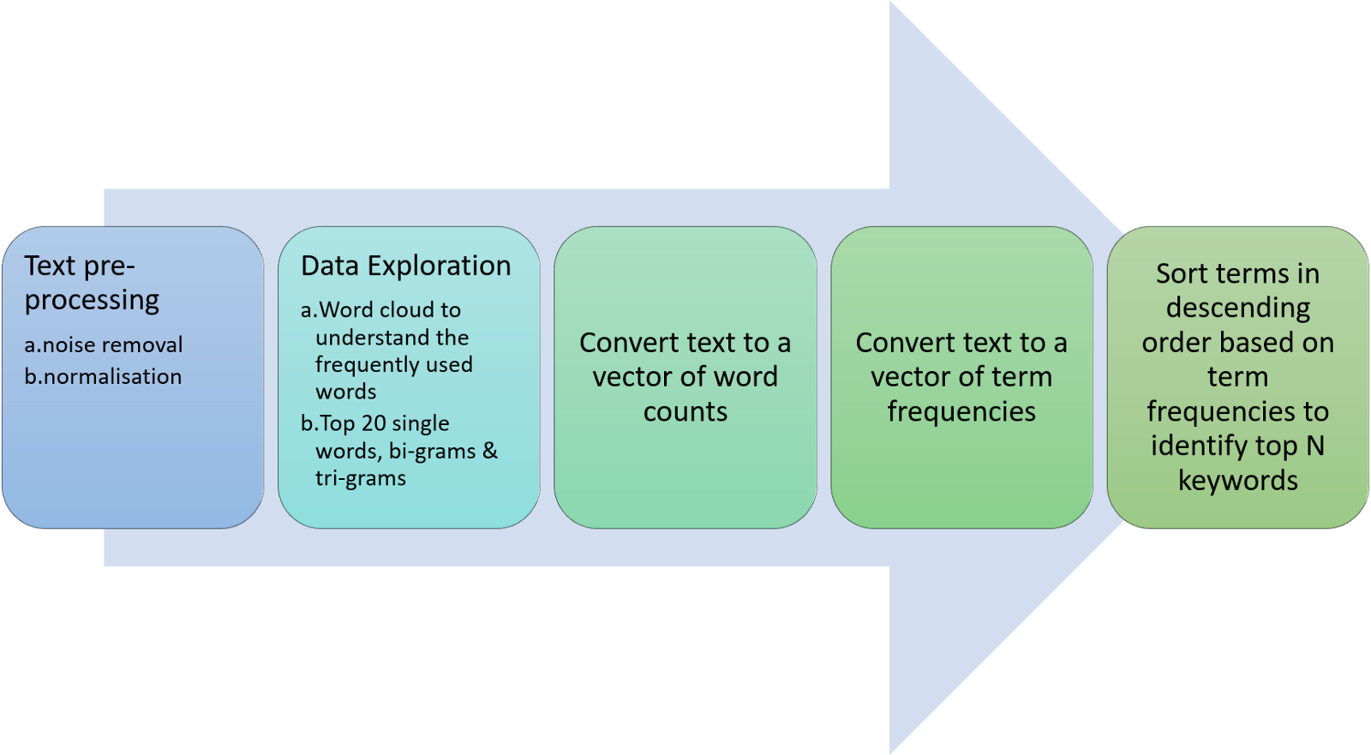
NLP Process
Image: https://medium.com/analytics-vidhya/automated-keyword-extraction-from-articles-using-nlp-bfd864f41b34

Slide 12
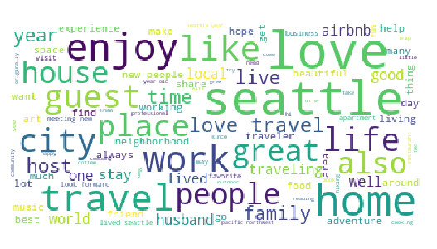
Data Cleaning
Extraction of words from the corpus using nltk library. This, in turn, removes noise comprising of punctuation, special characters, etc.
Changing every word to lowercase.
Removal of stop words using nltk English stop words. [1]
Using WordNetLemmatizer to lemmatize each word. [2]
Now, word-frequencies can be checked to find out the most frequent words. These can be used to make a list of context-based stop words, like ‘seattle’, ‘airbnb’, etc. which can be appended in the list of stop words for further removal from the corpus.
[1] https://gist.github.com/sebleier/554280
[2] https://www.nltk.org/_modules/nltk/stem/wordnet.html

Slide 13
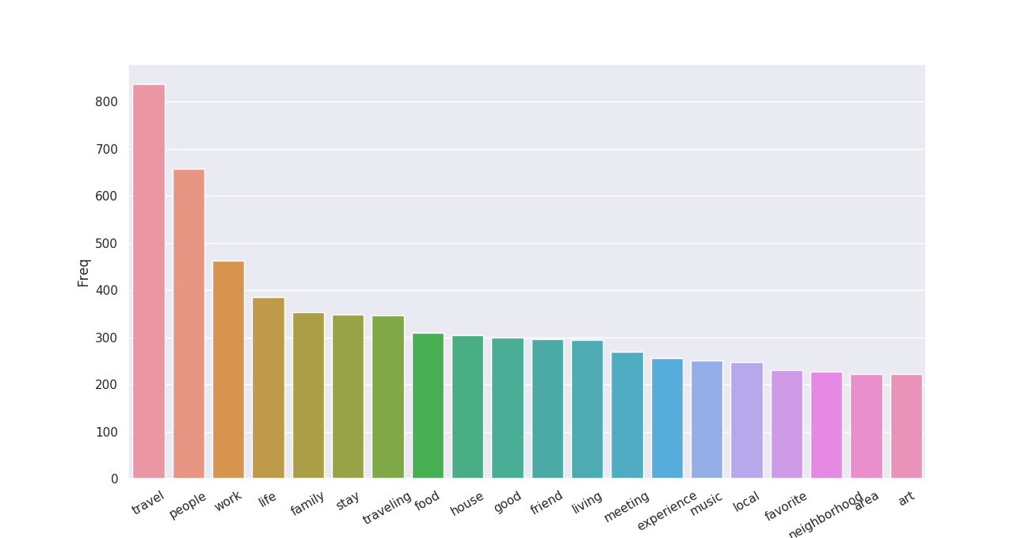
Tokenization
Uni-grams, bi-grams and tri-grams are obtained from the corpus to form a total of 10,000 tokens using CountVectorizer() [3]
For each of the above formed token, token frequency is calculated within each ‘host_about’ description to form the Bag-of-Words which is a sparse matrix. [4]
[3] https://scikit-learn.org/stable/modules/generated/sklearn.feature_extraction.text.CountVectorizer.html
[4] https://en.wikipedia.org/wiki/Bag-of-words_model

Slide 14
TF-IDF
TF-IDF is calculated from Bag-of-Words matrix. [5,6]
This will serve as the numerical feature matrix of size 2016x10,000 for an unsupervised clustering algorithm.
k-Means Clustering
From the scikit-learn library, k-Means is implemented.
The quality of the resulting clusters is evaluated by Silhouette metric. [7]
The optimal number of clusters is determined by the ‘Elbow’ method. [8]
[5] https://en.wikipedia.org/wiki/Tf%E2%80%93idf
[6] https://scikit-learn.org/stable/modules/generated/sklearn.feature_extraction.text.TfidfVectorizer.html
[7] https://scikit-learn.org/stable/modules/generated/sklearn.metrics.silhouette_score.html
[8] https://en.wikipedia.org/wiki/Elbow_method_(clustering)

Slide 15
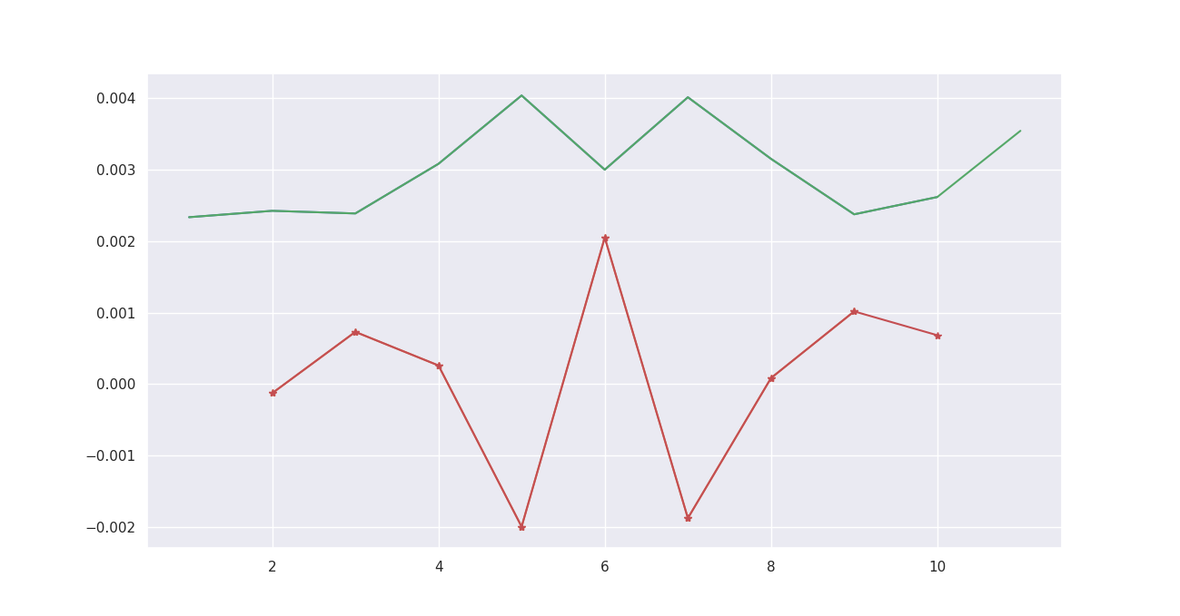
Elbow Method
Drastic change of score (‘elbows’) at k = 5 and 7
silhouette_score
Checking the resulting clusters by k-Means for both k = 5 and k = 7
Double differentiation
of silhouette score
k – no. of clusters

Slide 16
Inference
For k=7, most of the people within a cluster have similar interests which can be seen in the ‘results_clustered_hosts.csv’ file. For example,
Cluster 0 seem to have kids and read books.
Cluster 3 mostly mention about being in the real estate business, or about it.
Cluster 5 likes Yoga, music, have kids and read books.
Cluster 4 and 6 mostly like meeting new people.
Hosts in the same cluster can be recommended to connect with each other so that they can spend time talking about their concerns in their hobbies.

Slide 17
Scope of improvement…
Bag-of-words approach does not have sequential information of words. Parts of Speech needs to be incorporated for better normalization (Lemmatization).
Too many common English words makes it hard to extract the hobbies and interests of hosts. Deep learning encoding can be tested for performance.
A better way to validate the resulting clusters is needed.
Any suggestions and feedbacks are welcome.

Slide 18


