Slide 1
National Parks Visitations:
Task 4: Final
Aubrey Smiley McAuliffe, Beau Findley, Jason Viehman
STAT 656, Fall 2020

Slide 2
Interesting Things: Nonparametric fails

Slide 3
Interesting Things: xgboost for the win

Slide 4
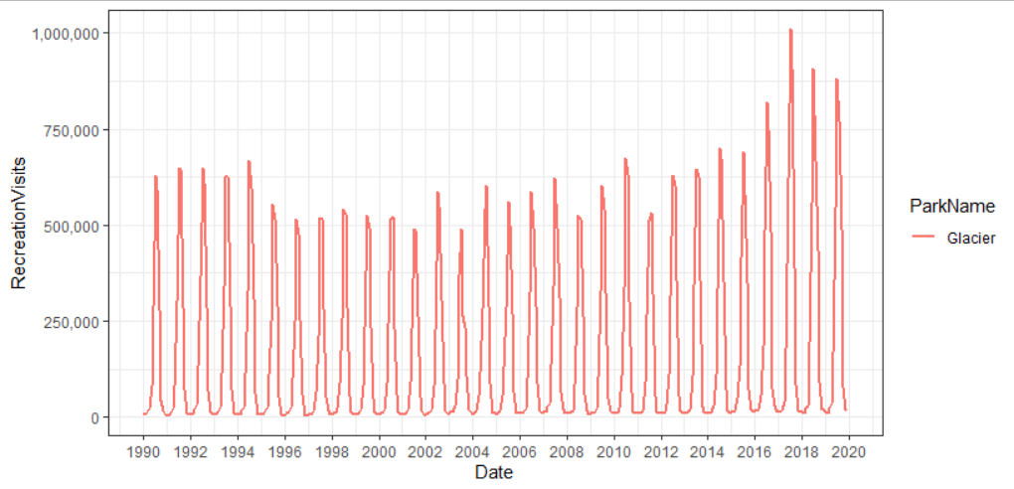
Interesting Things: No one size fits all
Time component is relatively negligible
Seasonal patterns are explained by month
Every park is unique and has trends that match its particular history
Makes it nearly impossible to generalize well

Slide 5





Biggest Challenge: API and fees
Learning how to connect properly
Converting JSON to usable formats
Wrangling individual idiosyncrasies
Fees
Time
Merging data from IRMA

Slide 6
If You Could Do It Again…
Precipitation data

Slide 7
R Shiny
Jason and Aubrey’s interesting things

