Slide 1
National Parks Visitations:
Task 3: Update
Aubrey Smiley McAuliffe, Beau Findley, Jason Viehman
STAT 656, Fall 2020

Slide 2
Introduction to the Business Problem
National Parks provide an invaluable service to ecosystems and the public alike, but they are run on a tight budget.
Parks must be monitored, protected, and maintained so that they may last for years to come.
Some of the funding comes from state governments and some comes from the federal government.
What characteristics do the most visited parks have in common?
Can we predict when the most people visit National Parks and Monuments and allocate funding and manning accordingly?
How do climate and socio-economic factors relate to park visitation? Are certain parks at risk and in need of more funding in coming years?

Slide 3
Primary Research Question
What is the main scientific question (or questions) that you are trying to answer? Be specific!

Slide 4
Initial Exploration - Clustering

Slide 5
Methodology
What methods are you using to answer this question. Again be specific! By specific, I mean: just saying multiple linear regression is not specific. Specify the supervisor and generally state the features and how this method can be used to answer one of the main scientific questions. If you are using the lasso, how are you choosing the tuning parameter? Are you standardizing your features?

Slide 6
Methodology (cont.)

Slide 7
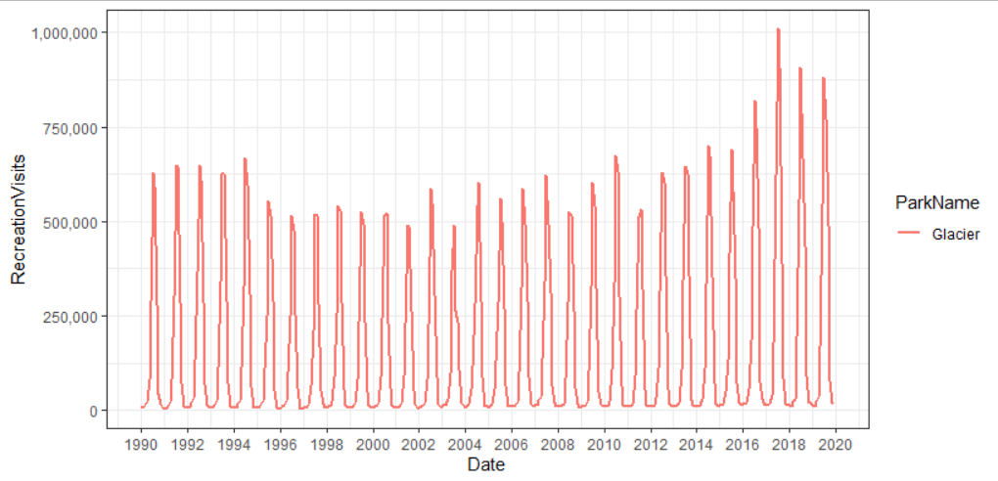
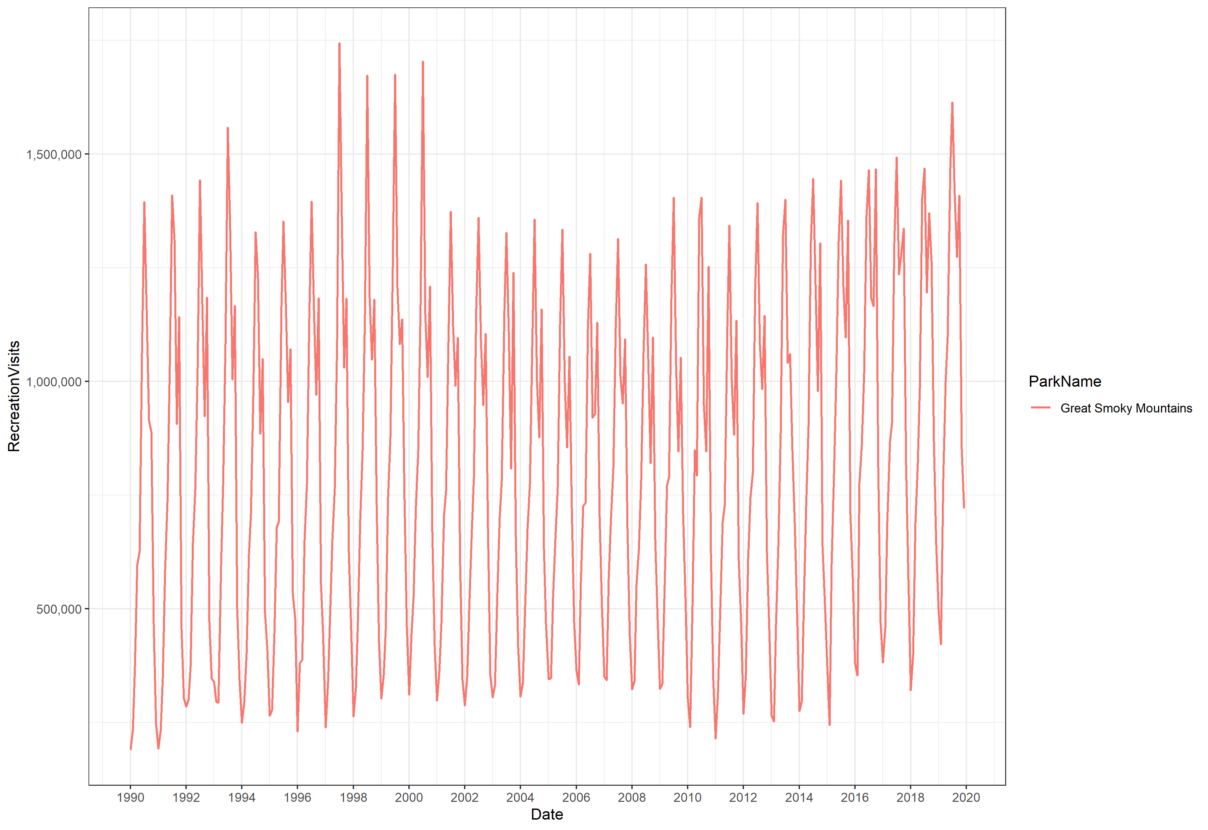
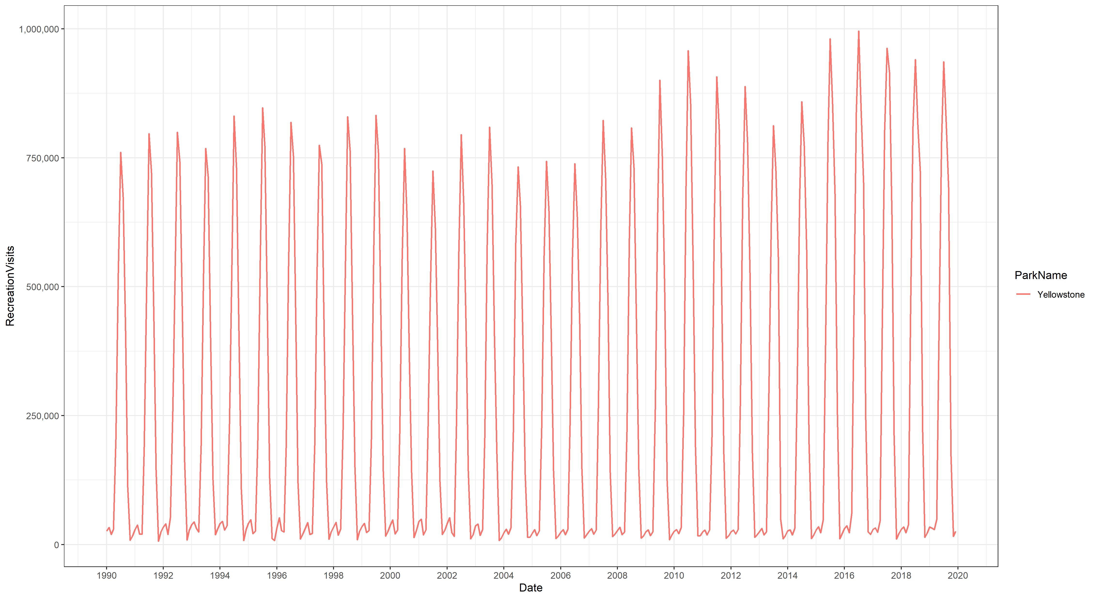
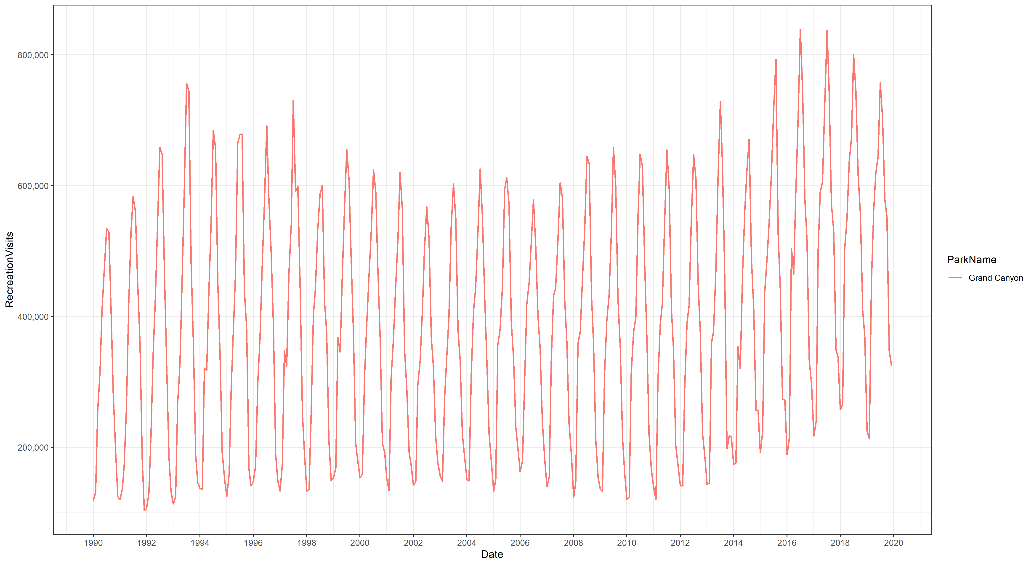
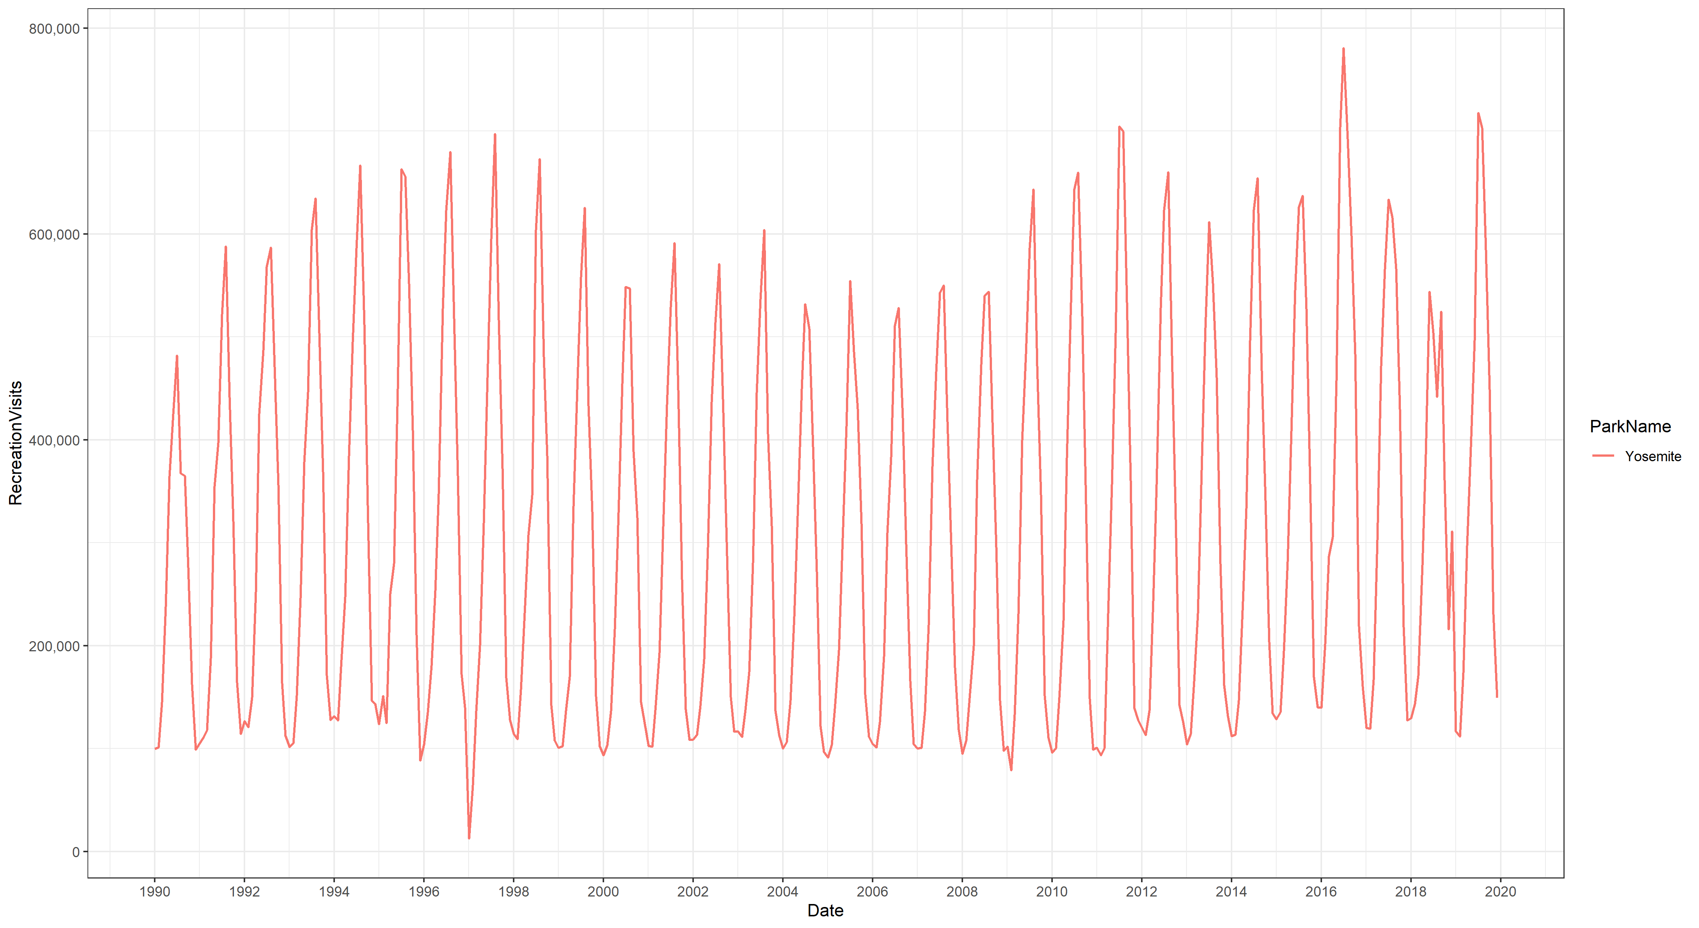
Interesting Things
The time component of our data is relatively negligible and any trends observed are due to seasonal patterns explained by month alone.

Slide 8
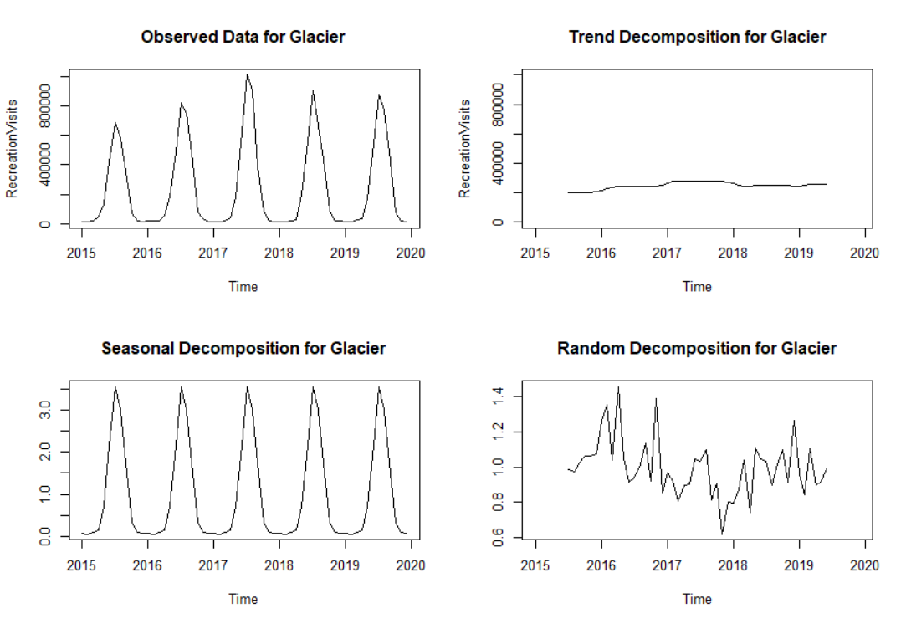
Interesting Things
Impact to Our Project:
Ignore possible autocorrelation in our data
Can drop some correlated variables like month with temperature
Enables us to use the broader range of supervised method (like MARS) instead of time-series only methods

