Slide 1
National Parks Visitations:
Task 4: Final
Aubrey Smiley McAuliffe, Beau Findley, Jason Viehman
STAT 656, Fall 2020

Slide 2
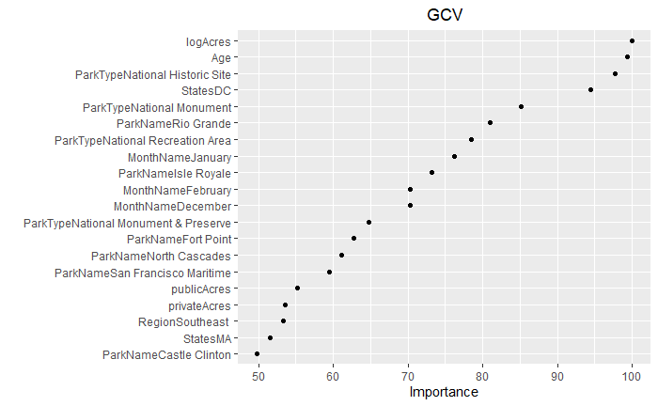
Interesting Things: MARS
MARS was our main analysis plan
Selected number of prunes (50) was too small
Number of degrees (2) seemed reasonable, but wasn’t used in the top important variables
Took a long time to run the cross-validation code
Typically bad predictions, and constant over years

Slide 3
Interesting Things: xgboost for the win

Slide 4
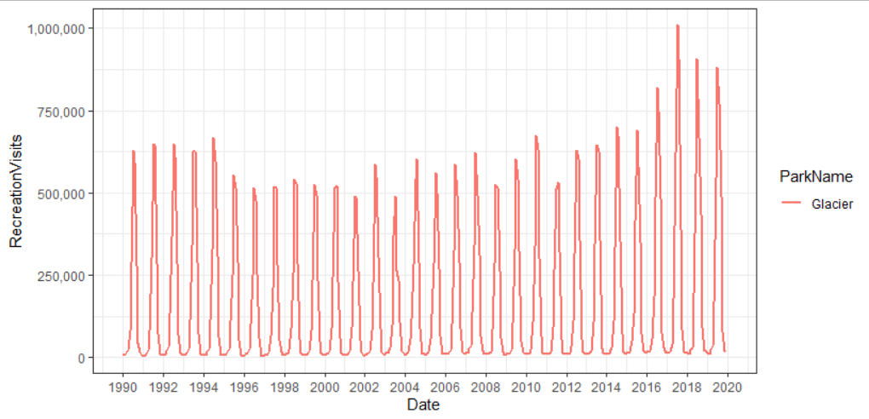
Interesting Things: No one size fits all
Time component is relatively negligible
Seasonal patterns are explained by month
Every park is unique and has trends that match its particular history
Makes it nearly impossible to generalize well

Slide 5





Biggest Challenge: API and fees
Learning how to connect properly
Converting JSON to usable formats
Wrangling individual idiosyncrasies
Fees
Time
Merging data from IRMA

Slide 6
If You Could Do It Again…
Precipitation Data took a long time to gather
There was too much data and the API was hard to work with
Limited number of pulls per line of code and per day
Wound up not using it because it was too difficult to combine datasets
2 Options:
Select specific stations to use for each park
Less data, easier to combine, easier to pull
Don’t use precipitation data
Likely is captured in the month variable anyways

Slide 7
R Shiny
Jason and Aubrey’s interesting things

