Slide 1
National Parks Visitations:
Task 3: Update
Aubrey Smiley McAuliffe, Beau Findley, Jason Viehman
STAT 656, Fall 2020

Slide 2
Introduction to the Business Problem
National Parks provide an invaluable service to ecosystems and the public alike, but they are run on a tight budget.
Parks must be monitored, protected, and maintained so that they may last for years to come.
Some of the funding comes from state governments and some comes from the federal government.
What characteristics do the most visited parks have in common?
Can we predict when the most people visit National Parks and Monuments and allocate funding and manning accordingly?
How do climate and socio-economic factors relate to park visitation? Are certain parks at risk and in need of more funding in coming years?

Slide 3
Primary Research Question
Can a National Park’s number of Visitors be predicted by its acreage, state-level poverty, public/private ownership, and fee structure?

Slide 4
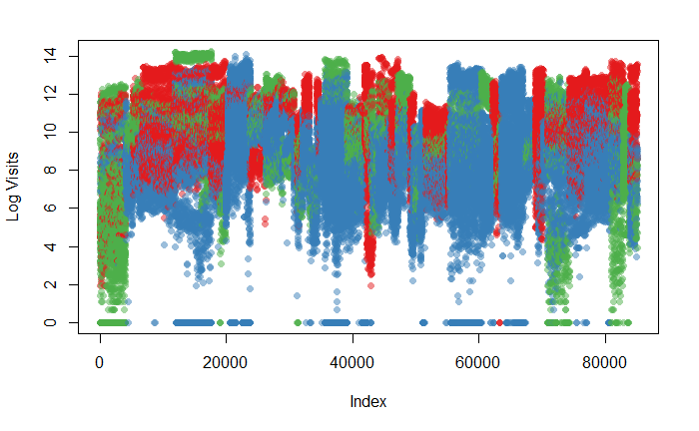
Initial Exploration - Clustering
K-Means Clustering
Region, Acreage, Poverty, Month, Fees
Three Clusters
Resultant Clusters had distinct visitations and fees

Slide 5
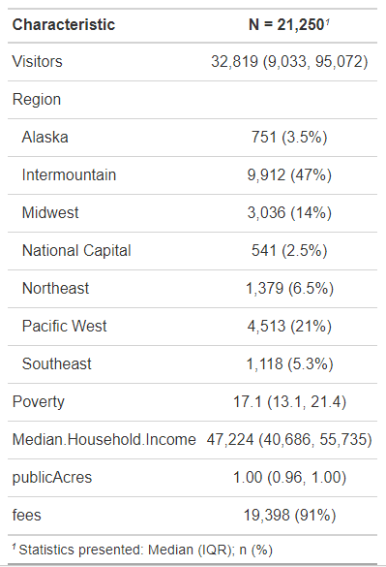
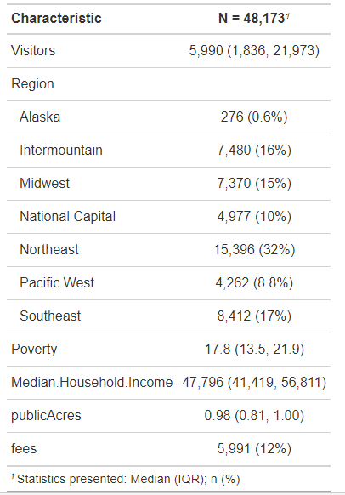
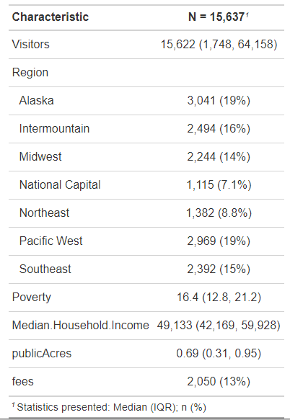
Cluster 1
Summary Statistics for Clusters
Cluster 2
Cluster 3

Slide 6
Methodology
MARS will be used to look at variable significance and develop a prediction model.
Supervisor: Number of Recreational Visits
Explanatory Variables: poverty index, month, year, park descriptives (region, park classification, size, age, % public area)
Tuning parameters will be 1-3 degrees and 10-50 knots.
Variable Importance will be shown using the vip graphing function

Slide 7
Methodology (cont.)
Training data
1995 – 2015
Used to try different models and select the best one to be used with the test data.
Will help assess variable importance in the chosen model.
Test Data
2016 – 2019
Used mainly for predictions of visitation.
Used to assess test error based off of model predictions

Slide 8
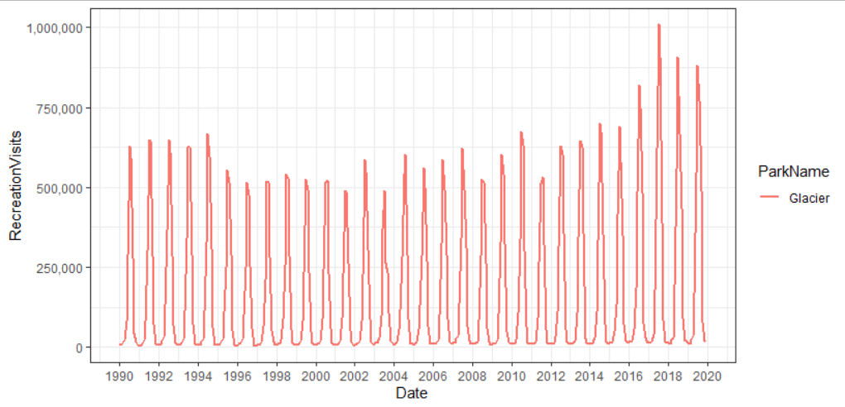
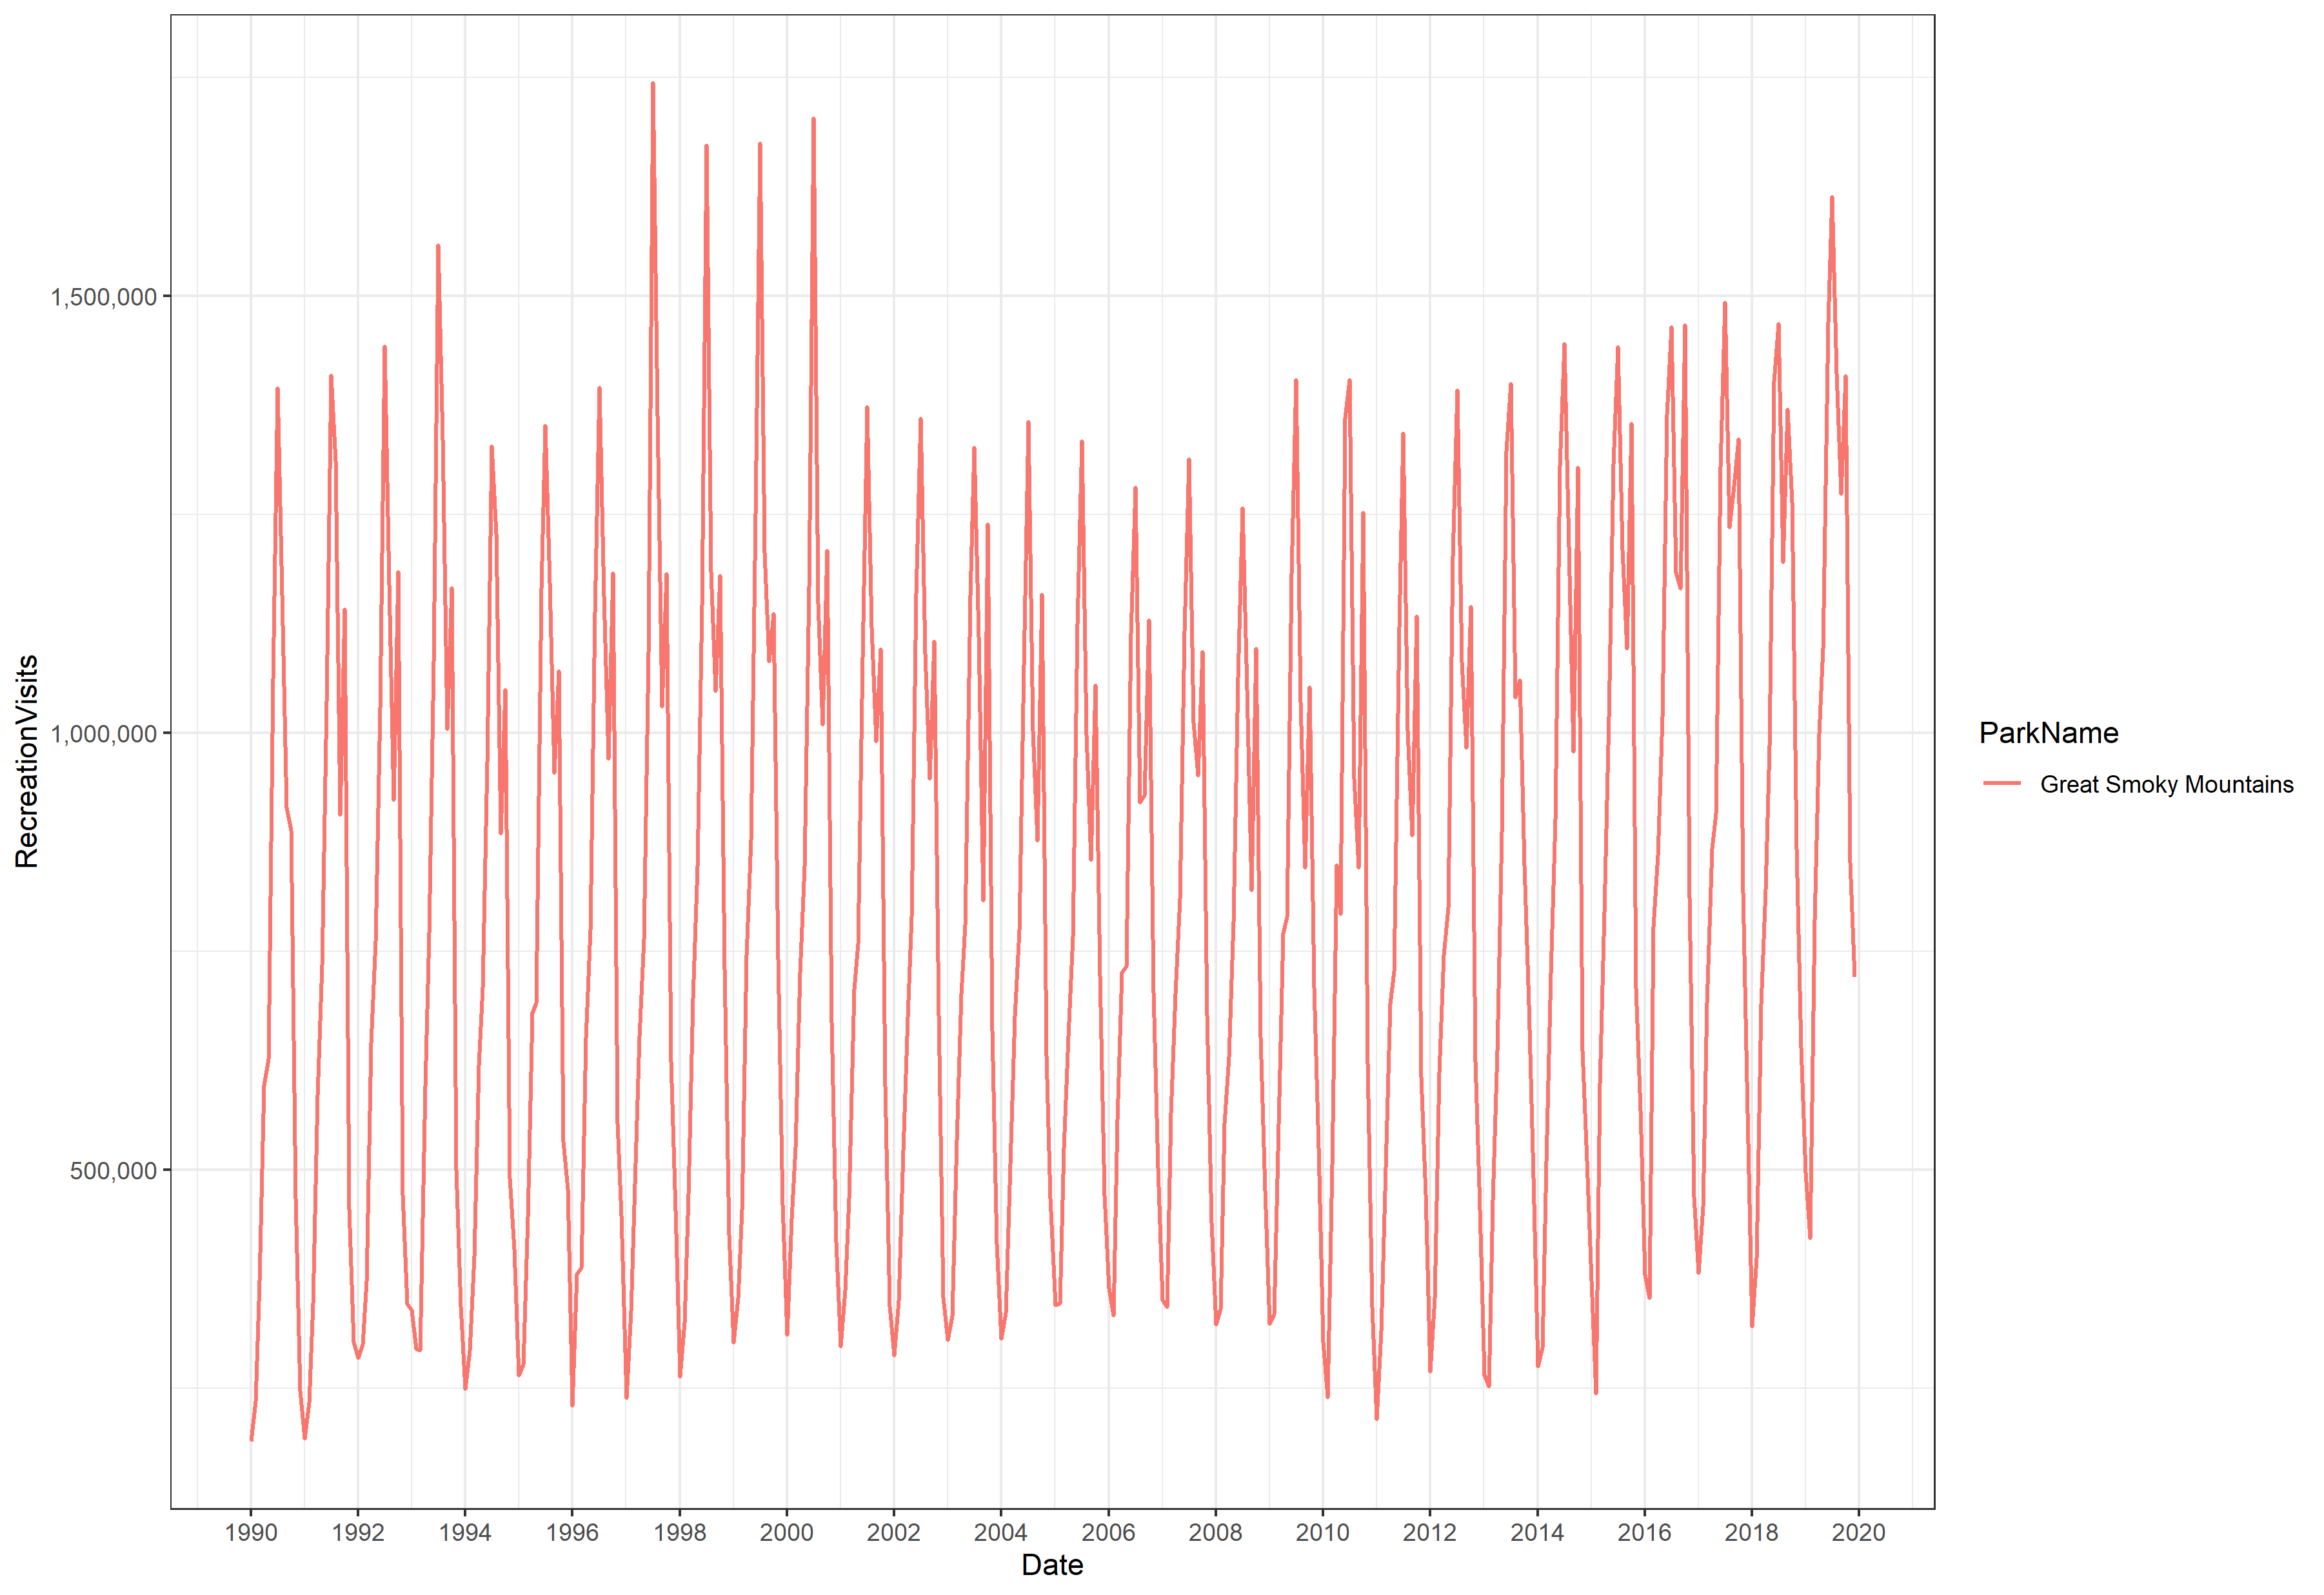
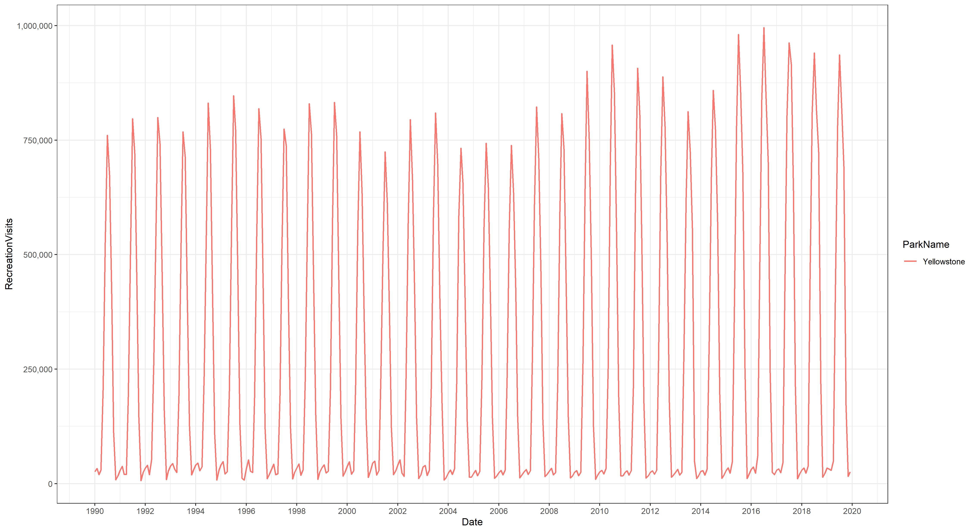
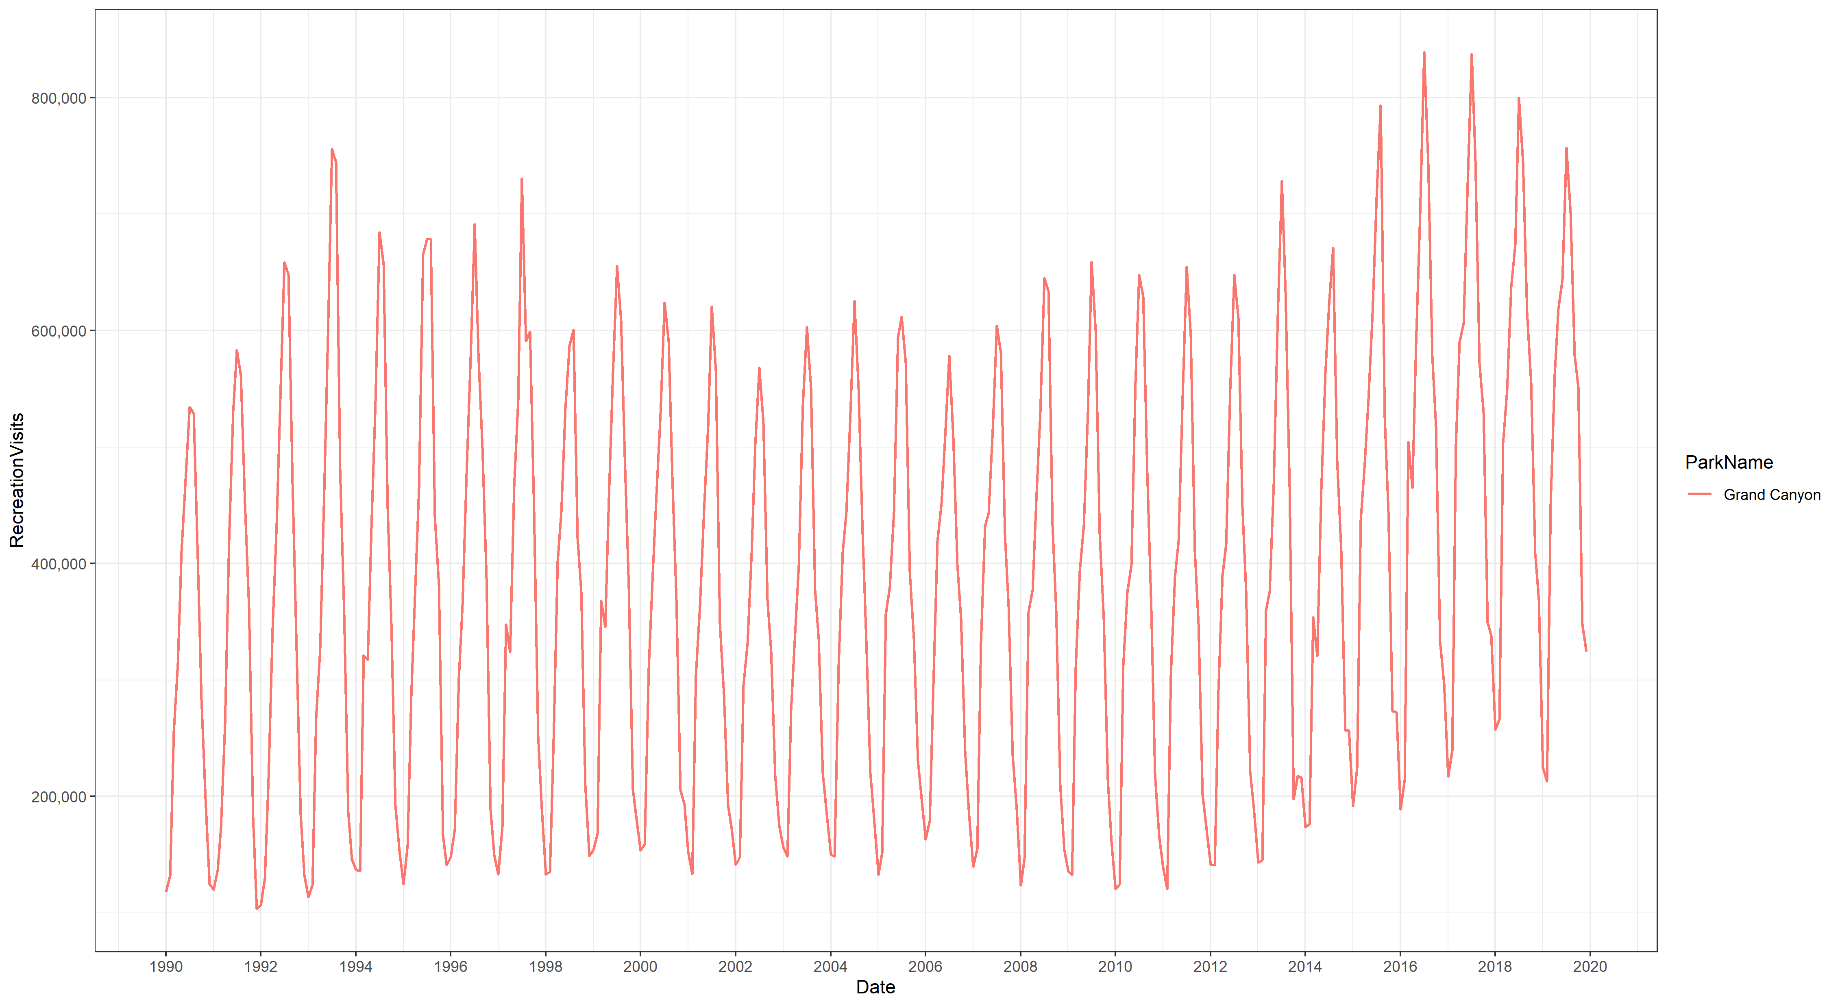
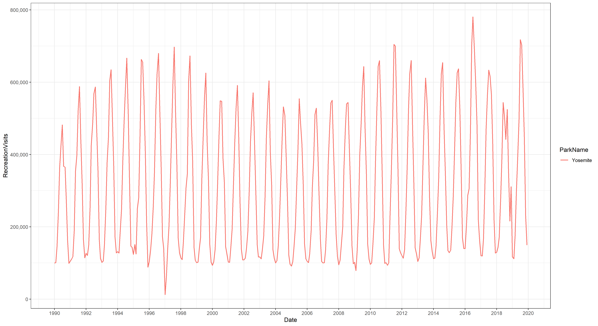
Interesting Things
The time component of our data is relatively negligible and any trends observed are due to seasonal patterns explained by month alone.

Slide 9
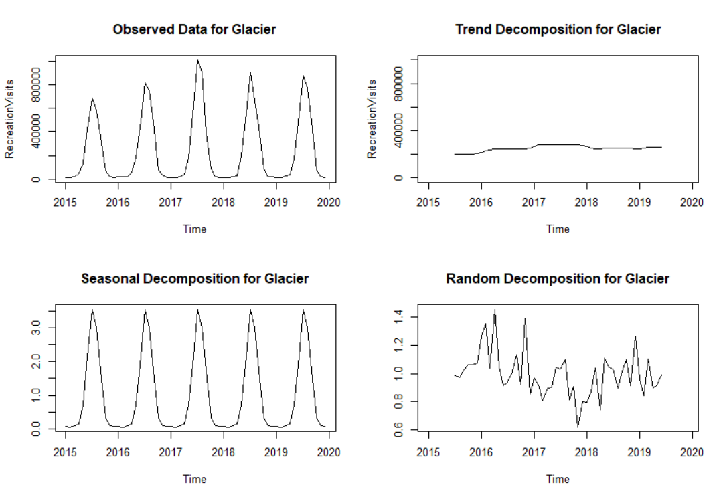
Interesting Things
Impact to Our Project:
Ignore possible autocorrelation in our data
Can drop some correlated variables like month with temperature
Enables us to use the broader range of supervised method (like MARS) instead of time-series only methods

