Slide 1
National Parks Visitations:
Task 4: Final
Aubrey Smiley McAuliffe, Beau Findley, Jason Viehman
STAT 656, Fall 2020

Slide 2
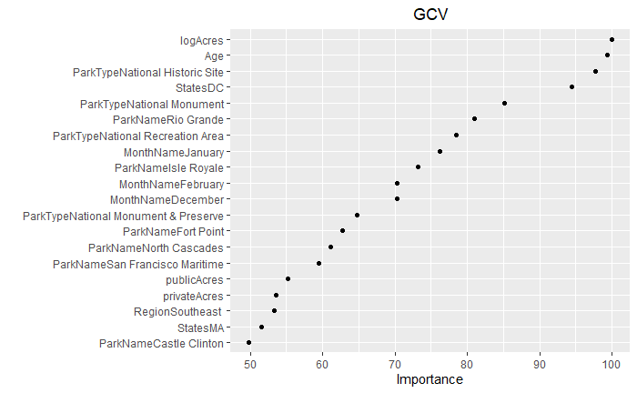
Interesting Things: MARS
MARS was our main analysis plan
Selected number of prunes (50) was too small
Number of degrees (2) seemed reasonable, but wasn’t used in the top important variables
Took a long time to run the cross-validation code
Typically bad predictions, and constant over years

Slide 3
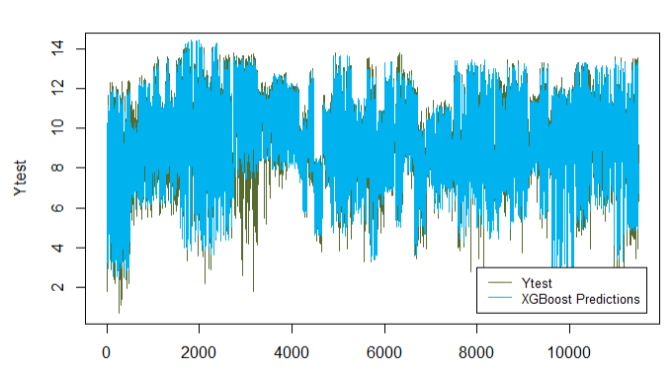
Interesting Things: The Power of Trees
XGBoost adapted well to seasonal changes and annual changes
Not depending on linear relationships allowed greater flexibility
Some parks still weren’t well modeled and MARS did just as well.
A fairly simple model (eta = 0.05, gamma = 2, lambda = 1, colsample-bytree = 0.85, subsample 0.6, max.depth = 8, nrounds = 1500, min-child-weight = 2) resulted in strong predictions on test set
MSE : 0.415, MAE: 0.399

Slide 4
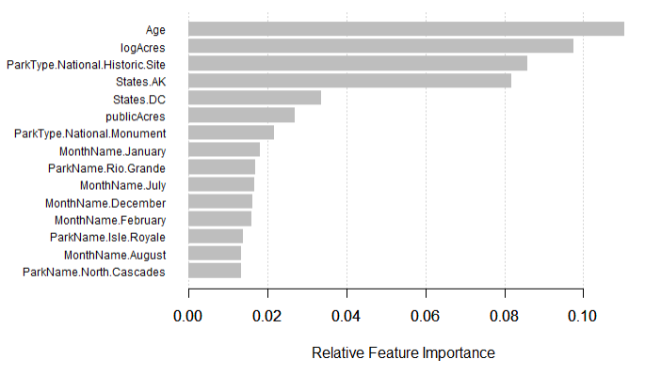
Feature Importance for XGBoost

Slide 5
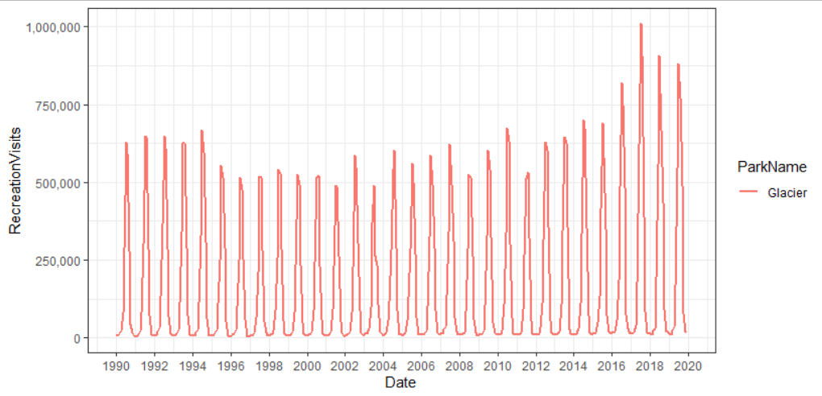
Interesting Things: No one size fits all
Time component is relatively negligible
Seasonal patterns are explained by month
Every park is unique and has trends that match its particular history
Makes it nearly impossible to generalize well

Slide 6





Biggest Challenge: API and fees
Learning how to connect properly
Converting JSON to usable formats
Wrangling individual idiosyncrasies
Fees
Time
Merging data from IRMA

Slide 7
If You Could Do It Again…
Precipitation Data took a long time to gather
There was too much data and the API was hard to work with
Limited number of pulls per line of code and per day
Wound up not using it because it was too difficult to combine datasets
2 Options:
Select specific stations to use for each park
Less data, easier to combine, easier to pull
Don’t use precipitation data
Likely is captured in the month variable anyways

Slide 8
Lessons Learned
Hopes, dreams, and ambitions are fenced in by time and resources
Data Pre-processing pays dividends for later modeling steps
Imputation is great, but sometimes the missing data can be filled in accurately with some tactical Googling
Sometimes the simple answer works best (ex. Fee structures, MARS)
Original Hypothesis: People prefer to visit free parks, especially in states with higher poverty
Reality: The states with the most visits are those which charge fees and this trend is true for states with all levels of poverty

Slide 9
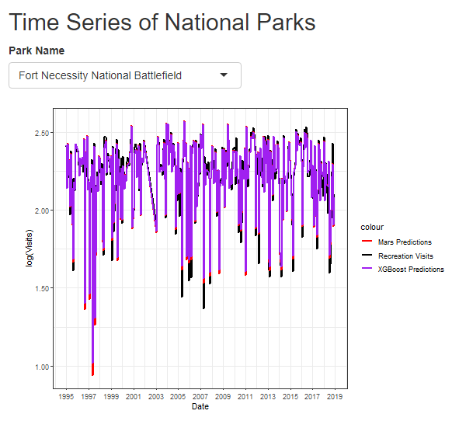
R Shiny
Our app allows users to view actual and predicted visitations for all National Parks listed with NPS from 1995 to 2018
Both XGBoost and MARS predictions are shown for each park
Rather than include the modeling steps in the app itself, we modeled and predicted ahead of time. Only the predictions are ported over to the app.
https://national-parks-visitation-model.shinyapps.io/ShinyApp/

