Slide 1
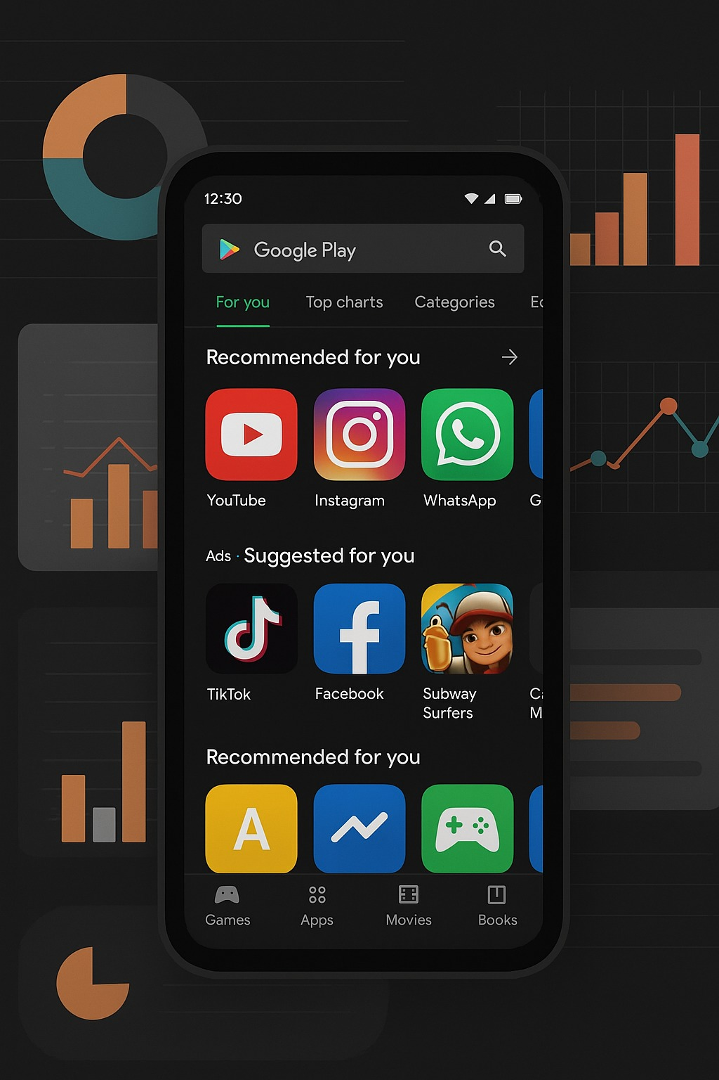

App Store Insights Dashboard
To analyze Google Play Store app data and extract insights on app performance, category-wise trends, user engagement, ratings, installs, pricing, and content distribution. This dashboard helps stakeholders quickly understand which apps perform well, what categories dominate the market, and how user ratings impact popularity.
Notes:
1

Slide 2
Data Description
Dataset Source: Google Playstore Apps – gauthamp10
Data Cleaning Performed:
Removed duplicates based on App name
Total Records: ~10,842 apps
Fixed formatting issues in Price and Installs
Replaced "NaN" and blank values in Rating
Key Columns Used:
Transformed columns into proper data types
App
Removed errors in Power Query
Category
Rating
Reviews
Size
Installs
Price
Type (Free/Paid)
Content Rating
Genres
Last Updated
Notes:
2

Slide 3
Target Audience
This dashboard is designed for:
Product Managers
App Developers
Marketing Teams
to track competitor performance
to understand trends & user expectations
to identify high-install categories
Business Leaders
Startups
to take strategic decisions based on app insights
to decide which category has high market potential
Notes:
3

Slide 4

Key Features
1
2
Dashboard 1: App Store Overview
Dashboard 2: App Insights & Performance Analysis
Total Apps Summary
Category Distribution
Category Trends
Top 10 Apps by Installs
Pricing Insights
Rating Analysis
Installs vs Ratings Relation
Free vs Paid Apps Breakdown
Content Rating Analysis
Top-Performing App Categories
Interactive Slicers: Category, Type, Content Rating, Price
Notes:
4

Slide 5

Tools & Techniques Used
Tools:
Microsoft Excel (Data cleaning)
Power BI Desktop (Modeling & Visualization)
Techniques:
Data Cleaning & Transformation in Power Query
Data Modeling (Fact & Dimension Tables)
DAX Measures (Total Installs, Average Rating, Count of Apps, Top N Logic)
Star Schema Design
Visual-level, Page-level & Report-level Filters
Dashboard Formatting & Theme Optimization
Notes:
5

Slide 6
Scope & Limitations
Scope:
Limitations:
Provides insights on app installs, ratings, genres, and pricing
Dataset is not 100% real-time
Some data fields may be inaccurate (user-entered app data)
Helps compare performance between categories
Offers quick decision-making visuals for stakeholders
Limited to Google Playstore, not combined with App Store
Covers both free and paid apps analysis
Rating and install numbers are approximate, not exact
Notes:
6

Slide 7
Outcome
Helped identify top-performing categories
Showed which apps gain high installs with fewer ratings
Revealed market share distribution across categories
Highlighted the difference between Free vs Paid app performance
Provided a clear understanding of user engagement and app trends
This dashboard can be presented in interviews as a complete end-to-end project explaining your understanding of data cleaning, modeling, and visualization.
Notes:
7

Slide 8
Future Enhancements
01
02
Add time-series analysis using Last Updated
Combine Google Play store & Apple Store datasets for cross-market insights
03
04
Include sentiment analysis of reviews
Add a prediction model for installs
05
06
Add bookmark navigation for professional storytelling
Build a mobile-optimized version of the dashboard
Notes:
8

Slide 9
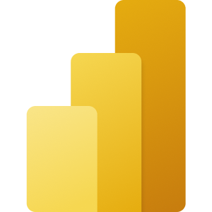

Microsoft Power BI

Slide 10
Microsoft Power BI

Slide 11
Thank You
We appreciate your time and attention. Feel free to reach out with any questions.
Notes:
11

