Slide 1
WINDOORS 11.3
Caretaker
A satirical Windows maintenance survival game — built end-to-end with Grok AI.
Play my-happy-place-game.grok.me · X @thimothybsirius
GitHub · JW-0042/my-happy-place-game

Slide 2
Agenda
01
Concept & why it exists
02
Gameplay loop & System Health
03
Maintenance tools showcase
04
Screenshots from the live game
05
Tech stack & architecture
06
Creator promotion & next steps
Windoors 11.3 Caretaker · Built with Grok AI
2 / 12

Slide 3
Concept
Windows maintenance trauma — as a game
Parody OS
Survival loop
Windoors 11.3 nods to Windows 3.11 and modern Win11 UI patterns.
System Health drains. Run tools or die on a classic BSOD.
AI-shipped
Viral hook
Full browser game vibe-coded with Grok — playable product, not a mock.
In-game credits + BSOD QR drive follows to @thimothybsirius.
Windoors 11.3 Caretaker · Built with Grok AI
3 / 12

Slide 4
How to play
1
Watch System Health
Top-right HUD. OPTIMAL → CRITICAL → 0%.
2
Answer FIX NOW toasts
Or open tools from desktop icons / taskbar.
3
Run maintenance apps
Complete phases to restore health.
4
Risk the BIOS flash
Lower drain tier — or roll a BSOD (32%).
5
Call Remote Support
Pause drain; each call worsens future decay.
6
Restart after BSOD
QR + link → creator X profile.
Windoors 11.3 Caretaker · Built with Grok AI
4 / 12

Slide 5
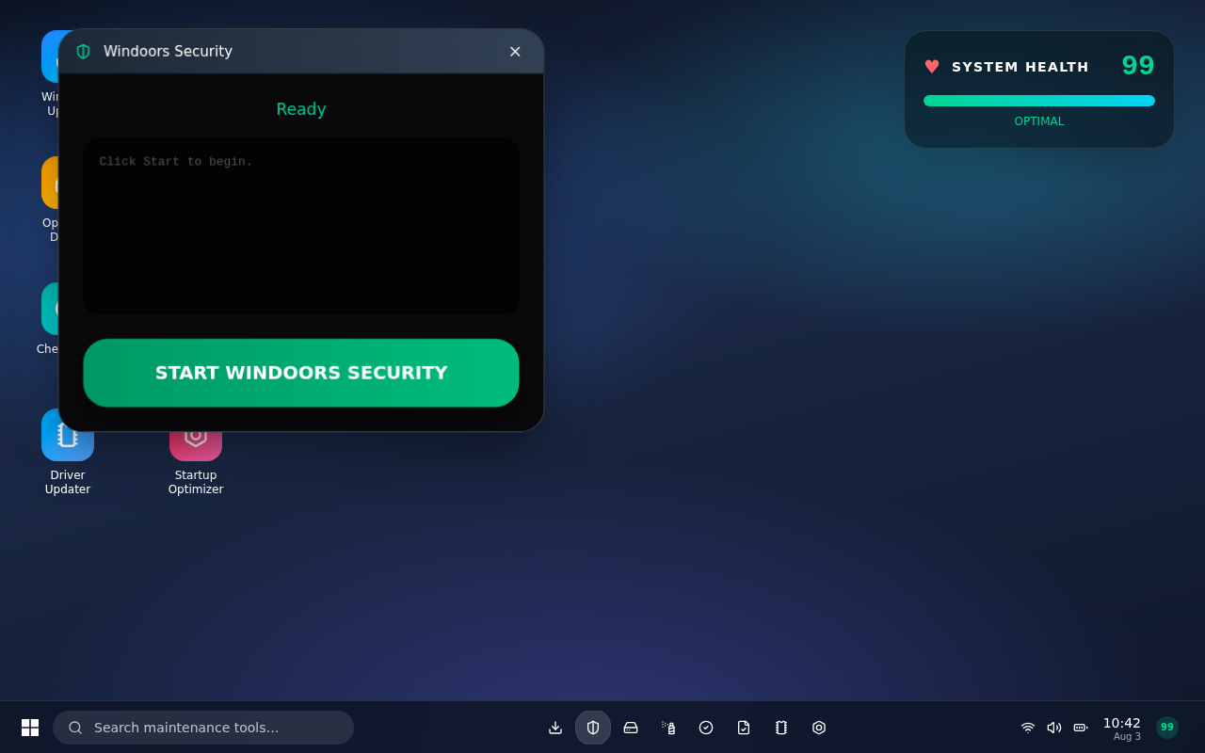
Live game — Desktop
Windoors Security ready · System Health OPTIMAL
Windoors 11.3 Caretaker · Built with Grok AI
5 / 12

Slide 6
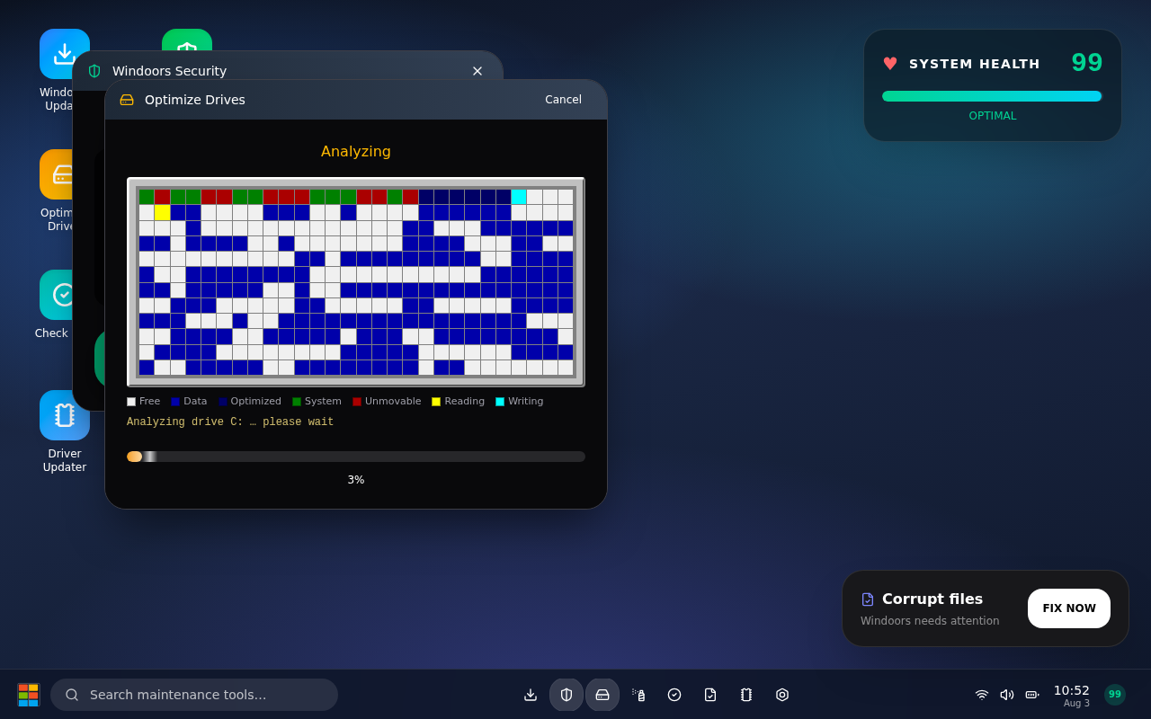
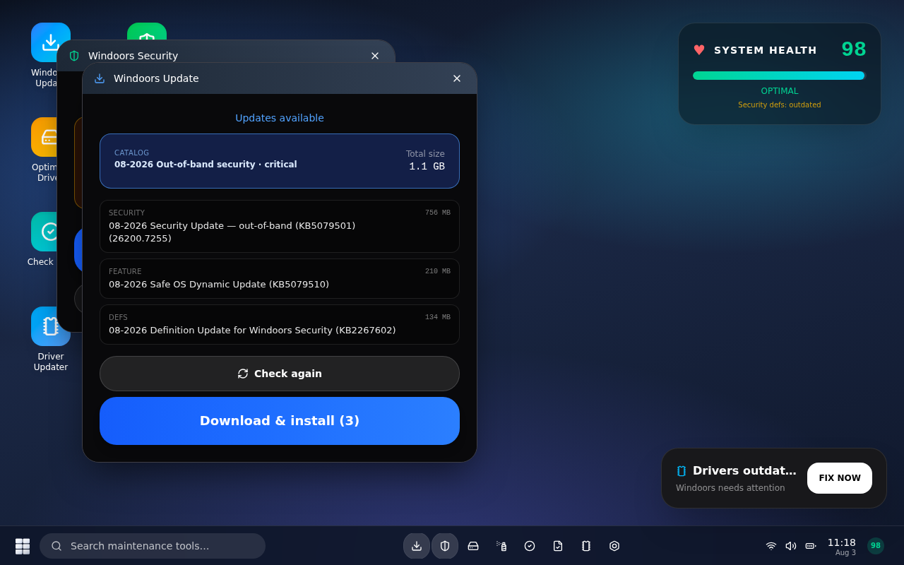
Tools — Defrag & Update
Classic cluster map
Fake KB catalog · Patch Tuesday energy
Windoors 11.3 Caretaker · Built with Grok AI
6 / 12

Slide 7
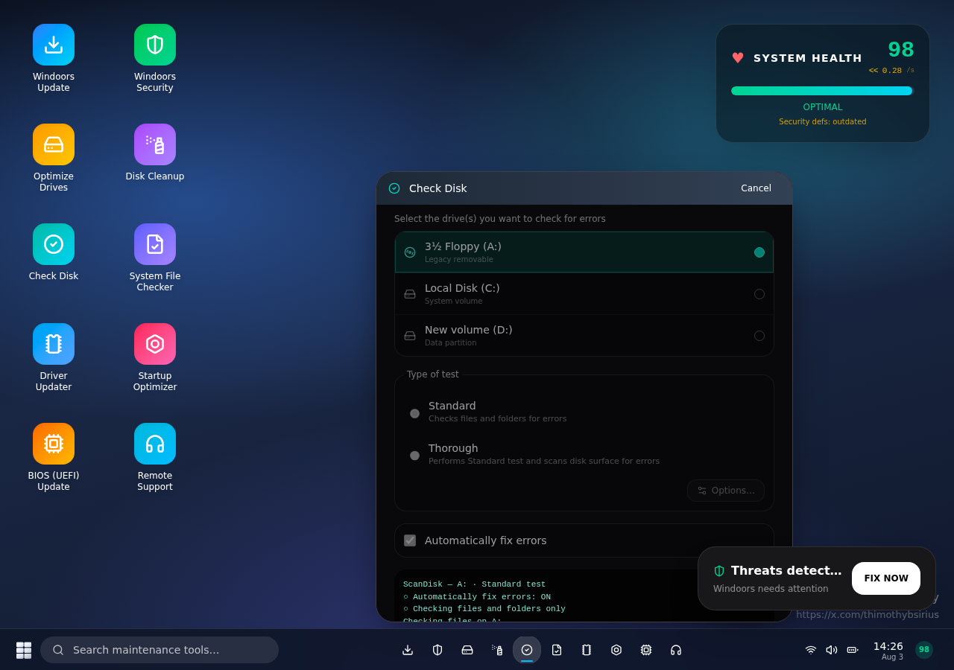
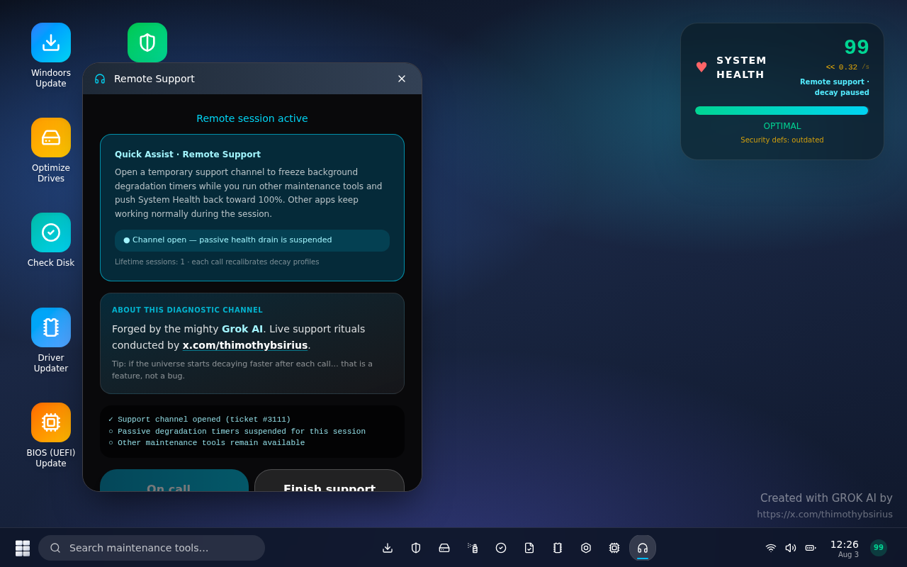
Tools — Check Disk & Remote Support
3½ Floppy (A:) · ScanDisk nostalgia
Pause drain · Grok + @thimothybsirius credit
Windoors 11.3 Caretaker · Built with Grok AI
7 / 12

Slide 8
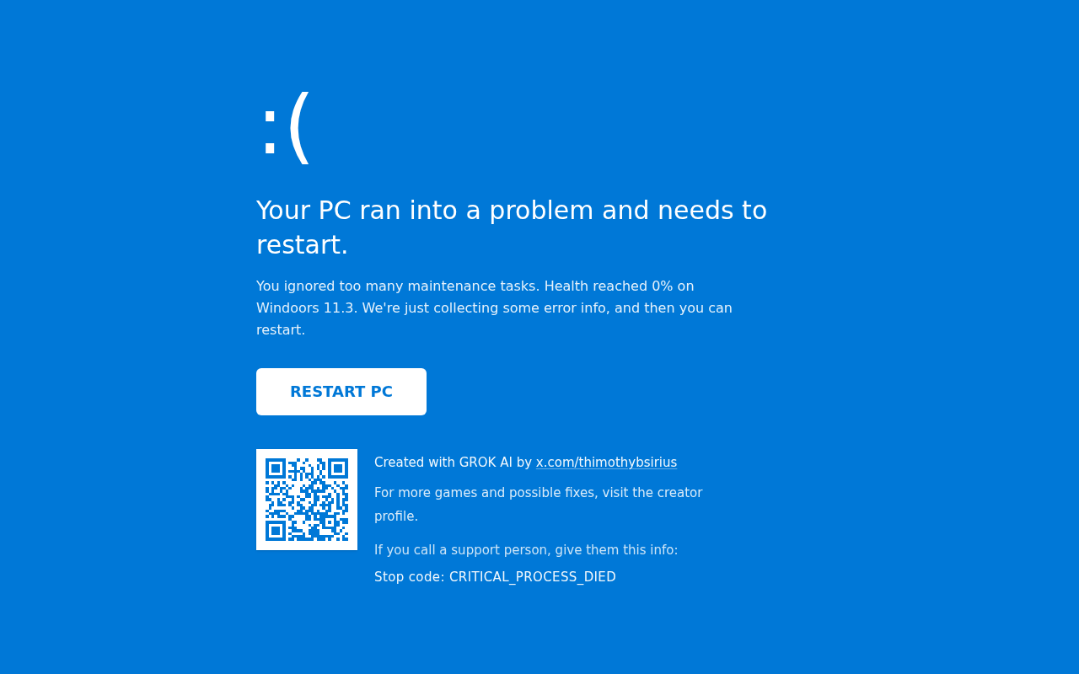
Game over — BSOD credit screen
QR + link → x.com/thimothybsirius · Stop code: CRITICAL_PROCESS_DIED
Windoors 11.3 Caretaker · Built with Grok AI
8 / 12

Slide 9
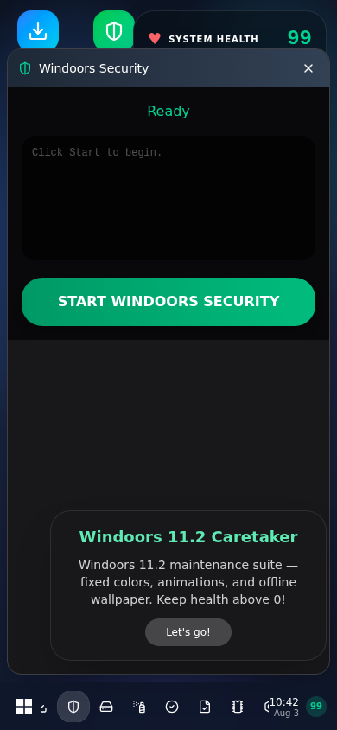
Mobile-ready
Responsive desktop: compact health bar, scrollable icons, full-screen windows on narrow viewports. Same survival loop on phone.
Touch-friendly FIX NOW toasts
Taskbar + tray health badge
BSOD credit on mobile too
Windoors 11.3 Caretaker · Built with Grok AI
9 / 12

Slide 10
Tech stack
React 19
TanStack Start
Vite 8
UI & game state
Router + app shell
Dev & build
Tailwind CSS 4
TypeScript
Grok / Vercel
Desktop chrome styling
Typed config & windows
Hosted on *.grok.me
Windoors 11.3 Caretaker · Built with Grok AI
10 / 12

Slide 11
All 10 maintenance apps
App | What it spoofs
Windoors Update | Patch Tuesday / KB catalog install
Windoors Security | Multi-phase threat scan
Optimize Drives | Classic defrag cluster map
Disk Cleanup | Temp file purge
Check Disk | ScanDisk · A:/C:/D:
System File Checker | Corrupt system files fantasy
Driver Updater | GPU / Audio / Chipset / WLAN
Startup Optimizer | Boot bloat cleanup
BIOS (UEFI) Update | High risk firmware · drain tier
Remote Support | Pause drain · creator credit
Windoors 11.3 Caretaker · Built with Grok AI
11 / 12

Slide 12
Play · Share · Follow
Survive the updates. Blame the BIOS. Tag the creator.
https://my-happy-place-game.grok.me/
https://x.com/thimothybsirius
github.com/JW-0042/my-happy-place-game
Built with Grok AI · Not affiliated with Microsoft

