Slide 1
Diet, gut microbiota, and long-term
outcome after colorectal cancer surgery
Project handover to Da-Young Kang
Follow-up to Huh et al., Microbiome 2022
Translational Microbiome Laboratory, Chungnam National University · 15 October 2026

Slide 2
Prior work: an enterotype that predicts outcome
Huh JW, Kim MJ, Kim J, Lee HG, Ryoo SB, Ku JL, Jeong SY, Park KJ, Kim D, Kim JF, Park JW. Microbiome 2022;10:203.
Preoperative stool from 333 primary colorectal cancer patients, profiled by 16S rRNA gene sequencing and followed for a median of 27.6 months for progression.
High abundance of Prevotella, the enterotype-defining genus, was associated with lower risk of both progression and death.
Higher risk was associated with Alistipes, a Bacteroides species, Pyramidobacter piscolens, Dialister invisus and Fusobacterium nucleatum.
A microbiota-based hazard score predicted progression better than CEA or lymphatic invasion, with adjusted HR 2.07 and C-index 0.78.
PICRUSt2 nominated thiamine salvage and L-histidine degradation as candidate mechanisms.
What the paper could not answer. It never measured what these patients ate. Whether the Prevotella-rich community is itself protective, or simply marks a diet that is, was left open.

Slide 3
The same cohort already has a diet paper, and it stops short
Hoang T, Kim MJ, Park JW, Jeong SY, Lee J, Shin A. BMC Cancer 2022;22:656. Nutrition-wide association study of microbiome diversity and composition in colorectal cancer patients.
115 of the 333 patients completed a validated 106-item semi-quantitative FFQ, which was expanded to 92 nutrients and 16 food groups and energy-adjusted by the residual method.
Diet was related to alpha diversity and to taxon abundance. Mature pumpkin tracked with several taxa, eggs inversely so, seaweed with lower Alistipes, and total beverages with higher Bacteroidetes.
No diet-diversity association survived FDR correction, and no Prevotella-specific dietary association was reported.
The design was cross-sectional. The authors state explicitly that they could not evaluate recurrence or prognosis.
The unresolved question
Two papers from this cohort cover diet to microbiota, and microbiota to outcome. Neither joins the two. Does habitual diet produce the survival advantage of the Prevotella-rich enterotype, or do diet and microbiota contribute independently?

Slide 4
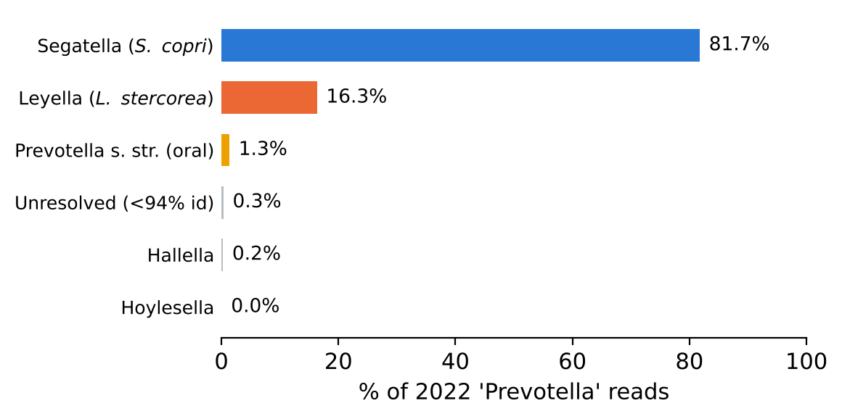
Prevotella degrades dietary fibre, and is no longer one genus
Segatella copri, formerly Prevotella copri, carries an unusually large set of xylan and arabinoxylan loci (GH10, GH43, GH51) and expands selectively on whole grains and plant-rich diets.
Hitch et al. (Syst Appl Microbiol 2022;45:126354) split Prevotella on genomic grounds into Segatella, Leyella, Hoylesella, Hallella and others. The names were validated in IJSEM in 2023 and are used by GTDB and SILVA 138.2.
Leyella stercorea, formerly Prevotella stercorea, is specific to the human gut and produces succinate and acetate. Almost nothing is published on its substrate preferences.
Any "Prevotella enterotype" derived from 2021-era SILVA therefore pools at least two genera whose biology differs.
Reads previously called Prevotella in this cohort, reassigned against the 56 type-strain references.

Slide 5
Objective
We ask whether the survival advantage of the Segatella-Leyella enterotype is produced by habitual diet, or whether diet and the gut microbiota contribute to outcome independently.
Aim 1
Characterise which dietary patterns track with Segatella and Leyella abundance in the patients who have both an FFQ and a stool sample (n = 114).
Aim 2
Test whether the same dietary patterns predict progression-free and overall survival in the larger clinical cohort with FFQ data (n = 519).
Aim 3
Determine whether the enterotype effect on survival persists after adjustment for diet, which separates a diet-mediated effect from an independent one.
Either answer carries a paper. If diet explains the effect, the result supports dietary intervention after surgery. If the effect is independent, the microbiota biomarker becomes stronger, not weaker.

Slide 6
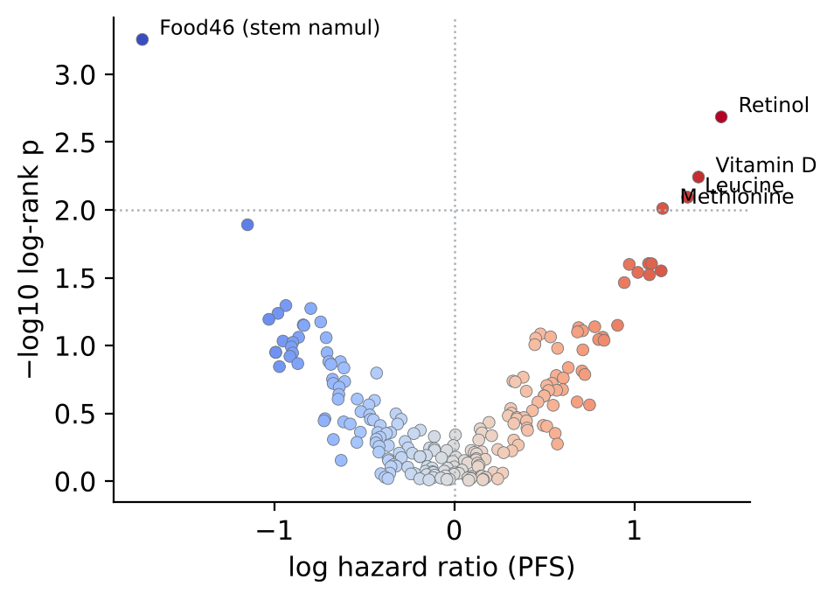
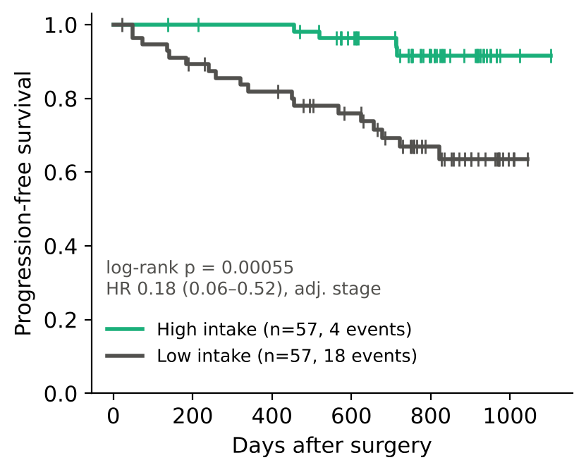
Status 1. One FFQ item ranked first in the 2022 screen
209 dietary variables were screened against progression-free survival in the 114 patients who had both an FFQ and a stool sample.
Food46, a single FFQ item covering bracken, sweet potato stalk and taro stem, ranked first at FDR 0.12. All three are stems eaten boiled as namul.
Four progression events occurred in the high-intake half against eighteen in the low-intake half.
Notes:
2022 diet values were recovered from Image_06_Diet.RDS and are already residual-adjusted for energy. Do not re-adjust.

Slide 7
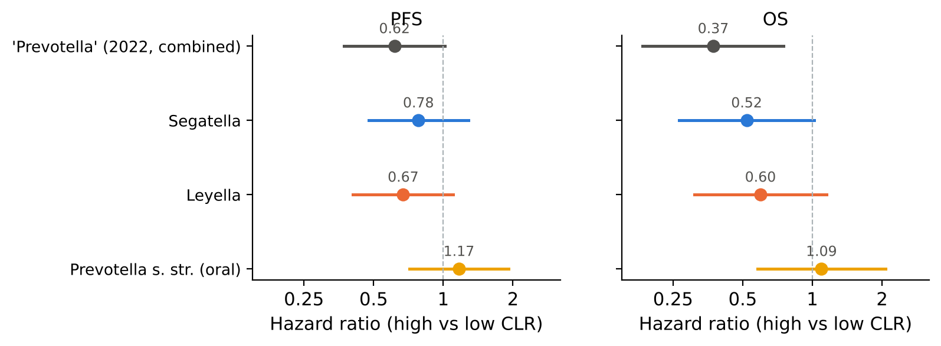
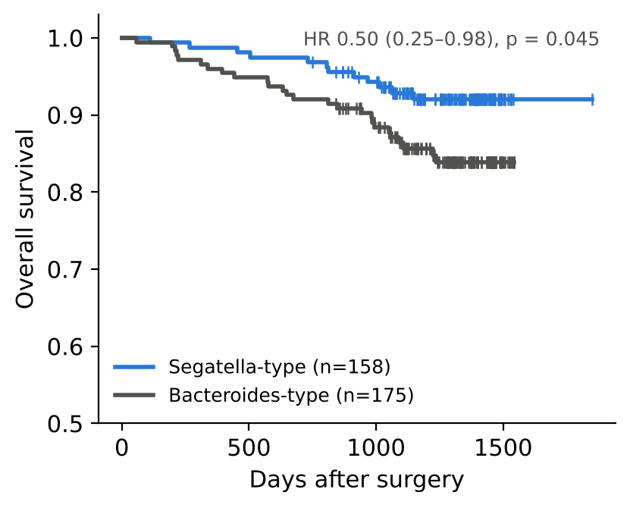
Status 2. The protective signal splits across two genera
Both gut genera point the same way, while the oral Prevotella clade points the other way. The 2022 combined variable was significant largely because it summed the two gut genera.
Re-deriving enterotypes by PAM clustering on Jensen-Shannon distance reproduces the 2022 survival difference, with overall survival HR 0.50 (0.25 to 0.98).
Separating the oral clade from the gut clades is itself a contribution relative to the 2022 paper.

Slide 8
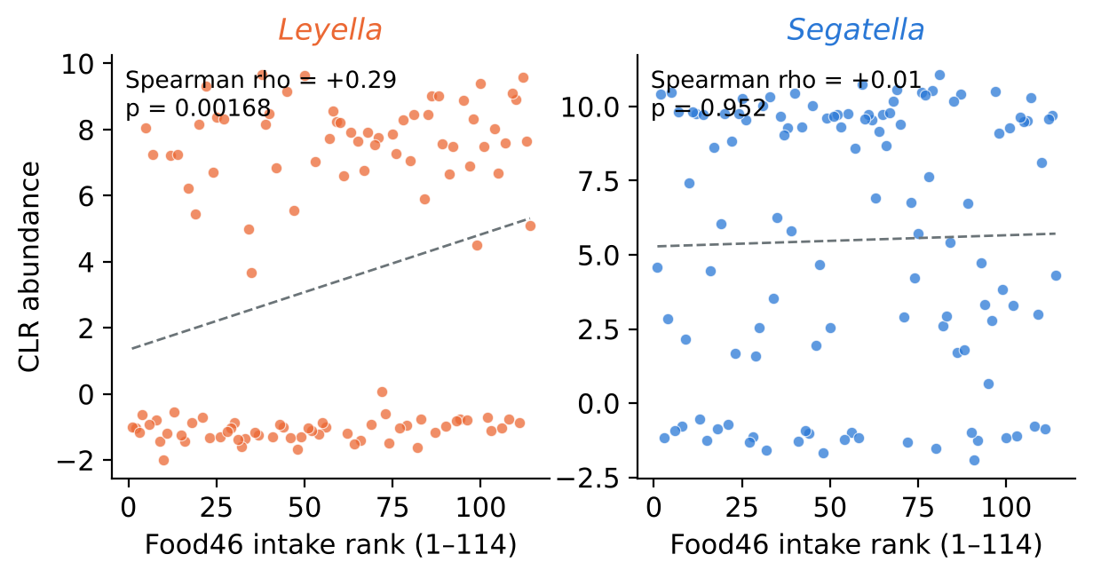
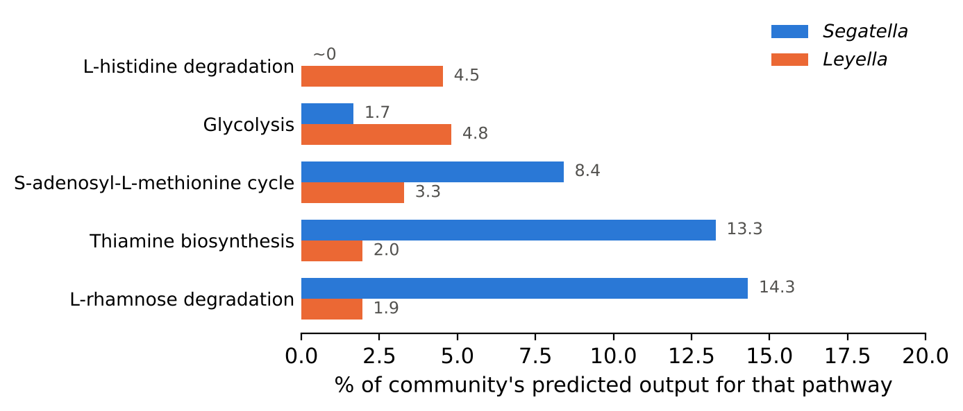
Status 3. Food46 tracks Leyella rather than Segatella
Across 70 genera present in at least 20% of samples, Leyella ranked first (Spearman rho 0.29, FDR 0.16) while Segatella showed no association at all.
The two mechanisms nominated in 2022 also separate between the genera: thiamine biosynthesis is almost entirely Segatella, and histidine degradation almost entirely Leyella.
Food46 remains associated with survival after adjusting for either genus, so this is not mediation. The two observations should be reported separately.

Slide 9
How the reassignment was done, and why it must be repeated
What was actually run
Each of the 1,004 ASVs previously labelled Prevotella was aligned by Needleman-Wunsch against the 56 type-strain V3-V4 sequences already present in 1-Input/tree/, using a k-mer prefilter to shortlist three candidates per ASV. The best hit at 97% identity or above was taken as a species call, then mapped to the Hitch 2022 genus. This ran in Python in a Linux container and took nine minutes.
What it is not
It is not DADA2 assignTaxonomy. It uses no reference database beyond those 56 sequences, and it produces no bootstrap confidence value. An ASV whose true species is absent from the reference set is forced onto its nearest available neighbour, 404 ASVs fell below 94% identity and were left unresolved, and the V3-V4 region cannot separate every species pair in this family.
What follows for you
Treat every Segatella and Leyella number in this deck as a likely direction rather than a final value. Redoing the assignment properly, with DADA2 against SILVA 138.2 and GTDB r220, is the first task and everything downstream depends on it.

Slide 10
Two datasets, mostly different patients
The 540-patient clinical and FFQ spreadsheet and the 333-patient microbiome metadata do not describe the same people. Surgery dates in the spreadsheet cluster in 2015-16 and 2020-21, while stool was collected between October 2017 and August 2019.
Patient numbers are not shared between the two files. Merging on NO gives a 2% age agreement and is simply wrong.
Matching on sex, age, haemoglobin, white cell count, BMI, stage and event status recovers 31 pairs. Fields held out of the matching agree closely: CEA in 97% of pairs, platelets in 94%, albumin in 94%.
Survival times in matched pairs differ by a constant 78 days at the median, which reflects a later data freeze in the spreadsheet rather than a mismatch. A permutation null yields about two spurious pairs, so roughly 29 of the 31 should be genuine.
Practical consequence. Any analysis that needs diet and microbiota in the same patient must use the 115-patient 2022 file, whose identifiers already match the microbiome data. The 540-patient spreadsheet is for the diet-to-outcome analysis only, and the two must never be pooled.

Slide 11
Work plan
1. Redo the taxonomic assignment
Start here. Run 02_retaxonomy_prevotella.R, which assigns the ASV table with DADA2 against SILVA 138.2 and GTDB r220, then compare the result with prevotella_reassignment.csv and re-derive the enterotypes. If the crosswalk holds, the current slides stand; if it does not, every number after this changes.
2. Dietary pattern analysis
This is the primary result. In the 519 spreadsheet patients, residual-adjust the 17 food groups for energy, extract two or three patterns by PCA, then fit Cox models for progression-free and overall survival adjusting for stage, age, sex and surgery year. Run sensitivity analyses in the 2014-16 surgeries and in stage III alone.
3. CAZyme comparison of the two genera
Run 03_dbcan_cazyme_compare.sh on S. copri and L. stercorea reference genomes. The question is whether Leyella carries pectin and mannan loci that Segatella lacks, which would give a genomic basis for its association with boiled stem vegetables.
4. External validation, by constituent rather than by food
No public cohort records an equivalent of Food46, so validation has to go through what the food is made of. Map it onto measurable constituents, such as insoluble fibre, pectin, hemicellulose and specific polyphenols, and test those in cohorts that report nutrients. For the microbiota-to-outcome half, Petersen et al. (JCO Oncol Adv 2026) is the closest independent design, with 294 Dutch patients, preoperative stool and 61 recurrences. It carries no dietary data, so it can validate the taxa-outcome link only, and would require contacting the authors.

Slide 12
Where everything is: 5-Ongoing (261015)
Folder | Contents
1-input | Dietary_data_2022_115_residual_from_Image06.csv, already energy-adjusted, keyed to microbiome NO. The 540-patient FFQ extract. genus_newtax_counts.csv and genus_oldtax_counts.csv. prevotella_reassignment.csv, the provisional crosswalk. merged_333_newtax.csv with CLR values and enterotypes. id_link_verified.csv, the 31 verified pairs.
2-script | 01 diet and prognosis in R, 02 re-taxonomy in R, 03 dbCAN3 in bash. Helpers: cox.py for Cox and log-rank without external packages, rdata.py to read R workspace files, reassign.py for the provisional assignment, make_panels2.py for the figures.
3-figure | P0 to P7 as paired SVG and PNG, one panel per file, sized to their native aspect ratio.
4-output | Cox result tables, the Food46 by 70-genus screen, PICRUSt2 contributions by genus, and README.md.
First step: open 2-script/02_retaxonomy_prevotella.R, download the two reference databases it names, and run it on the ASV table in 1-Input. Compare its genus assignments with prevotella_reassignment.csv before touching anything else.

