Slide 1
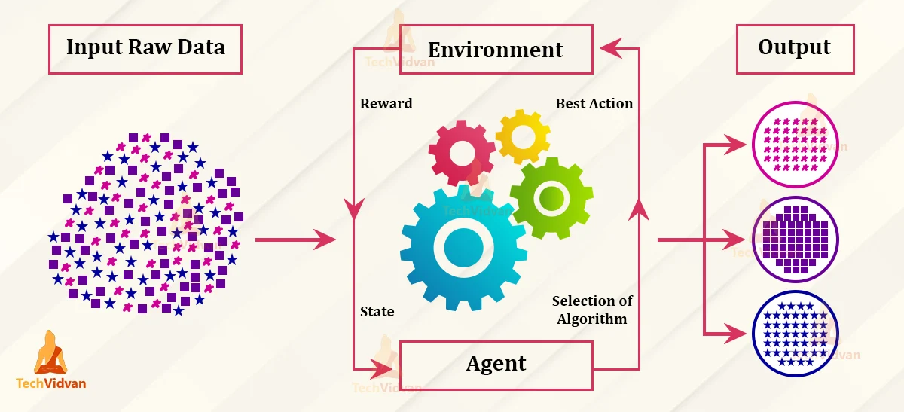
Reinforcement Machine Learning
Continuously Adaptive Convergence to Drive the Best Actions FANTASTIC
John Hebeler, PhD
Lockheed Martin Fellow
john.w.hebeler@lmco.com

Slide 2
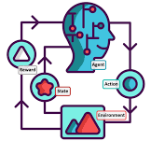

Agenda
RL Defined and Compared
RL Applied
RL Types
RL Vocabulary
RL Demonstrations
Summary
Code available at…

Slide 3
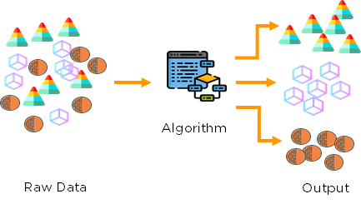
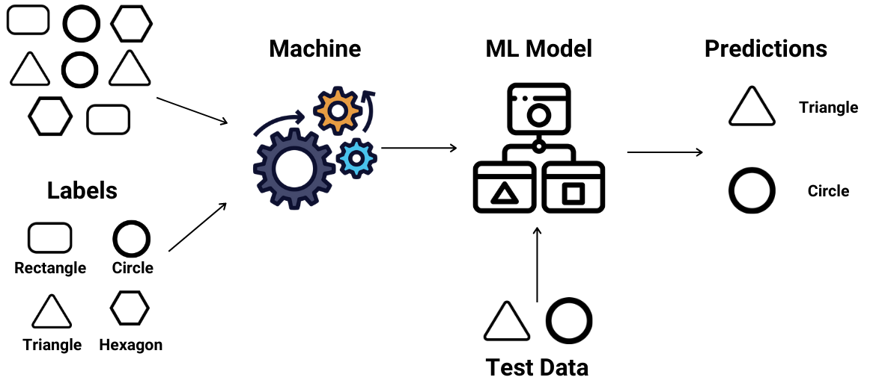
ML Types

Slide 4
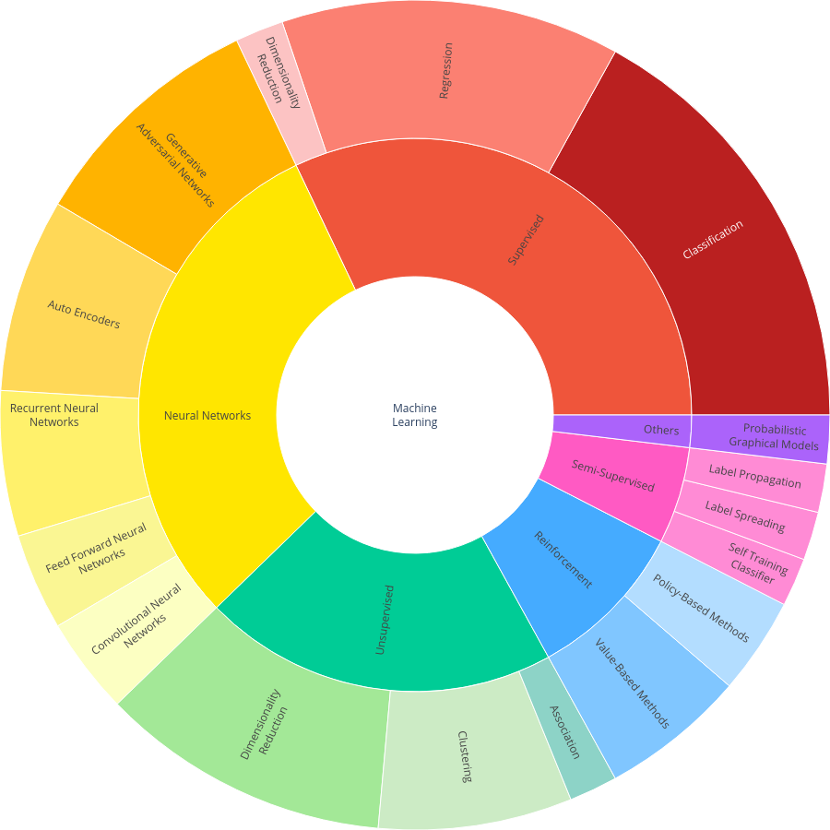
https://plotly.com/~jhebeler/1/

Slide 5
RL Vocabulary
Agent
Environment
Action Space
State (Observation Space)
Reward or Punishment

Slide 6
Key Question in Designing RL
How do I define a goal and a reward?
How do I make the agent act?
How do I model the environment?
How do I determine the current state?
Exploration-Exploitation Trade-Off?
Policy-based methods vs Value-based methods

Slide 7
Demonstrations
Environment
Local Hardware and Software
Cloud setup on AWS and Azure
Tic Tac Toe
Blackjack
Pole Balancing (AWS)

Slide 8
Summary
Powerful Complement to Other ML Methods
Powerful Environments Available
Get your hands into it

