Slide 1

BERT: Pre-training of Deep Bidirectional Transformers for Language Understanding
Jacob Devlin
Ming-Wei Chang
Kenton Lee
Kristina Toutanova
Google AI Language 2019.05.24

Slide 2

Author Info
Jacob Devlin – BBN Tech, MS Research, Google
2017 Visual Storytelling, Generating Natural Questions About an Image
2018 Universal Neural Machine Translation for Extremely Low Resource Languages
2019 Natural Questions: A Benchmark for Question Answering Research
Ming-Wei Chang – MS, Google
Kenton Lee – Google
Kristina N Toutanova – MS, Google

Slide 3
Introduction
Language model pre-training
Feature-based – ELMo
Fine-tuning – OpenAIGPT
Share pre-training, unidirectional function to learn language
Improve the fine-tuning based
Bidirectional Encoder Representations from Transformers
MLM(masked language model, Taylor 1953)

Slide 4
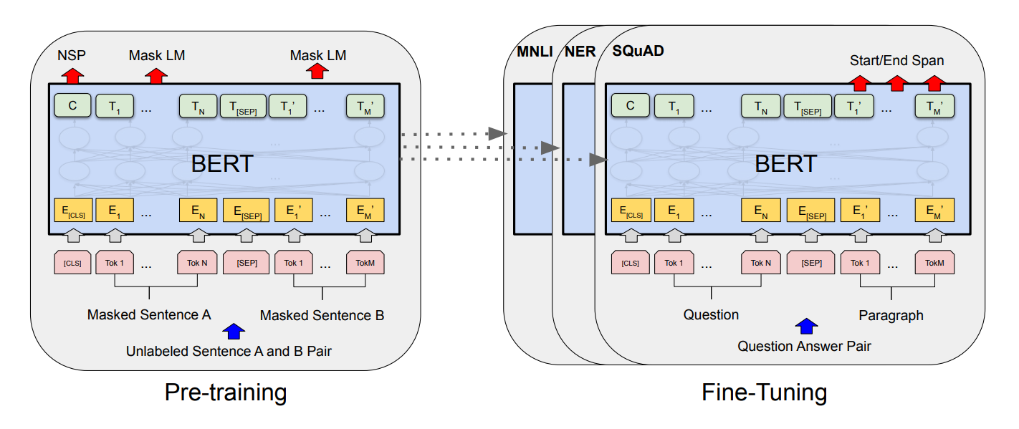
BERT
Two steps – pre-training(unlabeled), fine-tuning(labeled)
Vaswani - tensor2tensor(Transformer)
Wu – WordPiece [CLS] [SEP]

Slide 5
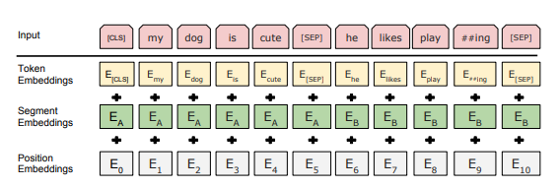
Pretraining BERT
1. Masked LM – bidirectional, see itself
2. Next Sentence Prediction – Figure1, c
Data – Books Corpus, Wikipedia

Slide 6
Fine-tuning BERT
Transformer - bidirectional cross attention
1) sentence pair in paraphrasing
2) hypothesis premise
3) question-passage in question answering
4) degenerate text – null (text classification/sequence tagging)

Slide 7
Experiments
GLUE(General Language Understanding Evaluation)
SQuAD v1.1(Stanford Question Answering Dataset)
SWAG(Situations With Adversarial Generations)
Select best fine-tuning learning rate(0.0005~0.05), Epoch, batch size

Slide 8
Ablation Studies
Pre-Training (Unidirectional)
a) twice expensive
b) non-intuitive
c) less powerful
Model Size
Num of Layer(L), Hidden(H), Num of Attention(A)
Feature-based
Not all tasks can be easily represented by a Transformer
No computational benefits

Slide 9
Conclusion
Unsupervised pre-training is an integral part of many language understanding systems.
Enable even low-resource tasks to benefit from deep unidirectional architectures.
Can be finetuned with just one output layer(State of art)

