Slide 1
An Iteration on the Horizon Simulation Framework to Include .NET and Python Scripting
Morgan Yost, California Polytechnic State University San Luis Obispo
Eric Mehiel

Slide 2
Agenda
Purpose Statement
Background Research
Horizon Overview
Improvements
Results
Conclusion
Future Work
Questions

Slide 3
Purpose Statement
The Horizon Simulation Framework is a useful modeling and simulation framework for system level requirements verification but can be updated from C++ and Lua to C# and Python to take advantage of current software development technologies.

Slide 4
Background Research

Slide 5
Spacecraft Design
Pre-PhaseA
Conceptual Study
PhaseA
Preliminary Analysis
PhaseB
Definition
Phase C/D
Design & Development
Phase E
Operations

Slide 6
Modeling and Simulation
Model: “a physical, mathematical, or otherwise logical representation of a system” ¹
Simulation: “a method for implementing a model over time.”¹
Engineering Approaches
Model Based Systems Engineering
Model Driven Development
¹Loper, Margaret (2015). Modeling and Simulation in the Systems Engineering Life Cycle: Core Concepts and Accompanying Lectures. XIX. Springer.

Slide 7
Searching for a Solution
Breadth First Search
Dynamic Programming
Solving subproblems
Principle of Optimality developed by Richard Bellman in 1954:
“An optimal policy has the property that whatever the initial state and initial conditions are, the remaining decisions must constitute an optimal policy with regard to the state resulting from the first decisions.”¹
Branch and Bound
¹Bellman, Richard (1954). “The Theory of Dynamic Programming”. In: Bulletin of the American Math Society 60, pp. 503–515.

Slide 8
Horizon Overview

Slide 9
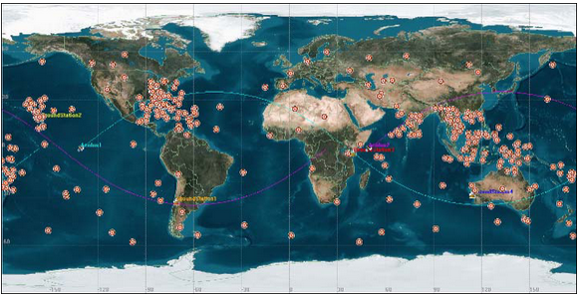
The Aeolus Mission
2 satellites, 5 subsystems each
6307 second orbit
296 Targets
Cory O’Connor, Eric Mehiel and Brian Butler (2008). “Horizon 2.1: A Space System Simulation Framework”. In: AIAA Conference Paper AIAA Modeling and Simulation Technologies Conference and Exhibit.

Slide 10
The Model
ADCS
Actuates spacecraft to target in user defined slew time
EO Sensor
Takes data in user defined low, medium or high resolution (number of pixels)
SSDR
Records data in user defined storage buffer
COMM
Downlinks data at user defined downlink rate
Power
Maintains depth of discharge information from subsystem power usage and solar panel power in

Slide 11
The Scheduler
Reference
A
B
C
1.
2.
3.
4.
5.
6.
7.
C
A
B
C
C
A
C
B
B
C
A
B
B
C
A
t₀ t₁ t₂
The process continues adding 4 more schedules but only 5 more elements in memory.
B
t₀ t₁ t₂

Slide 12
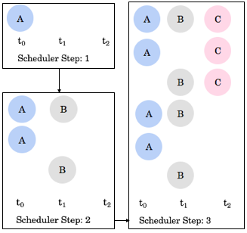
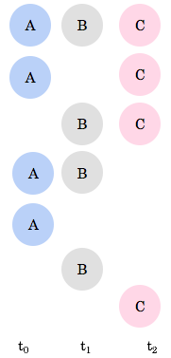
A
B
C
A
C
B
C
A
B
A
B
C
t₀ t₁ t₂

Slide 13
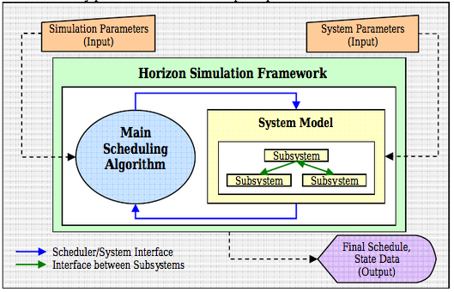
Framework Components
Cory O’Connor, Eric Mehiel and Brian Butler (2008). “Horizon 2.1: A Space System Simulation Framework”. In: AIAA Conference Paper AIAA Modeling and Simulation Technologies Conference and Exhibit.

Slide 14
HSF v2.3 Capabilities
Built in Subsystem Models
Multiple Asset Simulation capability
GUI Prototype
XML Specification
Lua Scripting
Multi-Threading
Genetic Scheduling Algorithm

Slide 15
Improvements

Slide 16
Motivation
Update the Scripting Language
Maintainable, Learnable and Usable
Architecture
Coding Style
User Interface
.NET Framework and Visual Studio

Slide 17
C# versus C++
Shoaib, F.M., et. Al. (2014). “An Evaluation Framework and Comparative Analysis of the Widely Used First Programming Languages: E88941”. In: PLoS One 9.2, pp. 1–25.

Slide 18
C#, .NET and Visual Studio
Managed Language
Exceptional User Interface
Built in libraries
XML
Serialization/Deserialization
LINQ
Generic Collections
The Object

Slide 19
Python versus Lua
Cass, Stephen (2014). Top 10 Programming Languages.

Slide 20
Dependencies
Dependency
Map 1
Integer Call Key → Integer Return Type Dependency Function
Map 2
Double Call Key → Double Return Type Dependency Function
Map 3
Boolean Call Key → Boolean Return Type Dependency Function
Map 4
Matrix Call Key → Matrix Return Type Dependency Function
Notes:
Node dependency looked through each map for you

Slide 21
Improved Dependencies
Dependency
Call Key → Object Return Type Dependency Function
C# and Python classes can and call post dependency functions
Changes to dependency functions doesn’t change dependency class/implementation
Subsystems convert Object to useful return type in their dependency collector
Changed where dependency functions live

Slide 22
Architecture- Schedules
System Schedule
E1A
E2A
E3A
E4A
E5A
Asset 1 Schedule
Asset 1 System State
E1B
E2B
E3B
E4B
E5B
Asset 2 Schedule
Asset 2 System State

Slide 23
Improved Multi-Asset Schedule
System Schedule
E1A
_______
E1B
E2A
_______
E2B
E3A
_______
E3B
E4A
_______
E4B
E5A
_______
E5B
State History
Asset 1 & 2 System State

Slide 24
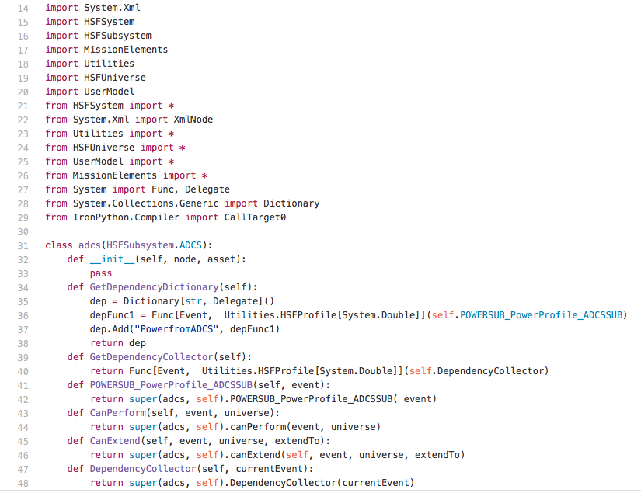
Python Inheritence
Everything that can be inherited can be overwritten
Template subsystem, evaluators and eoms

Slide 25
Simulation Results

Slide 26
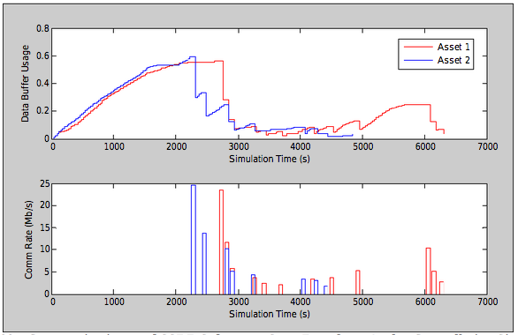
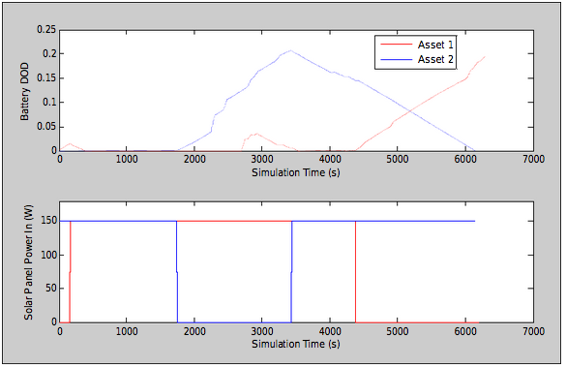
HSF v2.3 Simulation Results
Imaging Functions
Power Functions
Cory O’Connor, Eric Mehiel and Brian Butler (2008). “Horizon 2.1: A Space System Simulation Framework”. In: AIAA Conference Paper AIAA Modeling and Simulation Technologies Conference and Exhibit.

Slide 27
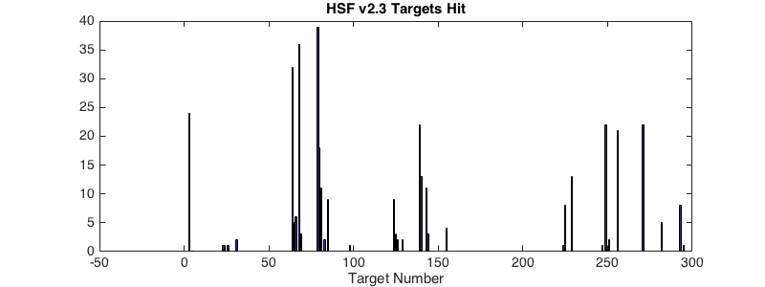
v2.3 Targets Hit
271 Hits

Slide 28
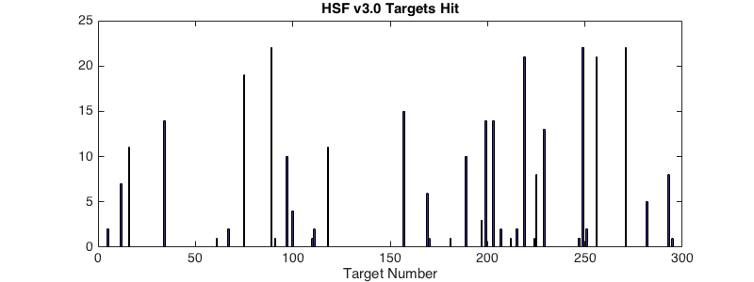
v3.0 Targets Hit
307 Hits

Slide 29
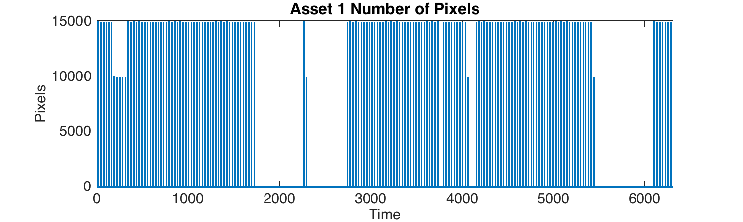
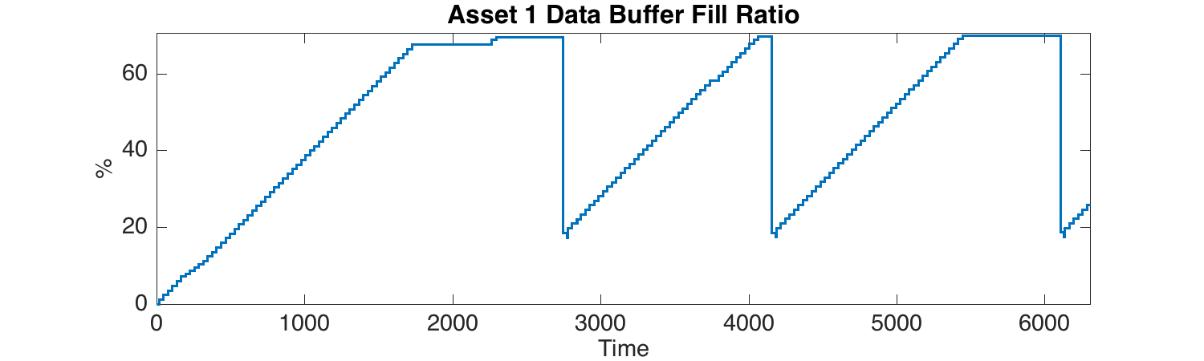
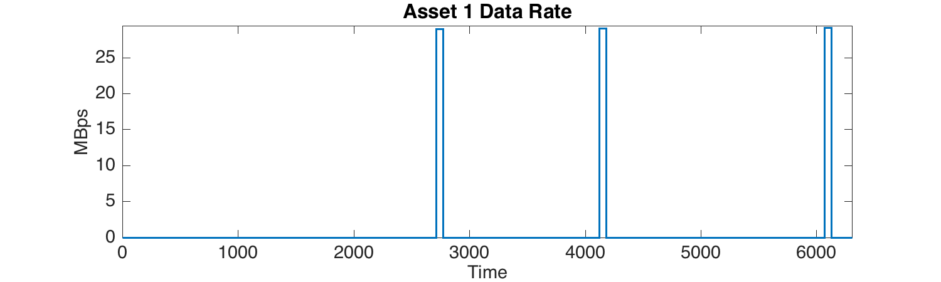

Slide 30
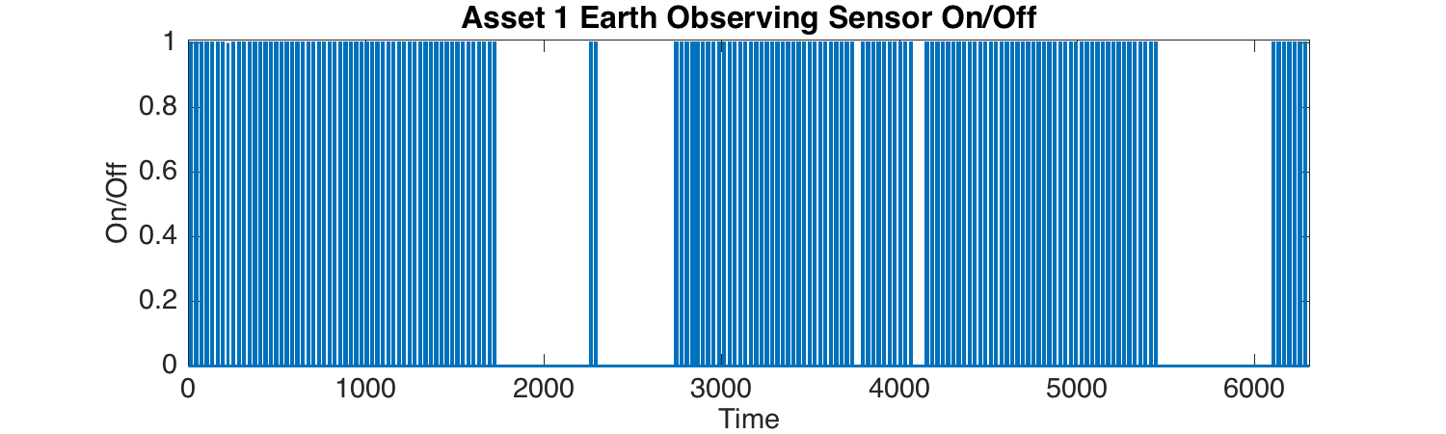
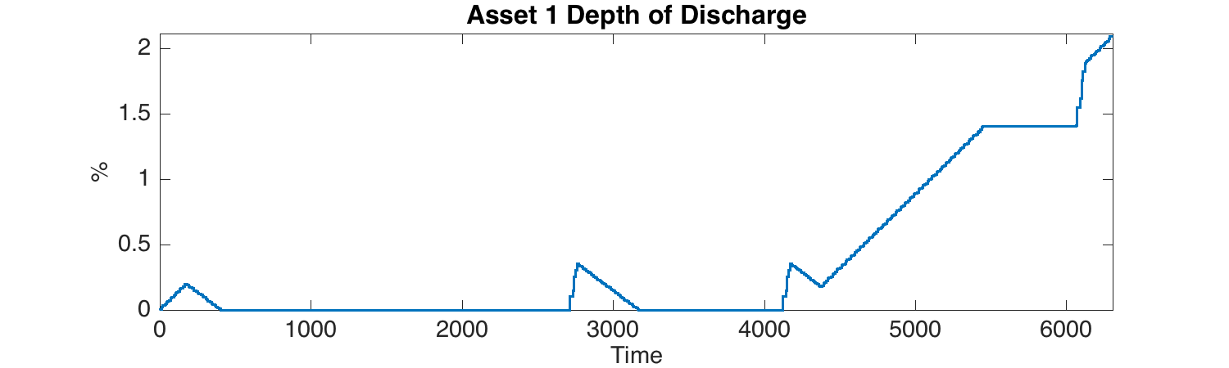
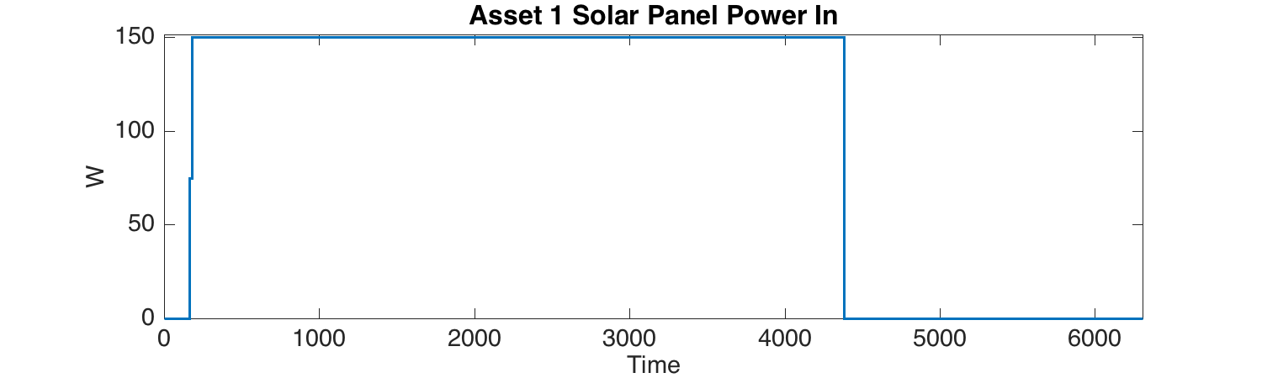

Slide 31
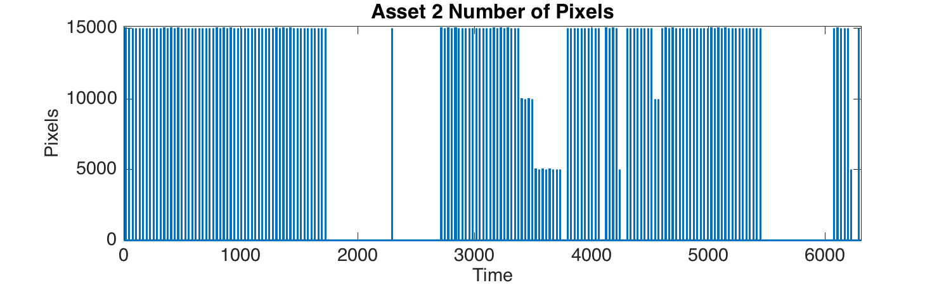
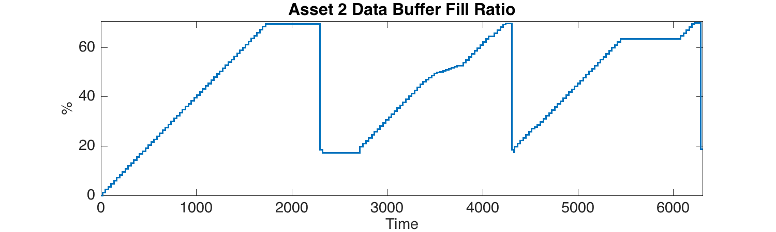
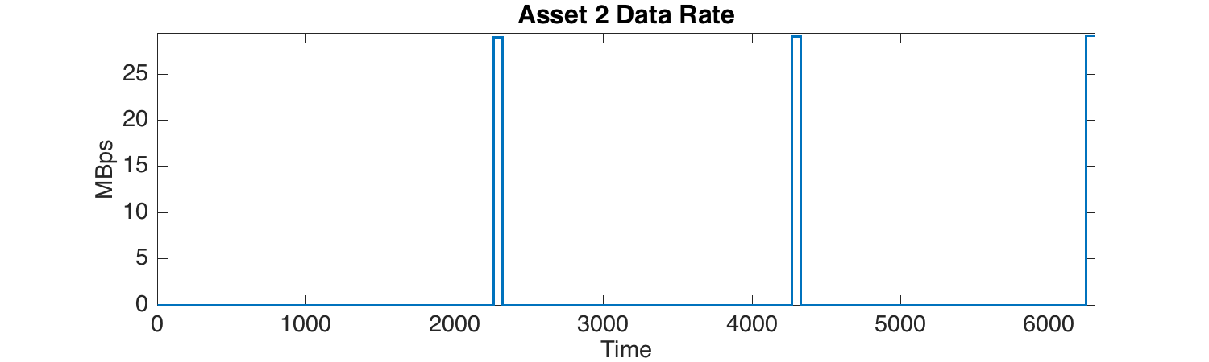

Slide 32
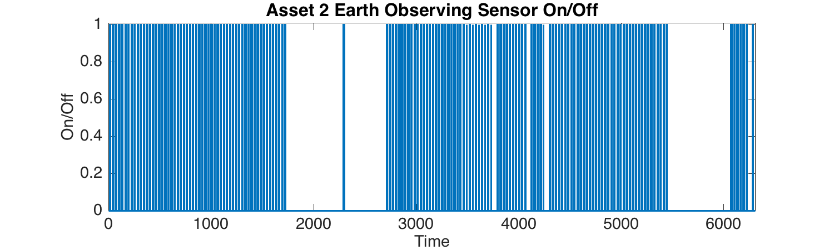
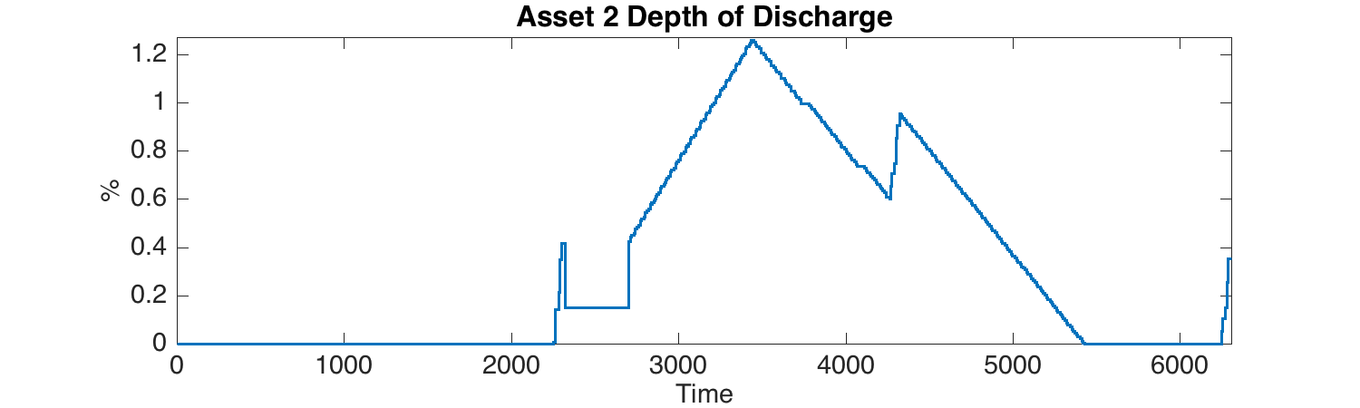
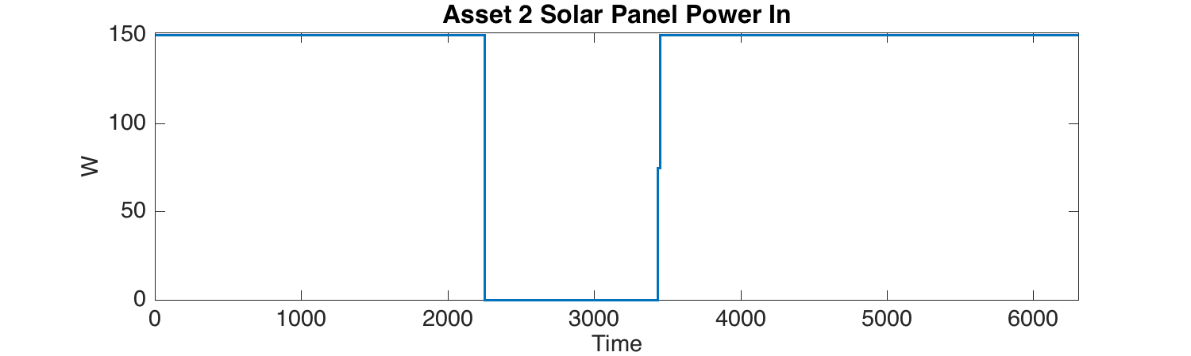

Slide 33
Performance Results

Slide 34
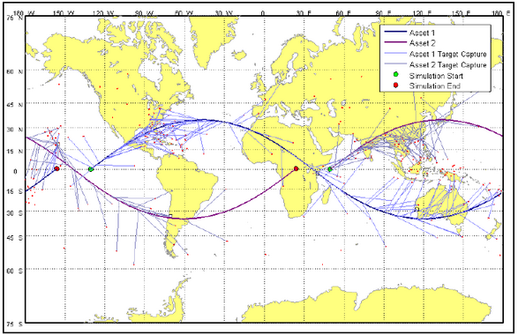
HSF v2.3
Roughly 5 hours for Aeolus Simulation

Slide 35
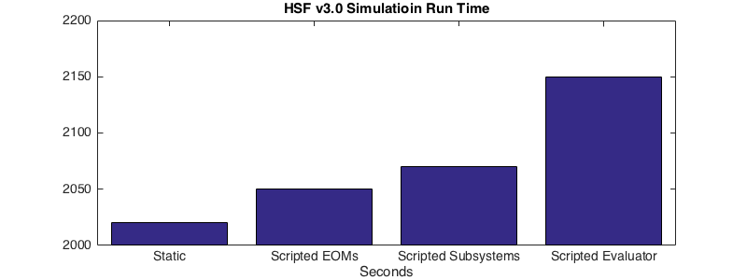
HSF v3.0
Roughly 35 minutes for Aeolus Simulation

Slide 36
Future Work

Slide 37
HSF Wish List
Expanded Schedule Diagnostics
Expanded Universe and System Models
Mult-Threading
GUI
Model Driven Development
Github Quality Control Integration

Slide 38
Conclusion

Slide 39
Questions

Slide 40
Uses Push or Pop?
Uses Key Value Storage?
Stack

