Slide 2

Client: Zachary Brooks

Slide 3
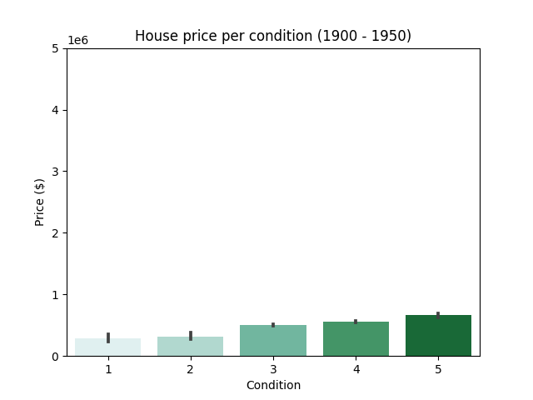
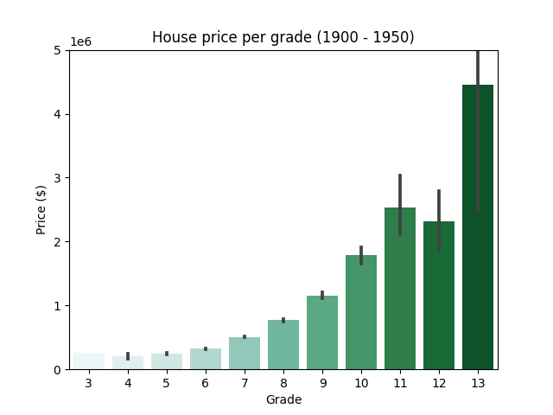
Which factors insfluence the price?
Condition
Grade
Blank.

Slide 4
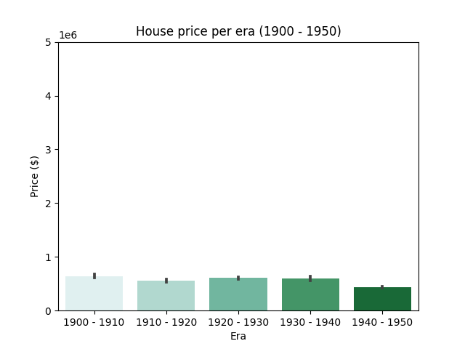
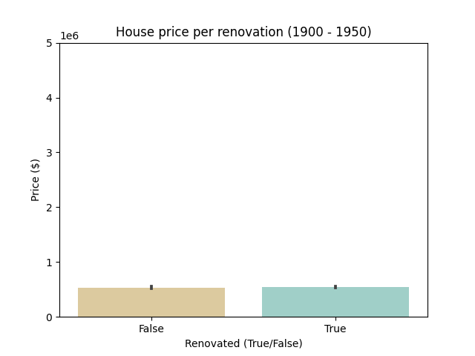
Which factors insfluence the price?
Era
Renovation
Blank.

Slide 5
Which factor insfluence the price?
Condition
Grade
Era
Renovation
Factors that seems to influence the price of a historical houses: Grade > Condition > Era > Renovation.

Slide 6
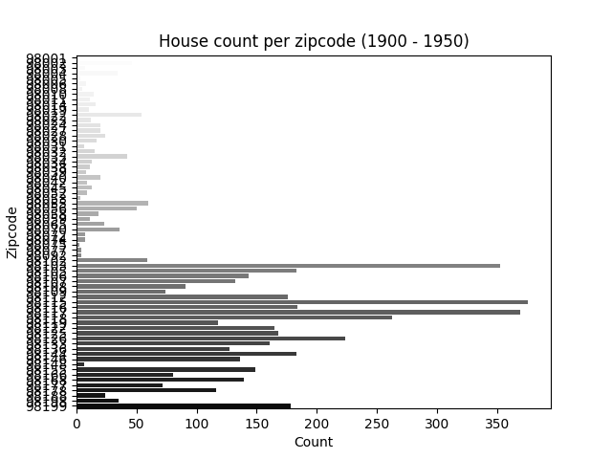
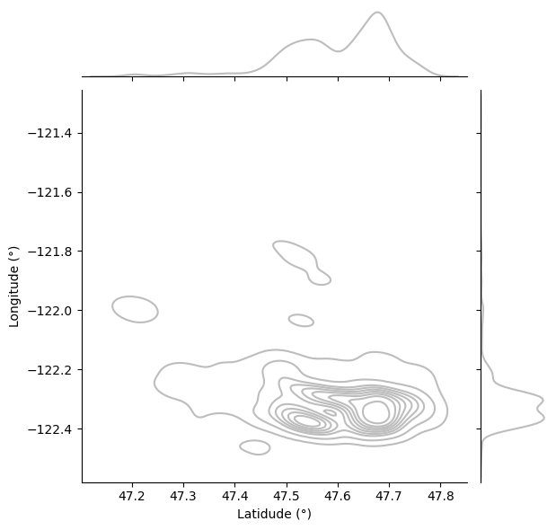
What could be the best neighboorhood?
Historical house count
Historical house areas
Blank.

Slide 7
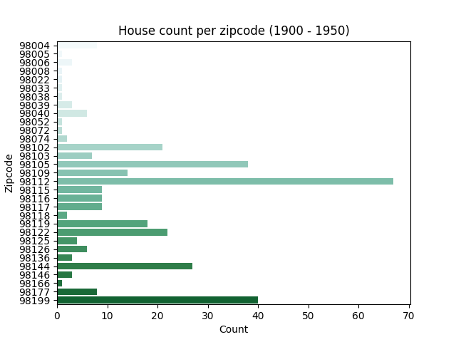
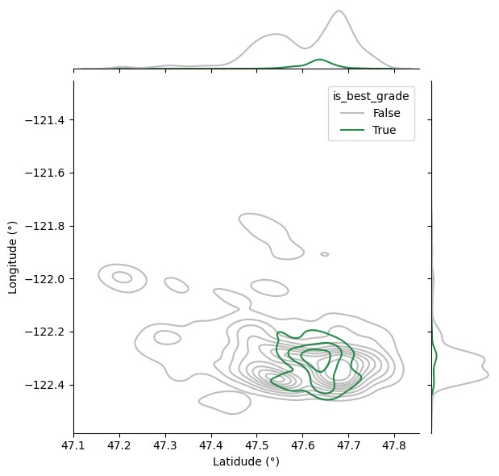
What could be the best neighboorhood?
Historical house count (best)
Historical house areas (best)
Blank.

Slide 8
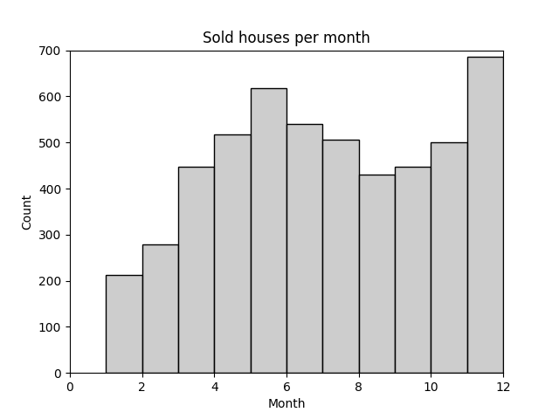
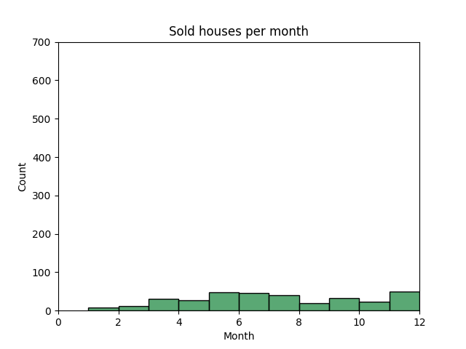
What could be the best months to buy and sell historical houses?
Historical houses
Historical houses (best)
The best months to buy historical houses are in December (Winter) and June (Summer).

