Slide 1

Data science bootcamp
Exploratory data analysis (by Julia Nowak) - King County Housing

Slide 2

Zachary Brooks (Seller)
Seller that invests in historical houses
Looks for:
High profits
Should a historical house be renovated?
Best neighbourhood to buy a historical house?
Best time to buy a historical house?

Slide 3
Assumtions
We assume a high profit to be related to a high price of historical houses (1900-1950)
Are there factors that are correlated with price? If so, which factors could be correlated with price and therefore profit?
Factors:
Condition of a house
Grade of a house
Era a house was build
Renovation
Is there a best neighbourhood to buy a historical house?
Is there a best time to buy a historical house?

Slide 4
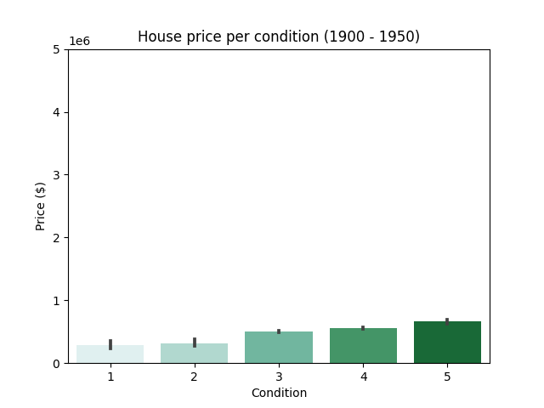
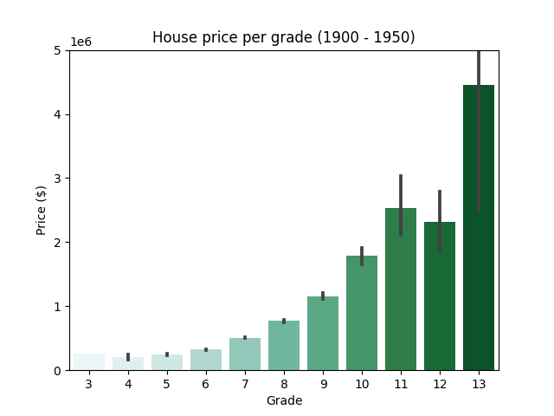
Which factors are correlated with the price?
r = 0.15
r = 0.74
Condition
Grade
The grade of a house seems to be correlated with the price of a historic house, but not the condition of a house.

Slide 5
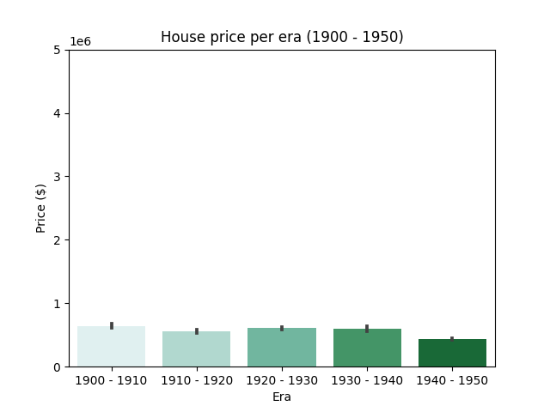
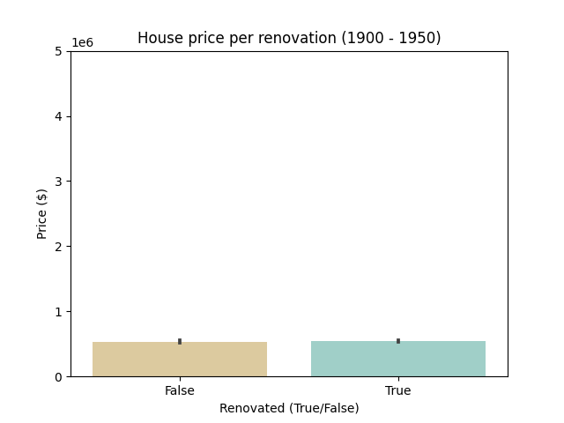
Which factors are correlated with the price?
r = -0.17
r = 0.01
Era
Renovation
Neither the era a house was build nor the renovation seems to be correlated with the price of a historic house.

Slide 6
Which factors are correlated with the price?
Condition
Grade
Era
Renovation
From the four factors we analysed only the grade of a house seems to be correlated with the price of a historic house.

Slide 7
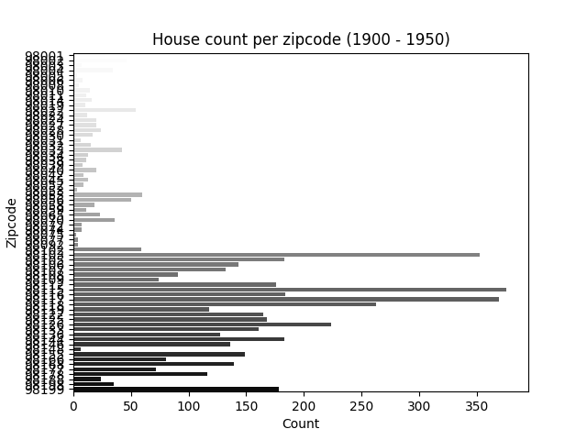
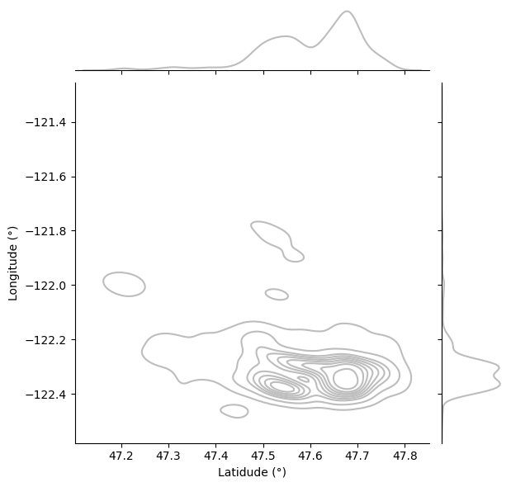
What could be the best neighbourhoods to buy historical houses?
Historical house count
Historical house areas
The best neighbourhood to buy historical houses seems to be: 47.4° – 47.8° latidude / -122.2° – -122.4° longitude.

Slide 8
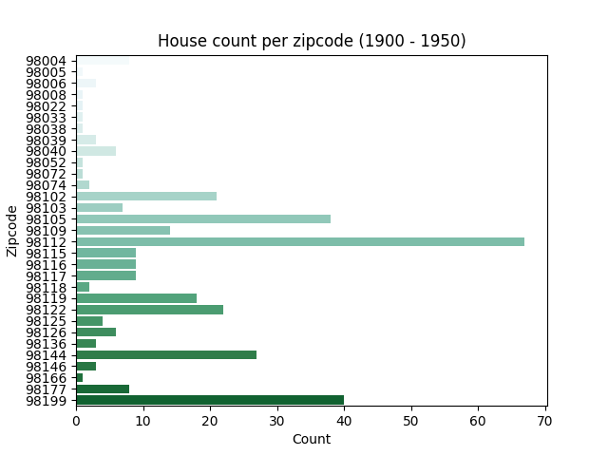
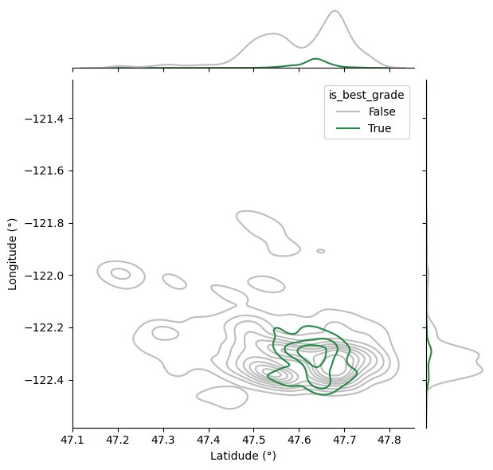
What could be the best neighbourhoods to buy historical houses?
Historical house count (best)
Historical house areas (best)
The best neighbourhood to buy the best historical houses seems to be: 47.5° – 47.7° latidude / -122.2° – -122.4° longitude.

Slide 9
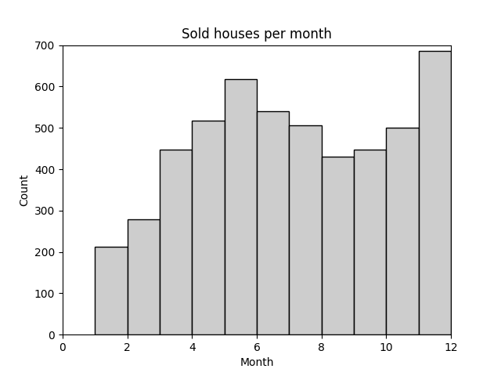
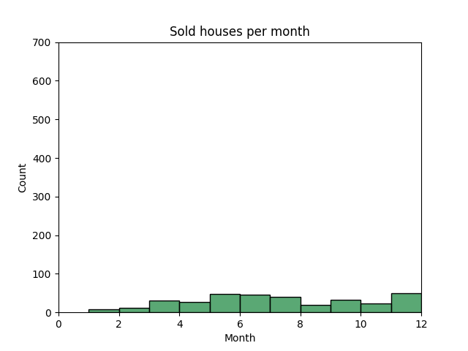
What could be the best time to buy historical houses?
Historical houses
Historical houses (best)
The best months to buy historical houses seem to be in December (Winter) and June (Summer).

Slide 10
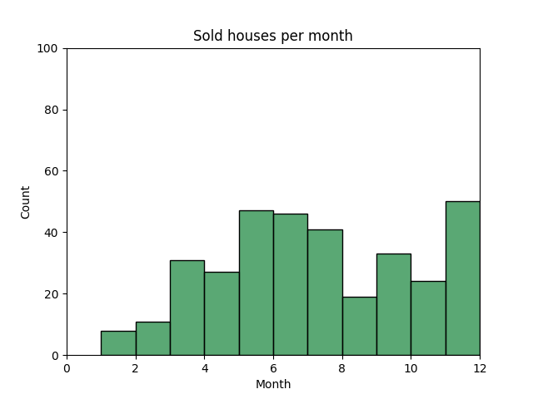
Conclusions
The factor that seems to be correlated with the price of historical houses is: Grade
The best neighbourhood to buy historical houses seems to be:
Houses: 47.4° – 47.8° latidude / -122.2° – -122.4° longitude
Best houses: 47.5° – 47.7° latidude / -122.2° – -122.4° longitude
The best months to buy historical houses seem to be in December and June

Slide 11
Thank you!

