Slide 1


Love Data: Git Good with Data – Workshop for Version Control
Please download tutorial materials from: https://rochester.box.com/v/LoveData-GitHub
Materials prepared by: Sarah Siddiqui, Marla Litsky, Aabha Pandit
Presented today by:
Marla Litsky, Student Employee
Sarah Siddiqui, Reproducibility Librarian
Zoom Support:
Aabha Pandit, Student Employee
Nishant Hegde, Student Employee

Slide 2

Love Data Month
2/03: Metadata & Documentation
2/05: Persistent Identifiers in Academic Networks: ORCID Advantage
2/07: In 3D – XR for Data Viz
2/11: Mapping the Past with QGIS
2/12: Data Viz in Special Collections
2/13: NSF & DOE Public Access Plans
2/17: 3D Data in VISTA
2/18: Panel: Ethics & Governance
2/21: Panel: Cultural Impact with Community-based Research
2/26: Git Good with Data: Workshop for Version Control
2/27: Spot the Robot: Recognizing AI-Generated A/V Material
For more information go to our QR code or to https://libguides.lib.rochester.edu/lovedata

Slide 3
Data Services
Service Types
Chat & Email
1-on-1 Consultations
Private Training and Workshops
Live Public Webinars and Recorded Webinars
Webpage
https://www.library.rochester.edu/services/data-management-and-sharing
Specialties
Data Management and Sharing Plans
Data Management Best Practices
Reproducibility
Data Curation and Repositories
Data Visualization
Data Tools
Data Tool Admins
UR Research Repository (URRR)
LabArchives
OSF
protocols.io
DMPTool
ICPSR

Slide 4
Agenda
Introduction
How to GitHub
Activity
Summary
Q & A
Please download workshop materials from this box link: https://rochester.box.com/v/LoveData-GitHub

Slide 5
PART I What is Version Control
Please download workshop materials from this box link: https://rochester.box.com/v/LoveData-GitHub

Slide 6
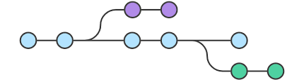
What does Version Control mean?
Track and Manage Changes Overtime
Keep a detailed record of changes made to a file
Allows collaboration without overwriting
Branch off to experiment without changing the main code
Popular Tools: Free
Git – free – Local
Azure DevOps – paid – Microsoft system
Popular Tools: Paid Options
GitHub (free version available) – Cloud based
GitLab (free version available) – Cloud based
GitKraken
Bit Bucket (free version available)

Slide 7
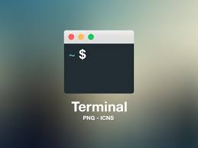
Workflow Overview
Terminal
Let's you interact with your computer
Used to run commands
Where you can access Git locally
Mac
Built in Terminal app
Git is already downloaded
Windows
Use Git Bash
Need to install Git

Slide 8


Git vs GitHub
Git
Local to your computer
Access through the Command Line
GitHub
Web based
Access through the Web
Good for collaboration, allows access

Slide 9
Flow
git pull
git add
git commit
git push
Working Files
(Local)
Staging Area
Local Repository
Remote Repository
Edit / Create files
Where you edit the code
Add files once they are ready for saving
Review files before committing
Files saved locally
Changes will not change GitHub
Store files online
GitHub

Slide 10
Key Git Commands for Reference
Command | What it does
git --v (Windows) / git --version (Mac) | Check the version of git on your machine
git init | Initialize an empty git repository
git add <file or directory name> | Adds files to the staging area
git commit –m “Commit message in quotes” | Record changes to your local repository
git status | Check the status of your current repository
git branch <branch_name> | Create a new branch
git branch -a | List all branches
git branch -d <branch_name> | Delete a specific branch
git checkout <branch_name> | Checkout (switch) to an existing branch
git merge <branch_name> | Merge changes from one branch to another
git remote <command> <remote_name> <remote_URL> | Connect a local repository to a remote repository
git clone <remote_URL> | Create a local working copy of an existing remote repository
git pull <branch_name> <remote_URL/remote_name> | Get the latest version of a repository
git push <remote_URL/remote_name> <branch> | Sends local branch to remote repository
git push -all | Sends all local branches to remote repository

Slide 11
PART II Using GitHub

Slide 12
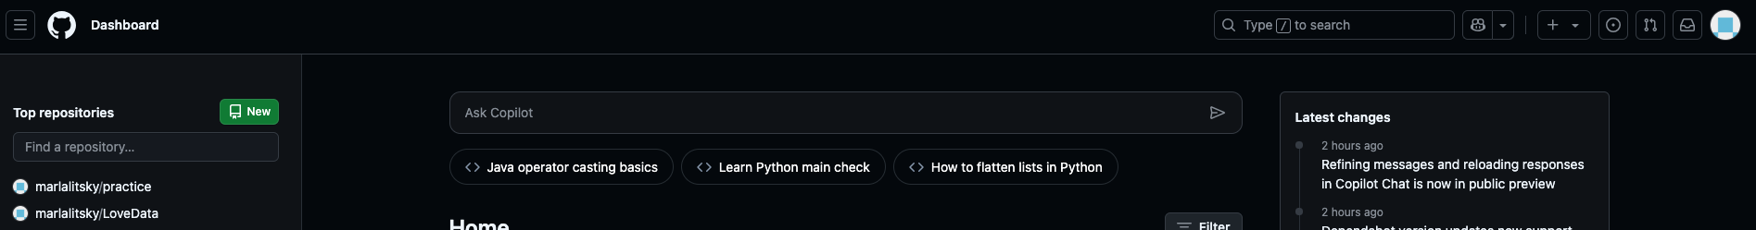
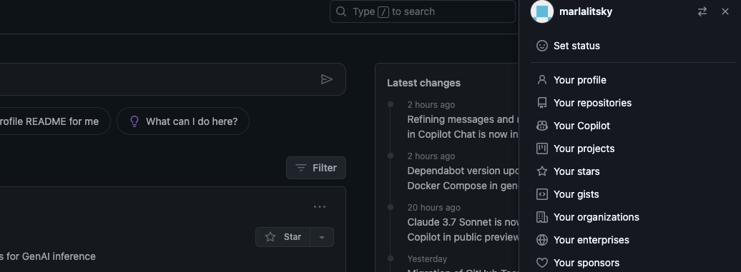
Creating Repositories in GitHub
From the Home Page
From Repositories Tab
Navigate to “Your Repositories” by clicking your profile photo and select the “New” button

Slide 13
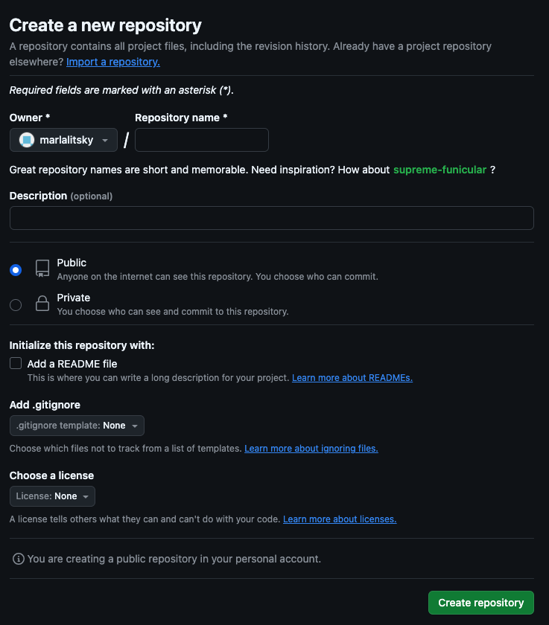
Repository Options
Description
Clarify the purpose of the repository
Helps the repository be more discoverable if you are creating it publicly
Public vs Private
Who do you want to access this repository
What level of collaboration do you want

Slide 14
Hands on Activity – Follow Along With Us
Guide, Data, Slides: https://rochester.box.com/v/LoveData-GitHub

Slide 15
PART III Summary
Please download workshop materials from this box link: https://rochester.box.com/v/LoveData-GitHub

Slide 16
Hands-on Activity Summary
Committing
Branching
Best Practices
Creating Directory
Creating Files
Staging
Pushing
Commit Messages
Creating Branches
Pulling
Merging
Consistent Messages
Organization
Saving Often

Slide 17
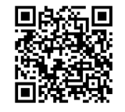
Please Fill Out Our Survey
It should only take 5-10 minutes.
Everyone who completes the survey will be entered into a raffle and may win a prize.
https://rochester.libwizard.com/f/lovedata2025_survey

Slide 18
Thank you! Please feel free to contact us with any questions you have!
Materials prepared by: Sarah Siddiqui, Marla Litsky, Aabha Pandit
Presented today by:
Marla Litsky, Student Employee
Sarah Siddiqui, Reproducibility Librarian
Zoom Support:
Aabha Pandit, Student Employee
Nishant Hegde, Student Employee

