Slide 1


ESG Associate - Case Study
John Stephen
London - 12th December 2025

Slide 2
CONTENT
Portfolio Safety Performance
Benchmarking
Data Limitations
Recommendations

Slide 3
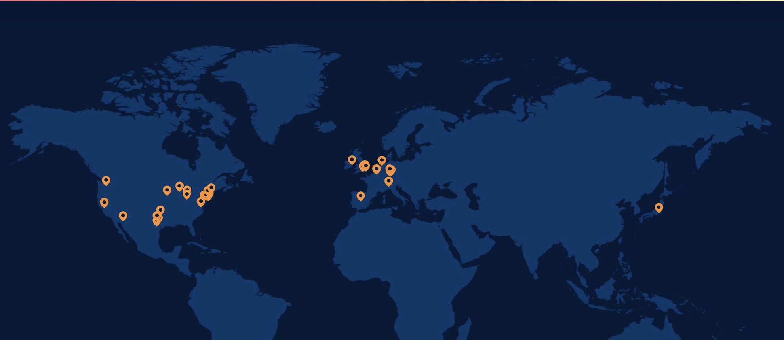







Cyrus one Performance
Portfolio Overview
Other Indicators
2025 Summary
HQ Dallas, Texas
Energy use and associated carbon - Impact
After the regression was run, no correlation was identified between all metrics and Fines paid.
Likewise with training completion rate
50 Data centres
CSRD Aligned Reporting
Executive Summary
Company Supporting Metrics 2025:
Digital: Performance.
Energy & Midstream: TRIR.
Renewables: Slight.
Transport: Clear improvement
Risk
100% of European operations renewable energy
Climate neutral by 2030 (SBTI Validated)
Total carbon free electricity 75%
18 Regulatory findings
40-45 inspections per asset
Digital: Stable (–0.10).
Energy & Midstream:.
Renewables: .
Transport:.
Opportunities
Generally flat or z:
Energy: FR 3.38).
Renewables & Transport: Stable
Notes:
Emissions cuts are in line with limiting warming to 1.5°C (i.e. very steep, front-loaded reductions – usually ~90%+ by 2050 across Scopes 1–3).
Offsets/credits are only for the small residual (typically <5–10%) after deep real reductions
Total carbon-free electricity up 61% from 2023 to 18% 2017.
For our internal controlled emissions (net scope 1 and market-based scope 2), there was a 33% decrease in GHG emissions from 637k metric tons of CO2-equivalent (MTCO2 e) in 2018 to 427k MTCO2 e in 2024. This decrease was driven by increased carbon-free electricity procurement, even while total business activity increased substantially. In 2024, our internal controlled emissions were 47% of our total inventory.
It means they prioritise the most credible forms of clean energy — long-term renewable PPAs and green tariffs — and only rely on certificates like RECs or nuclear guarantees as a last resort, to avoid greenwash and strengthen the real decarbonisation impact.”
REC → a low-credibility renewable certificate; no link to physical power.
PPA/VPPA → long-term contract with a renewable project; top-tier decarbonisation method.
EFECs → carbon-free nuclear certificates; credible but not renewable.
Hyperscalers → AWS, Azure, Google, Meta, NVIDIA; the biggest cloud/AI players.
Colocation capacity → MW of IT load customers can deploy in a data centre.
If I strip it back to the infra-material ESG drivers for CyrusOne, it’s power, carbon, water, resilience and info-sec. Most of the rest is hygiene.”

Slide 4
CONTENT
Portfolio Safety Performance
Benchmarking
Data Limitations
Recommendations

Slide 5


Cyrus Benchmark
Other GIP Data Centre Assets
Key Insights
Benchmark total recordable injury rates against OSHA ‘Total recordable cases’ by NAICS code
Majority of companies perform below OSHA benchmarks for LTIR (negative deltas)
TRIR shows mixed performance:
  Renewables and Transport Outperform
  Energy and mix of other sectors often underperform
Some companies improved from 2023 → 2024 (deltas shrink)
Some worsened (deltas increased - e.g., Digital 1, Energy 2/5/8, Transport 2/8))
Contractors drive a large share of recordables in Energy & Transport
Several companies have steady small recordables, suggesting possible under-reporting
One company has #VALUE entries → data quality issue to follow up
Performance Overview
Company | OSHA 2023 vs TRIR 2023 vs | OSHA 2023 - TRIR 2024 | OSHA vs LTIR 2023 | OSHA vs LTIR 2024
Digital 1 | 0.35 | 0.93 | -0.26 | 0.00
Digital 2 | -0.55 | -0.40 | -0.59 | 0.15
Digital 3 | N/A | N/A | N/A | N/A
Energy 1 | N/A | N/A | N/A | N/A
Energy 2 | 0.81 | 1.70 | 0.40 | 0.60
Energy 3 | -1.34 | -2.32 | -1.08 | -1.55
Energy 4 | 0.96 | -0.45 | -0.34 | 0.24
Energy 5 | 1.70 | 1.70 | 0.40 | 0.60
Energy 6 | N/A | N/A | N/A | N/A
Energy 7 | -0.65 | -1.12 | 0.40 | -0.46
Energy 8 | 1.70 | 1.12 | 0.40 | 0.13
Renewables 1 | -1.94 | -0.25 | -1.36 | -0.70
Renewables 2 | -3.69 | -2.01 | -2.49 | -1.52
Renewables 3 | -2.36 | -4.62 | -1.02 | -3.61
Renewables 4 | 0.87 | 0.19 | 0.22 | -0.15
Transport 1 | 1.98 | -0.46 | 0.56 | -0.83
Transport 2 | 2.50 | 2.39 | 0.56 | 0.27
Transport 3 | N/A | N/A | N/A | N/A
Transport 4 | -4.90 | -4.13 | -1.07 | -2.58
Transport 5 | -2.39 | 0.07 | -2.03 | -1.19
Transport 6 | -1.81 | -2.82 | -2.34 | -1.32
Transport 7 | N/A | N/A | N/A | N/A
Transport 8 | -1.10 | 1.05 | -1.03 | 0.93
Transport 9 | N/A | N/A | N/A | N/A
Risks
Notes:
What are some key figures for other GIP Data centres to compare?

Slide 6
CONTENT
Portfolio Safety Performance
Benchmarking
Data Limitations
Recommendations

Slide 7





Data & reporting Limitations
OSHA Benchmark Data
OSHA Data Limitations Highlights
The LTIR data rate is compared to the OHSA benchmark data for “Cases with days away from work”
Potential Under-Reporting
OSHA sectors aren’t perfect matches
Lack of data from certain companies reduces the reliability of findings
No financial data to give an impact on the portfolio (Weighting Analysis)

Slide 8
CONTENT
Portfolio Safety Performance
Benchmarking
Data Limitations
Recommendations

Slide 9


Engagement RecommEndations
Material Measure
Feasibility
Fund Impact
Debt Owned
z
Targeted Safety Programme
For higher-risk sectors (Energy & Midstream, Transport) based on their elevated TRIR/LTIR relative to OSHA benchmarks
Lenders prioritise downside protection, not long-term alignment
Control over asset-level interventions is limited
1
Focus on loan-level ESG Covenants
(Replace Safety Programme)
Instead of direct control, lenders would require minimum Safety requirements, capex plans, or safety reporting from borrowers to mitigate risk
Near Miss Reporting
Introduce near-miss and hazard observation reporting to identify risks before they result in recordables.
2
Enhanced Borrower Due Diligence
Data Collection
Focusing on assets with N/R entries or inconsistent reporting.
(Refines Data Collection)
Accurate safety data becomes part of underwriting and risk pricing. This shifts data responsibility to borrowers via term sheets
3
Loan Structuring with Performance Triggers
Root Cause Analysis
Must be completed by Asset Management Team – top-level implementation harder to enforce
Investigate root causes where TRIR/LTIR exceed benchmarks consistently
(New Tool)
Use margin ratchets or capex reserves tied to Safety Performance or OSHA Benchmarks improvements
4
Feasibility Level
Key ESG Team Q for FM’s
HIGH
MEDIUM
LOW
How are current reporting mechanisms failing at collecting complete data sets, and can you identify new engagement methods for the ESG team to collect a complete dataset?
``````

Slide 10


ABOUT GLOBAL INFRASTRUCTURE PARTNERS
Contact Information
5 Wilton Road
London, SW1V 1AN
United Kingdom
 irgroup@global-infra.com
+44 20 7798 0400
https://www.global-infra.com
At a glance
$170 bn+
In assets under management
80
Equity portcos
127,000
People employed in equity portfolio
170+
Credit investments

Slide 11


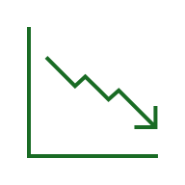
Risk and opportunity - REDUCTION REQUIRED
CRREM 2030 Shortfall – Required Energy and Emissions Reduction
CRREM 2030 Shortfall – Interpretation & Portfolio Impact
CRREM 2030 Shortfall is a measure of how far short each asset is in terms of the relevant 2030 target
Fund Managers can use this metric to assist in prioritisation of assets for refurbishment or possibly disposal prior to 2030
& Portfolio Impact
59% of the kWh 2030 shortfall is caused by the 5 worst-performing assets by this measure
& Portfolio Impact
Refurbish 18 assets to 2050 Target = Fund 2030 Compliant
  49% of the kgCO₂e 2030 shortfall is caused by the 5 worst-performing assets by this measure
PAI | Fund Total 2023 | CRREM 2030 Target | CRREM 2030 after 18 refurbishments
Total energy (kWh) | 135.6m | 82.4m | 81.8m
Total GHG (kgC\O₂e) | 28.3m | 12.3m | 9.7m
& Portfolio Impact
If the 18 poorest-performing assets (by energy intensity) are refurbished to meet the CRREM 2050 target within the next five years, the overall fund would become compliant with the CRREM 2030 target

