Slide 1
What were the most popular family-friendly categories of movie?
The most popular category of friendly family movie was Animation that covered 20% of all family-friendly movie rentals. The least popular family-friendly movie category was Music which covered only 14% of family-friendly movie rentals.

Slide 2
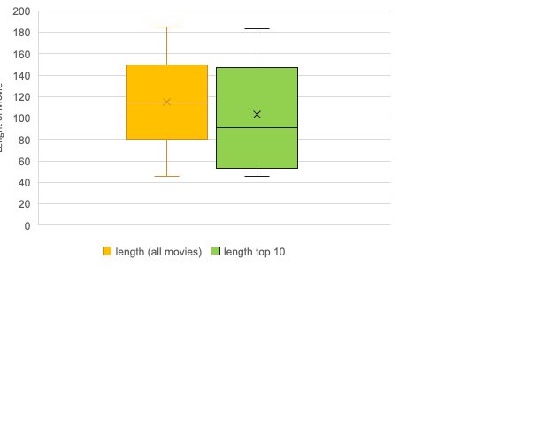
Is there a relationship between the most popular movies and the length of the movie?
The orange box-and-whisker plot is the five-number summary for the run-time (the length of time the movie lasts) of all movie titles shared between the two movie rental stores. The green box-and-whisker plot is the five-number summary for the run-time of the top 10 most rented movies. I believe the biggest takeaway is that the median for the duration of the top 10 movies is significantly lower (~1.5 hrs) than for the median of all movies (~110 minutes) POSSIBLY indicating that the more popular movies are under 110 minutes.

Slide 3
Is the decrease in movie rentals occurring across both stores?
If we plot the total movie rentals verse time, then it is easily seen that movie rentals have, indeed, taken a dramatic decline. One possible/probable reason for this is increasing competition in the mid-late 2000s from services such as Redbox and Netflix.
The major increase in sales from May 2005 – June 2005 can be explained by the summer season, since, many people tend to have a little more leisure time in the summer, and therefore, watch more movies. It is quite possible that there will be another increase in sales in May 2006.

Slide 4
Who are the top 5 customers and what is the difference in their monthly spending?
As can be seen from the bar chart the top 5 paying customers are: Rhonda Kennedy, Marion Snyder, Karl Seal, and Eleanor Hunt. The largest increase in spending was for Eleanor with a value of $64.87 from February 2007 to March 2007. The largest decrease in spending was for Marion Snyder with a decrease in $80.83 from April to May 2007.

