Slide 1
Why commodity futures data impact planting?

Slide 2
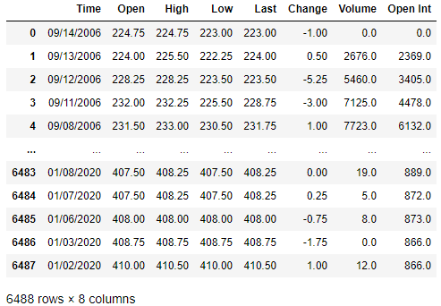
Futures data
Open/Last: Opening/Closing price of the day.
Change: the difference between Open & Last
Volume: the number of exchange. (Kinetic energy of Market)
Open Interest: total number of outstanding contracts that have not been settled. (The potential of Market)

Slide 3
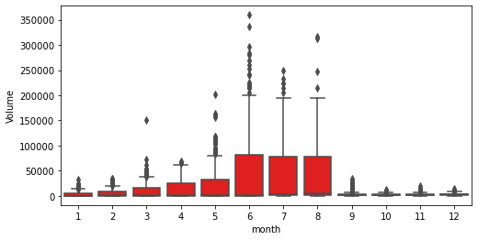
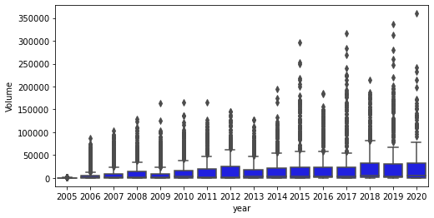
"Volume" related to "Month", not "Year".
High <Volume> and fluctuation during Jun to Aug.
No significant changes on <Volume> during years.
"Change" feature does not relate to time-series as well.

Slide 4
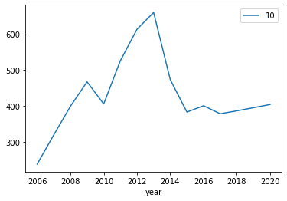
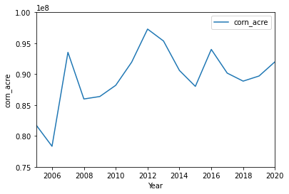
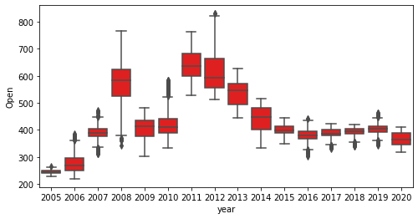
We choose "Open" as our candidate feature.
"Open" in 'Oct'
Corn acre.
(Market year)
"High", "Low", "Last" show similar traces as 'Open'.
Corr Coef.(acre, Open) = 0.69
Averaged "Open"

Slide 5
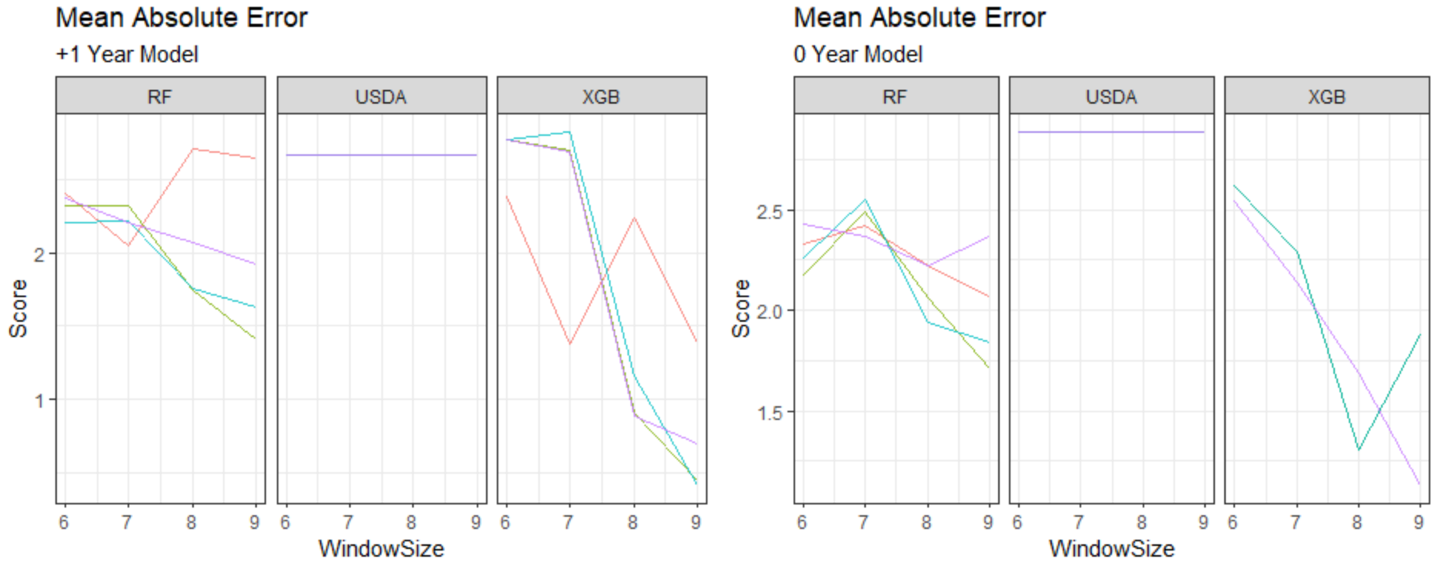
Result imporved
Model | Metric | Score | ModelRun
USDA | MAE | 2.67
XGB | MAE | 0.7 | SeptemberOrders
XGB | MAE | 0.41 | OctoberOrders
XGB | MAE | 0.44 | NovemberOrders

