Slide 1
Xgb vs Linear and naïve Models: Predicting Planting Acres in y+1
Oliver Causey
11AUG2020

Slide 2
data
Same as before with added soy/corn futures ratio lags 1:3 for all features.

Slide 3
Experimental design
Using 25 (1991 – 2017) years of data with three years of lags, we predict the next years results using all previous years (chronologically).
Examples: 1991-1992 -> 1993
1991-1993 –>1994
…
1991-2016 -> 2017
Performed this for gradient boosting (with and without the soy/corn futures ratios and their respective lags), a linear model (with last year’s planting as an input) and a naïve model (use last year as a prediction for this year)

Slide 4
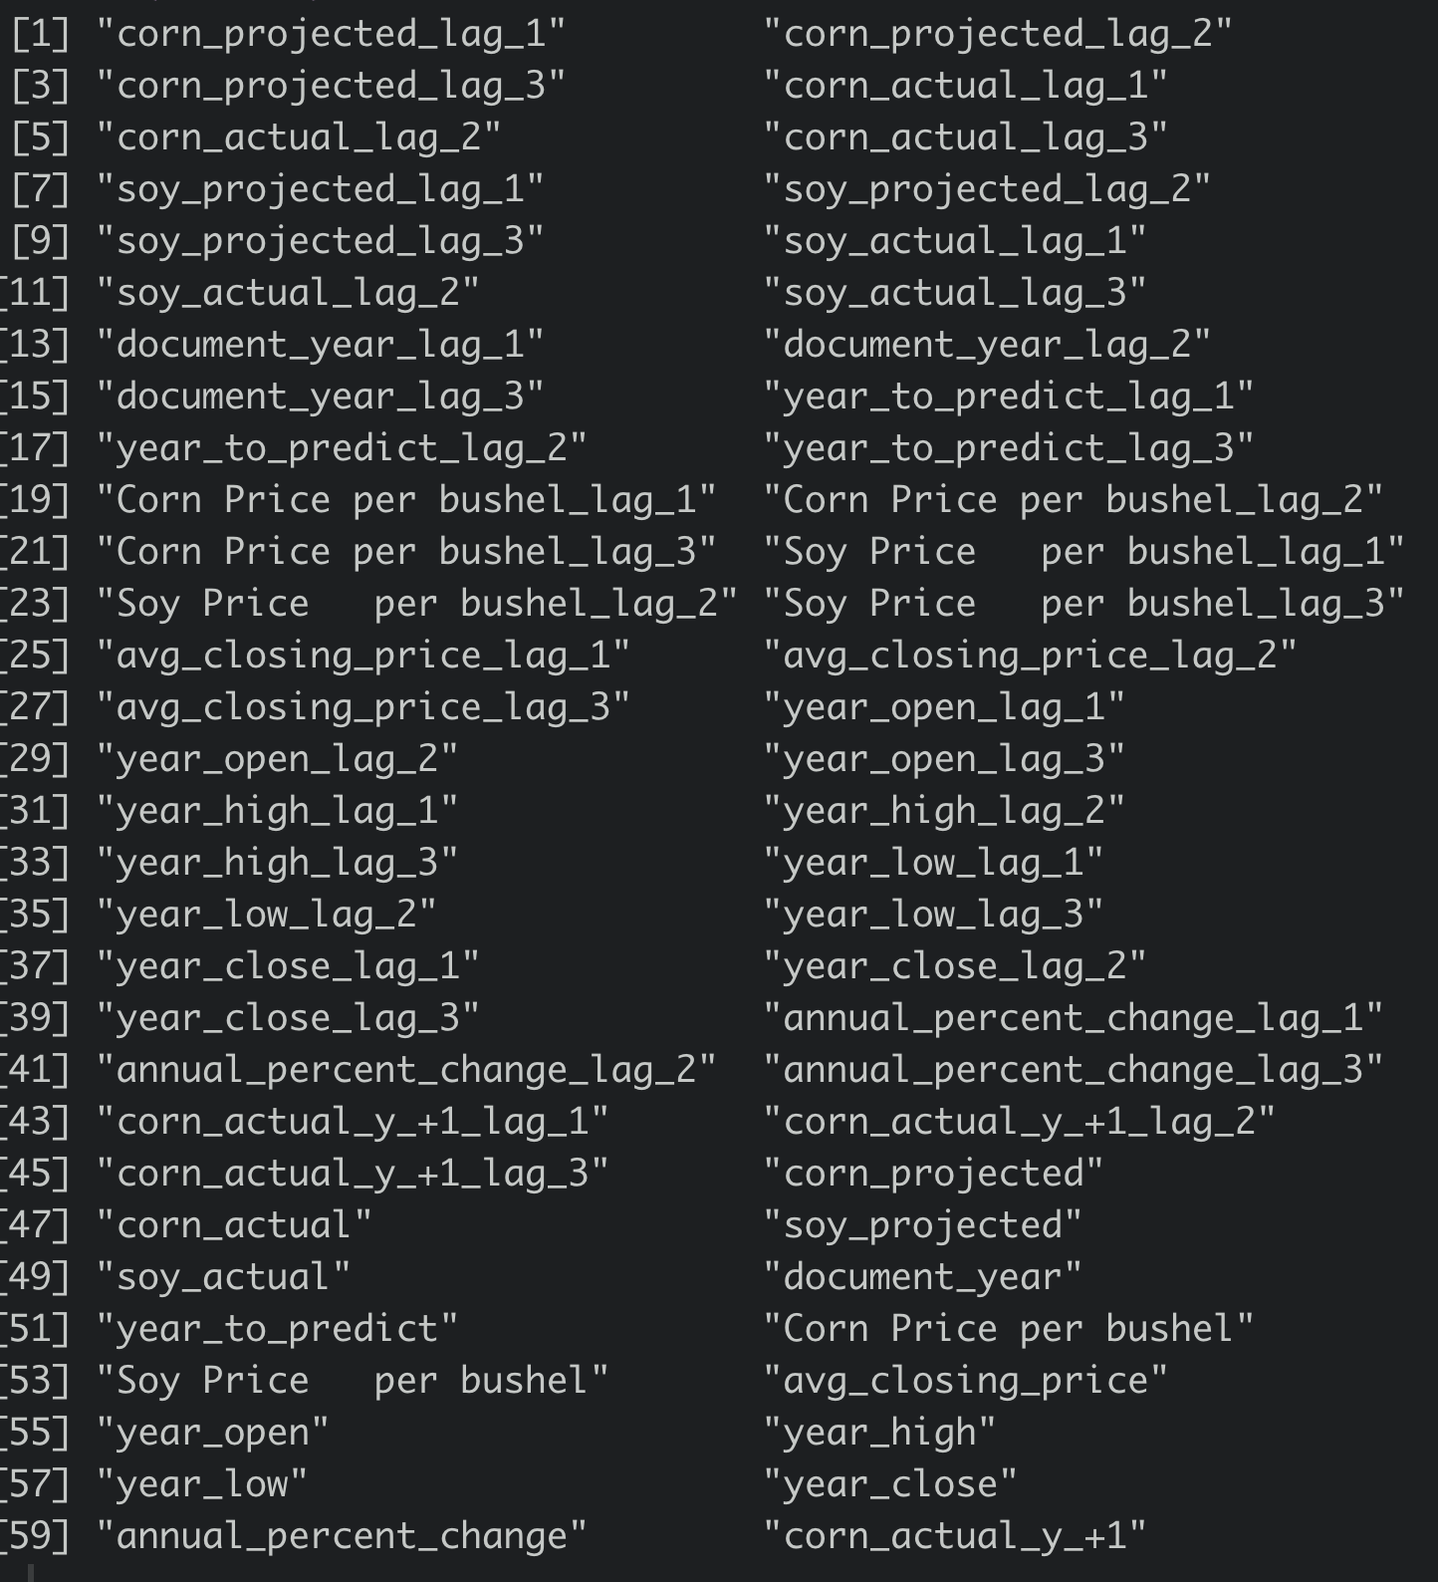
Predictors

Slide 5
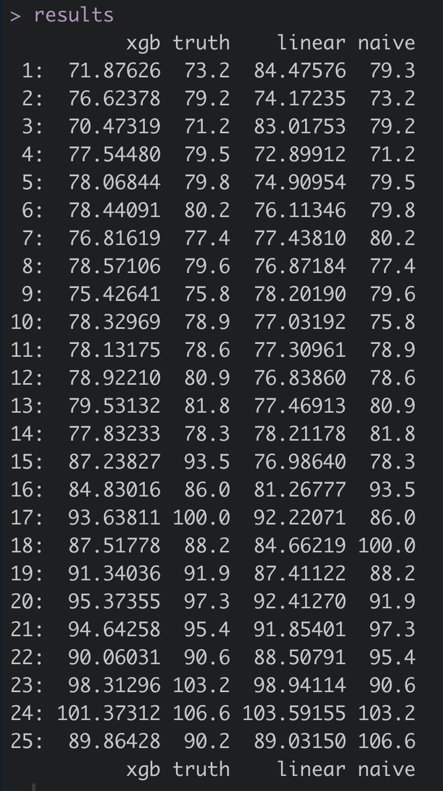
predictions

Slide 6
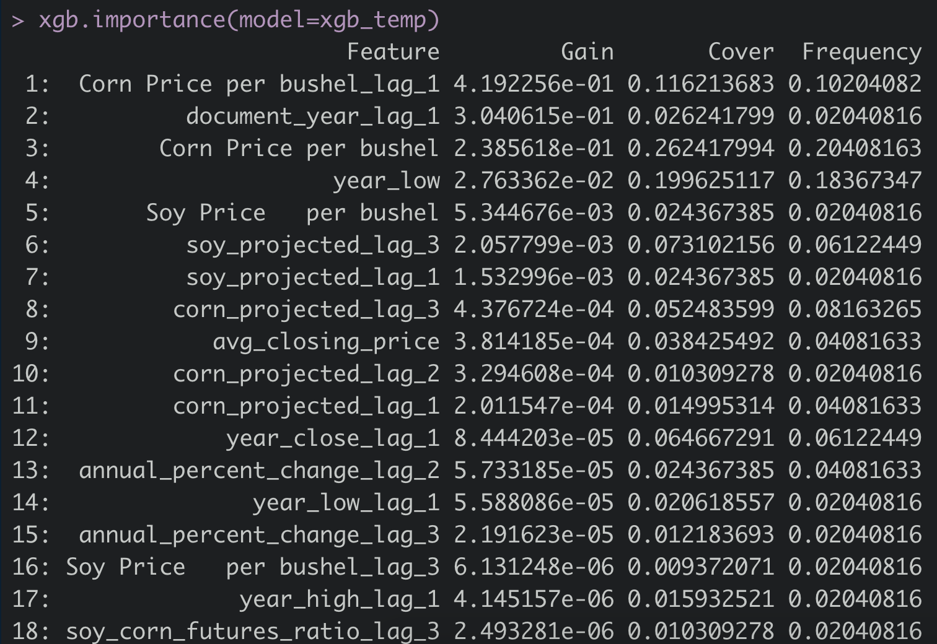
What do we actually care about: get a correlation matrix

Slide 7
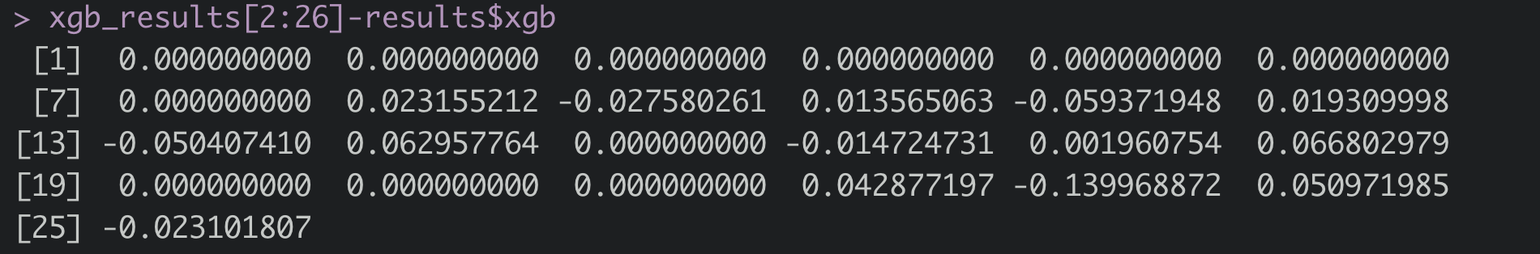
Does the ratio of soy/corn futures price matter? Maybe
Difference for each year predicting using soy/corn futures prices (and their respective lags) and not using them. Maximum of ~140k acres prediction difference.

Slide 8
Results
Normalized by the SD of the Distribution of Acres planted over time (sqrt of the variance of acres planted per year [~9.64 Million Acres])
Statistic/metric | XGB | Linear | Naive | XGB | Linear | Naive
RMSE | 2.59 | 5.96 | 7.21 | 0.27 | 0.62 | 0.75
MAE (10^6 Acres) | 1.86 | 4.66 | 5.52 | 0.19 | 0.48 | 0.57
MAPE (%) | 2.07 | 5.52 | 6.32 | 0.21 | 0.57 | 0.66
Do random forest, full linear using more of the features (ridge regression and lasso), look into bootstrap for forecasting techniques, jackknife, add harvest and lags as predictors, corn yield per acre and lags, soy yield and lags, ask larry swift for order data: not finalized sales data; start with channel; month by month data

Slide 9
Notes
Fill lag zeros with current year’s data
Remove mean imputed for yield
Get the data for the yield
Look deeper into US govt acre forecasting
More literature searching

Slide 10
Notes 13AUG
Accumulate sep-dec order data and use as a predictor
Remove imputed data
Add in new data
John Martens: request package to search hyperparameter subspace
It does Bayesian optimization using gaussian kernels.
Log transform your response
Introduce noise to the inputs

