Slide 1
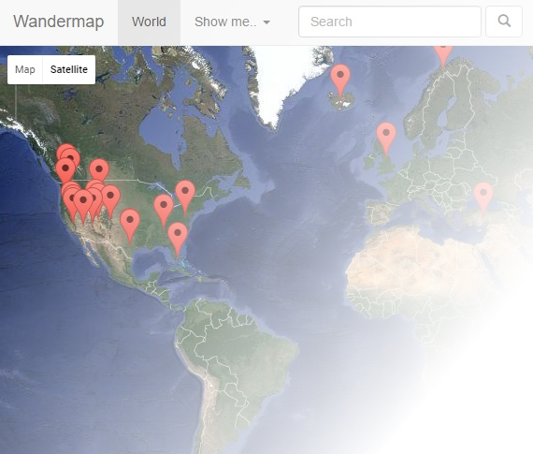
WanderMap
WanderMap
Harry Hinch
Devon Jones
Joshua Zepf
Griffin Smith
Landon Ledbetter

Slide 2

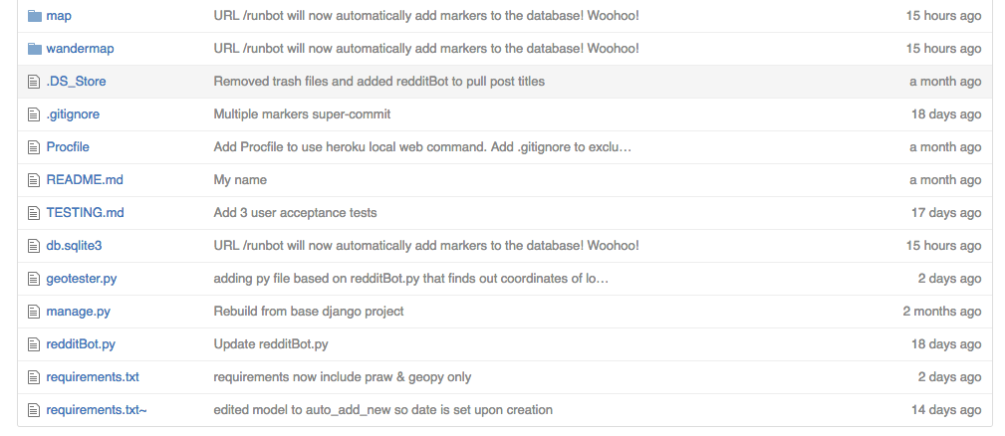
GitHub
Version Control System
https://github.com/JWZepf/WanderMap
Allowed for easy collaboration
Little bit of a learning curve

Slide 3

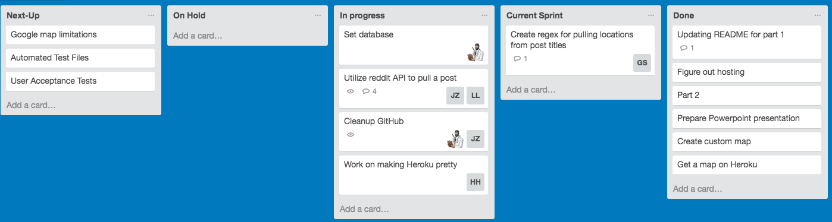
Trello
Progress Tracking Service
https://trello.com/b/qP67Wj6Q/agile-board
Very useful for assigning tasks
Organized tasks in an intuitive manner
Hard to maintain
Should have put one person in charge of Trello

Slide 4

Heroku
Deployment Environment
https://wandermap.herokuapp.com/
The simplest way to host online
Easy to deploy program
Easy to scale for traffic

Slide 5

Django
Python Framework
https://www.djangoproject.com/
Model-View-Controller architecture
Incredibly difficult learning curve, parts of the code can get very convoluted

Slide 6

SQLite
Database
Default when used with Django’s models
Had to learn Django’s equivalents to SQL commands, so SQL knowledge is not as useful as it could have been
Works great to store our marker data

Slide 7

Sphinx
Documentation generation
Quick
Not useful for this size project

Slide 8
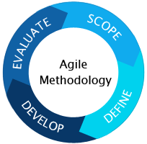
Methodologies
Agile Project Management
Met Sunday at 10 AM
Assessed individual progress
Set tasks for the upcoming week
Peer Programming
RedditBot - Landon and Joshua
Django framework - Harry and Devon

Slide 9
Challenges
Pulling location data from reddit post titles was incredibly challenging. We’ve overcome this challenge with the reddit API, regular expressions, and google geocoding API.
Problems figuring out Django’s database system. Set aside a Plan B offline database, but eventually realized Django’s abstraction of the database
Issues with inconsistent rules for reddit posts: the image link sometimes points to a .jpg or .png, and sometimes points to an imgur.com or flickr.com page. This means the img tag in our html breaks. Can be fixed by manually editing each image link.
Every tool we used was new to us

Slide 10
Demo

