Slide 1
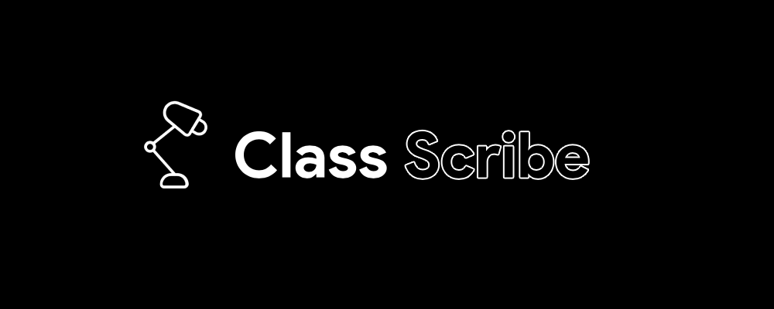
Ben Brown
Rahat Maini
Johnny Watkins
Hank Weber

Slide 2
PROBLEMS
Taking notes is complicated
Current methods are detrimental
This is worth caring about
Notes:
Rahat. Fragmentation with so many products each with their own set of pros and cons, the popular method of laptop notetaking actually BAD for retention, and as a society we should care about education, of which notetaking is an unmistakably huge component

Slide 3
REQUIREMENTS
Offload cost away from student
Uncompromised pencil/paper note taking
Added functionality from cloud and specialized hardware
Invisible
Notes:
Rahat. Make the product accessible, make it familiar, make people want to use it, and make people barely realize they are using it. The 4 bullet points.

Slide 4
REQUIREMENTS
Offload cost away from student
Uncompromised pencil/paper note taking
Added functionality from cloud and specialized hardware
Invisible
Notes:
Rahat. Make the product accessible, make it familiar, make people want to use it, and make people barely realize they are using it. The 4 bullet points.

Slide 5
TECHNOLOGIES
Django
React
Notes:
Johnny

Slide 6
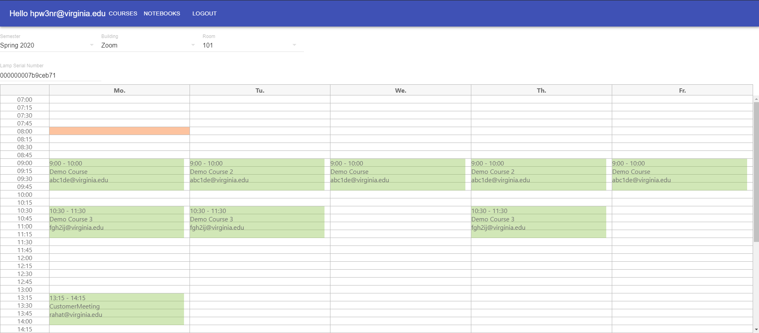
DEMO: Admin Tools
Notes:
Hank

Slide 7
DEMO #1
Placeholder for Lamp notetaking video
Notes:
Rahat

Slide 8
DEMO #1
Student browsing notes
Notes:
Ben

Slide 9
DIFFICULTIES AND SOLUTIONS
Lecture/note syncing
Notes:
Ben

Slide 10
DIFFICULTIES AND SOLUTIONS
Registering hundreds of Lamps
Notes:
Rahat

Slide 11
DIFFICULTIES AND SOLUTIONS
Detecting a new page
Notes:
Rahat

Slide 12
LIVE DEMO
End-to-end ownership of experience
Unique level of integration
Collaborative network
Notes:
Rahat then Hank

Slide 13
THANK YOU
Optical character recognition for handwriting Lecture audio transcription Sending scans to professors
Privacy settings for your notebooks Over-the-air Lamp software updates RFID scanning for student IDs
Page-to-audio syncing Audio-to-page syncing Perspective/alignment corrective document scanning
JPG notes exporting Spatially filtered (beamforming) audio capturing Notebook sharing and saving system
Notebook rating system Lamp audio cues as status alerts
Mass-Lamp registration via audio packets Renaming/deleting notebooks Split into new page functionality
SDAC-Ready labelling Edge-detecting and color correcting document scanning Page fingerprinting tech
Exporting lecture audio files Full page history throughout time Auto-link of course/notebook/student

