Slide 1

does price change in electricity affect usage?
(THE GIT COMMITS)
Jordan Alonzo
Amy Castillon
Josh Watson
Emanuel Villa

Slide 2
Electricity Consumption
Americans consume 26% of the world’s energy.
Our demand for energy grows by about 3% per year.
18% of total emissions comes from operating our homes.
Energy-efficient washing machines use about 1/3 less electricity than older machines.
Heating and cooling account for about 56% of the energy use in a typical home.
Reference: www.chelseagreen.com/2008/ten-surprising-facts-about-the-energy-we-use/

Slide 3
Questions:
Hypothesis:
Usage will drop due to price increases.
Do energy sales as a utility overall match the supply and demand curve?
At what price point does it stop being profitable to sell energy?
At what price point do people reduce energy usage by region?
Compared to the energy cost, at what price point does it stop being profitable to sell energy?

Slide 4

Sources:
U.S. Energy Information Administration

Slide 5
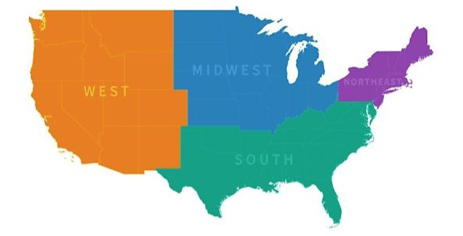
Data we are analyzing
Energy Consumption over a ten year period
Energy Price over a ten year period
Energy Consumption per region
Energy Price per Region
Production Costs
Usage Trends
U.S. Region Breakdown

Slide 6
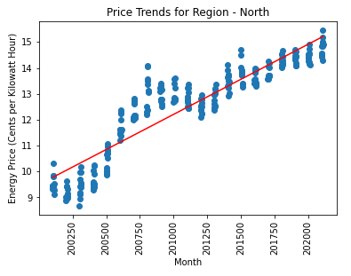
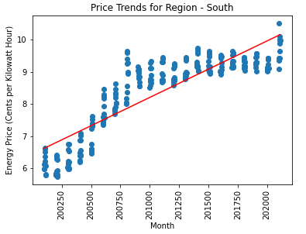
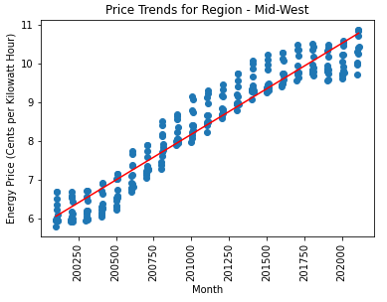
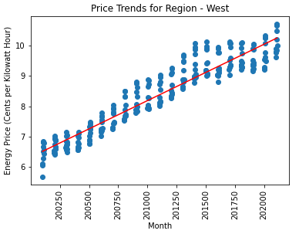
Energy Price Trends
Energy Retal Price Trends per U.S. Region
In the last four years the South has had small increments to price.
The Midwest has had a high increase between 2007-2017

Slide 7
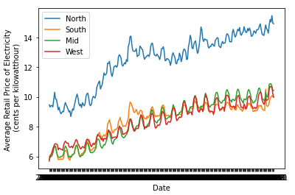
Price per Kilowatt-hour
Retail Price for Electricity
Retail increasing over time.
North has the highest cost for electricity.

Slide 8
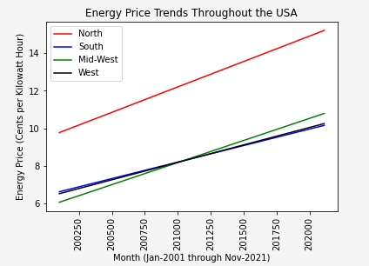
Energy Price Trends
Retail Price for Electricity
.
Throughout the US, we see that Prices for Electricity has maintained a steady upward trend, with all regions experiencing a similar percentage in rate of increase.

Slide 9
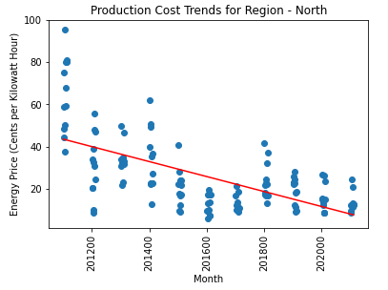
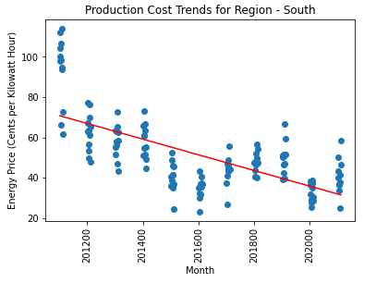
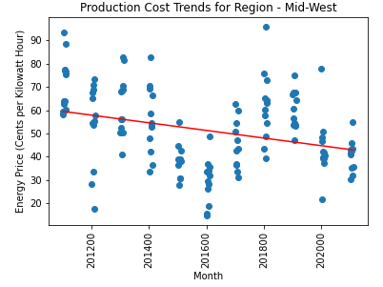
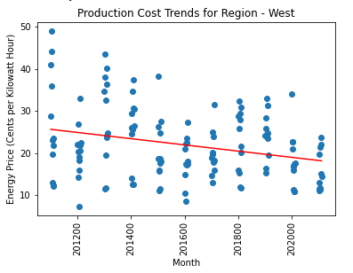
Production Cost Trends
Production Cost Trends per U.S. Region
Monthly Rate of increase of Production Costs:
North: -4.00%
South: -3.89%
Mid-West: -1.64%
West: -0.74%

Slide 10
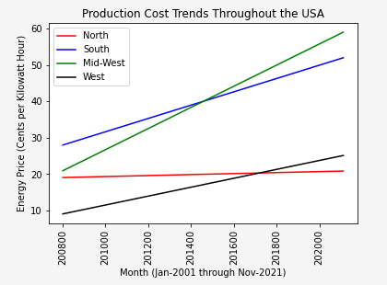
Production Trends
Production Costs
Production costs do vary for every region, but they all show a decrease production costs.

Slide 11
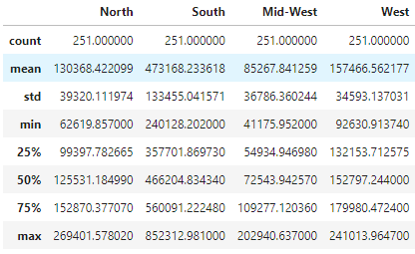
Energy Usage Table
Energy Usage and Consumption
Snapshot of Usage average and other information.

Slide 12
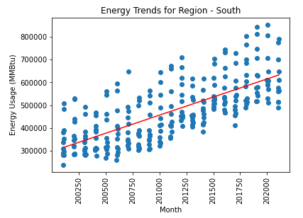
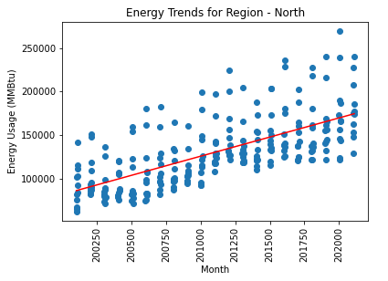
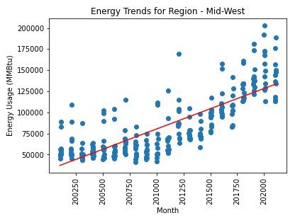
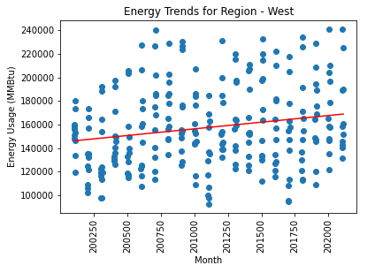
Energy Usage Trends
Energy Usage Trends per U.S. Region
Energy usage is considerable higher in the South region.
Usage in the West has a low rate of increase, despite having California as much higher usage state.
The Midwest showed a higher rate of increase during this time period.

Slide 13
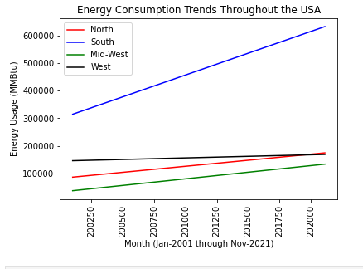
Energy Usage Trends
Projected Energy Usage
Energy usage will increase year after year.

Slide 14
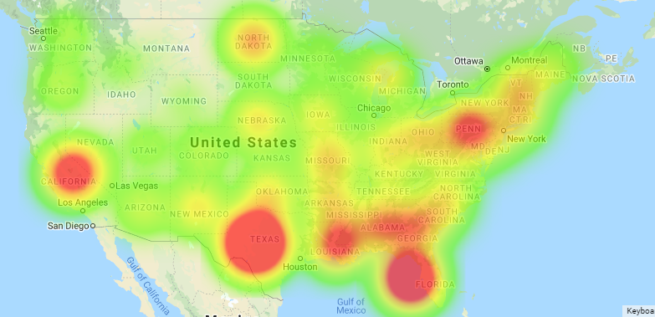
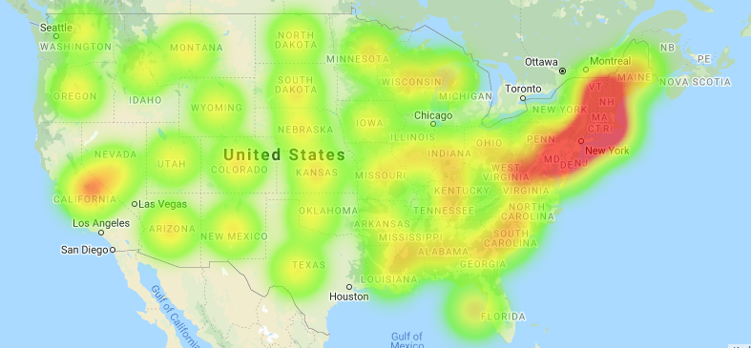
Average Price over 10 years vs Average Usage over 10 years.
Comparing Price vs Usage
Usage Heatmap
The price is much higher in the northern region.
California seems to have higher usage compared to the other state in its region.
Consumption in the South is very high as a Region.
Price Heatmap

Slide 15
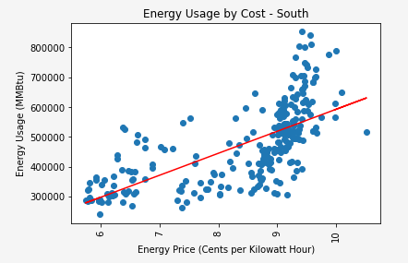
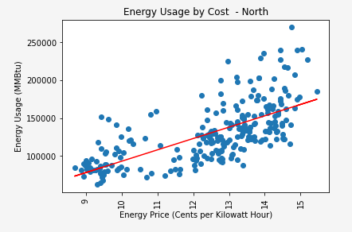
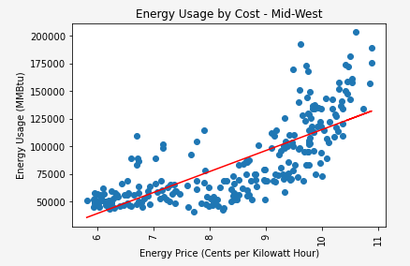
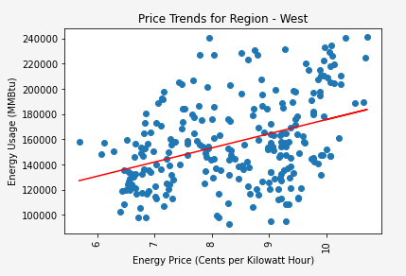
Energy Usage Trends
Energy Usage vs Price
No matter the price increase the usage seems to be the same.
Usage in the West has a low rate of increase, despite having California as much higher usage state.
The Midwest showed a higher rate of increase during this time period.

Slide 16
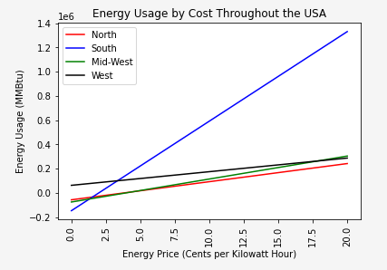
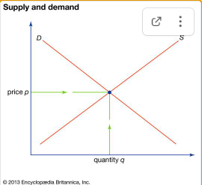
Usage vs Price
Energy Usage vs Price
As we time goes on we continue to use Energy. Our consumption increase and the Supply and Demand curve have no effect how we consume energy.

Slide 17
Conclusion
As we continue to increase in population and find new devices to plug-in into our homes, we will continue to demand more power.
Electrical companies have enjoyed profits due lowered production costs and our unsatiable need for energy.
Price ultimately, has little baring to our consumer demand and thus we will likely continue our habits of energy consumption.

