Slide 1

does price change in electricity affect usage?
(THE GIT COMMITS)
Jordan Alonzo
Amy Castillon
Josh Watson
Emanuel Villa

Slide 2
Electricity Consumption
Americans consume 26% of the world’s energy.
Our demand for energy grows by about 3% per year.
18% of total emissions comes from operating our homes.
Energy-efficient washing machines use about 1/3 less electricity than older machines.
Heating and cooling account for about 56% of the energy use in a typical home.
Reference: www.chelseagreen.com/2008/ten-surprising-facts-about-the-energy-we-use/

Slide 3
Questions:
Hypothesis:
Usage will drop due to price increases.
Do price changes affect usage?
Does energy’s status as a utility create a base usage outside of normal purchasing?
What is the expected tolerance by consumers to price change?

Slide 4

Sources:
U.S. Energy Information Administration

Slide 5
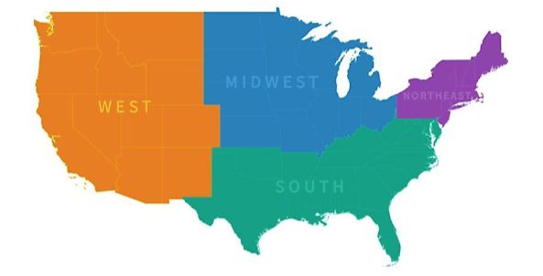
Data we are analyzing
Energy Consumption over a ten year period
Energy Price over a ten year period
Energy Consumption per region
Energy Price per Region
Production Costs
Usage Trends
U.S. Region Breakdown

Slide 6
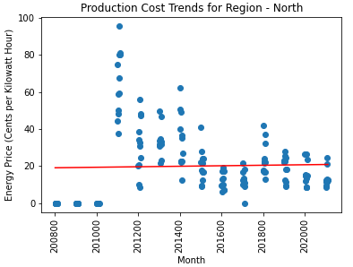
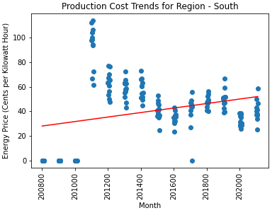
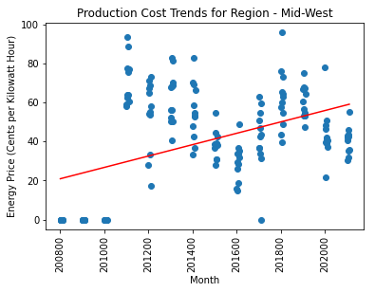
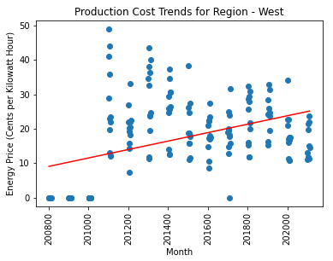
Production Cost Trends
Production Cost Trends per U.S. Region
Monthly Rate of increase of Production Costs:
North: Undetermined
South: 1.83%
Mid-West: 2.91%
West: 1.23%

Slide 7
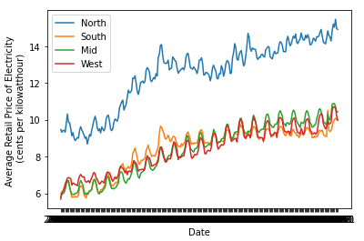
Price per Kilowatt-hour
Retail Price for Electricity
Retail increasing over time.
North has the highest cost for electricity.

Slide 8
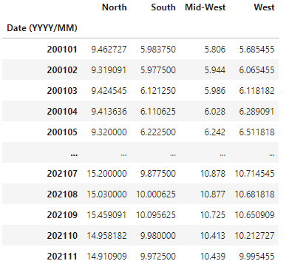
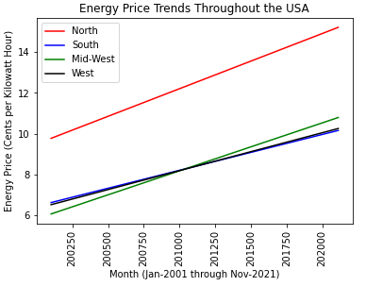
Energy Price Trends
Side by Side Price Commentary
.

Slide 9
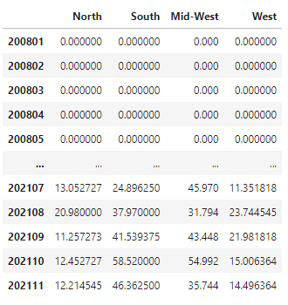
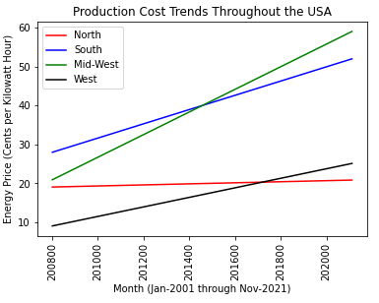
Production Cost Trends
Side by Side Production Cost Commentary
.

Slide 10
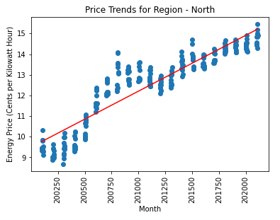
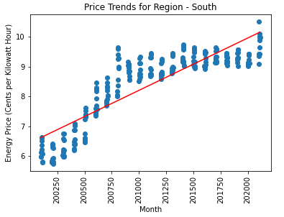
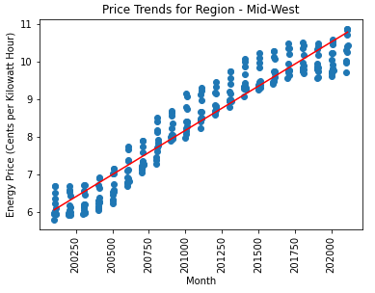
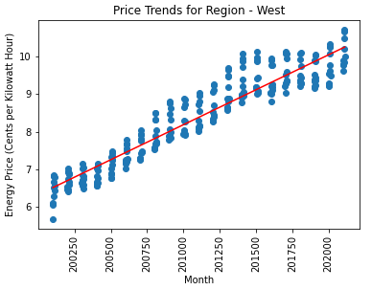
Energy Price Trends
Energy Price Trends per U.S. Region
In the last four years the South has had small increments to price.
The Midwest has had a high increase between 2007-2017
.

Slide 11
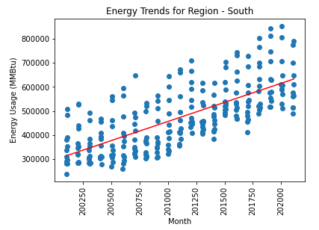
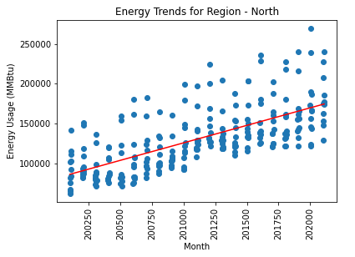
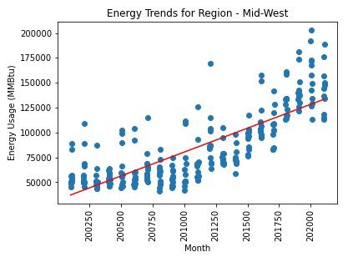
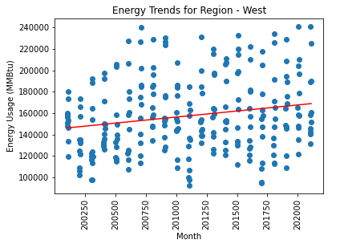
Energy Usage Trends
Energy Usage Trends per U.S. Region
Energy usage is considerable higher in the South region.
Usage in the West has a low rate of increase, despite having California as much higher usage state.
The Midwest showed a higher rate of increase during this time period.

Slide 12
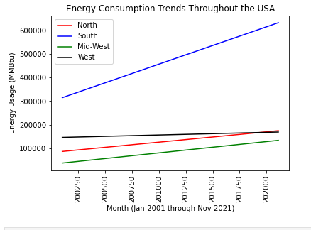
Energy Usage Trends
Projected Energy Usage
Energy usage will increase year after year.
.

Slide 13
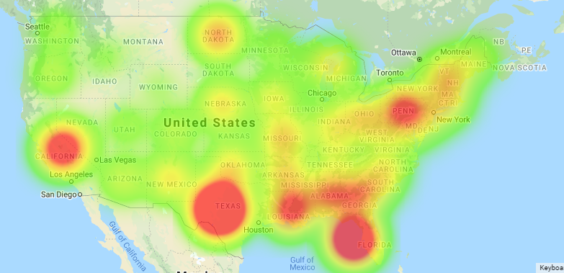
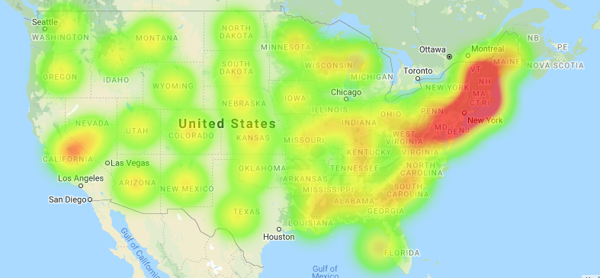
Average Price over 10 years vs Average Usage over 10 years.
Comparing Price vs Usage
Usage Heatmap
The price is much higher in the northern region.
California seems to have higher usage compared to the other state in its region.
Consumption in the South is very high as a Region.
Price Heatmap

Slide 14
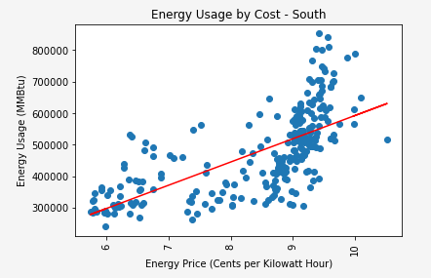
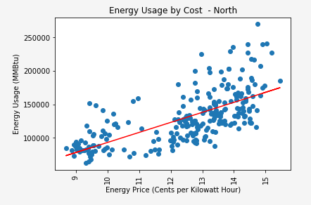
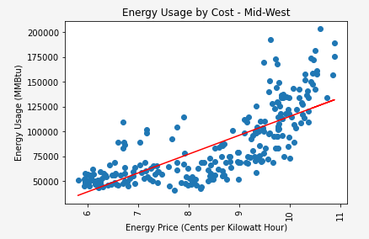
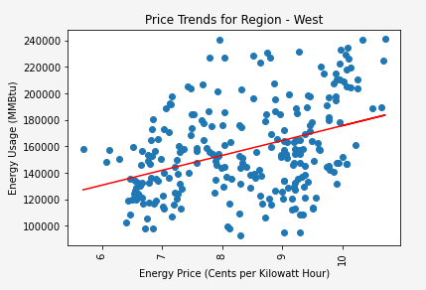
Energy Usage Trends
Energy Usage vs Price
No matter the price increase the usage seems to be the same.
Usage in the West has a low rate of increase, despite having California as much higher usage state.
The Midwest showed a higher rate of increase during this time period.

