Slide 1

does price change in electricity affect usage?
(THE GIT COMMITS)
Jordan Alonzo
Amy Castillon
Josh Watson
Emanuel Villa

Slide 2
Electricity Consumption
Americans consume 26% of the world’s energy.
Our demand for energy grows by about 3% per year.
18% of total emissions comes from operating our homes.
Energy-efficient washing machines use about 1/3 less electricity than older machines.
Heating and cooling account for about 56% of the energy use in a typical home.
Reference: www.chelseagreen.com/2008/ten-surprising-facts-about-the-energy-we-use/

Slide 3
Questions:
Hypothesis:
Usage will drop due to price increases.
Do price changes affect usage?
Does energy’s status as a utility create a base usage outside of normal purchasing?
What is the expected tolerance by consumers to price change?

Slide 4

Sources:
U.S. Energy Information Administration

Slide 5
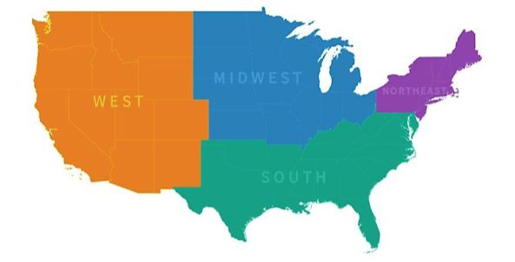
Data we are analyzing
U.S. Region Breakdown
Energy Consumption per region
Price per Region
Energy Consumption dating back 10 years
Total Consumption
Production Costs
Usage Trends

Slide 6
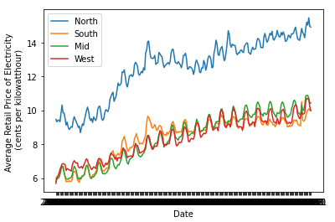
Price per Kilowatt-hour
Retail Price for Electricity
Retail increasing over time.
North has the highest cost for electricity.
Variations happen throughout the year for seasonal changes.

Slide 7
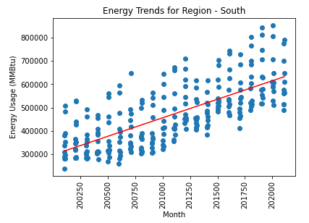
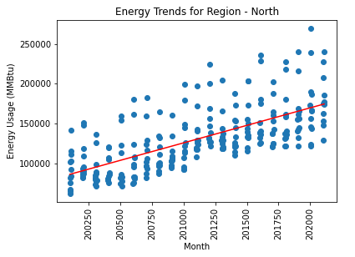
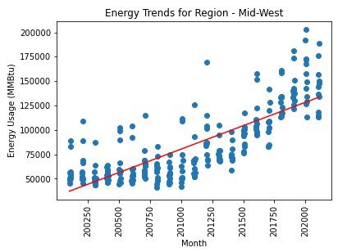
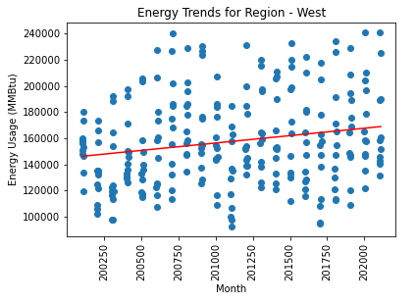
Energy Usage Trends
Energy Usage Trends per U.S. Region
Energy usage is considerable higher in the South region.
Usage in the West has a low rate of increase, despite having California as much higher usage state.
The Midwest showed a higher rate of increase during this time period.

Slide 8
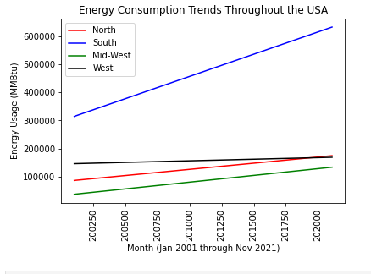
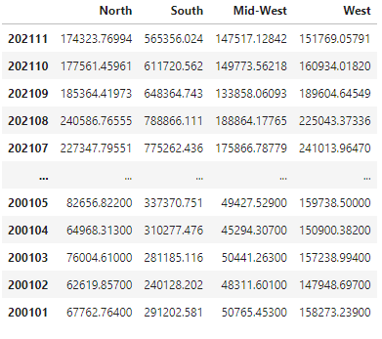
Energy Usage Trends
Side by Side Usage Commentary
Energy usage is considerable higher in the South region while the mid west has a lower usage.
.

Slide 9
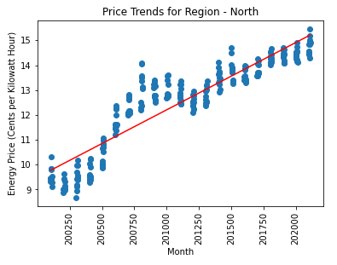
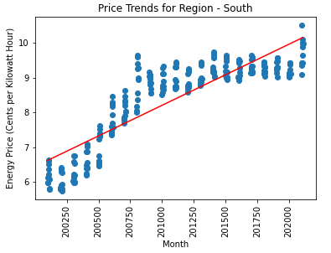
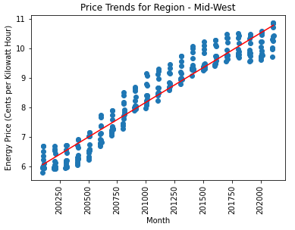
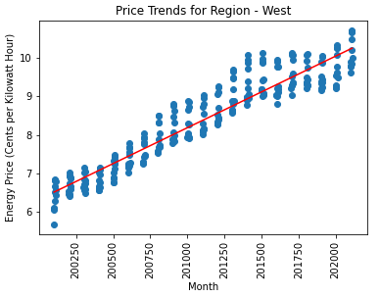
Energy Price Trends
Energy Price Trends per U.S. Region
In the last four years the South has had small increments to price.
The Midwest has had a high increase between 2007-2017
.

Slide 10
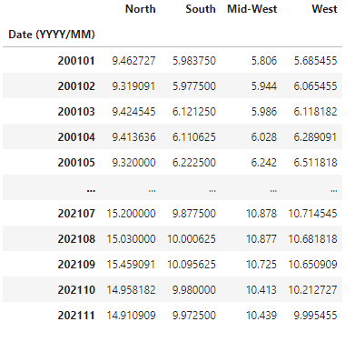
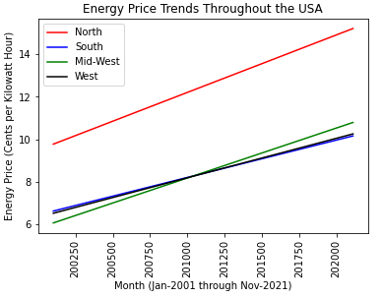
Energy Price Trends
Side by Side Price Commentary
.

Slide 11
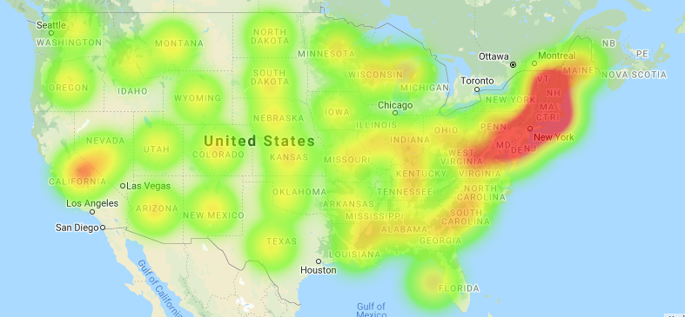
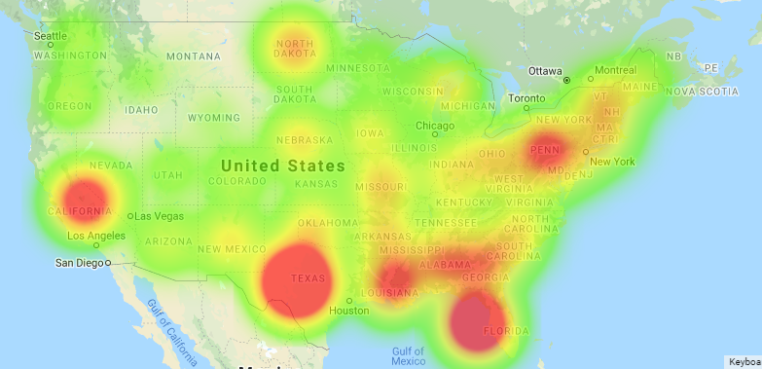
Data collected over 10 years
Comparing Price vs Usage
Price Heatmap
Consumption in the South is very high as a Region.
However, California seems to be higher usage compared to the other state in its region.
The price is much higher in the northeast region and it doe have one hotspot in Pennsylvania.
Usage Heatmap

Slide 12
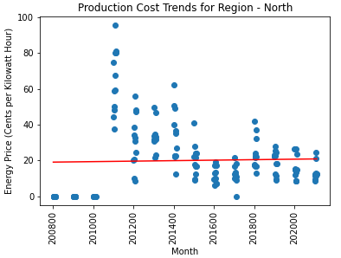
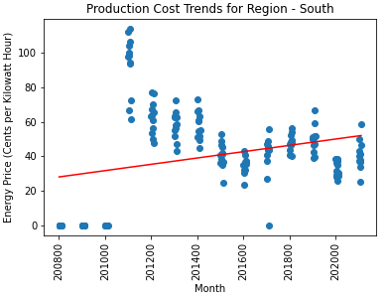
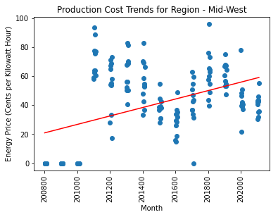
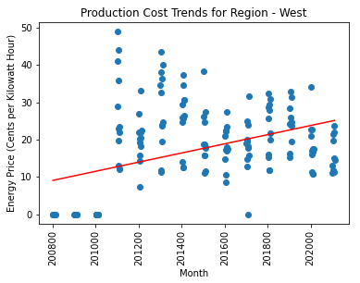
Production Cost Trends
Production Cost Trends per U.S. Region
Monthly Rate of increase of Production Costs:
North: Undetermined
South: 1.83%
Mid-West: 2.91%
West: 1.23%

Slide 13
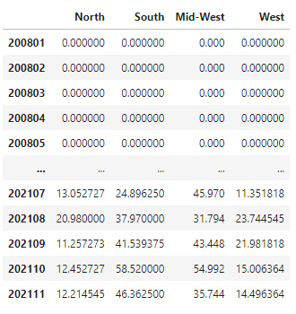
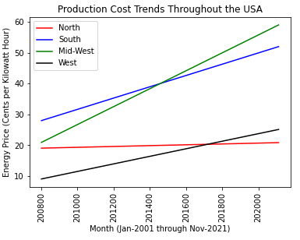
Production Cost Trends
Side by Side Production Cost Commentary
.

