Slide 1

Ruby on Rails Tech Talk
Prepared for CIS 440
By: Nicholas Muscara and Jason Weeks

Slide 2
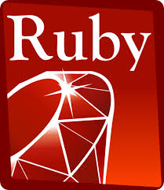
What is Ruby?
General-purpose programming language
“For me, the purpose of life is, at least partly, to have joy. Programmers often feel joy when they can concentrate on the creative side of programming, so Ruby is designed to make programmers happy.”
Yukihiro Matsumoto (creator of Ruby)
Informit.com, The Ruby Programming Language

Slide 3

What is Rails?
Created by David Heinemeier Hanson 2003 under The MIT license (open source)
Released 2004
Web Database Application Framework
Favors Convention over Configuration
Optimized for:
Programmer Happiness
Sustainable Productivity
MVC

Slide 4
Model View Controller
Image by Hartl,
Ruby on Rails Tutorial

Slide 5
Model View Controller
Controllers handle requests from users, views, and models
Models handle heavy lifting
Database
Schema
Associations
Controllers auto render views with the corresponding routes
Image by Hartl,
Ruby on Rails Tutorial

Slide 6
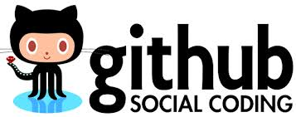


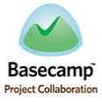





Who Uses Rails?

Slide 7
Why Use Rails?
Easy development
Front and Back
Generators (controller)
Boilerplate code
GEMS
Scaffolding (model-controller-view)
Creates full database model
Migration for that model
Controllers and Views
Notes:
generate command uses templates to create boilerplate code (code necessary for the app to work)
scaffold command creates a full set model, database migration for that model, controller to manipulate it, views to view and manipulate the data and a test suite for each
Routes handles and generates URLs and paths

Slide 8





Why Use Rails?
Compatibility
Windows
Mac
Unix
Linux
Notes:
\

Slide 9

Issues & Drawbacks
Windows Issues (JavaScript issues)
Many Versions
Deprecated GEMS
methods change/update
Tutorial Issues

Slide 10

Live Demo
System
Requirements
How many lines of code will it take to create a social network database web app?

Slide 11
Resources & Additional Information
Develop Starter - Build a Simple Ruby on Rails Application (videos)
Michael Hartl – The Ruby on rails Tutorial (eBook)
Yukihiro Matsumoto- The Ruby Programing Language (article)
Leonard Teo- Ruby on Rails v. PHP (blog article)
Rubyonrails.org – Rails Guides (online user guides )

