Slide 1




RDF triplestores and SPARQL endpoints
Lecturer: Mathias Bonduel
mathias.Bonduel@kuleuven.be
LDAC summer school 2019 – Lisbon, Portugal
Notes:
Input needed from experience of other lecturers:
used triplestore, RDF libary (incl. version)
used/tested functionality
limits
No benchmarking => brief overview of what to expect

Slide 2
Lecture outline
Storing RDF data: RDF triplestores
Available methods to store RDF data
RDF triplestores
Triplestore applications – databases – default graph – named graphs
List of triplestore applications
Comparing triplestores
Relevant triplestore settings
Communication with triplestores
Distributing RDF data: SPARQL endpoints
Available methods to distribute RDF data
SPARQL endpoints
Reuse of SPARQL queries
SPARQL communication protocol: requests and responses

Slide 3
Storing RDF data

Slide 4
Available methods to store RDF data
In-memory storage (local RAM)
Working memory of application (e.g. client side web app, desktop app)
Frameworks/libraries: RDFLib (Python), rdflib.js (JavaScript), N3 (JavaScript), rdfstore-js (JavaScript), Jena (Java), RDF4J (Java), dotNetRDF (.NET), etc.
Varied support for SPARQL querying
Persistent storage (storage drive)
RDF file/dump (diff. RDF serializations): TTL, RDF/XML, N-Quads, JSON-LD, N-triples, TriG, N3, TriX, RDFa (RDF embedded in HTML), etc.
RDF triplestore
(ontology editing applications: Protégé, Topbraid Composer, etc.)
Notes:
in-memory: limited by RAM + volatile => ideal for small, temporal datasets ⬄ persistent storage: more scalable, better consistency and smaller memory footprint => some triplestores offer the option to choose between in-memory or persistent storage

Slide 5

RDF triplestores
“a database to store and query RDF triples”
Member of the family of graph/NoSQL databases
Data structure: RDF
Main query language: SPARQL
Oftentimes support for RDFS/OWL/rules reasoning
Data storage is typically persistent
standards
Notes:
data storage is typically persistent => there are exceptions allowing in-memory storage

Slide 6
Triplestore applications – databases - default graph - named graphs
An RDF triplestore instance (application) can have one or multiple databases (repositories)
Each database has one default graph and zero or more named graphs
a good practice is to place TBox in a separate named graph. Most triplestores’ reasoning engines consider all TBox statements in the database
You can also use the TBox without reasoning => query directly
Notes:
Parliament triplestore does not take Tbox from named graphs into consideration
A triplestore can also be called a quadstore if it supports named graphs (similar for Triple Pattern Fragment server => Quad Pattern Fragment server)
Also possible for reasoners of some triplestore applications to only use certain Tbox (e.g. by defining the name of the named graph)

Slide 7
Instance of an RDF triplestore application (e.g. an Apache Jena Fuseki instance)
Named graph 1
Default graph
Default graph
Named graph n
Named graph 2
Database 1
Database 2
Database m

Slide 8




List of triplestore applications
Apache Jena:
TDB
Fuseki
Blazegraph DB
Stardog
Strabon
Apache Marmotta/KiWi
Ontotext GraphDB (former OWLIM)
Openlink Virtuoso
Cambridge Semantics AnzoGraph
Amazon Neptune
Franz AllegroGraph
BBN Parliament
ClioPatria
...
Notes:
Apache Jena TDB: no support for setting up a SPARQL endpoint => use Fuseki (SPARQL endpoint over TDB or in-memory DB)
hybrid databases:
Openlink Virtuoso Universal Server => triplestore, RDBMS, XML and free text documents
AnzoGraph: RDF and LPG
Amazon Neptune: RDF and LPG

Slide 9
List of triplestore applications
Apache Jena Fuseki
Stardog
Ontotext GraphDB
BBN Parliament

Slide 10
Comparing triplestores (1/4)
Hardware sizing: recommended RAM, disk space, etc.
Efficiency (speed and memory usage)
RDF loading/import efficiency
Querying efficiency
Reasoning efficiency
License options
open source/proprietary
free/educational/commercial
Security: SSH, access roles
Notes:
https://medium.com/wallscope/comparison-of-linked-data-triplestores-developing-the-methodology-e87771cb3011
RDF querying/loading efficiency:
triplestore
triplestore settings
data structure and size
query structure

Slide 11
Comparing triplestores (2/4)
API programming language support
SPARQL 1.1 support + SPARQL extensions (spatial, temporal, PATHS, etc.)
Reasoning: support for RDFS, OWL flavors, rule languages, SHACL
Validity/conformity check of input data
Documentation (or the lack of it)
(Commercial) support
Extras:
GraphQL, support for Apache TinkerPop API (e.g. Gremlin), etc.
plug-and-play cloud database
full-text search, machine learning
virtual graphs

Slide 12
Comparing triplestores (3/4)
Disclaimer: no liability regarding completeness and correctness
Name triplestore | GeoSPARQL querying | Multiple repositories per DB instance | Named graphs | Supported reasoning schemes | Licensing options | Bulk loading
Apache Jena Fuseki | No* | Yes | Yes | RDFS/OWL rule engines** | Open source (Apache License v2.0) | Yes
Stardog | Yes | Yes | Yes | RDFS, OWL DL/QL/RL, SL (includes SWRL), SHACL | Proprietary: Enterprise licenses (60 day trial), free academic license | Yes
Ontotext GraphDB | No*** | Yes | Yes | RDFS, OWL QL/RL, custom rulesets | Proprietary: Enterprise license (60 day trial), standard license (60 day trial), free license | Yes
BBN Parliament | Yes | No | Yes | Selection of RDFS and OWL rules (config), SWRL | Open source (BSD) | Yes
* Limited custom geospatial queries possible over WGS84 and GeoSPARQL WKT data (newest versions might include GeoSPARQL querying)
** Jena modules can be connected for extensions: http://jena.apache.org/documentation/inference/
*** Limited custom geospatial queries possible over WGS84 data (GraphDB functions)
Notes:
https://en.wikipedia.org/wiki/Comparison_of_triplestores
Parliament:
named graphs: editing is only possible via SPARQL protocol (not in web interface: no quad formats allowed)
no validity check, indexing before spatial querying
reasoning: SWRL rules, subclass, inferRdfsClass, inferOwlClass, inferRdfsResource, inferOwlThing, subproperty, domain, range, equivalentProp, equivalentClass, inverseOf, symmetricProp, functionalProp, invFunctionalProp, transitiveProp => no prop chain axioms, disjunct classes/properties, reflexive/irreflexive, asymmetric, owl:sameAs => rule language based (subprofile of OWL 2 RL?)
config file (no request prop)
extendible?
Fuseki:
options for geospatial queries
https://jena.apache.org/documentation/query/spatial-query.html
https://github.com/galbiston/geosparql-fuseki
https://github.com/galbiston/geosparql-jena
Full text search
https://jena.apache.org/documentation/query/text-query.html

Slide 13
Comparing triplestores (3/4)
Disclaimer: no liability regarding completeness and correctness
Name triplestore | Support | Programming interface | Extras: rule languages, validity check, built-in security
Apache Jena Fuseki | (Public mailinglist) | Java (Jena) | Support for rules, authentication (Apache Shiro), extensions via Jena (advanced reasoning, geospatial querying, full text search, etc.)
Stardog | Commercial support, Stardog forum | Java (SNARL (native API), Sesame, RDF4J, Jena) | Validation (SHACL/ICV), rules (SWRL and Stardog Rules), PATHS queries, virtual graphs (RDBMS, CSV/JSON/XML, MongoDB, Cosmos DB, Cassandra, etc. using R2RML or Stardog mapping syntax), GraphQL, property graph model (Tinkerpop), built-in authentication, full-text search, NLP, query/reasoning(inconsistency/inference)/validation explanations, machine learning functions
Ontotext GraphDB | Commercial support, email, Stack Overflow | Java (RDF4J, Jena) | Validity check, separate plug and play cloud database, full-text search, RDFRank (interconnectedness), built-in authentication, custom GraphDB Rules, query explanations
BBN Parliament | (Github) | Java, C++ | Support for SWRL rules, temporal indexing
Notes:
programming against triplestores in other languages: over HTTP (SPARQL protocol)
Stardog provides wrappings for Javascript, Clojure, .Net, Spring, Groovy
GraphDB: wrapping for Javascript (node.js)

Slide 14
Relevant triplestore configuration settings (1/2)
SPARQL endpoint host and port
Query timeout
Heap size
Security and authorisation
Connection methods to HTTP server: enable/require SSL encryption
users: name and password
roles connected to users
rights for user/role: read/write RDF content, create/delete databases, adjust settings/users, grant/revoke permissions
Treatment of literals: strict parsing, canonicalization
RAM
JVM Heap
Off-Heap
OS
Settings with potential impact on loading/querying efficiency
Notes:
Available settings depend on triplestore app
impact on the loading and/or querying efficiency
triplestore and settings
data structure
query (query plans)
Scope of settings: global (triplestore app instance) vs database vs named graph settings

Slide 15
Relevant triplestore configuration settings (1/2)
Indexing: regular, geospatial, temporal, text (literals)
Query scope: default graph, union of all named graphs, union of all named graphs and default graph
Active reasoning profiles: RDFS, OWL RL, OWL QL, etc.
Active rule engines
Enable spatial querying, reasoning, etc.
...
Settings with potential impact on loading/querying efficiency
Notes:
Available settings depend on triplestore app
impact on the loading and/or querying efficiency
triplestore and settings
data structure
query (query plans)
Scope of settings: global (triplestore app instance) vs database vs named graph settings

Slide 16
Communication with triplestores
SPARQL over HTTP request: SPARQL protocol (code, cURL, Postman, etc.):
SPARQL endpoint URL: read ⬄ update
Options: query, authentication, inference, input/output format
standardized
Native API of triplestore (own code, commandline):
Bulk loading RDF files
Management of databases: (all/active) databases, start, stop, drop, settings, roles, etc.
Direct queries
Web/desktop client:
Triplestore specific client: via SPARQL protocol or native API
Generic client: via SPARQL protocol
Notes:
Fuseki settings: https://jena.apache.org/documentation/fuseki2/fuseki-configuration.html
auth (using Apache Shiro):
https://jena.apache.org/documentation/fuseki2/fuseki-security.html
https://jena.apache.org/documentation/permissions/example.html
reasoning: http://web.archive.org/web/20180730115728/http://www.juanfelipe.info/node/182
config files (assembler): https://jena.apache.org/documentation/assembler/assembler.ttl
Stardog HTTP API: https://stardog.docs.apiary.io/#
Stardog help [command_group_name] or https://www.stardog.com/docs/#_man_pages
GraphDB: GraphDB Workbench Help -> REST API Documentation menu. (http://localhost:7200/webapi)
GraphDB cloud: http://cloud-docs.ontotext.com/display/S4docs/GraphDB+Cloud+REST+APIs#GraphDBCloudRESTAPIs-GraphDBCloudAPIManagingRepositories%26QueryingData
Parliament: generic SPARQL protocol (no own API?)

Slide 17
Links to installation guidelines
Apache Jena Fuseki:
Visual interface: Fuseki web app on localhost:3030 (comes with triplestore)
Triplestore: all OS
Stardog:
Visual interface: Stardog Studio (and web app)
Triplestore: Linux and Mac OS / Docker / Windows
GraphDB:
Visual interface: GraphDB workbench web app on localhost:7200 (comes with triplestore)
Triplestore: Linux / Mac OS / Windows
Parliament:
Visual interface: Parliament web app on localhost:8089/parliament (comes with triplestore)
Triplestore: all OS (download from Github repository, old website is depreciated)
Notes:
all based on Java: best to have Java v8 or higher installed

Slide 18
Distributing RDF data

Slide 19
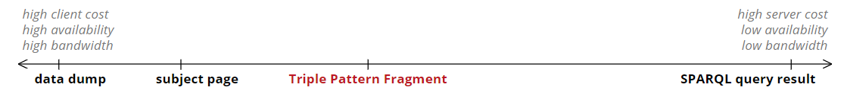
Available methods to distribute RDF data
SPARQL endpoint
Triple Pattern Fragment
server endpoint
RDF files:
dump file
subject page
RDF embedded in HTML (i.e. RDFa)
in-memory RDF store (local access only)
Source: http://linkeddatafragments.org/concept/
Notes:
Servers/files can be local on one computer (localhost) or shared in a local network or a public network
A public SPARQL endpoint over an RDF triplestore is often very brittle (limited availability)
other options: data dumps and triple pattern fragment server (read only)
usage of SPARQL endpoint in controlled local network

Slide 20
SPARQL endpoint (1/4)
“An entry point for HTTP access to shared RDF data using SPARQL as a query language”
( standardized SPARQL communication protocol)

Slide 21






SPARQL endpoint (2/4)
Triplestores
RDF files
HTTP request with SPARQL query
RDBMS
HTTP response
NoSQL
Virtual graphs
Client
Server
XML files
JSON files
CSV files
Triple Pattern Fragment Servers
Notes:
Servers/files can be local on one computer (localhost) or shared in a local network or a public network
Topbraid Composer can be used to set up a SPARQL endpoint: https://www.topquadrant.com/2010/05/07/how-to-publish-your-linked-data-with-topbraid-live-sparql-endpoints/

Slide 22
SPARQL endpoint: RDF triplestore (3/4)
Standalone server
Windows service
Web application (e.g. in Apache Tomcat, Jetty Boots, etc.)
Cloud server
In-Process (embedded in your own code)
Notes:
available options depend on triplestore: minimum is a standalone server

Slide 23
SPARQL endpoint: simplest configuration (4/4)
HTTP request with SPARQL query
Triplestore
HTTP response
Client
Server
Example 1: https://dbpedia.org/sparql
= public (read only) SPARQL endpoint of DBpedia’s triplestore (Virtuoso)
Example 2: https://rdf.ontotext.com/4139541402/mydb/repositories/OpenSmartHomeDataSet
= public (read only) SPARQL endpoint of Open Smart House (OSH) dataset (GraphDB cloud)
Notes:
Server and triplestore can be local on one computer (localhost) or shared in a local network or a public network

Slide 24
SPARQL queries can be reused everywhere?
in theory: yes (e.g. compliant to SPARQL 1.1)
in practice: watch out
< 100% coverage for SPARQL 1.1 standard
Different interpretation of some parts of the specification
Different behavior towards named graphs and default graph
SPARQL extensions (e.g. PATHS, geospatial, temporal, Custom Datatypes (CDT), ...)
Reasoning engine
well-formed RDF literals (canonicalization)
extensive testing is always needed!
Notes:
e.g. query in GraphDB default graph: includes triples from RDFS, RDF, OWL
Some triplestore engines allow to loosen the RDF literal well-formedness (canonicalization)
* triplestores compatible with RDF4J framework should be more compatible

Slide 25
SPARQL communication protocol: URLs and options
Triplestore | Type | HTTP method | Default local endpoint URL | Properties
Apache Jena Fuseki | Read | GET/POST | http://localhost:3030/MyDB/query http://localhost:3030/MyDB/sparql | “query”: containing SPARQL read query “Accept”: application/json, etc.
 | Update | POST | http://localhost:3030/MyDB/update | “update”: containing SPARQL update query
Stardog | Read | GET/POST | http://localhost:5820/MyDB/query | “query”: containing SPARQL read query “accept” : application/json, etc. “reasoning”: Boolean to activate reasoning
 | Update | POST | http://localhost:5820/MyDB/update | “query”/”update”: containing SPARQL update query “reasoning”: Boolean to activate reasoning
Ontotext GraphDB | Read | GET/POST | http://localhost:7200/repositories/MyDB | “query”: containing SPARQL read query “accept” : application/json, etc. “infer”: Boolean to activate reasoning
 | Update | POST | http://localhost:7200/repositories/MyDB /statements | “update”: containing SPARQL update query “infer”: Boolean to activate reasoning
BBN Parliament | Read | GET/POST | http://localhost:8089/parliament/sparql | “query”: containing SPARQL read query “Accept”: application/sparql-results+json, etc.
 | Update | POST | http://localhost:8089/parliament/sparql | “update”: containing SPARQL update query
Notes:
read query: https://www.w3.org/TR/2013/REC-sparql11-query-20130321/
SELECT, CONSTRUCT, ASK, DESCRIBE
update query: https://www.w3.org/TR/sparql11-update/
graph update: INSERT, INSERT DATA, DELETE, DELETE DATA, LOAD, CLEAR (+ combinations with named graph)
graph management: CREATE, DROP, COPY, MOVE, ADD (+ combinations with named graph)

Slide 26
SPARQL communication protocol: media types
SPARQL SELECT/ASK results
JSON: application/sparql-results+json (sometimes also application/json)
XML: application/sparql-results+xml (sometimes also application/xml)
TSV: text/tab-separated-values
CSV: text/csv
Boolean: text/Boolean
Binary RDF results: application/x-binary-rdf-results-table
SPARQL CONSTRUCT/DESCRIBE results
Turtle: text/turtle (sometimes also application/x-turtle)
JSON-LD: application/json (sometimes also application/ld+json)
N3: text/n3
RDF/XML: application/rdf+xml
TriG: application/trig
TriX: application/trix
N-Quads: application/n-quads
...
Notes:
support depends on triplestore

Slide 27
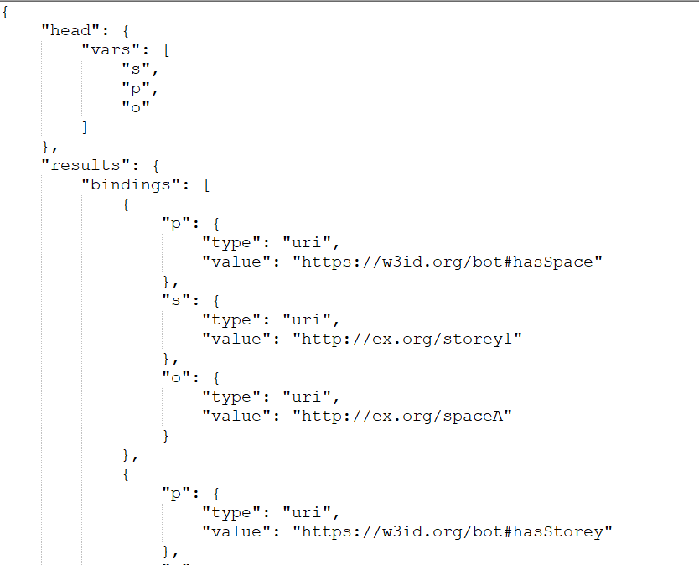
SPARQL communication protocol: response
SELECT *
WHERE { ?s ?p ?o }
Accept: application/
sparql-results+json

