Slide 1
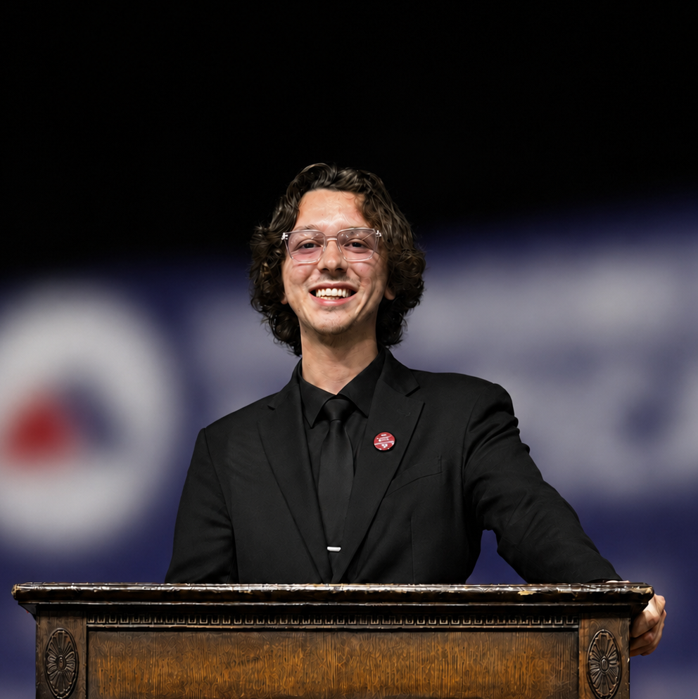
Dynamic-Resolution Control for RGB/IR Early-Fusion Object Detection
PRESENTER
Jacob Whisenant
PhD student
AFFILIATION
Dept. of Mechanical Engineering
University of South Carolina
Columbia, SC

Slide 2
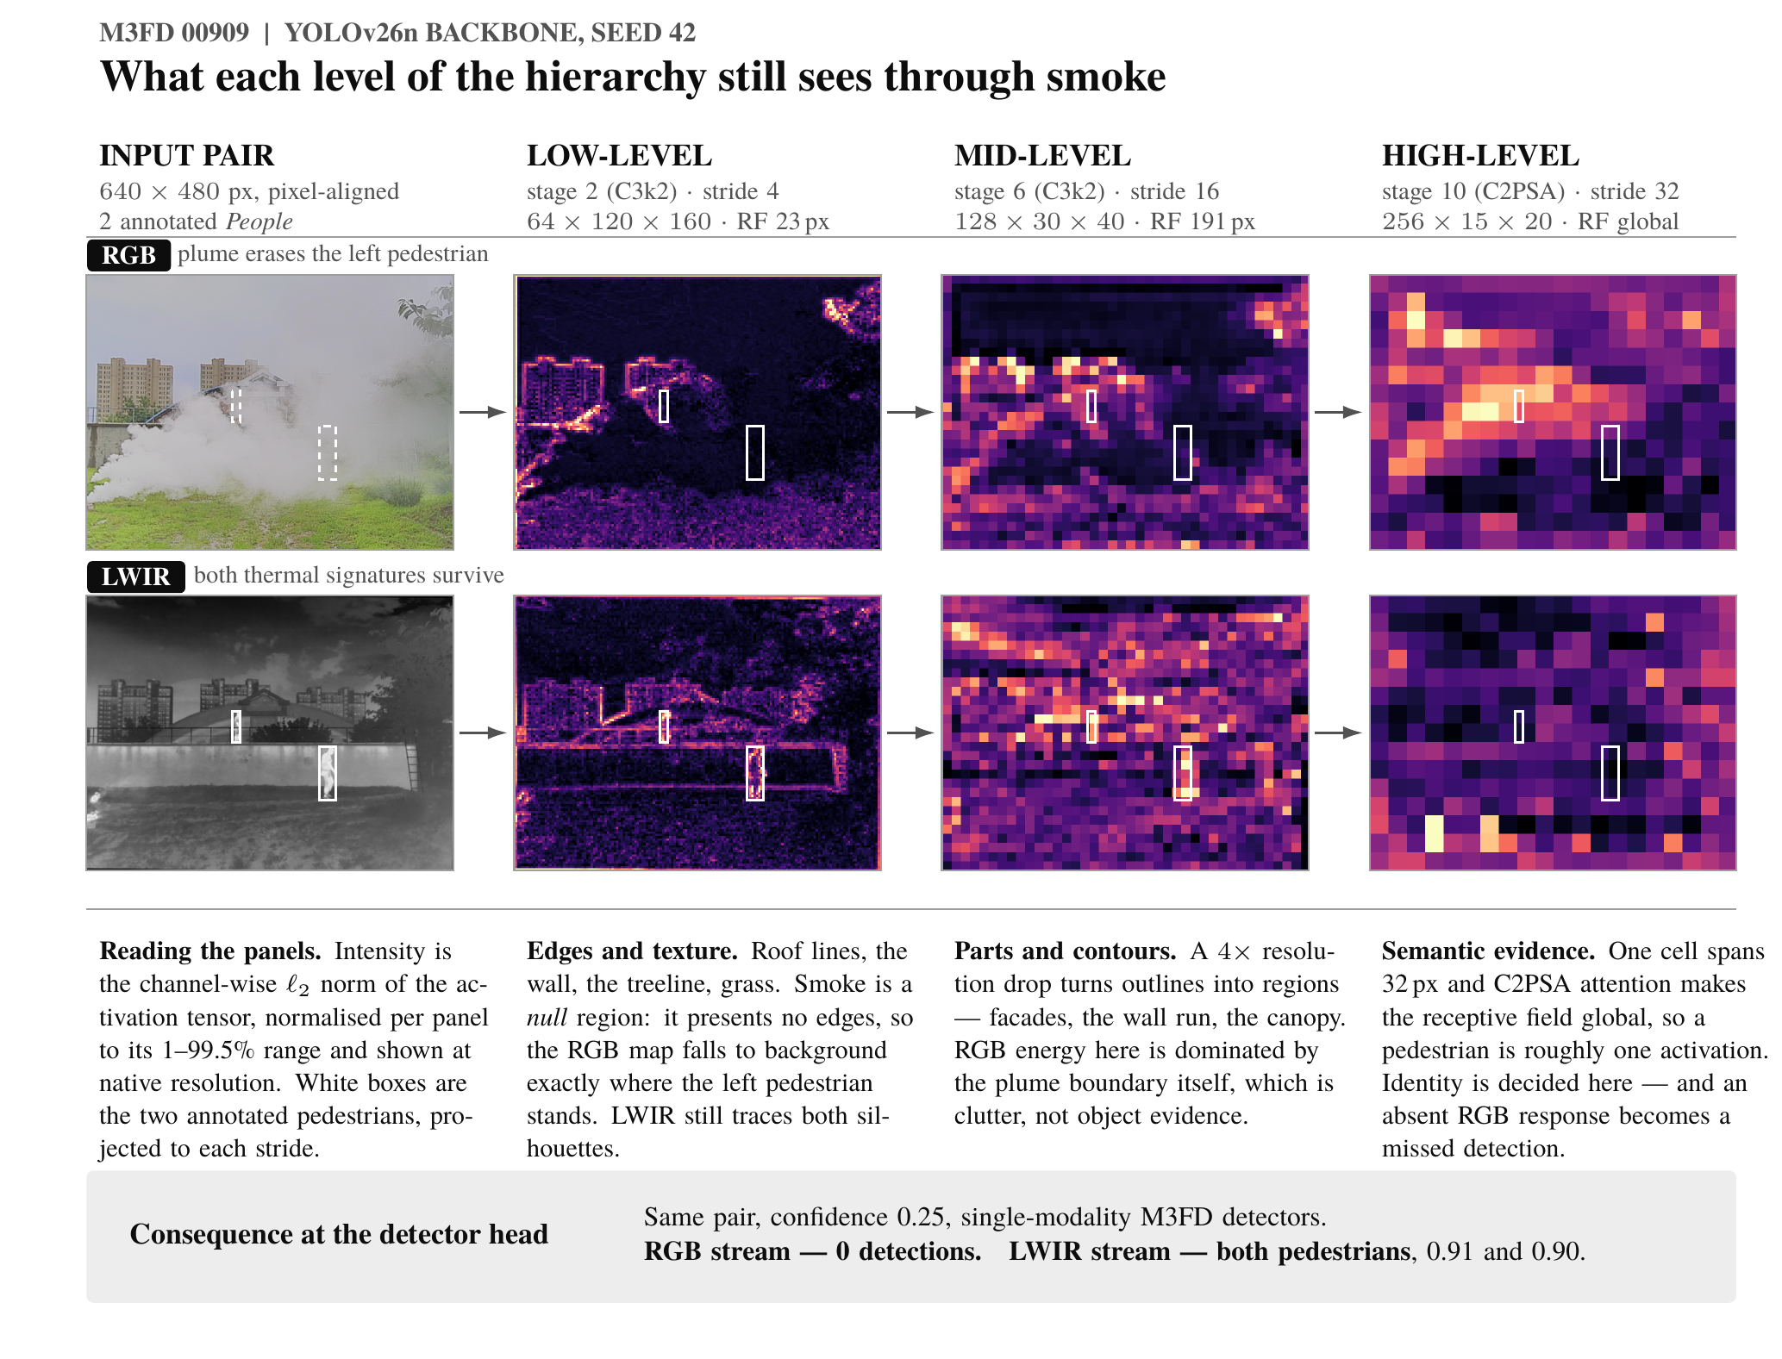
Proposed Problem
RGB/IR scenes vary in lighting, thermal contrast, and object size.
Current detectors process every scene at the same resolution.
High resolution = better detection, but higher latency, memory, and energy.
Low resolution = lower cost but may lose important features.
Affects real-time edge systems with limited computing resources.
Develop easy to use API
Can adaptive resolution reduce early-fusion inference cost while preserving detection accuracy?

Slide 3
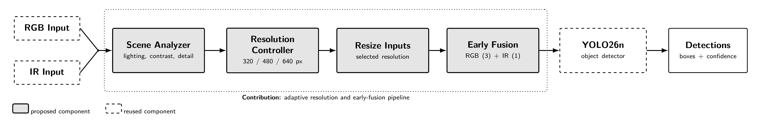
Proposed Solution

Slide 4
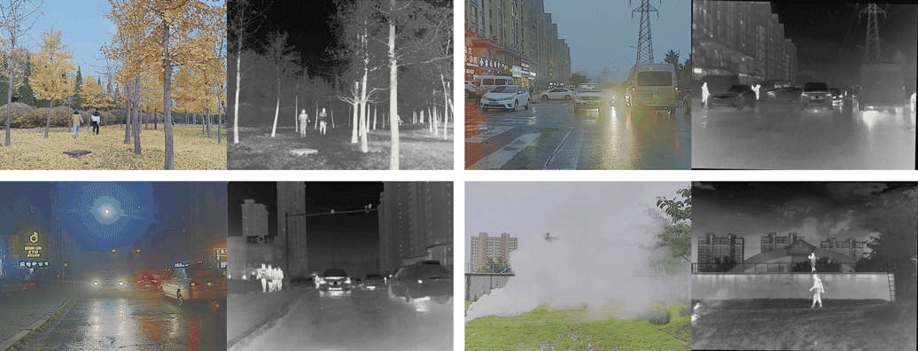
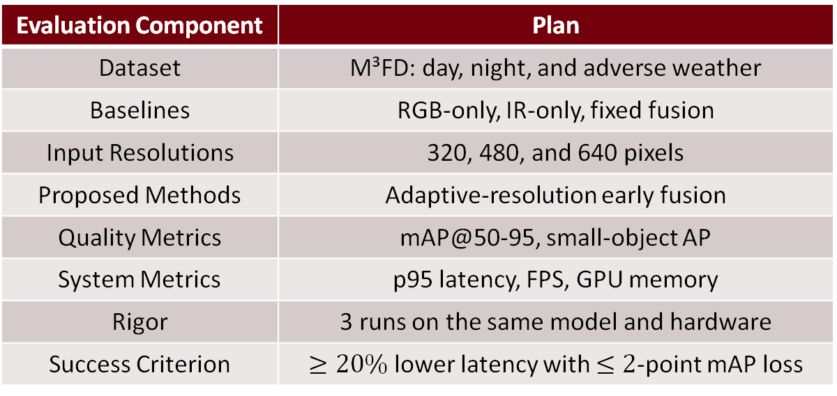
Evaluation
Evaluation Component | Plan
Dataset | M³FD: day, night, and adverse weather
Baselines | RGB-only, IR-only, fixed fusion
Input Resolutions | 320, 480, and 640 pixels
Proposed Methods | Adaptive-resolution early fusion
Quality Metrics | mAP@50-95, small-object AP
System Metrics | p95 latency, FPS, GPU memory
Rigor | 3 runs on the same model and hardware
Success Criterion | $≥20\%$ lower latency with $≤2$-point mAP loss
Questions: Accuracy–efficiency trade-off across resolutions and scenes
Variables: Fixed/adaptive resolution, modality, and lighting condition
Evidence: Accuracy–latency plot, comparison table, and detection examples

