Slide 1
Dynamic-Resolution Control for RGB/IR Early-Fusion Object Detection
PRESENTER
Jacob Whisenant
PhD student
AFFILIATION
Dept. of Mechanical Engineering
University of South Carolina
Columbia, SC

Slide 2
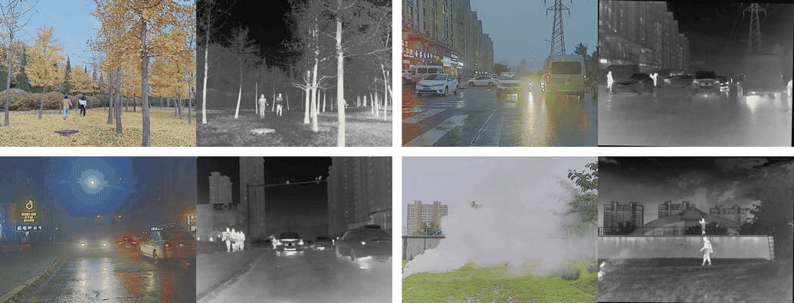
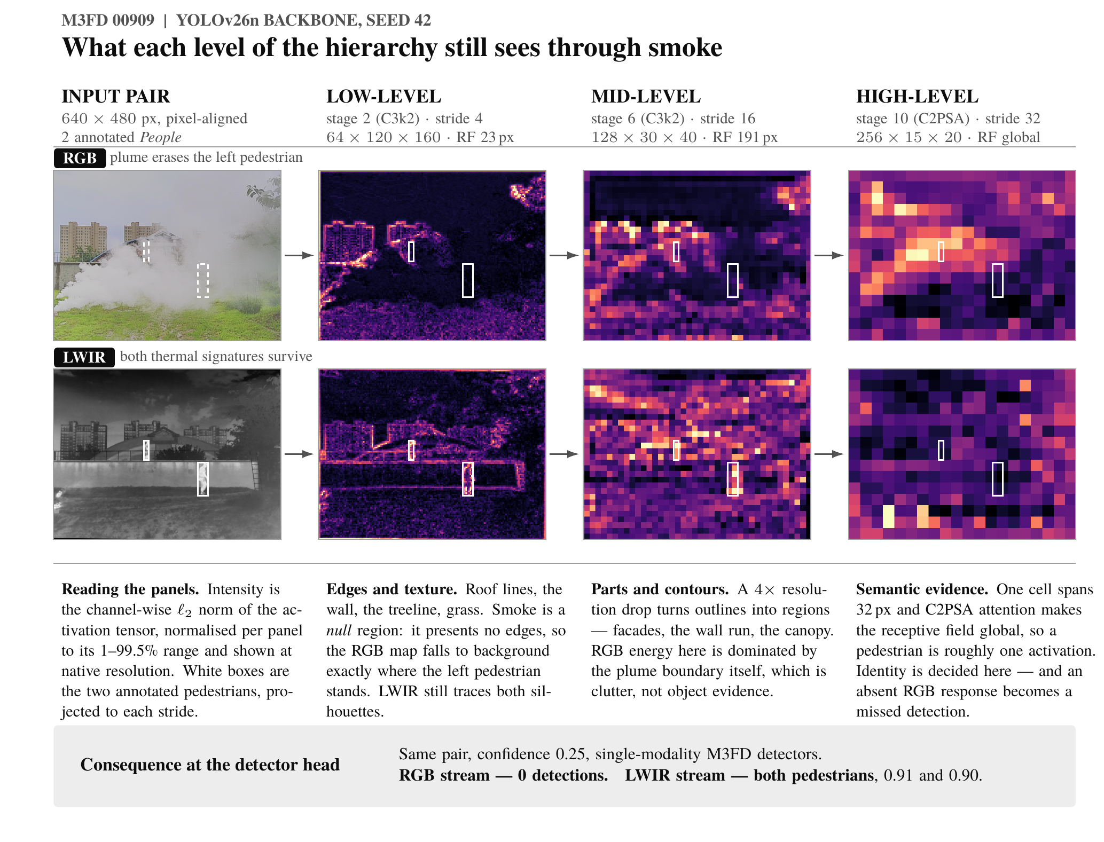
Proposed Problem
RGB/IR scenes vary in lighting, thermal contrast, and object size.
Current detectors process every scene at the same resolution.
High resolution = better detection, but higher latency, memory, and energy.
Low resolution = lower cost but may lose important features.
Affects real-time edge systems with limited computing resources.
Develop easy to use API
Can adaptive resolution reduce early-fusion inference cost while preserving detection accuracy?

Slide 3
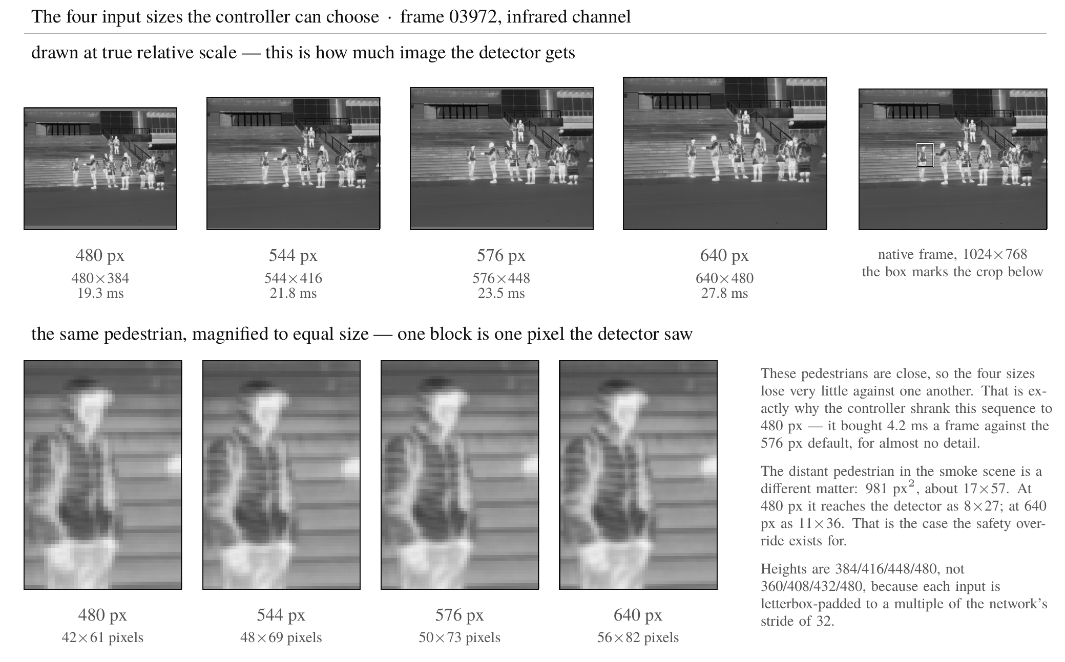
Initial Hypotheses
Reducing resolution from 640 to 480 pixels would substantially lower latency while causing only a small loss in detection accuracy.
Per-image adaptive resolution would outperform fixed-resolution settings and random resolution selection at a similar computational cost.
A learned resolution controller would capture more performance savings than a hand-designed heuristic while adding minimal overhead.
Notes:
Briefly describe what you hoped to observe based on your initial hypotheses.

Slide 4
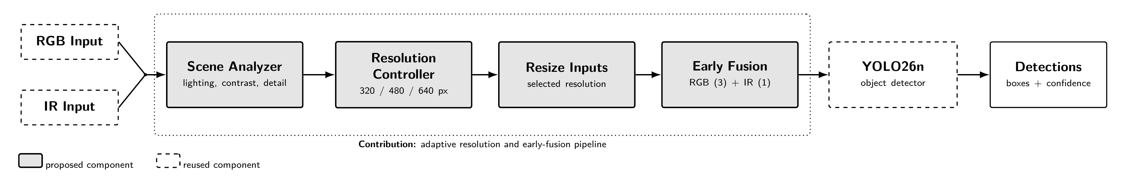
Proposed Pipeline

Slide 5
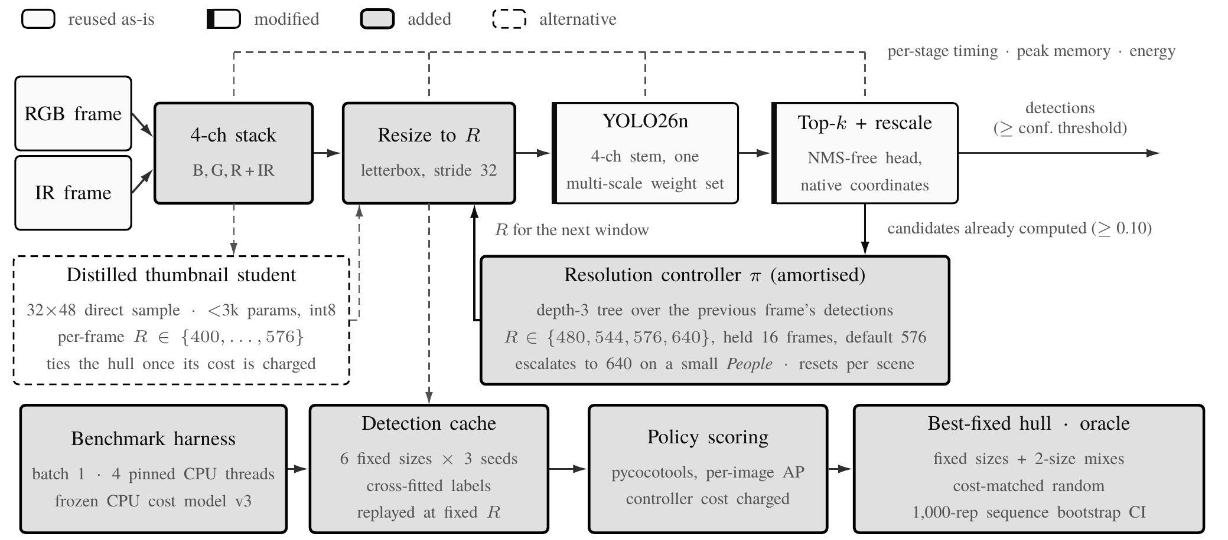
Tested Pipeline - Full

Slide 6


Tested Pipeline – 4 channel Stack
4 channel stack - just stacks the two inputs into a single 4-channel image (blue, green, red, infrared) at full resolution
Distilled thumbnail student
  Is just a tiny network that guesses a good resolution by glancing at the frame itself, instead of looking at the previous frame’s detections.
  It grabs a 32x48 thumbnail by sampling every Nth pixel rather than resizing since resizing first would cost time.
  It’s dashed as it worked well just not well enough and only gained us 0.5AP at the cost of 0.11 ms to run.

Slide 7

Tested Pipeline – Resize to R
Resize to R – takes the stacked image and shrinks it so its longside equals the size the controller picked
Benchmark harness – measures what the path actually costs, one frame at a time.
Detection cache – runs the detector once over every image at every candidate resolution and saves all the results. Because only one image is run at a time, an image’s detections depend only on its own resolution
Policy scoring – takes the detections a policy would have produced and grades them with the standard COCO metric (map@50-95) against the ground truth
Best fixed hull oracle - The bar to beat and the ceiling to aim at. Hull is the best accuracy at any given speed and the oracle is the best gain at the ideal resolution.

Slide 8
Tested Pipeline – YOLO26n
YOLO26n
  Off the shelf detector with nano being the smallest weights from Ultralytics
  Updated from 3 input channels to 4, with the pretrained RGB filters

Slide 9
Tested Pipeline – Top K + rescale

Slide 10
Tested Pipeline – Top K + rescale
Top-k + rescale
  The detector always spits out exactly 300 boxes, best guess first, whether the scene is empty or crowded, this block throws away anything it isn't confident about
  Surviving boxes are measured against the shrunken, gray padded image the network actually looked at, not the real photo. This black converts them back (peel off the padding and undo the shrink)
  Confident boxes go out as the answer and unconfident ones get handed to the controller instead

Slide 11
Tested Pipeline – Resolution Controller
Resolution Controller
  High resolution is accurate but slow and small resolution is fast but misses objects
  Most systems just pick one size and than they stick with it, but frames aren’t equally hard.
  Controller here picks the resolution per the situation.
  Frames 1-16 run at the default 576 and the detector reports what it finds.
  After frame 16 the controller looks at what that frame’s results and looks at size of box and confidence than determines the difficulty of the scene and adjust the resolution.
  It watches what the detector found a moment ago, and uses that to guess whether the next stretch of video can be run cheaply or needs the expensive setting and it only re-guesses every 16 frames (b/c guessing costs)

Slide 12
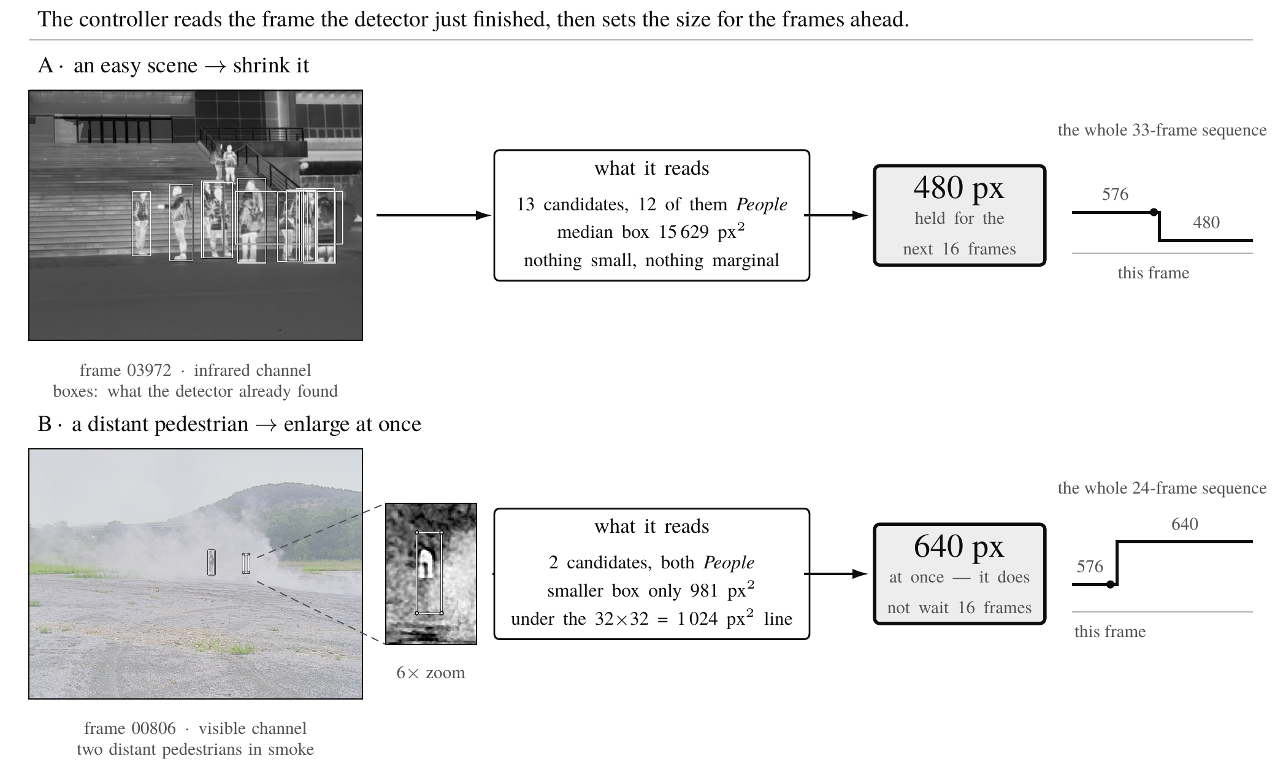
Resolution Controller

Slide 13
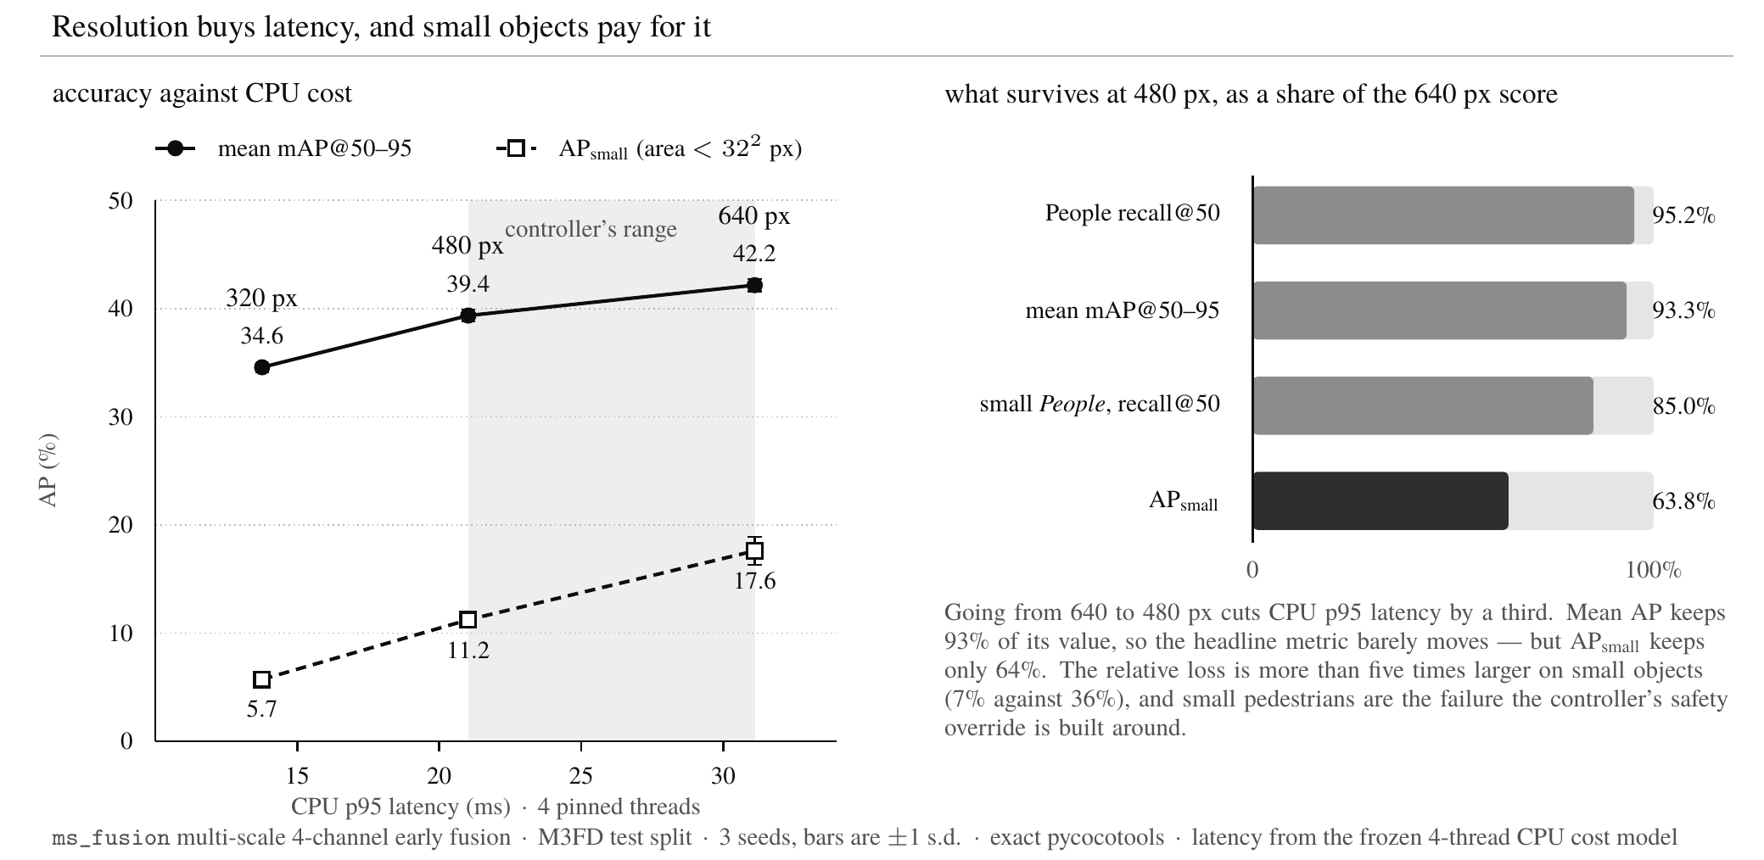
Results - Resolution
Dropping resolution from 640 to 480 px cuts CPU p95 latency from 31.1 ms to 21.0 ms, a 32.4% reduction (mean: 27.8 → 19.3 ms, 4 pinned threads)
Accuracy pays for it: mAP@50-95 falls from 42.2 ± 0.6 to 39.4 ± 0.5, a 2.8-point loss (3 seeds, test split)
The cost is concentrated in small objects: AP_small falls from 17.6 to 11.2 — a 36% relative drop, more than four times the relative loss in overall mAP
Small-pedestrian recall@50 falls with it, 48.0% → 40.8%
How long it takes one frame to process
Notes:
Briefly describe what you hoped to observe based on your initial hypotheses.

Slide 14
Summary of Positive Results
Fusion is the most solid result. Four-channel RGB+IR early fusion beats RGB-only by +2.8 AP and IR-only by +7.7 AP. For the multi-scale model used in the controller work the gaps are +2.1 and +7.0.
Resolution is a real latency lever. 640 → 480 px cuts CPU p95 latency 32.4% (31.1 → 21.0 ms).
An intermediate resolution is effectively free. 576 px costs 15% less mean CPU latency than 640 px for a difference of −0.37 AP — within seed noise. Same accuracy, meaningfully cheaper.
Image-dependent selection has measurable headroom: a cross-seed oracle reaches +0.6 to +1.8 AP above the best fixed-resolution frontier.
That headroom is mostly scene-level. One decision per sequence retains 60–90% of it, which is what makes scene level control worth building.
Learned controllers do find the pattern: +0.4 to +0.9 AP.
Notes:
Begin with the strengths. Describe successful aspects, include quantitative improvements, and interpret their importance.

Slide 15
Discussion of Shortcomings
Controller overhead sets the real bar. The signal is worth 0.4–0.9 AP, but a millisecond of deciding costs ~0.6 AP — so the design target isn't a better predictor, it’s a nearly free one. That's why the current controller reuses detections the detector has already computed.
The headroom is small. A perfect chooser gains 0.6–1.8 AP.
M3FD limits what can be shown. Only one test sequence exceeds the 16-frame decision window
Results are on a CPU. Haven’t tested on the Jetson Orin yet
Current best is +0.10 AP against a +0.5 AP target
Great for latency reduction and accuracy degradation mitigation but not great for both latency reduction and accuracy improvement

Slide 16
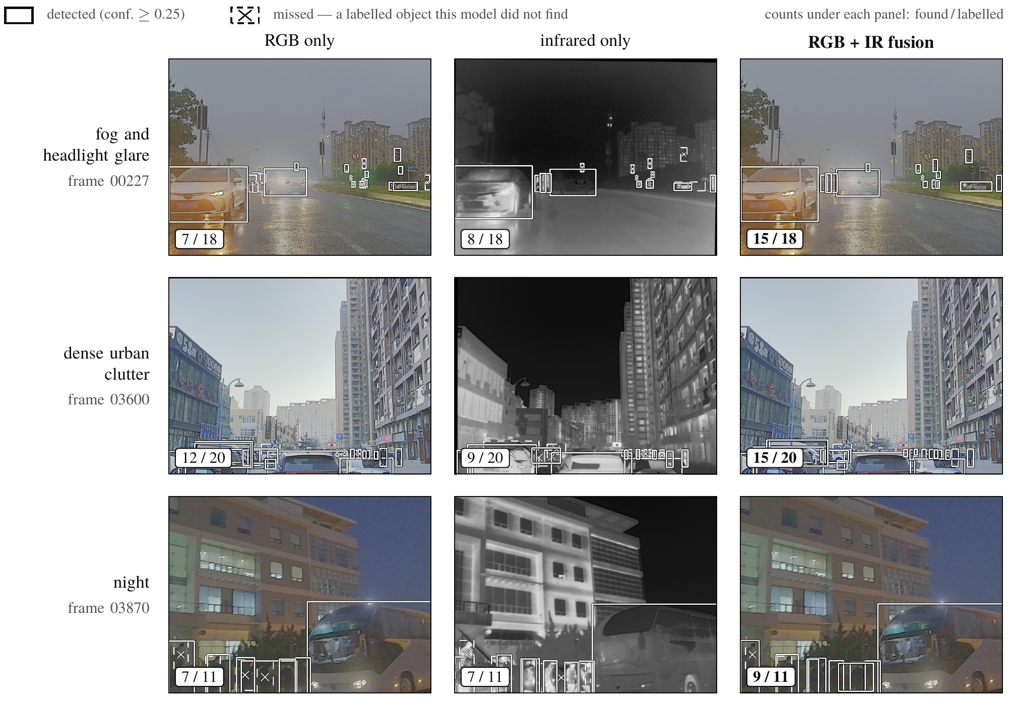
Conclusion
Fusion delivered. RGB+IR beats RGB-only by 2.8 AP and IR-only by 7.7 AP
Shrinking the input is a cheap way to go faster.
Scenes matter more than individual frames. Making one decision per scene keeps 60 to 90% of the available gain.
We built a controller that costs essentially nothing, by reusing detections the detector already produces.
Notes:
Wrap up with a reflection on how these findings shape your next steps. Specify which modifications you plan to implement to address the shortcomings or to build on the strengths observed.

Slide 17
Next Steps
Get onto the Jetson Orin
Measure energy, not just time
Test on longer video
Tighten the evidence. More seeds and narrower intervals
GUI Development once a decent model is made
Controller Design Branches:
  Average the features over the whole window, not just the last frame. Som the decision covering 16 frames rest on one frame’s detections
  Invert the problem. First run cheap, then retry when unsure. Only rerun resolution on cheap frames when there is doubt
  Decide at scene changes instead of every 16 frames
Notes:
Wrap up with a reflection on how these findings shape your next steps. Specify which modifications you plan to implement to address the shortcomings or to build on the strengths observed.

